Slide 1
Social Cost benefit Analysis

Slide 2
Introduction
Social Cost Benefit Analysis (SCBA), also called economic analysis, is a methodology developed for evaluating investment projects from the point of view of the society (or economy) as a whole.
Used primarily for evaluating public investments.
SCBA aids in evaluating individual projects within the planning framework which spells out national economic objectives and broad allocation of resources to various sectors.
The perspectives and parameters provided by the macro-level plans serve as the basis of SCBA which is a tool for analyzing and appraising individual projects

Slide 3
RATIONALE FOR SCBA
Market imperfections
Externalities
Taxes and subsidies
Concern for savings
Concern for redistribution
Merit wants

Slide 4
Market imperfections
Which form the basis for computing the monetary costs and benefits from the point of view of the project sponsor, reflect social values only under conditions of perfect competition
Common market imperfections found in developing countries are: (i) rationing, (ii) prescription of minimum wage rates, and (iii) foreign exchange regulation.

Slide 5
Externalities
A project may have beneficial external effects. For example, it may create certain infrastructural facilities like roads which benefit the neighboring areas.
A project may have a harmful external effect like environmental pollution.

Slide 6
Taxes and Subsidies
From the private point of view, taxes are definite monetary costs and subsidies are definite monetary gains.

Slide 7
Concern for Savings
Unconcerned about how its benefits are divided between consumption and savings, a private firm does not put differential valuation on savings and consumption.

Slide 8
Concern for Redistribution
The society, however, is concerned about the distribution of benefits across different groups. A rupee of benefit going to an economically poor section is considered more valuable than a rupee of benefit going to an affluent section

Slide 9
Merit Wants
Goals and preferences not expressed in the marketplaces, believed by policymakers to be in the larger interest, may be referred as merit wants
The government may prefer to promote an adult education programme or a balanced nutrition programme for school-going children even though these are not sought by consumers in the market place. While merit wants are not relevant from the private point of view, they are important from the social point of view.

Slide 10
UNIDO APPROACH
UNIDO approach and the Little-Mirrlees approach.
The UNIDO approach was first articulated in the Guidelines for Project Evaluation
Guidelines for Project Evaluation
Guide to Practical Project Appraisal

Slide 11
UNIDO APPROACH
Calculation of the financial profitability of the project measured at market prices.
Obtaining the net benefit of the project measured in terms of economic (efficiency) prices.
Adjustment for the impact of the project on savings and investment.
Adjustment for the impact of the project on income distribution.
Adjustment for the impact of the project on merit goods and demerit goods whose social values differ from their economic values.

Slide 12
NET BENEFIT IN TERMS OF ECONOMIC
(EFFICIENCY) PRICES
Concerned with the determination of the net benefit of the project in terms of economic (efficiency) prices, also referred to as shadow prices.
Shadow Pricing: Basic Issues
Choice of numeraire, Concept of tradability, Source of shadow prices, Treatment of taxes, and Consumer willingness to pay.
Net present consumption in the hands of people at the base level o consumption in the private sector in terms of constant price in domestic accounting rupees."

Slide 13
Choice of numeraire
Determination of the numeraire, the unit of account in which the value of inputs or outputs is expressed.
To define the numeraire, the following questions have to be answered:
What unit of currency, domestic or foreign, should be used to express benefits and costs? Should costs and benefits be measured in current values or constant values?
With reference to which point-present or future-should costs and benefits be evaluated?
What use-consumption or investment-will be made of the income from the project?
Should the income of the project be measured in terms of consumption or investment?
With reference to which group should the income of the project be measured?

Slide 14
Concept of Tradability
For a good that is tradable, the international price is a measure of its opportunity cost to the country. Why?
For a tradable good, it is possible to substitute import for domestic production and vice versa; similarly it is possible to substitute export for domestic consumption and vice versa.

Slide 15
Sources of Shadow Prices
The UNIDO approach suggests three sources of shadow pricing.
A project, as it uses and produces resources, may for any given input or output
increase or decrease the total consumption in the economy,
decrease or increase production in the economy,
decrease imports or increase imports,
increase exports or decrease exports.

Slide 16
Sources of Shadow Prices
If the impact of the project is on consumption in the economy, the basis of shadow pricing is the consumer willingness to pay.
If the impact of the project is on production in the economy, the basis of shadow pricing is the cost of production.
If the impact of the project is on international trade-increase in exports, decrease in imports, increase in imports, or decrease in exports-the basis of shadow pricing is the foreign exchange value.

Slide 17
Taxes
When a project results in diversion of non-traded inputs which are in fixed supply from other producers or addition to non-traded consumer goods, taxes should be included.
When a project augments domestic production by other producers, taxes should be excluded.
For fully traded goods, taxes should be ignored.

Slide 18
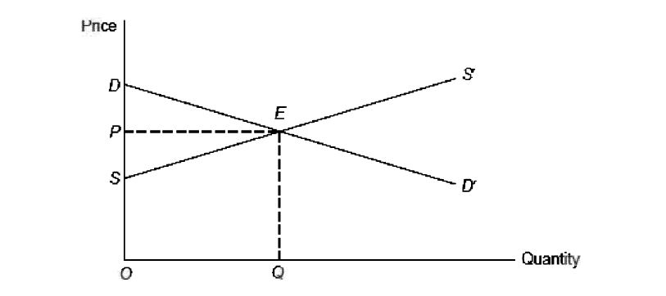
consumer willingness to pay (Measurement )

Slide 19
Shadow Pricing of Specific Resources
Tradable Inputs and Outputs
A good is fully traded when an increase in its consumption results in a corresponding increase in import or decrease in export.
Non-tradable Inputs and Outputs
A good is non-tradable when the following conditions are satisfied:
(i) its import price (CIF price) is greater than its domestic cost of production, and (ii) its export price (FOB price) is less than it domestic cost of production

Slide 20
Externalities
Referred to as an external effect, is a special class of good which has the following characteristics:
(i) It is not deliberately created by the project sponsor but is an incidental outcome of legitimate economic activity.
(ii) It is beyond the control of the persons who are affected by it, for better or for worse.
(iii) It is not traded in the marketplace

Slide 21
Externalities
An external effect may be beneficial or harmful. Examples of beneficial external effects are:
An oil company drilling in its own fields may generate useful information about oil potential in the neighbouring fields.
The approach roads built by a company may improve the transport system in that area.
The training programme of a firm may upgrade the skills of its workers thereby enhancing their earning power in subsequent employments.

Slide 22
Externalities
Examples of harmful external effects are:
A factory may cause environmental pollution by emitting large volumes of smoke and dirt. People living in the neighbourhood may be exposed to health hazards and put to inconvenience.
The location of an airport in a certain area may raise noise level considerably in the neighbourhood.
A highway may cut a farmer's holding in two, separating his grazing land and his cowsheds, thereby adversely affecting his physical output.

Slide 23
Measurement of Externalities
The valuation of external effects is rather difficult because they are often intangible in nature and there is no market price which can be used as a starting point. Their value is estimated by indirect means.
The benefit of information provided by the oil field to neighbouring oil fields may be equated with what the neighbouring oil fields would have spent to obtain such information.
The value of better transport provided by the approach roads may be estimated in terms of increased activities and benefits derived therefrom.
The benefit from the training programme may be estimated in terms of the increased earning power of workers.
The cost of pollution may be estimated in terms of the loss of earnings as a result of damage to health caused by it and the cost of time spent for coping with the unhygienic surroundings.
The cost of noise may be inferred from the differences in rent between the noise-affected area and that of some other area which is comparable except for the level of noise.
The harmful external effect of the highway may be measured by the consumer willingness to pay for the output of the farmer which has been reduced due to the highway.

Slide 24
Labour Inputs
When a project hires labour, it could have three possible impacts on the rest of the economy:
(i) it may take labour away from other employments;
(ii) it may induce the production of new workers;
(iii) and it may involve import of workers.

Slide 25
Capital Inputs
When a capital investment is made in a project two things happen:
Financial resources are converted into physical assets.
Financial resources are withdrawn from the national pool of savings and hence alternative projects are foregone.

Slide 26
MEASUREMENT OF THE IMPACT ON
DISTRIBUTION
Stages three and four of the UNIDO method are concerned with measuring the value of a project in terms of its contribution to savings and income redistribution.
We must first measure the income gained or lost by individual groups within the society.
Groups
Project
Other private business
Government
Workers
Consumers
External sector

Slide 27
Measure of Gain or Loss
For Physical Resource
Gain or loss = Shadow Price – Market Price
For financial transactions
Gain or loss = Price Paid –Value received
Example 1: Farmers in a certain area use Rs1 million units of electricity generate by a hydroelectric project. The benefit derived by them, measured in terms o the willingness to pay, is equal to Rs o.4 million. The tariff paid by them to the electricity board is Rs 0.25 million. So, the impact of the project on the farmers I a gain of Rs o.15 million.

Slide 28
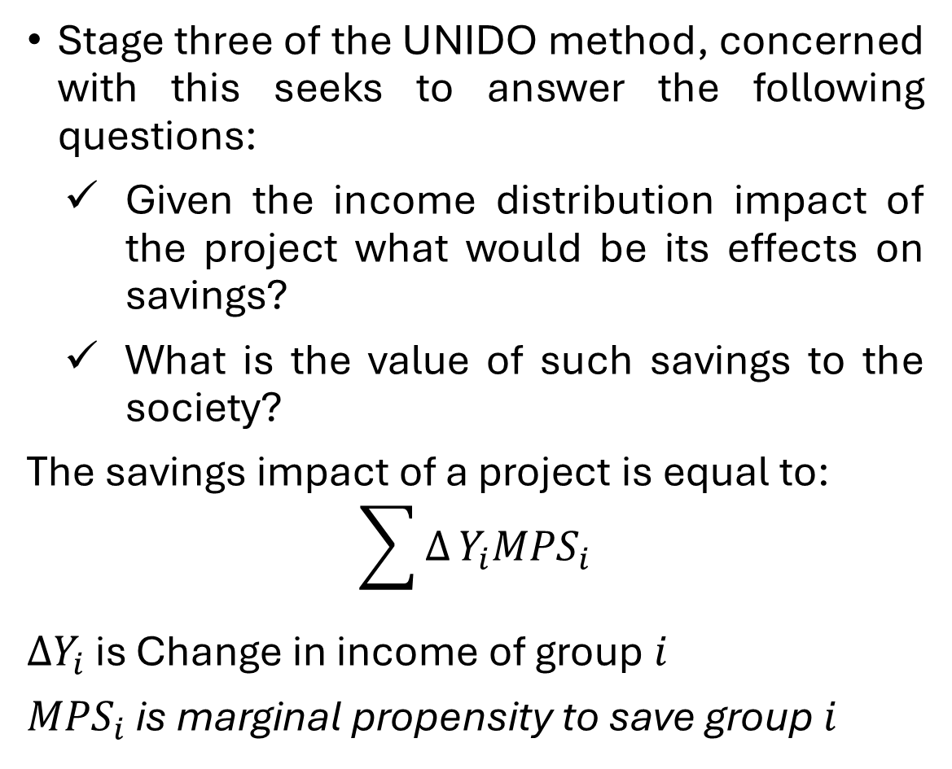
SAVINGS IMPACT AND ITS VALUE
Stage three of the UNIDO method, concerned with this seeks to answer the following questions:
Given the income distribution impact of the project what would be its effects on savings?
What is the value of such savings to the society?
The savings impact of a project is equal to:
$$\sum{∆}Y_{i}{MPS}_{i}$$
$∆Y_{i}$ is Change in income of group $ⅈ$
${MPS}_{i}$ is marginal propensity to save group $ⅈ$

Slide 29
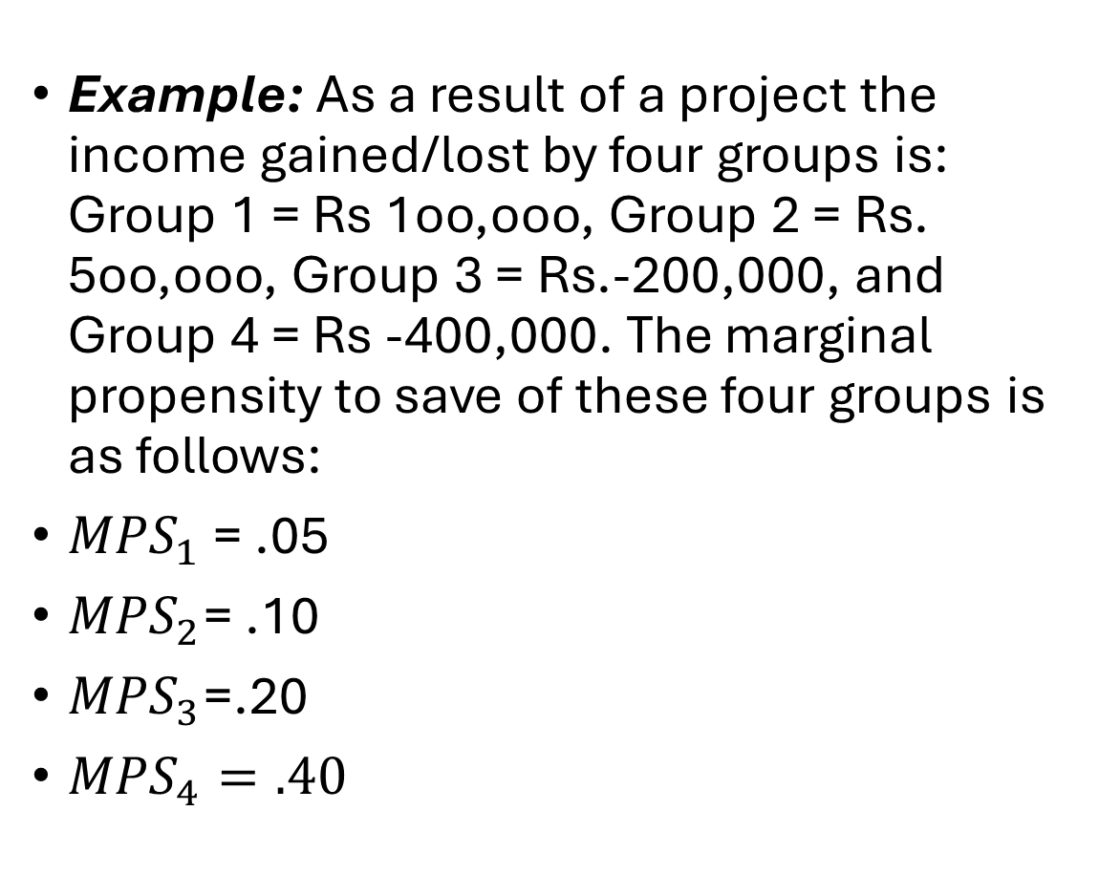
Example: As a result of a project the income gained/lost by four groups is: Group 1 = Rs 1oo,ooo, Group 2 = Rs. 5oo,ooo, Group 3 = Rs.-200,000, and Group 4 = Rs -400,000. The marginal propensity to save of these four groups is as follows:
${MPS}_{1}$ = .05
${MPS}_{2}$= .10
${MPS}_{3}$=.20
${MPS}_{4}=.40$

Slide 30
Value of Savings
The value of a rupee of savings is the present value of the additional consumption stream produced when that rupee of savings is invested at the margin.
The additional stream of consumption generated by a rupee of investment depends on the marginal productivity of capital and the rate of reinvestment from additional income.
If the marginal productivity of capital is r and the rate of reinvestment from additional income a, the additional stream of consumption generated by a rupee of investment

Slide 31
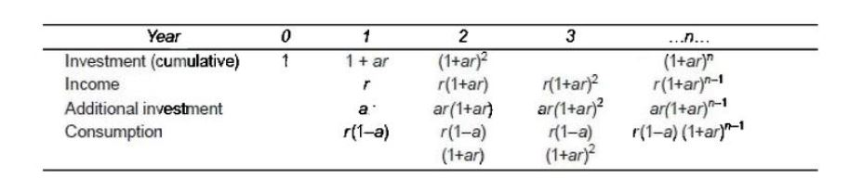
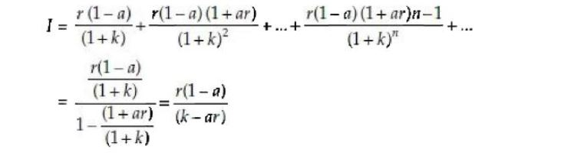
where I is the social value of a rupee of savings (investment)
k is the social discount rate

Slide 32
INCOME DISTRIBUTION IMPACT
Many governments regard redistribution of income in favour of economically weaker sections or economically backward regions as a socially desirable objective.
Due to practical difficulties in pursuing the objective of redistribution entirely through the tax, subsidy, and transfer measures of the government, investment projects are also considered as investments for income redistribution and their contribution toward this goal is considered in their evaluation.

Slide 33
ADJUSTMENT FOR MERIT AND DEMERIT
GOODS
:The analysis has to be extended beyond stage four to reflect the difference between the economic value and social value of resources.
A merit good is one for which the social value exceeds the economic value. Ex. a country may place a higher social value than economic value on production of oil because it reduces dependence on foreign supplies.
A demerit good, the social value of the good is less than its economic value. For example, a country may regard alcoholic products as having a social value less than the economic value

Slide 34
The procedure for adjusting for the difference between social value and economic value is as follows:
(i) Estimate the economic value.
(ii} Calculate the adjustment factor as the difference between the ratio of social value to economic value and unity.
(iii} Multiply the economic value by the adjustment factor to obtain the adjustment.
(iv) Add the adjustment to the net present value of the project as calculated in stage four

Slide 35
To illustrate, consider a project for which the following information is available:
(i) The present economic value of the output of the project is Rs. 25 million.
(ii) The output of the project has a social value which exceeds it economic value by 20 percent. Given this information, the adjustment factor would be 0.2 (120 percent/100 percent - 1). Multiplying the present economic value by 0.2, we get an adjustment of 5 million. This, then, is added to the present economic value of 25 million.

Slide 36
Cost Benefit Analysis of Adhaaar
In 2012,National Institute of public Finance and Policy did a Cost and Benefit Analysis of Aadhar .
Two categories of cost involved : Capital and operational expenditure, and the Cost of integrating Aadhar with various government schemes.
Benefits to be derived by the government by way of saving leakages in central government Programme such as: PDS, MNREGS, Fertilizer and LPG Subsidies, SSA, MDM, IAY, JSY, ASHA ICDS, pension and scholarship
IRR =52.85%

Slide 37
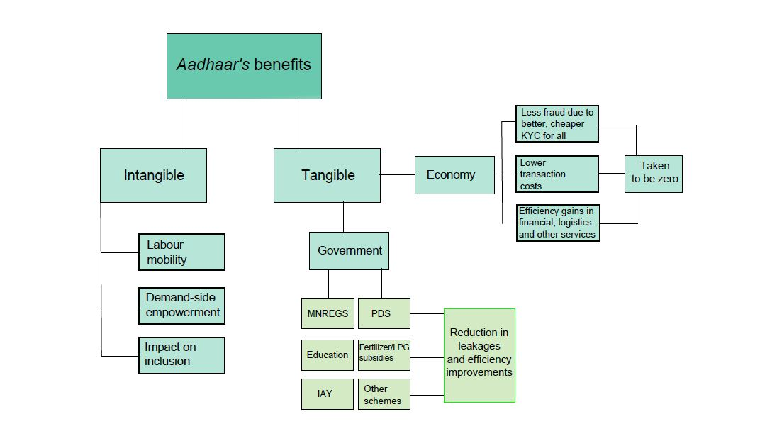

Slide 38
Public Sector Investment Decisions India
The public sector today commands a predominant position in many basic industries: coal, crude oil and refining, steel, power, fertilisers, locomotives, basic drugs, machine tools, and so on.
Initiatives to Improve the Quality of Investment Decisions

Slide 39
Initiatives to Improve the Quality of Investment Decisions
In 1965, the Government of India set up a separate Bureau of Public Enterprises (BPE), with the objective of "integrating and strengthening the arrangement for economic coordination and evaluation of technical, economic, and financial aspects of projects and the working of public enterprises in India."
In 1965, the Planning Commission prepared and circulated a Manual of Feasibility Studies for Public Sector Projects
In 1972, the Government of India set up a special division in the Planning Commission called the Project Appraisal Division (PAD) to appraise the central sector projects from the national viewpoint and to make observations regarding the economic viability of investment projects whose capital cost exceeds a certain limit

Slide 40
In 1972, the Government of India set up a high-powered Public Investment Board (PIB) with a view to evolve a scientific procedure for taking investment decisions

Slide 41
Key Steps in the Public Investment Decisio Making Process in India
The Planning Commission formulates the five-year plan indicating the broad strategy of planning, the role of each sector, the physical targets to be achieved by each sector, and the financial outlays to be made available for the development of each sector.
The administrative ministries develop sectoral plans.
The concerned public sector enterprise prepares the feasibility report and forwards it to its administrative ministry.
The administrative ministry carries out a preliminary scrutiny of the feasibility report and sends copies of the same to the various appraising agencies, namely, the Planning Commission, the Department of Economic Affairs and the Plan Finance Division of the Finance Ministry, and the Bureau of Public Enterprises for their comments

Slide 42
The PAD of the Planning Commission carries out a detailed appraisal.
The Investment Planning Committee of the Planning Commission discusses the appraisal note of the PAD and recommends to the PIB the view of the Planning Commission on whether the project should be accepted, rejected, deferred, reformulated, or redesigned.
The cabinet generally accepts the recommendation of the PIB an approves its implementation.

