Slide 1
Agenda for today
Generic Business Strategies
What are business-level strategies?
How can firms obtain a competitive advantage from internal & external sources?
How can firms focus, and what are its benefits?
What is Strategic Positioning?
What is ambidexterity?

Slide 2
The Strategic Management Process
Difference between Business and Corporate Strategy
External
Analysis
Strategic
Choice
Strategy
Implementation
Competitive
Advantage
Mission
Objectives
Internal
Analysis
Business Level
Strategy
Corporate Level
Strategy
How to Position a
Business
in the Market?
Which Businesses
to Enter?

Slide 3
Business Level Strategies
Generic Business Level Strategies
Cost Leadership:
• generate economic value by having lower costs
than competitors
COST
ADVANTAGE
Example: Wal-Mart
Similar product
at lower cost
COMPETITIVE
ADVANTAGE
Differentiation:
Price premium
from unique product
DIFFERENTIATION
ADVANTAGE
• generate economic value by offering a product
that customers prefer over competitors’ product
Example: Harley-Davidson

Slide 4
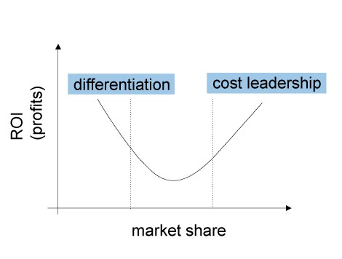
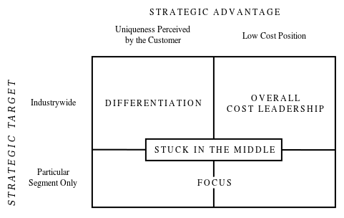
Porter’s Generic Strategies
Cost Leadership & Differentiation
Notes:
8

Slide 5
Value creation
Differentiation
Consumer Surplus
Willingness to Pay
Price
Firm Profits
Cost Leadership
Supplier Surplus
Cost
Opportunity Cost
Adapted from (Brandenburger & Stuart Jr., 1996)
Notes:
Hence apart from considering that powerful stakeholders might siphon away some of the fruits of high operational performance, there is also the possibility that some stakeholders may influence the operational performance directly or indirectly and thereby influence organizational performance.

Slide 6
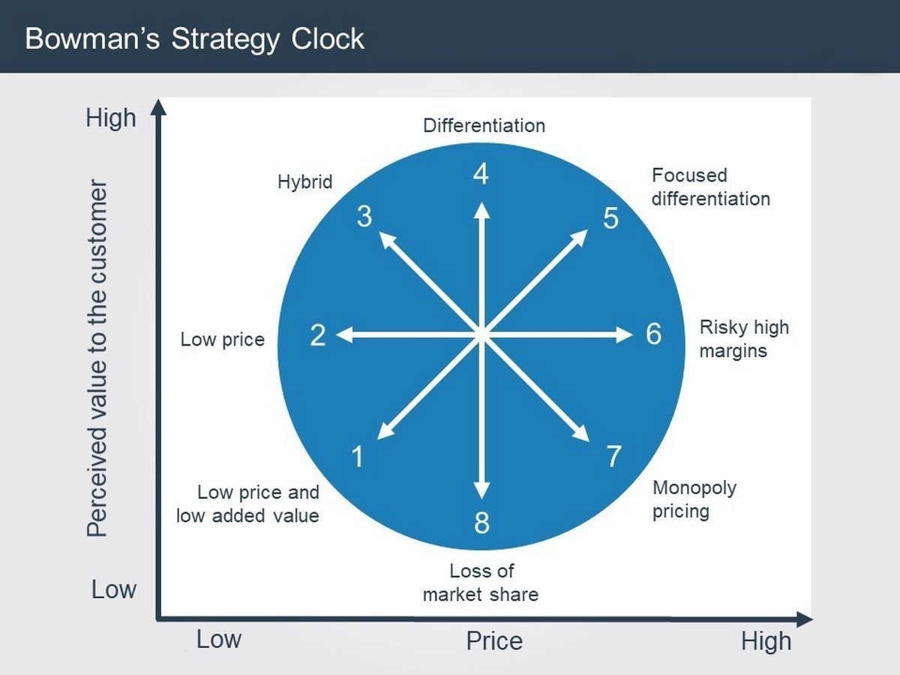

Slide 7
Porters Generic Strategies
Summary
Cost Leadership
    Economies of Scale
    Diseconomies of Scale
    Learning Curve Economies
    Low-cost access to factors of production
    Technology independent of Scale
    Policy Choices
  Differentiation
    Product Attributes
    Firm – Customer Relationships
    Firm Linkages

Slide 8
Benefits of cost leadership
Enjoy higher than average profits
Engage in price war
Eliminate rivals
Defend market share
Increase market share
Build barriers to the entry of newcomers to the market
Weaken the threat of substitutes
Enter new markets

Slide 9
Five forces and cost leadership
The five forces | The cost leader is
Entry barriers | Able to cut prices to discourage potential entrants to the market
Buyer power | Able to offer a competitive price to buyers with power
Supplier power | Protected from a powerful buyer by low costs
Threat of substitution | Able to make use of low price as defence against substitutes
Rivalry | Is better able to compete on price

Slide 10
Risks of cost leadership
Vulnerability to even lower cost operators
As technology improves, a competitor may be able to leapfrog the production capabilities, thus eliminating the competitive advantage
It could lead to a damaging price wars
There might by difficulty in sustaining cost leadership in the long run
A firm following a focus strategy might be able to achieve even lower cost within their segment

Slide 11
Differentiation: benefits
Differentiation offers the prospect of charging a premium price
Demand for a differentiated product will be less elastic than that for competitors products
Differentiation can result in above average profits
Differentiation can create additional barriers to entry to the market for newcomers

Slide 12
The five forces and differentiation
Five forces | A firm pursuing a differentiation strategy…
Entry barriers | Benefits from customer loyalty which discourages potential entrants
Buyer power | Enjoys some protection since large buyers have less power to negotiate because of the absence of close alternatives
Supplier power | Is better able to pass on supplier price increases to customers
Threat of substitution | Is protected from the threat of substitutes by customer loyalty
Rivalry | Benefits from brand loyalty to keep customers from rivals

Slide 13
Risks of differentiation strategy
There are difficulties of sustaining differentiation
Differentiation involves higher costs
There is a risk of creating differences that customers do not value
Customers might become price sensitive and choose on price rather than uniqueness
It might involve differentiation on dimensions that become less important to customers over time
Customers may no longer need the differentiation factor
Imitators may narrow the differentiation
Rivals pursuing a focus strategy may be able to achieve even greater differentiation in their market segments

Slide 14
HOW IS COMPETITIVE ADVANTAGE ESTABLISHED?
The Emergence of Competitive Advantage
How does competitive
advantage emerge?
External sources of
change e.g.:
Changing customer demand
Changing prices
Technological change
Internal sources
of change
Some firms
have greater creative
and innovative
capability
Resource heterogeneity
among firms means
differential impact
Some firms faster
and more effective
in exploiting change
Notes:
2

Slide 15
HOW IS COMPETITIVE ADVANTAGE ESTABLISHED?
Competitive Advantage from Externally-Generated Change:
Dynamic Capabilities
Dynamic capability is a “firm’s ability to integrate, build, and reconfigure internal and external competences to address rapidly changing environments”
Dynamic capabilities typically viewed as “higher order” capabilities that orchestrate change among lower-level “ordinary” or “operational” capabilities.
There are three types of dynamic capability:
  sensing and shaping of opportunities and threats
  seizing opportunities
  maintaining competitiveness through enhancing, combining, protecting, and, when necessary, reconfiguring the enterprise’s intangible and tangible assets

Slide 16
HOW IS COMPETITIVE ADVANTAGE ESTABLISHED?
Competitive Advantage from Internally-Generated Change:
Strategic Innovation
STRATEGIC INNOVATION: creating customer value from new products, experiences, or modes of product delivery
Innovatory strategies may involve:
  Creating whole new markets/industries
    Creating new customer segments
    Blue Ocean Strategy
  New sources of competitive advantage
    Reconfiguring the value chain
    Reconceptualizing the product
    New performance combinations
    Business Model Innovation
Notes:
3

Slide 17
Focus strategy
In a focus strategy the firm concentrates on one (or at most a limited number of) segments of the market
The premise behind this strategy is that the needs of the group can be bettered served by focussing entirely on it
The firm might feel more secure in the niche with greater insulation from competition
A focus strategy means that the firm’s efforts are not spread too thinly
Focus strategies are
  Cost focus: cost leader in a particular segment
  Focus differentiation: differentiation in the chosen segment

Slide 18
Requirements of a focus strategy
A focus strategy requires…
The identification of a suitable target customer group
Identification of the specific needs of that group
Confirmation that the market is sufficiently large to sustain the business
Estimation of the extent of competition within the segment
Production of products to meet the specific needs of that group
A decision on whether to opt for cost leadership or differentiation within the segment

Slide 19
Benefits of a focus strategy
It involves lower investment in resources
The firm benefits from specialisation
It provides scope for greater knowledge of a segment of the market
It makes entry to new markets easier and less costly
Firms using a focus strategy often enjoy a high degree of customer loyalty

Slide 20
Focussed cost leadership
A strategy that aims…
To attract one type of customer with a low cost product
To be the lowest cost operator in one particular niche segment of the market
Example :Hyundai

Slide 21
Focussed differentiation
A strategy that aims to attract one type of customer with a differentiated product
It involves distinctiveness in one segment
Aims to exploit unique position in a niche segment of the market
Not the cheapest but the best or most distinctive in that segment
Example: BMW, Mercedes

Slide 22
The five forces and a focus strategy
The five forces | A firm pursuing a focus strategy…
Entry barriers | Develops core competencies that can act as an entry barrier
Buyer power | Enjoys some insulation since large buyers have less power to negotiate because few alternatives are available
Supplier power | Is better able to pass on supplier price rises thereby reducing the impact of supplier power
Threat of substitution | Enjoys some protection against substitutes by specialised products and core competencies
Rivalry | Enjoys some protection because rivals cannot meet differentiation focused customer needs

Slide 23
Problems associated with focus strategy
Limited opportunities for growth
Sacrifice of economies of scale that would be available from a larger market
The firm could outgrow the market
Danger of decline in the chose segment or niche
A reputation for specialisation inhibits move into new sectors
Risk of imitation
Risk of changes in the target segment

Slide 24
What is strategy?
Positioning
Strategy is the creation of a unique and valuable position
  Serving few needs of many customers
  Serving broad needs of many customers
  Serving broad need of many customers in a narrow market
The essence of Strategy is choosing what not to do
Strategy is creating a fit among a company’s activities

Slide 25
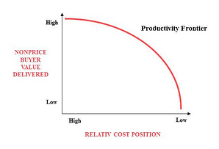
Positioning
What a company must do
Deliver greater value to customers
  (higher average unit price)
Create comparable value at a lower cost
  (lower average unit cost)
Performing different activities than rivals

Slide 26
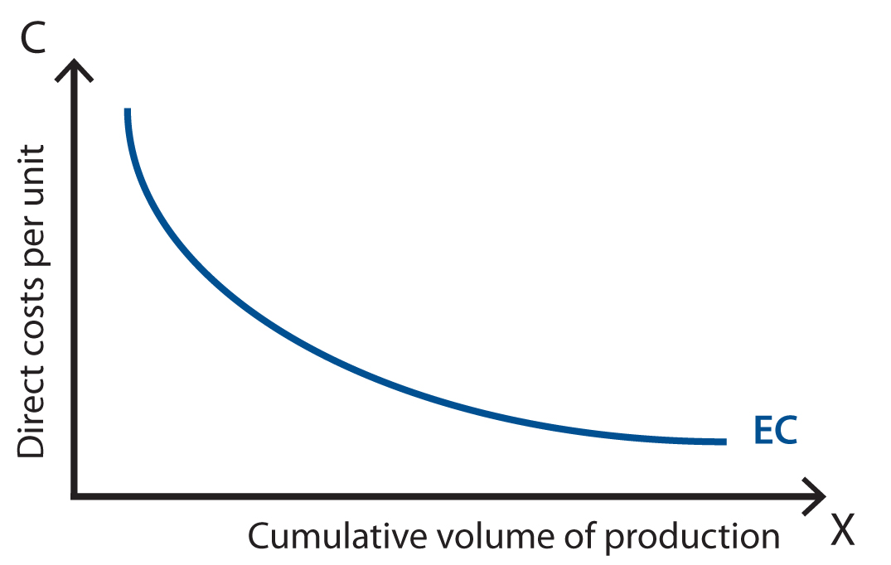
Operational effectiveness
Is it enough?
Performing similar activities better than rivals
Operational effectiveness necessary but not sufficient
  Can be replicated
  Over capacity
  Reduced capability for innovation

Slide 27
Strategic positioning
Ways to get Competitive Advantage
Performing different activities or performing similar activities in different ways
  Variety based positioning: particular product or service
  Needs based positioning: particular customer segment
  Access based positioning: delivery channel
Marketing myopia: companies fail to adapt and respond to constantly changing consumer tastes and demands

Slide 28
Imitation of Strategic Positioning
Why straddling or repositioning is difficult…
Strategic positioning is not sustainable unless there is trade-off with other positions
  Inconsistencies in image or reputation
  Inflexibility in activities
  Limits on internal coordination and control

Slide 29
Cost Leadership & Differentiation
Can a firm pursue both simultaneously?
No
Yes
Use of structure,
management control,
and compensation
policies are nearly
opposites.
Firms can do both
because some bases
of differentiation also
lend themselves to
low cost.
Structure, controls, and
policies are not opposites.
Example: Rolex
Example: Toyota

Slide 30
Ambidexterity
Exploitation vs Exploration
Exploitation and exploration are two fundamentally different learning activities between which firms divide their attention and resources (March, 1991)
  Long-term survival and success depend on an organization’s ability to “engage in enough exploitation to ensure the organization’s current viability and to engage in enough exploration to ensure future viability” (Levinthal and March, 1993)
Exploitation is associated with activities such as “refinement, efficiency, selection, and implementation”
  One-sided focus on exploitation may enhance short-term performance, but it can result in a competency trap because firms may not be able to respond adequately to environmental changes
Exploration refers to notions such as “search, variation, experimentation, and discovery”
  Too much exploration may enhance a firm’s ability to renew its knowledge base but can trap organizations in an endless cycle of search and unrewarding change

Slide 31
Summary
Porters Generic Strategies
Recap of Generic Strategies
  Benefits
  Impact on Industry 5 Forces
  Shortcomings
Focus Strategies
Strategy as Positioning
Ambidexterity

