Slide 1
Leadership anda Change Management
Anubha Dadhich (PhD-IITD)
IIM Raipur

Slide 2
GE Transformation: Case Discussion
Is GE’s success dependent on Welch’s leadership?
Can His successor CEO continue the growth trajectory –or even maintain GE’s current position ?

Slide 3
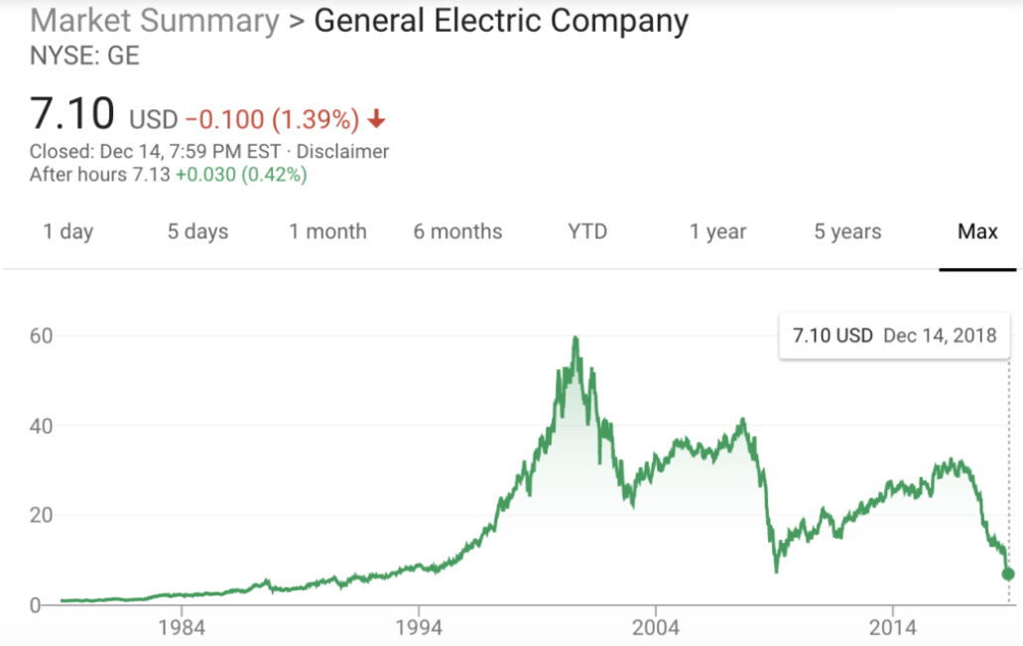

Slide 4
Current Status @ GE
https://www.washingtonpost.com/business/2018/10/01/general-electric-replaces-new-chief-executive-announces-massive-billion-charge-amid-struggles/?utm_term=.e6fdbd99cb3a
https://www.foxbusiness.com/markets/ge-ceo-feud-welch-vs-immelt
https://www.cnbc.com/2018/10/01/ge-removes-flannery-as-ceo-takes-23-billion-non-cash-charge-for-power-business-problems-and-withdraws-guidance.html

Slide 5
Leadership Skills
Learned Competencies that leader are able to demonstrate in performance (Katz, 1955)
Capacity to influence others
Critical component in successful leadership

Slide 6
Core Leadership Skills
Interpersonal
Conceptual
Administrative
Core Leadership Skills

Slide 7
Administrative
Showing Technical Competence
Managing Resources
Managing People

Slide 8
Interpersonal Skills
Being Socially Perceptive
Showing Emotional Intelligence
Managing Interpersonal Conflict

Slide 9
Conceptual
Creating Visions
Strategic Planning
Problem Solving

Slide 10
Leadership Skill Questionnaire
Identify your own leadership skills
Ratings:
Not True = 1
Seldom True = 2
Occasionally True = 3
Somewhat True = 4
Very True = 5

Slide 11
Measuring Leadership Skills
Q1. I am effective with the detailed aspect of my work ?
Q2. I usually know ahead of time how people will respond to a new idea or proposal ?
Q3. I am effective at problem solving ?

Slide 12

Measuring Leadership Skills
Q4. Filling out form and working with details comes easily for me.
Q5. Understanding the social fabric of the organizations is important to me.
Q6.When problem arise, I immediately address them

Slide 13
Measuring Leadership Skills
Q7. Managing People and Resources is one of my strengths.
Q8. I am able to sense the emotional undercurrents in my group.
Q9. Seeing the big picture comes easily for me.
Q10. In my work, I enjoy responding to people’s requests and concerns.

Slide 14
Measuring Leadership Skills
Q11. I use my emotional energy to motivate others.
Q12. Making Strategic plans for my company appeals to me.
Q13.Obtaining and Allocating resources is a challenging aspect of my job
Q14. The key to successful conflict resolution is respecting my opponent

Slide 15
Measuring Leadership Skills
Q15. I enjoy discussing organizational values and philosophy.
Q16. I am effective at obtaining resources to support our programs.
Q17. I work hard to find consensus in conflict situations
Q18. I am flexible about making changes in our organization.

Slide 16
Scoring
Sum of responses: 1,4,7,10,13,16
Sum of responses: 2,5,8,11,14,17
Sum of responses: 3,6,9,12,15,18
Total scores:
AS………………………….
IS…………………………..
CS………………………….

Slide 17
Ethical Leadership
The demonstration of normatively appropriate conduct through
personal actions
interpersonal relationships, and
the promotion of such conduct to followers
through two-way communication,
reinforcement, and
decision-making.

