Slide 1
GE’s Two Decades Transformation: Jack Welch Leadership
Leadership and Change Management
Dr Anubha Dadhich
IIM Raipur

Slide 2
GE Transformation
Power Generation,
Distribution
Use of Electric Power
Household Appliance
Automotive Engines
Medical Systems
Diesel Locomotives

Slide 3
GE Transformation
Year
1930 | Highly Centralized, Tightly Controlled Management
1950 | Delegated Responsibility, Decentralization
1960 | Strengthening of Corporate staff, Strategic Planning System

Slide 4
Key Actions and Initiatives
Revitalize and Transform the Highly Diversified Company
Role of Top Management in Leading Change

Slide 5
GE Transformation: Case Discussion
How Difficult a Challenge did Welch face in 1981?
How effectively did he take charge ?

Slide 6
Two Big Challenges
Radical Transformational Change– Huge Corporation
Adding Value to Highly Diversified Strategic Portfolio

Slide 7
Manger of the Century
Market Cap $13 billion (1981) to $330 billion (1999)

Slide 8
Welch & GE: Step-by step Approach
Be # 1 or # 2– Fix it, Sell it or Close it
A Strategy or just a slogan
……………………………………………
You can’t set an overall theme or a single strategy for giant corp. like GE

Slide 9
Welch’s Three Circles : Do they represent strategy
Di
Services
Core
Technology
Differentiated investment model is Strategic

Slide 10
GE Transformation: Case Discussion
Is Welch creating/adding value in the early 1980s? If so , how?
Long Term and Short Term Impact of Strategic shift
Reducing Bureaucracy,
Lean & Agile Neutron Jack

Slide 11
Latter 80’s…………Welch acted different leadership
Fix—Sell– Close Vs Global Expansion
Destaffing– Delayering Progm Vs Software Initiatives
Employee layoffs Vs Leadership Development
………………………………………………………..
Soft Issues: Culture Change, People Change,
And Process Development

Slide 12
How Welch implemented this radical Change ??
Why workout ? What’s he trying to accomplish?

Slide 13
GE Transformation: Case Discussion
Why is Neutron jack now focusing on people development ?
Why is he defining a new leadership model?

Slide 14
GE Transformation: Case Discussion
With all this emphasis on the soft stuff , is Welch still adding value ?
How?

Slide 15
GE Transformation: Case Discussion
Can Welch be adding value to this highly diverse portfolio?
Is GE’s internal organization a more efficient resource allocator than the market?

Slide 16
GE Transformation: Case Discussion
What do you think of his notion of stretch targets?
What is he trying to do with the service business initiative?

Slide 17
GE Transformation: Case Discussion
How would you characterize Welch’s role in the change process? What kind of leader is he?
Is the business model and organization form Welch has created sustainable?

Slide 18
GE Transformation: Case Discussion
Is GE’s success dependent on Welch’s leadership?
Can His successor CEO continue the growth trajectory –or even maintain GE’s current position ?

Slide 19
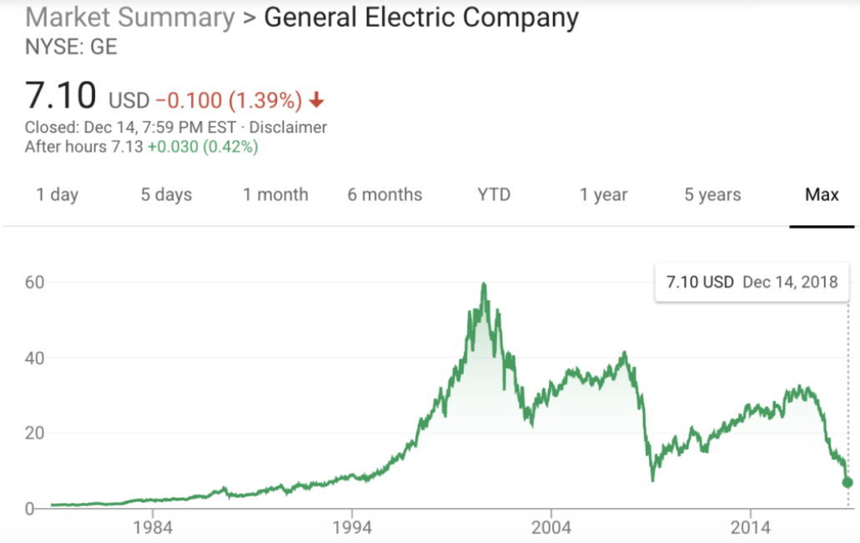

Slide 20
https://www.washingtonpost.com/business/2018/10/01/general-electric-replaces-new-chief-executive-announces-massive-billion-charge-amid-struggles/?utm_term=.e6fdbd99cb3a
https://www.foxbusiness.com/markets/ge-ceo-feud-welch-vs-immelt
https://www.cnbc.com/2018/10/01/ge-removes-flannery-as-ceo-takes-23-billion-non-cash-charge-for-power-business-problems-and-withdraws-guidance.html

