Slide 1
Leadership and Change Management
Anubha Dadhich
IIM Raipur

Slide 2

Factors affecting Change
Multiple Factors
DICE
Change Vs Transformation
Role of leaders in Transformation

Slide 3
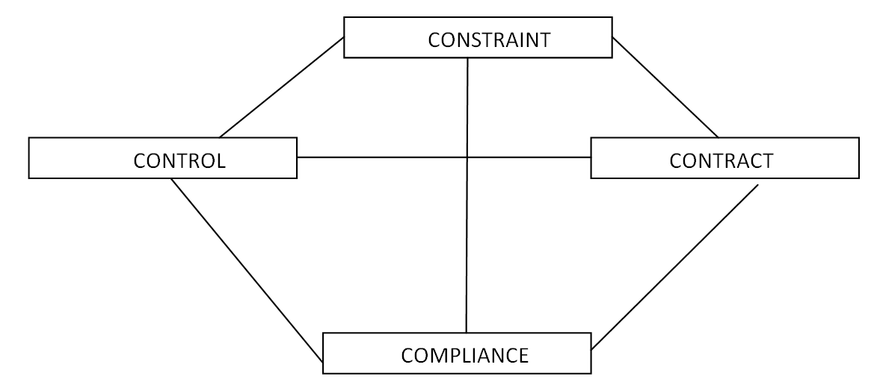
Internal behavioral context

Slide 4
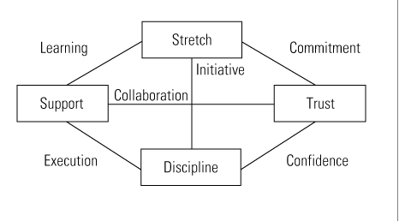
Behavioral Context: Pragmatic Model

Slide 5
Critical Elements of Change Management
Two out of every three transformation process fails .
We need to understand, WHY ???
Overemphasize on soft side of change
Leadership style, Corporate culture, Employees Motivation
Hard Side is equally Important
Need to address first on ground
DICE

Slide 6
DICE : FRAMEWORK
Duration: Long term or Short term
Misconception – Long term projects fails
Short term get less time to review frequently
Ideally bimonthly review for long term projects
Set your milestones (major actions & achievements) and Impact assessment
Milestone e.g.: “ Consultation with stakeholders is completed” Or Consult Stakeholders

Slide 7
Duration (continue….)
Team members and Sponsors must check that project is on track
Problems & Challenges
How present state of achievement going to affect next phase of project
Sponsors and team members – power to address weaknesses
Alter , push-slow, new resources, new objective, new direction
Senior executives– team dynamics, communication, organization’s perception about the initiatives.

Slide 8
Integrity
Performance Integrity – means extent to which companies can rely on team of managers, supervisors, and staff to execute change project successfully
Senior executive- discourage star performers for change efforts
Misconception – regular work will get suffer
Employee needs to go an Extra mile to balance both
Right Combination of Skills, Knowledge and Social Network
Project time– All days or specific days and duration
Appraisal process of project team– Streamline with KPI
Ensure within team environment/interaction
Good Manager cannot be always a good team lead specially in Change organizations

Slide 9
Continue…….
Good team leaders: problem solving skills, methodical in their approach, result oriented, tolerate ambiguity, Willing to accept responsibilities, highly motivated so don’t crave the limelight.

Slide 10
Commitment
Companies must boost the two categories of executives
C1: Most Influential senior executives, not necessarily with titles
C2: Most Enthusiastic executives– new system, new process
Support from top management should be visible at line managers/ staff level
Its all “understood”, Back initiatives
Organize speeches meetings– Layoffs
Recruit GM for Change Management
Avoid different versions of message
Don’t underestimate their ability to built staff support

Slide 11
Effort
Calculate how many work hours per employee per week must do for change process.
Ideally no one’s workload should increase by 10%
Going beyond: Initiative Trouble, resources overstretched, Compromise at normal operations or change program
Morale down, Conflict increases among teams, line staff

Slide 12
How to create a balance ??
Take away some responsibilities – who are key players in transformation process
Review of all the projects in operating plans
Re-prioritize the critical one's for change process
Restructured 120 out of 250 projects sub-projects– to relieve line managers to focus on change projects
Get in temporary workers for routine operations or outsource business process for day-to-day activities
Need to think before kick start the transformation process

Slide 13
DICE Formula
DICE SCORE = D + 2I +C1 + C2 + E
Scoring:
7 and 14 = Win Zone
>14 but < 17 = Worry Zone
17 and above = Woe Zone

Slide 14
Merits of DICE Framework
It allows companies to tap into the Insight & Experience of the Employees
Track Projects --- Early Warning Indicators
Win Zone, Woe Zone or Worry Zone
Manage Portfolio of Projects
Force Conversations
Companies Conduct Workshops to review Floundering Projects

Slide 15
Change Vs Transformation
Incremental Change is different from transformation
Change is – Companies need to realign some aspects of their strategy, organization or culture, while retaining the others.
………………………………………………………………………………….
Transformation is the systematic and simultaneous attack across many fronts that fundamentally alters the basic rhythm and character of a company.

Slide 16
Transformational Change
Transformational Change is a journey through valley of death
Organization experience very different kind of emotions
From Complacence, Denial & Resistance, Anger & Depression,
To Exploration, Enthusiasm and Commitment
Leadership is very different at each phase

Slide 17
From Caterpillar to Butterfly
Excitement
Complacence Identification
Denial
Emotional Time
Energy Finger Pointing Curiosity
Outburst
Depression

Slide 18
Leadership Roles in Different Transformation Process
Phase | Symptoms | Leadership Role
Denial | Focus on the Past | Confront with Information
 | Rationalization | Provide Illustrations
 | Withdrawal | Project consequences of “business as usual “
Resistance | Anger, blame | Listen to what is said and what is not said
 | Downing of Tools | Shared mourning
 | Company does not care | Show personal commitment
 |  | Cut losses when unavoidable

Slide 19
Continue…………..
Phase | Symptoms | Leadership Role
Exploration | Over preparation | Guide priorities
 | Incoherent energy | Educate to improve the quality of analysis
 | Confusion & Chaos | Set short term goals
Commitment | Cooperation & Coordination | Set Long term goals
 | Frustration about speed | Celebrate Success
 | Looking for new Challenges | Focus on Team Building
 |  | Step back- let the next tier of leadership emerge

