Slide 1

STRATEGIC PLANNING
AT
UNITED PARCEL SERVICE

Slide 2
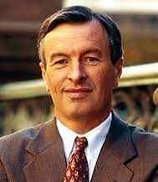
About UPS
Mike Eskew – ninth CEO and chairman of UPS in 2002
  Believed quality of future planning results in future of the company.
  Highly centralized and hierarchical organization
    Corporate office- Strategic Decisions
    Field Operations- focus on execution and delivering for next quarter
  Efficiency driven – low-cost business model
  “Constructive dissatisfaction” – continuous improvement
  Loyal workforce – low turnover

Slide 3
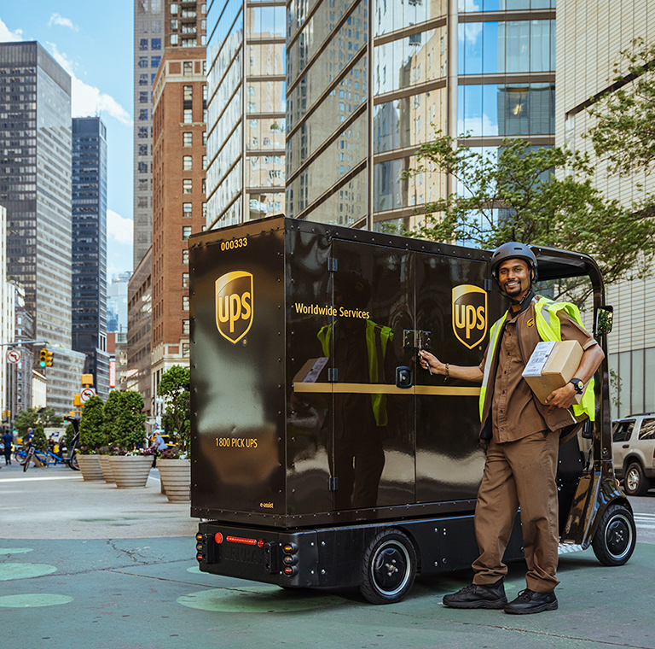

Culture
Focus on Efficient and Execution
Like Military Operation
Continuous Improvement (Constructive Dissatisfaction)
Service Excellence
Employee Ownership
Loyal Workforce (Low Turnover)
Company CEO (Long Term Employee of UPS)

Slide 4

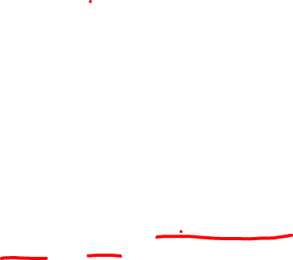
Key Milestones
Company Background:
  1907 - started by Jim Casey from $100, Seattle, Washington
  1970s – Global expansion
  1990s - Strong competition from Federal express and Duetsche post.
  1996 - Kelly formed Strategy Advisory group and CSG
  1999 - went public
  2005 - $37Bn corporation
    Acquired Mail Boxes Etc, resulting in 3500 retail shops and large workforce of 384,000

Slide 5
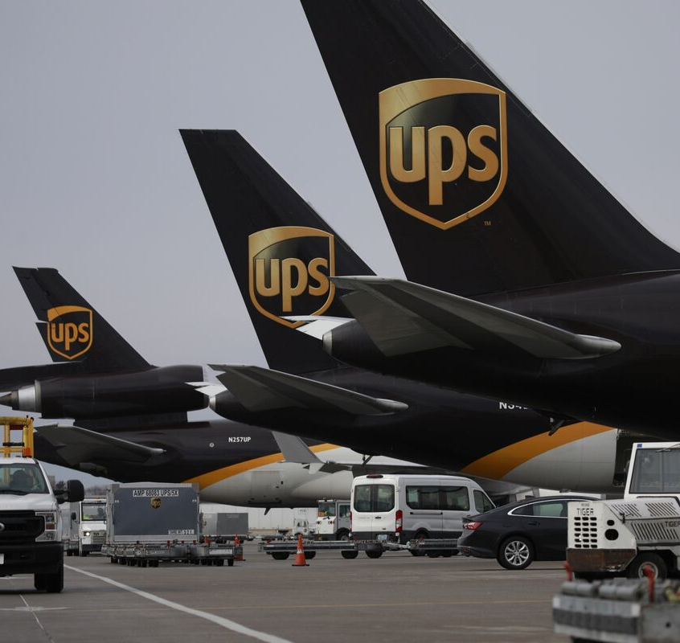
Transformations
98 years of journey (leader in all three streams by 2005)
  Package delivery company
  International air transportation company (10th largest airline in US)
  Logistics company (200 countries)

Slide 6
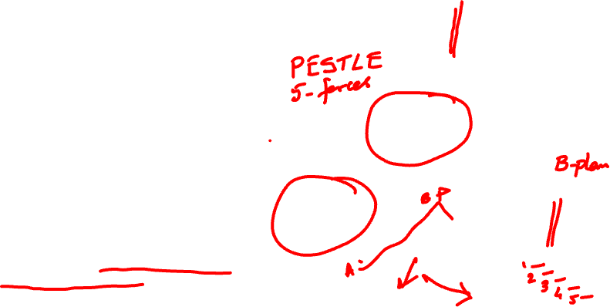
1997 Scenario Planning
Environmental Scanning
(Options)
Senior Management reviewed long range planning approaches
Brought consultants from Global Business network
Key focal issue facing UPS:
  The future of UPS’s global business in an ever-changing competitive environment.
  Axes of uncertainty: Market Environment and Demand Characteristics
  Four different scenarios that could impact UPS’s future
Strategy Formulation
(Where to go)
Scenario Planning
UPS Charter
Centennial Plan
Strategy Road Map
Strategic Programming
(How to get there)
Strategy Implementation
(Am I going in the right direction)

Slide 7
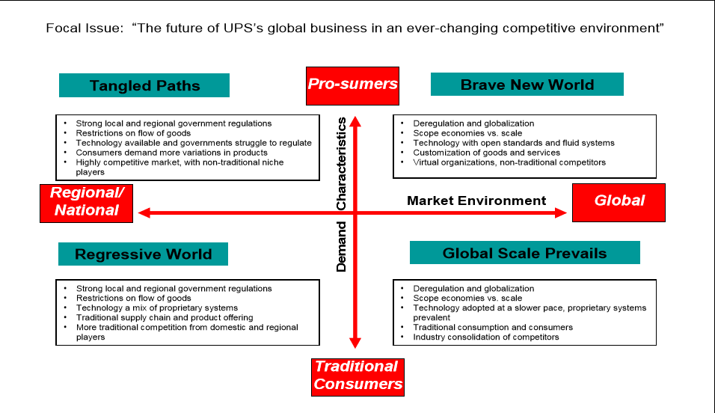
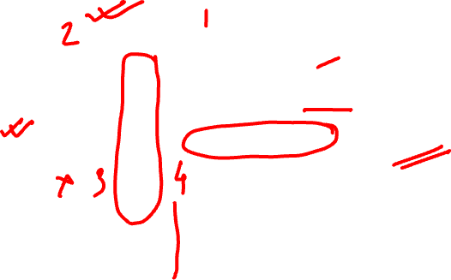

Slide 8
Strategic Plans
300+ functional projects were running on their own without control
Identification of 4 Strategic Imperatives
  Winning Team: Highly skilled global workforce
  Value-Added solution: Services for movement of good, information and funds
  Customer Focus: Expansion by loyalty and market
  Enterprise Excellence: High-quality service with value

Slide 9
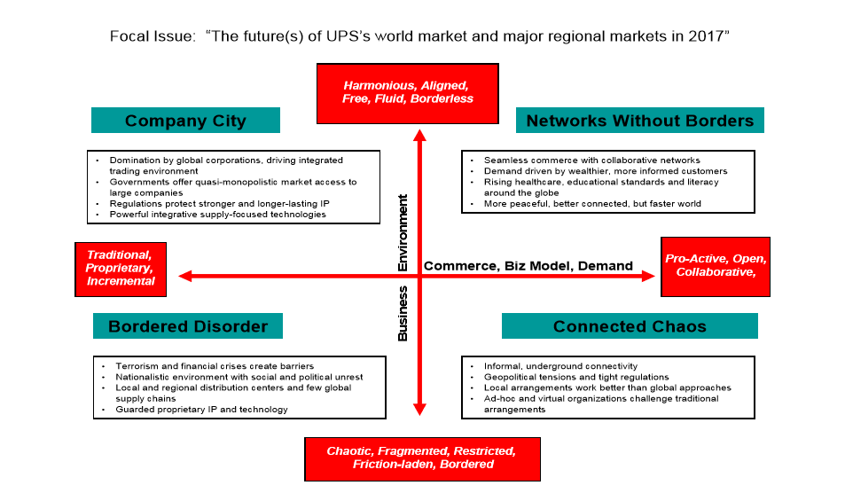

Slide 10
Strategic Planning & STRATEGIC THINKING
“Chance favours the prepared mind.”
Louis Pasteur

Slide 11
Strategic Planning
Strategic planning is not strategic thinking
  Planning is about analysis – breaking down a goal into steps, formalizing the steps so that they may be implemented
  Strategic thinking is about synthesis
Strategic planning, as it has been practiced has really been strategic programming
  Programming is about the articulation and elaboration of strategies, visions, that already exist

Slide 12
Fallacies of Strategic Planning
Fallacy of prediction
  A world without change. The world is supposed to hold still while a plan is being developed and then stay on the predicted course while that plan is being implemented
Fallacy of detachment
  Takes human idiosyncrasies out of the equation. Managers over-rely on formalized information, such as market research reports or accounting statements and tend to be detached. However, effective managers rely on soft information, such as gossip, hearsay, and various other scraps of information.
Fallacy of formalization
  No place for intuition. The failure of strategic planning is the failure of systems to do better than, or nearly as well as, human beings. Formal systems can process more information; however, they can’t internalize it, comprehend it, and synthesize it.

Slide 13
Challenges of Strategic Planning
Future is uncertain
  Not possible to predict all scenarios
Emergent phenomenon
  Weak signals
Lack of diverse perspectives
  Convergence, consensus
Dominated by numbers
  Short-term thinking
Lack of link between ambitions & implementation
  Bottoms-up approach
Failure in execution
  Lack of buy-in

Slide 14
Strategic Thinking
Strategic thinking is about synthesis
  It involves intuition and creativity
  It produces an integrated perspective of the enterprise and a not too well formulated vision of direction
  It can’t be developed on schedule and immaculately conceived

Slide 15
Intended Strategy
An intended strategy is the strategy that an organization hopes to execute
Intended strategies are usually described in detail within an organization’s strategic plan
  When a strategic plan is created for a new venture, it is called a business plan

Slide 16
Emergent Strategy
An emergent strategy is the one that emerges with time
  Emergent strategies are dynamic in nature
An emergent strategy is an unplanned strategy that arises in response to unexpected opportunities and challenges
Sometimes emergent strategies can result in disasters or lead to tremendous success

Slide 17

Realized Strategies
A realized strategy is the strategy that an organization actually follows
Realized strategies are a product of a firm’s
  intended strategy (i.e., what the firm planned to do)
  deliberate strategy (i.e., the parts of the intended strategy that the firm continues to pursue over time), and its
  emergent strategy (i.e., what the firm did in reaction to unexpected opportunities and challenges)

Slide 18
Non realized Strategy
A nonrealized strategy refers to the abandoned parts of the intended strategy
In most cases, a firms’ original intended strategies are lost during its journey

Slide 19
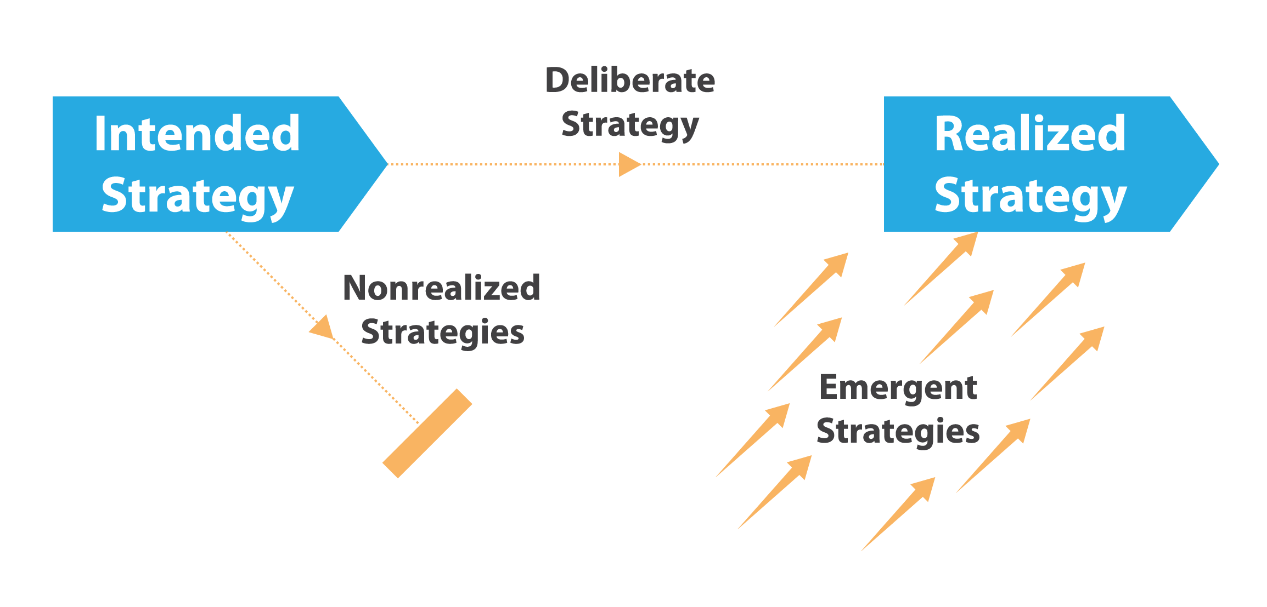
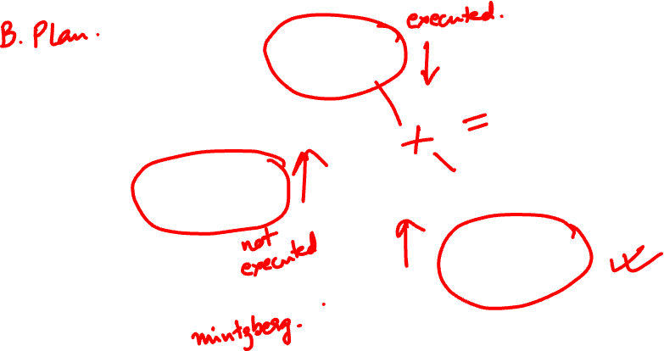
When an organization’s environment is stable and predictable, strategic planning can provide enough of a strategy for the organization to gain and maintain success

Slide 20
Scenario Planning
“Never make forecasts, especially about the future.”
(Samuel Goldwyn)

Slide 21
Origin
Scenario planning emerged from military use in war games and was introduced into the corporate world in 1960s.
It evolved from the traditional approach of “predict and control approach” to planning based on the probabilistic assessment of different futures, leading to the most likely scenarios.
It includes both probability as well as qualitative causal thinking.

Slide 22
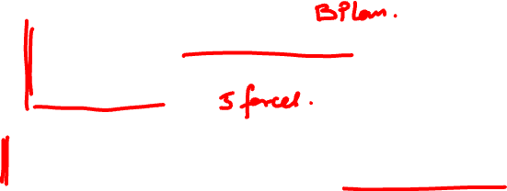
Competing Paradigms
Rationalists – “Optimal Strategy” - people who feel that there is one right way of doing something and given time we can find that right way (e.g. Michael Porter)
Evolutionists – strategies emerge over time, and can only be truly understood in retrospect (e.g. Henry Mintzberg)
Processualists – “Strategy Process or Strategy Conversation” - those who believe that there is a mid-way between the two.
  Today’s world is fast changing and there are a lot of uncertainties. What seems to be the best strategy today may be completely wrong from the time the strategy of decision making to the time of implementation.
  Therefore, the focus should be on the strategy process as much as the end result, especially in situations of high uncertainty.

Slide 23
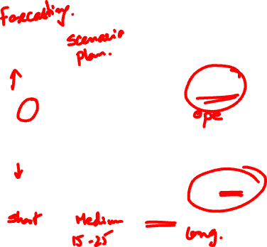
Predictability
Predictability goes down and uncertainty goes up – attempts to planning demonstrate diminishing returns. In the very short term – predictability is high and frequent forecasting is the planning mode most appropriate. Middle zone – there is a level of predictability but also considerable uncertainty – scenarios are the best way to go.

Slide 24
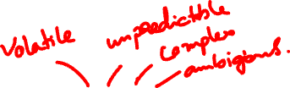
Corporate failures are often self-inflicted
  e.g., from inertia, prior strategic commitments, lack of foresight, etc.
Companies are also subject to VUCA conditions
  Recession, world terrorism, COVID-19, War

Slide 25
In the face of so much uncertainty, too many managers overestimate their ability to control events.
How can we develop a strategy today to respond effectively to alternative futures that might occur 3, 10, even 25 years from now?

Slide 26
“Scenario planning” guides and supports the imagination, creativity, and vision necessary for mapping a range of viable strategies for competitive success.
  Scenario planning is not a vehicle for predicting the future; it is a method of preparing for the future regardless of what happens.

Slide 27
Groups systematically share data and beliefs about their environmental assumptions and create “scenes” that describe combinations of critical events and trends.
  Managers are better able to prepare for the unexpected by developing contingency (“What if?”) plans.

Slide 28
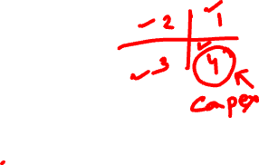
Scenario Planning
Advantages
Disadvantages
Forces managers to consider multiple evolutionary paths
Builds in divergence in the process
Helps to combat traditional biases in decision making
  Group thinking
  Tunnel vision
  Premature closure
A tool for collective learning
Time-consuming
Can become abstract pipedreams
De-linked from bottomline
Risk of misusing scenarios
  Favour any one
  Justify decisions

Slide 29
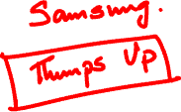
Let’s create a Scenario Plan
“One of the extraordinary things about human events is that the unthinkable becomes thinkable.”
Salman Rushdie, “Rushdie in Hiding” interview in New York Times, November 4, 1990

Slide 30
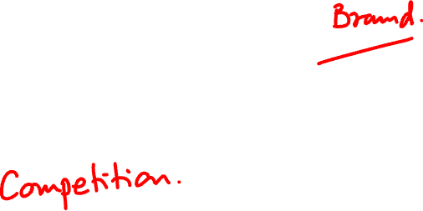
Strategic issue facing the company

Slide 31
Critical events in Environment
A critical event is a possible driving force or future development that potentially creates a material change in the firm’s financial structure, management and organization, corporate culture, and quality of stakeholder relationships.

Slide 32
Critical events in Environment
The competitive environment involves stakeholders who directly or indirectly affect the process and profitability of making and selling goods and/or services, including the following:
Customers – focus of products and services
Creditors – providers of financial leverage including banks, insurance companies, investment bankers, suppliers, preferred stockholders, etc.

Slide 33
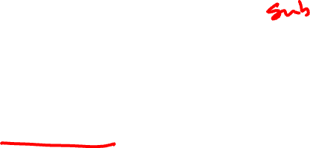
Critical events in Environment
Competitors – companies attempting to satisfy the same customer needs as those addressed by “our” company
Substitute Service/Products – any in a series of services and/or products, while not a duplicate for “our” product or service, would in fact be a satisfactory replacement.
Suppliers – provider of good and services including subcontractors

Slide 34
Critical events in Environment
Labour Unions – significant and important factor to many corporations. They control quality and impact productivity, which affects the cost of products and services.
Professional and Trade Associations – indirectly affect competitive cooperation and are a source of new ideas and innovation.

Slide 35

Critical events in Environment
New Entrants – potentially new competitors. In a market that is not rapidly expanding these can have a strong negative impact on revenue of companies currently competing within the market.
Other Interest Groups – organizations such as environmentalists and groups concerned about the moral aspect of company behaviour are forces that cannot and should not be ignored.

Slide 36
Critical events in Environment
The general environment relates to the broader human, political, and economic driving forces and include the following changes:
Political – divestment, fiscal, trade and tariff policies, impacting the business
Economic – trade balance, inflation, deflation, recession or expansion, interest rates, currency value and exchange rates, etc.

Slide 37
Critical events in Environment
Sociocultural – values, belief systems, lifestyles. May also include age of the population, general affluence, and family size, etc.
Technological – development of new possibilities; products and/or services for satisfying consumer demands.
Legal – rules and regulations impacting the business
Environmental – pressure on business due global changes in climate, environmental offsets etc

Slide 38
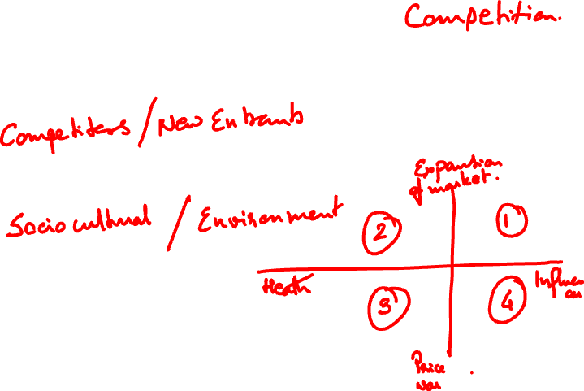
Critical Events that could impact Strategic Issue

Slide 39
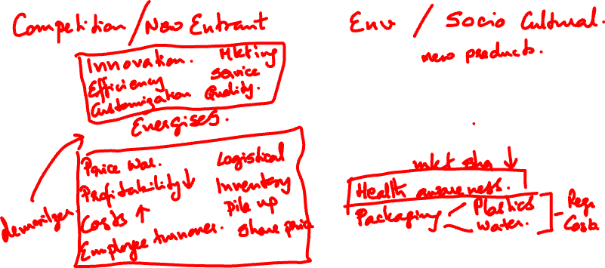
One good and one bad thing due to the critical event
Good:
Bad:
Good:
Bad:

Slide 40
What will we do if this happens?
Examine what could happen if these scenes become reality, and what that can mean to your company.
Consider both the immediate and longer-term consequences to your organization for each of your scenarios.
Next, list contingencies you should put in place now to deal with these scenarios.

Slide 41
What will we do if this happens?
Finally, develop a robust strategy that is resilient and viable regardless of which scenario actually does occur.
Given these possible futures, what is your overall assessment of the organization’s strategy?
What environmental forces challenge your future?
Are there common opportunities and threats, regardless of scenario?

Slide 42
What will we do if this happens?
Where is it vulnerable?
What major modifications do you recommend to the strategy?
Will you be flexible to change this strategy in response to shifting scenarios?

Slide 43

What will we do if this happens?
How will you know which scenario is actually unfolding?
What are the “flash points” or “signposts” (either metrics or events)?
Which key indicators must occur for that scene to become reality?

