Slide 1
Leadership and Change Management:
Organizational Climate, Transformation and Change
Dr. Anubha Dadhich
IIM Raipur

Slide 2
Session plan
Cognitive Differences: Whole brain Concept
MBTI
Leadership and Change
Organizational Climate & Change
Transformation Journey
Behavioral Context: Pragmatic Model

Slide 3
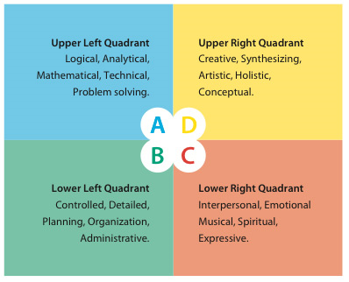
Cognitive Differences: Whole Brain Concept

Slide 4
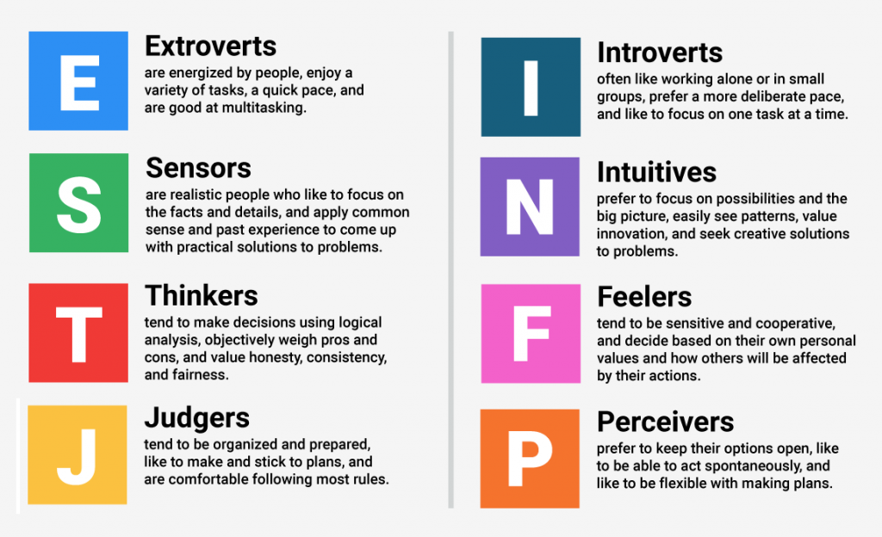
Problem Solving: MBTI

Slide 5
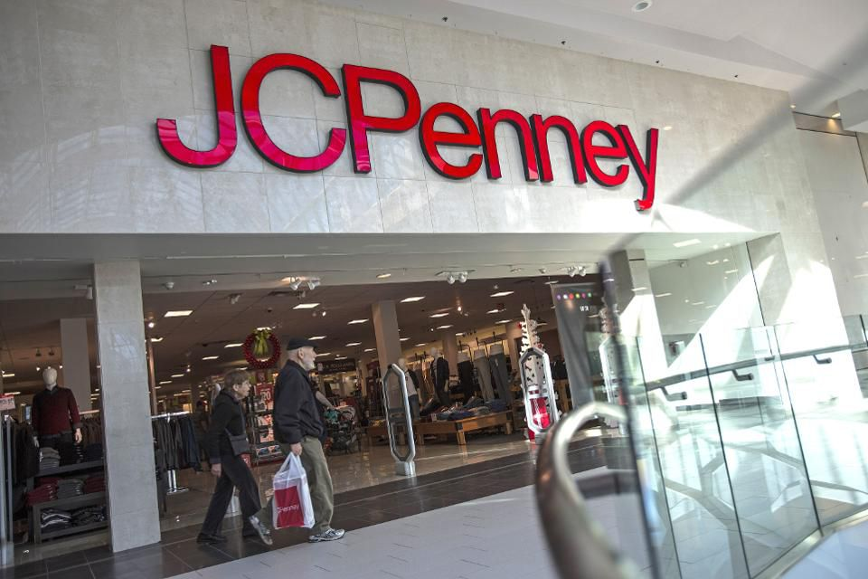
Leadership and Change
Ron Johnson 2012-13

Slide 6

Kodak Failed : Do not adopt Smartphone technology
First prototype of a digital camera was created in 1975 by Steve Sasson, an engineer working for … Kodak.
Invested in technology
Failed to realize new business models demand for digital as compare to printing

Slide 7
Blockbuster Vs Netflix
Blockbuster was bringing in $6 billion in revenue (2004) and Netflix was trailing behind as a scrappy start-up.
Just six years later, Netflix was a $2.2 billion company and Blockbuster was bankrupt.
Today, Netflix is worth more than $28 billion and Blockbuster is ancient history.

Slide 8
Are we ready to embrace change ??
Identify the problem you are providing solutions to your customers in current context.
Need to identify opportunity in disruption
Are we ready to harness this or how to prepare yourself to maximize growth and development of business

Slide 9
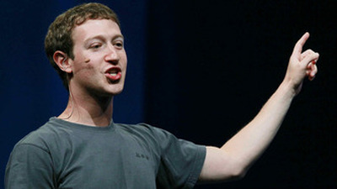
Leaders Who Change the Business
No Traditional Hierarchy, Everyone’s ideas are valued
Removing Barriers, Glass walls
Clear Vision: create a more open and connected world
Fearless: Courage to act and back owns decision with intelligence
Communication
Extra Perks

Slide 10

General Electric: Transformation: 3 Circles
Allocation of resources maintaining balance with competitiveness
Core Business– Re-investing in productivity and quality
Technology based business– Invest more on R&D to keep them on leading edge
In Service- Invest in People
Differentiated investment model is clearly strategic

Slide 11
Organization Climate
Success depends on people’s ability to change.
You cannot renew a business without changing behavior
No company can achieve radical improvement in business performance without revitalizing people
what does "revitalizing people' really mean ?
Is it an attitudinal change ? Or Mindset Change?
Large-scale culture change programme with this objective.

Slide 12
Organizational Change and Transformation
How to change ?
What to change—in particular, what to change first.
If Transformation process– not chosen wisely– Negative effect on performance of business
Example: JC Penney and Kodak

Slide 13
Continue…….
How likely is that?
Can you change people's attitudes?
Can you really teach old dogs new tricks?
The answer is unambiguous.

Slide 14
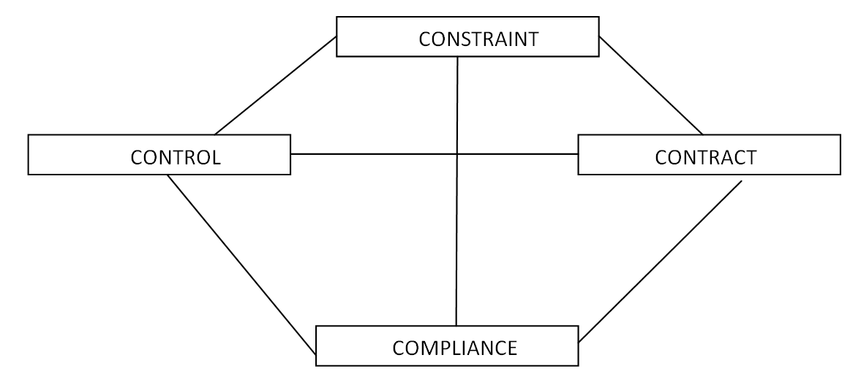
Internal behavioral context

Slide 15
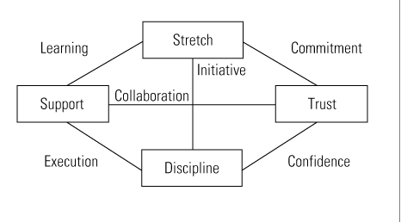
Behavioral Context: Pragmatic Model

Slide 16


