Slide 1
Leadership and Change Management
Dr. Anubha Dadhich
IIM Raipur

Slide 2
Session Plan
Leadership Theories: Research Orientation
Leadership Models
Cognitive differences
Self Assessment- Leadership Style
Personality and Leadership
Linking Personality , Leadership & Change

Slide 3
Leadership Theories: Research Orientation
1840–1940
Trait Theory & Great Man Theory
1940–1960
Behavioral
1960–2000
Situational/Contingency Approach
1980
onwards: New Leadership (Transformational/Transactional/Servant)
1990–2010
Relational (Individual/Dyads/LMX)

Slide 4
Continue…….
Traits: are the distinguishing personal characteristics of leader: intelligence, honesty, self-confidence and appearance
The Great Man Approach: Leaders who had achieved a level of greatness, e.g. Mahatma Gandhi, Lincoln.
In 1940’s & 1950’s – advancement in the field of psychology, by using the aptitude and psychological tests

Slide 5
Stogdill’s Research Findings (1948)
Examined more than 100 studies based on trait approach.
Uncovered several traits consistent with Effective Leadership
Intelligence, Initiative, Interpersonal skills, self-confidence, drive for responsibility, personal integrity.
Findings also indicate: Particular trait is often related to a SITUATION
E.g.: Many contributes to the success of a leader in one situation, but it may be irrelevant to a leader in another SITUATION
Possessing certain personal characteristics is NO guarantee to SUCCESS

Slide 6
Kurt Lewin & Associates : University of Iowa: Behavioural Approach
First studies on leadership behavior was conducted by them
Experiment: Group of children and designated adult leaders to act as either Democratic/Autocratic or Participative style
Autocratic: Feeling f hostility/Excellent Performance
Democratic: Positive feeling/Good
Participative: Comfortable/near to excellent

Slide 7
Ohio State Studies
Identify specific dimension of leadership behavior
Nearly 2000 behaviors
Leadership Behavior Description Questionnaire (LBDQ)
Finding: Two Dimensions
1) Consideration- leader cares about subordinate
2) Initiating Structure- directs subordinate work activities

Slide 8
University of Michigan Studies
Different Approach
Comparing the behavior of Effective and Ineffective Supervisors
Effectiveness of leaders was determined by productivity of the subordinate group
Findings: two type of behavior
1)Employee Centered
2) Job-centered

Slide 9
How Ohio & Michigan findings different ??
1)M Research: considered employee centered and job centered leadership to be distinct style in opposition to one another.
2) A leader is identifiable by behavior characteristics of one or the other style
But NOT BOTH.
3) Acknowledgement not only by designated leader but also by peer’s (enhanced performance).

Slide 10
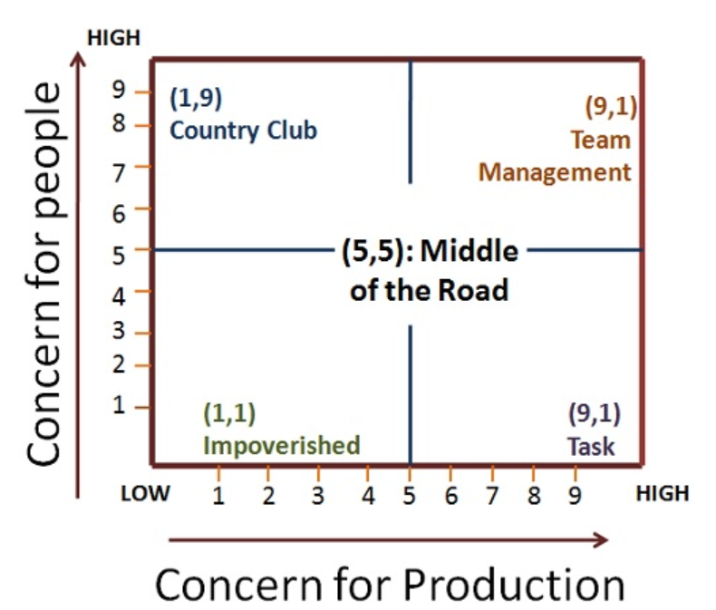
University of Texas: Blake & Mouton proposed Leadership Grid

Slide 11
Self Assessment- Leadership Style
Strongly Disagree=1
Disagree=2
Neutral=3
Agree=4
Strongly Agree=5

Slide 12
Questions
Q1. Employee needs to be supervised closely or they are not likely to do their work.
Q2. Employees want to be part of the decision-making process.
Q3. In Complex situations, leaders should let subordinates work problems out on their own.
Q4. It is fair to say that most employees in the general population are lazy.

Slide 13
Questions
Q5. Providing guidance without pressure is the key to being a good leader.
Q6. Leadership requires staying out of the way of subordinates as they do their work.
Q7. As a rule, employees must be given rewards or punishments in order to motivate them to achieve organizational objectives.
Q8. Most workers prefer supportive communication from their leaders.

Slide 14
Questions
Q9. As a rule, leaders should allow subordinates to appraise their own work.
Q10. Most employees feel insecure about their work and need direction.
Q11. Leaders need to help subordinates accept responsibility for completing their work.
Q12.Leaders should give subordinates complete freedom to solve problems on their own.

Slide 15
Questions
Q13. The leader is the chief judge of the achievements of the members of the group.
Q14. It is the leaders job to help the subordinates find their “passion”
Q15. In most situations, workers prefer little input from the leader.
Q16. Effective leaders give orders and clarify procedures.

Slide 16
Questions
Q17.People are basically competent and if given a task will do a good job.
Q18. In general, it is best to leave subordinates alone.

Slide 17
Scoring:
Sum of : 1,4,7,10,13 and 16
Sum of: 2,5,8,11,14 and 17
Sum of: 3,6,9,12,15 and 18

Slide 18
Big Five Personality Dimensions
Extraversion- Outgoing, sociable
Agreeableness- Cooperative, Forgiving
Conscientiousness- Persistent, Achievement oriented
Emotional Stability- Well adjusted, calm
Openness to Experience- Imaginative, Creative
……………………………………
Locus of Control

Slide 19
Why Leaders behave differently ??
Personality
Locus of Control
Values and attitudes
Instrumental & End Values

Slide 20
Cognitive Differences
How person perceives, processes, interpret and uses the information
Whole Brain Concept
Herman Brain Dominance Instrument
Problem solving : MBTI

Slide 21
Linking Leadership and Personality and Change
E Sreedharan: Metro man
It indicates that a single man can bring huge change/difference
Created a world class system
Clean Setting
Precise Timing
Zero Corruption Level
Fixing accountability
Carbon Credits from UN- Regenerative breaking system

Slide 22
Thanks

