Slide 1
Motivation & Empowerment
Anubha Dadhich (PhD/IITD)
Assistant Professor
IIM Raipur

Slide 2
Motivation
Motivation refers to the forces either internal or external to a person that arouse enthusiasm and persistence to pursue a certain course of action.
Motivation helps leaders understand
what prompts people to initiate action
what influences their choice of action
why they persist in that action over time

Slide 3
Model of Motivation
NEED Creates desire to fulfill needs(money, friendship, recognition, achievement
BEHAVIOUR Results in actions to fulfill needs
REWARDS Satisfy needs intrinsic or extrinsic rewards
FEEDBACK Reward informs person whether behavior was appropriate and
should be used again

Slide 4
Model of Motivation…
Studies have found that high employee , high organizational performance and profits go hand in hand .
An extensive survey by Gallup organizations found that when all organization’s employees are highly motivated and performing at their peak, customers are 70 percent more loyal, turnover drops by 70 percent and profit jumps 40 percent .

Slide 5
Intrinsic and Extrinsic Rewards
INTRINSIC
Large Merit increase
Feeling of self-fulfillment
Insurance benefits
Pride in being part of a “winning "organization
EXTRINSIC
INDIVIDUAL
SYSTEMWIDE

Slide 6
Intrinsic and Extrinsic Rewards
Intrinsic Rewards – internal satisfaction a person receives in the process of performing a particular action
Extrinsic Rewards- Rewards given by another person , typically a supervisor such as pay increases and promotions
System wide Rewards- rewards that apply the same to all people within an organization or within a specific category or department
Individual rewards- rewards that differ among individuals within the same organization or department .

Slide 7
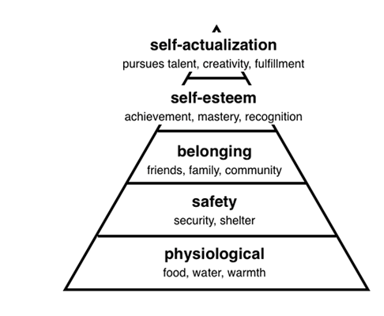
Maslow’s Hierarchy of Needs
Fulfillment on the Job
Opportunities for advancement,
Autonomy , growth, creativity
Recognition, approval, high status
, increased responsibilities
Workgroup, clients, coworkers,
supervisors
Safe work, clients, coworkers,
job security
Heat, air, base, salary

Slide 8
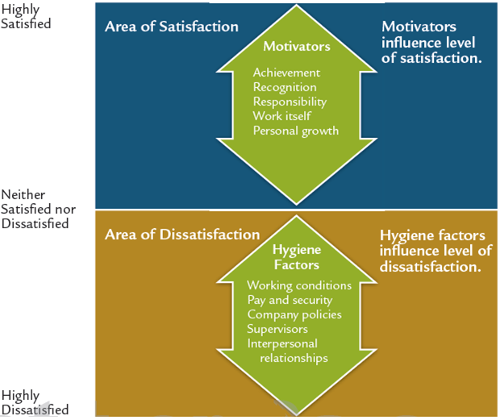
Herzberg’s Two-factor Theory

Slide 9
Empowering People to Meet Higher Needs
Empowerment refers to power sharing, the delegation of power or authority to subordinates in the organization.
Empowerment provides strong motivation because it meets the higher needs of individuals Research indicates that individuals have a need for self-efficacy which is the capacity to produce results or outcomes, to feel they are effective.
Most people come into an organization with the desire to do a good job, and empowerment enables leaders to release the motivation already there. Increased responsibility motivates most people to strive to do their best.

Slide 10
Elements of Empowerment
Five elements must be in place before employees can be truly empowered perform their jobs effectively:
Employees receive information about company performance.
Employees receive knowledge and skills to contribute to company goals.
Employees have the power to make substantive decisions.
Employees understand the meaning and impact of their jobs.
Employees are rewarded based on company performance.

Slide 11
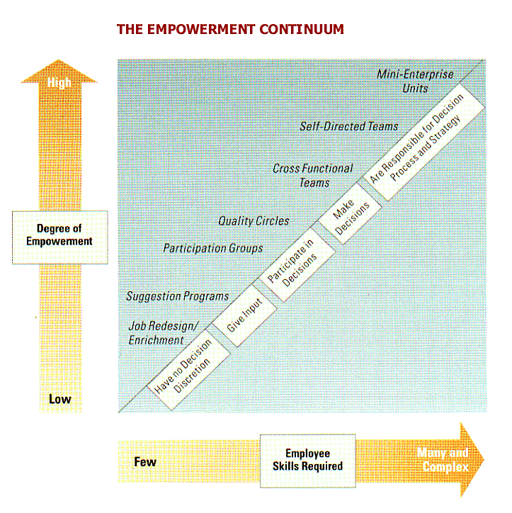
Empowerment Applications

Slide 12
Empowerment Applications….
Current methods of empowering employees fall along a continuum shown in previous slides.
The continuum runs from a situation where frontline employees have no discretion to full empowerment where workers even participate in formulating organizational strategy.
An example of full empowerment is when self-directed teams are given the power to hire, discipline, and dismiss team members and to set compensation rates .
Few organization have moved to this level of empowerment.
For example SEMCO a brazil –based company involved in manufacturing , services and e-business. SEMCO lets people control their work hours, location , and even pay plans. Employees also participate in all organizational decisions, including what businesses SEMCO should pursue.

Slide 13
Employee Engagement Programs
Giving Meaning to work through Engagement one-way people get intrinsic rewards at work is when they feel a deep sense of importance and meaningfulness, such as people who work for a social cause or mission . However, people can find a sense of meaning and importance no matter what type of organization .
When people feel that they’re a part of something special, they are more highly motivated and committed to the success of an organization and all its members.
One path to meaning is through employee engagement, which researchers have found contribute to stronger organizational performance and higher profitability.
Employee Engagement means that people enjoy their jobs and are satisfied with their work conditions, contribute enthusiastically to meeting team and organizational goals , and feel a sense of belonging and commitment to the organization.

