Slide 1
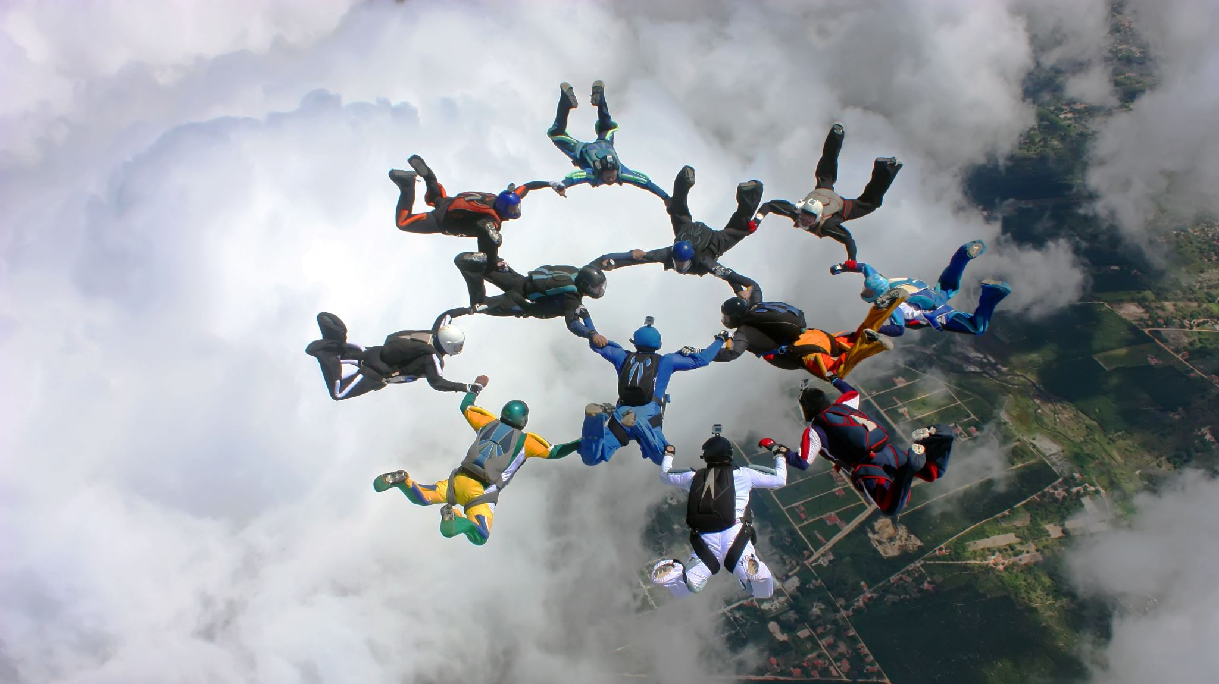
Team Effectiveness
Anubha Dadhich (PhD/IITD)
Assistant Professor
IIM Raipur

Slide 2

Effective Teams
Teams are the critical component of modern organizations
High-performing teams can accomplish more then the collected total of individual working individually

Slide 3

Team Effectiveness: Four Performance Outcomes
Innovation/Adaptation
Efficiency
Quality
Employee Satisfaction

Slide 4

Innovational Adaptation
Degree to which teams affect the organization’s ability to learn and to rapidly respond to environmental needs and changes

Slide 5

Efficiency
Pertain to whether the team helps the organization to attain goals using fewer resources

Slide 6
Quality
Refers to achieving fewer defects and exceeding customer expectations

Slide 7

Satisfaction
Pertains to the team's ability to maintain employee commitment and enthusiasm by meeting the personal needs of its members

Slide 8

Team Cohesiveness
Defined as the extent to which members stick together and remain united in the pursuit of common goal

Slide 9

Factors influence team cohesiveness
Interaction
Shared mission and goals
Feel – Involved – immensely relevant & important
Personal Attraction – like & respect
Organizational Context – also matter

Slide 10
Consequences of Team Cohesiveness
Moral – Increased communication, friendly atmosphere, loyalty, members participation in decision and activities
Performance – cohesiveness and performance are positively related

Slide 11
Disney:
Leading Team effectiveness in todays business environment

Slide 12
Discussion
Q. What is lost when collaboration across silos’ is not strong ??
Q. Where do people struggle to collaborate across boundaries ??
Q. What factors contribute to this ??

Slide 13
Learnings
Everyone is team lead
Creating lean start-up model in big corporations ?? Is it possible?
Make discussions/meetings minimal and in small teams.
Experimentation
Choose your own leader
Removing or rethinking of titles
Make slow changes in office culture

