Slide 1
Leading Collaborative Teams
Anubha Dadhich (PhD/IITD)
Assistant Professor
IIM Raipur

Slide 2
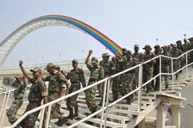
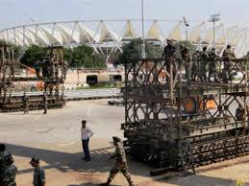
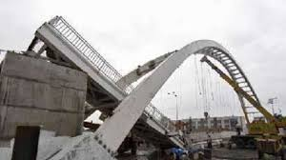
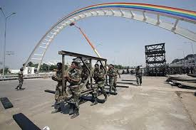
Collaborative Teams
Jawaharlal Nehru Stadium
2010 Commonwealth Games
Pedestrian Bridge Collapsed
3 Engineers & 100 Soldiers
Six Days -260 ft long bridge in record time
World War Style- Bailey Bridge

Slide 3
Differences between group and team
Group | Team
Focus on individual Roles | Both individual & Shared Responsibilities
Support based on Personal rapport | Natural Support System, Collective responsibility
Less Cohesive | More Synergy & Cohesiveness
I feeling dominate | We feeling Dominate
Less Meeting together | Frequent Regular Meeting
Individual Performance Orientation | Team Performance
More Group Think more group Conflict | Less group think, conflicts are issue based
Random Varied Skills | Complementary Skills

Slide 4
Reflective Exercise
Some time we have enjoyed being part of a team and other tomes we did not.
Similarly, sometimes those teams were effective and other ties they were not.
Q. Think about the possible reasons for their effectiveness and ineffectiveness

Slide 5
Teams Goals and Purposes
Are the goals and tasks clear to everyone ?
Are they engaging ?
Do all members believe in them ?
Are they linked with or integrate individual member’s goals ?
Are they Flexible ?

Slide 6
Team Size
Size has different bearing on different aspects of team effectiveness
Large: Provides varied skill pool but also more conflict & Slow progress
Small: Stronger bonds, close relationship
Frequent & better communication
Higher Participation
Less chance of social loafing

Slide 7
Cohesiveness
Creation of we feeling as compared to I feeling
Team size: 4-7
Communication
Shared Goals– Else feeling of disgruntleness
Team Composition
Team Performance

Slide 8
Team Norms
Rule or code of conduct for the members
Implicit or explicit
.....................................
Are they helpful in performance ?
Are they supportive in relationship development in team ?
How do they impact the climate of the group ?

Slide 9
Team Structure
What is the formal Structure and informal (invisible) structure that is working in teams ?
Are the two structure more or less similar ?
Who usually initiate things ?
Who takes up the responsibility ?
Who dominates the structure ?

Slide 10
Team Composition
Age
Gender
Skills
Interest Areas

Slide 11
Reflective Exercise
Reflect: Can you recall the times when the leader/chairman has suggested something, and members accepted even when all of them were not convinced ?
Example: A senior vice president (Marketing) of a company dealing in white goods, called on a meeting to discuss the strategy to combat increasing competition.
As the meeting convened, he said, “We are not going to start the price cutting war that our stupid competitors are on. What do you say?”

Slide 12
Recall a time, when you wanted to raise a question or disagree but kept quiet.
Why do think this happens ?
In what kind of a teams is it low and when is it high ?
What role leadership can play in it ?

Slide 13
Team Development Stages
Forming: Unclear Purpose & Doubts
Storming: Chaos & Conflict, Unclear Roles
Norming: Rules & Structure, Emerging Leadership
Performing: Commitment & Collaboration, High Morale + Environment
Adjournment: Withdrawal

Slide 14

Characteristics of Effective Teams
Clear & Shared Goals
Effective Communication
Shared Accountability & Participation
High Trust & Mutual Respect
Shared & Progressive Leadership
Complimentary Skills
Flexibility & Collaboration
Performance Focus & Regular Monitoring

Slide 15
Team Building
Sequence of planned process and activities designed together, introspect, explore and analyze the data on the functioning of the group.
To bring certain changes in their approach to improve the teamwork and increase the team effectiveness.

Slide 16
What we Do?
Diagnostic Exercises – Questionnaires, reflections, Observations, etc
Outbound Training: Informal team Activities and games to enhance the team bonding
Interpersonal effectiveness workshops using tools like FIRO-B & Johari Window, Transactional Analysis etc

