Slide 1
Risk Return
Prof. M S Jawed

Slide 2
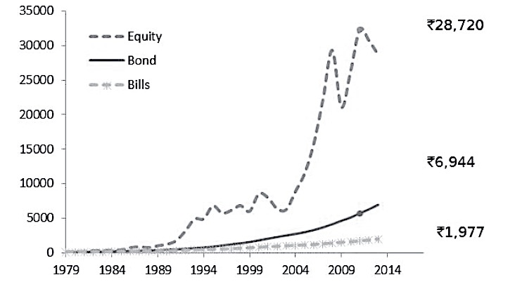
The Value of an Investment of Rs.100 in 1978

Slide 3
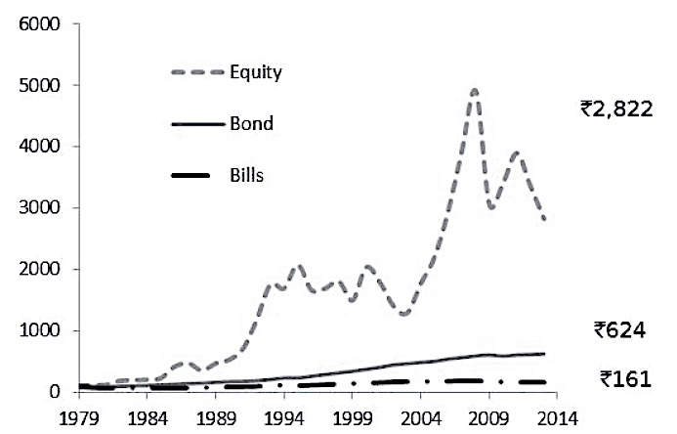
The Value of an Investment of Rs.100 in 1978, Real Returns

Slide 4
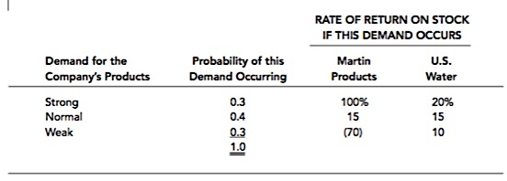
Probability Distributions for Martin Products and U.S. Water

Slide 5
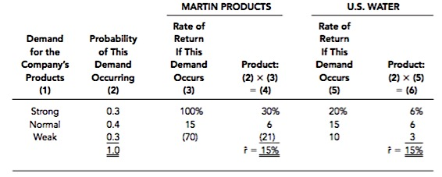
Calculation of Expected Rates of Return: Payoff Matrix

Slide 6
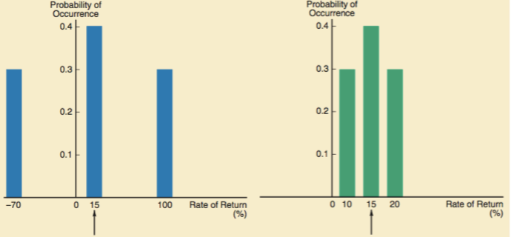

Slide 7
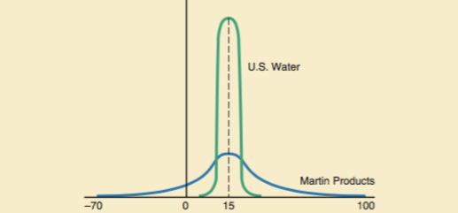
Continuous Prob. Dist.

Slide 8


Variance with Discrete Probability estimates of return vs Multiple Historical Data

Slide 9

Higher Return or Lower Variance ?

Slide 10
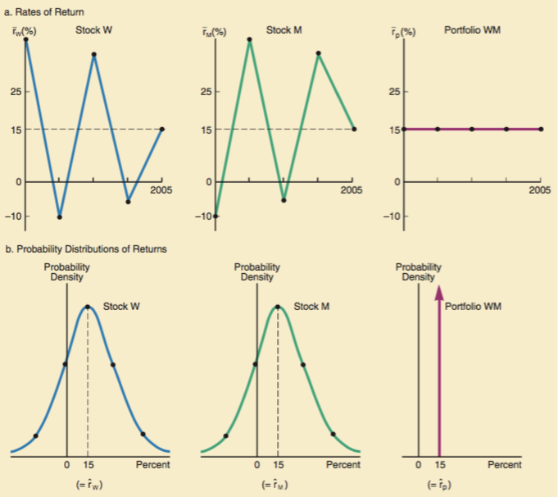

Slide 11
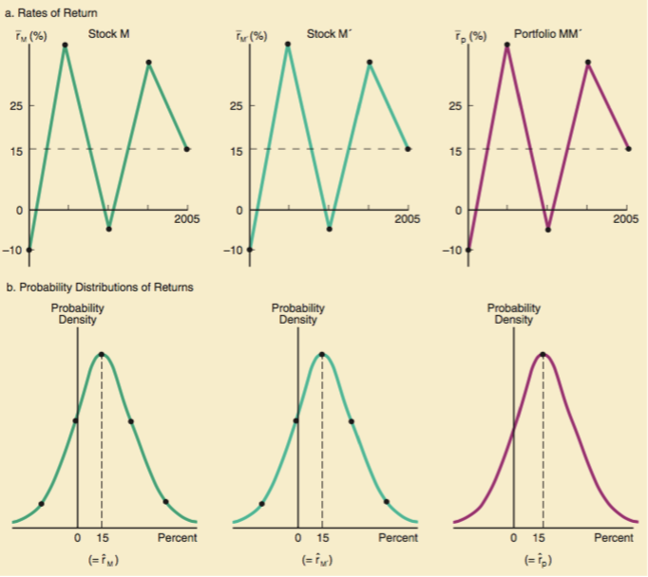

Slide 12
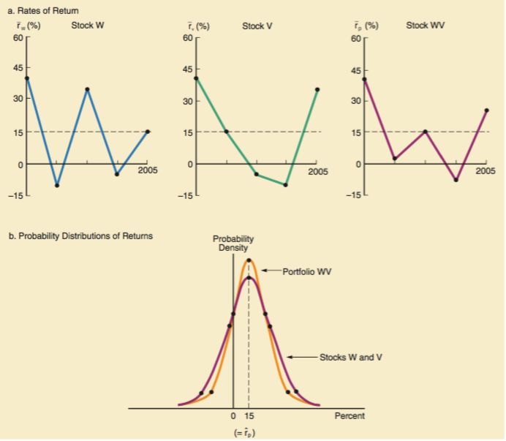

Slide 13
Calculating Portfolio Risk & Return

Slide 14
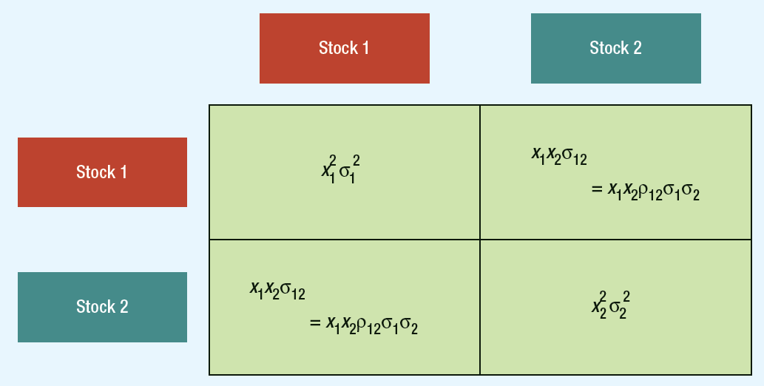
Variance of a Two-stock Portfolio

Slide 15
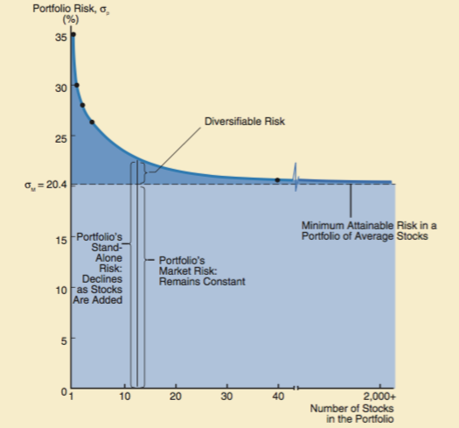

Slide 16
Lets Solve a problem
Invest 58% of portfolio in Bharti and 42% in Tata Motors. Expected return on Bharti stock is 13% and 19% on Tata Motors. Standard deviation of annualized daily returns are 30% and 40%, respectively. Assume correlation coefficient of 1.0 and calculate portfolio return and variance.

Slide 17

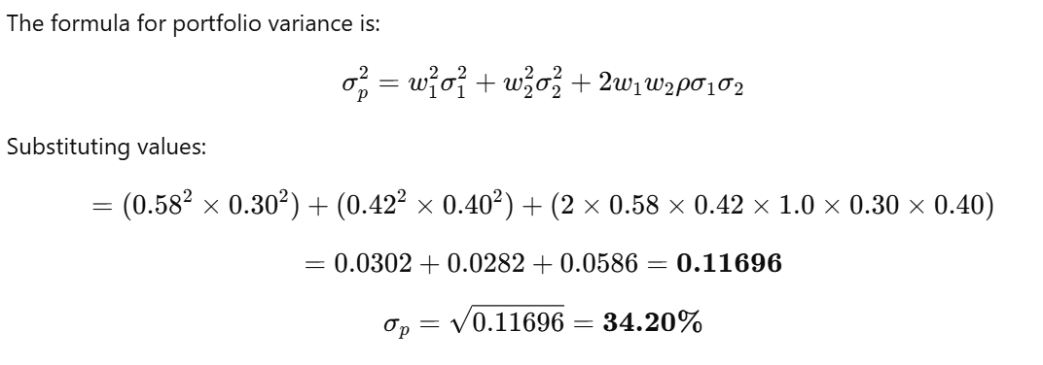

Slide 18
Diversification
When we examine the risks associated with individual assets, we find that there are two types of risks:
  Systematic risk
  And Unsystematic risk
Systematic risk affects almost all assets in the economy to a degree
Unsystematic risk affects at most a small number of assets

Slide 19
Diversification
The principle of diversification states that highly diversified portfolios will have virtually no unsystematic risk
This has an important implication
  To a diversified investor only systematic risk matters
  So, in deciding whether to buy an individual asset a diversified investor will be concerned with only the asset’s systematic risk

Slide 20
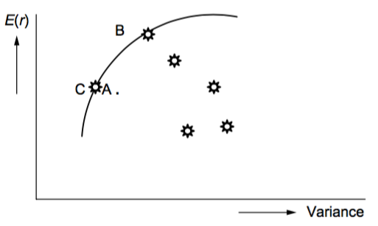
Markowitz Model

Slide 21
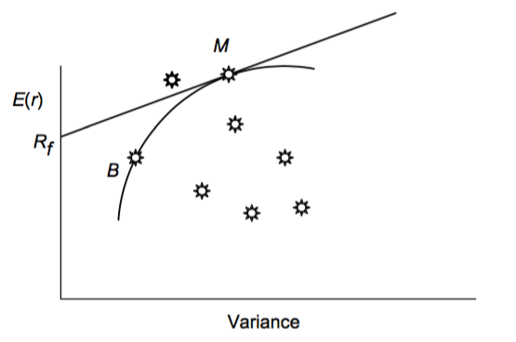
Capital Market Line

Slide 22
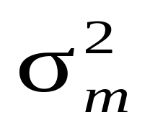
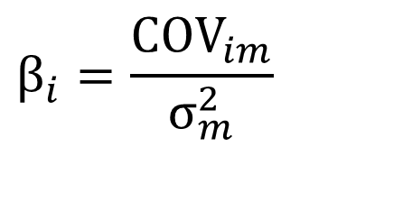
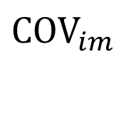
How Individual Securities Affect Portfolio Risk
Beta Formula
  : covariance with market
  : variance of market
$$β_{i}=\frac{{COV}_{im}}{σ_{m}^{2}}$$
$${COV}_{im}$$
Notes:
This equation is useful for estimating beta. The ratio of covariance to variance measures a stock’s contribution to portfolio risk. Beta (β) = σ_{im}/(σ_{m}²)
Beta (β) = σ_{im}/(σ_{m}²)
σ_{im} = covariance with the market
σ_{m}² = variance of the market
Explain that the covariance of the market with itself is the same as the variance of the market. Thus, the beta of the market is always 1.0.

Slide 23
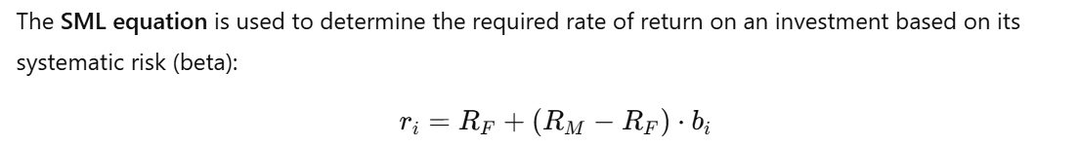
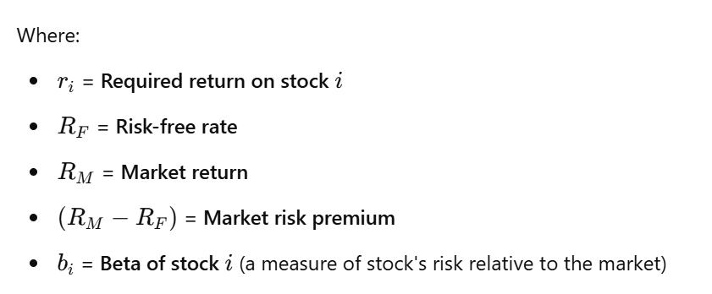

Slide 24
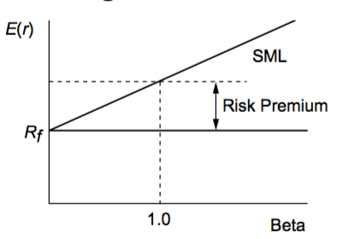
Security Market Line

