Slide 1
Risk and Return

Slide 2
Risk vs Return
There is a trade off between risk and expected return
The higher the risk, the higher the expected return

Slide 3
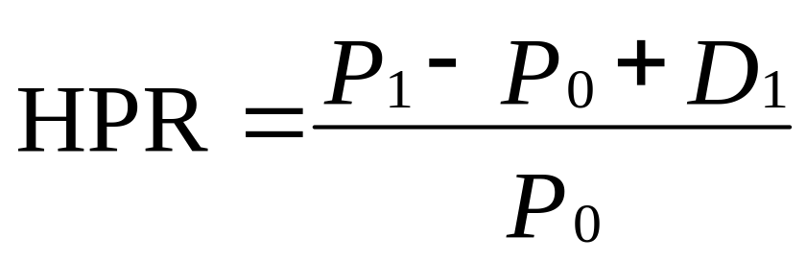
Return
Rates of return: Single period
  HPR = Holding period return
  P₀ = Beginning price
  P₁ = Ending price
  D₁ = Dividend during period one

Slide 4
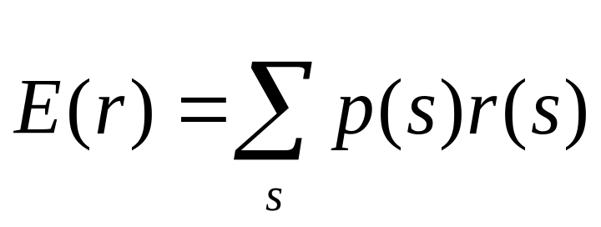
Expected Return and Standard Deviation
Expected returns
  p(s) = Probability of a state
  r(s) = Return if a state occurs
  s = State

Slide 5
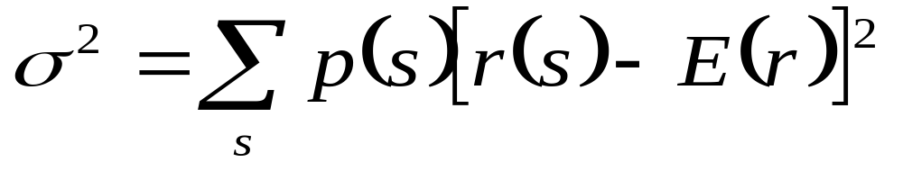
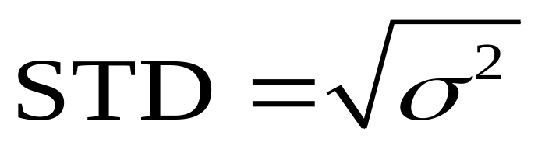
Expected Return and Standard Deviation
Variance (VAR):
Standard Deviation (STD):

Slide 6
Diversification
  Strategy designed to reduce risk by spreading the portfolio across many investments
Unique Risk
  Risk factors affecting only that firm; also called “diversifiable risk”
Market Risk
  Economy-wide sources of risk that affect the overall stock market; also called “systematic risk”

Slide 7
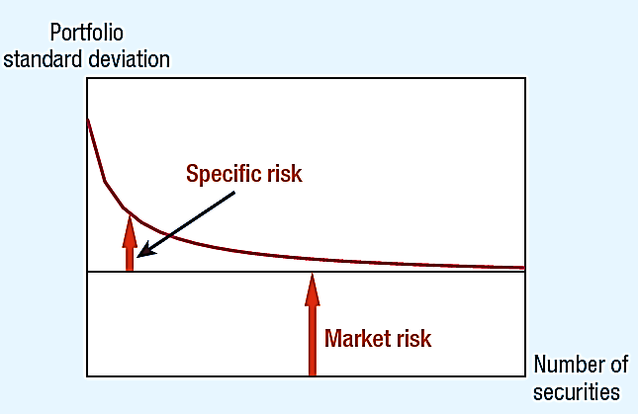
Diversification Eliminates Specific Risk

Slide 8
Diversification
The principle of diversification states that highly diversified portfolios will have virtually no unsystematic risk
This has an important implication
  To a diversified investor, only systematic risk matters
  So, in deciding whether to buy an individual asset, a diversified investor will be concerned with only the asset’s systematic risk

Slide 9
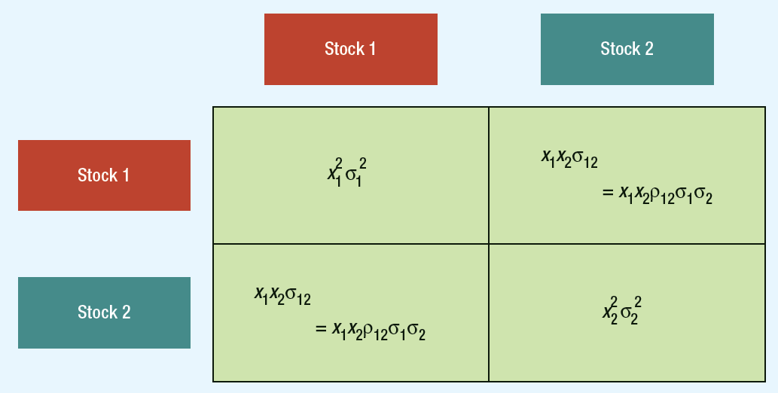
Variance of a Two-stock Portfolio

Slide 10
Calculating Portfolio Risk & Return

Slide 11
Example
Invest 58% of portfolio in Bharti Airtel and 42% in Tata Motors. Expected return on Bharti stock is 13% and 19% on Tata Motors. Standard deviation of daily returns are 33.5% and 46.5%, respectively. Assume correlation coefficient of 1.0 and calculate portfolio return and variance.

Slide 12
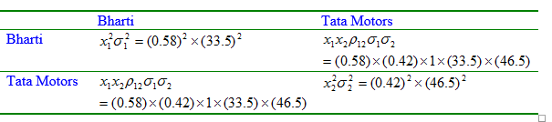

Portfolio Risk

Slide 13
Calculating Portfolio Risk
Example Correlation Coefficient = .4
Return: r = (15%)(.60) + (21%)(.4) = 17.4%
Standard deviation:
= sqrt [(28²)(.6²) + (42²)(.4²) + 2(.4)(.6)(28)(42)(.4)]
= 28.1
Stocks | Std dev | % of Portfolio | Average Return
ABC Corp | 28 | 60% | 15%
Big Corp | 42 | 40% | 21%

Slide 14
Calculating Portfolio Risk
Example (Continued)
  Adding a third company to the portfolio: Correlation Coefficient = .3
Standard deviation = portfolio = 23.43
NEW return = weighted average = portfolio = 18.20%
Higher return, lower risk through diversification
Stocks | σ | % of Portfolio | Average Return
Portfolio | 28.1 | 50% | 17.4%
New Corp | 30 | 50% | 19%

Slide 15
How Individual Securities Affect Portfolio Risk
Market Portfolio
  Portfolio of all assets in economy
  Usually uses broad stock market index to represent market
Beta
  Sensitivity of stock’s return to return on market portfolio

Slide 16
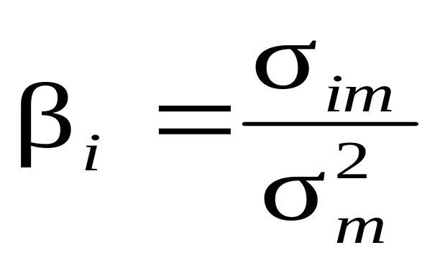
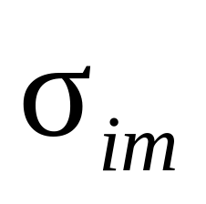
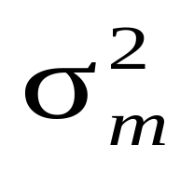
How Individual Securities Affect Portfolio Risk
Beta Formula
  covariance with market
  variance of market

Slide 17
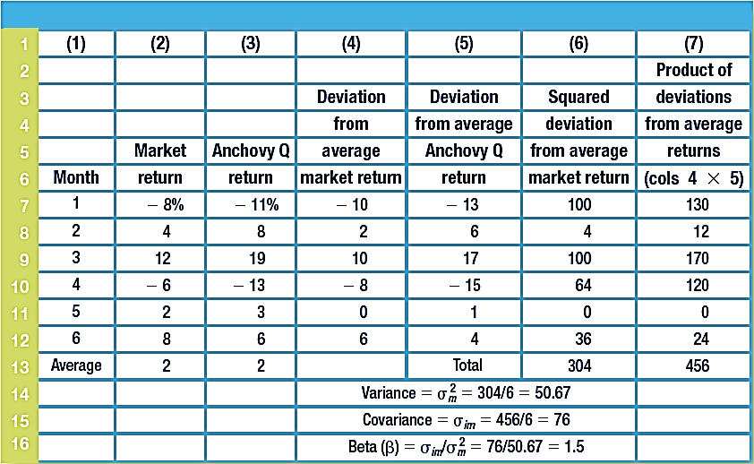
Calculating Variance and Covariance

Slide 18
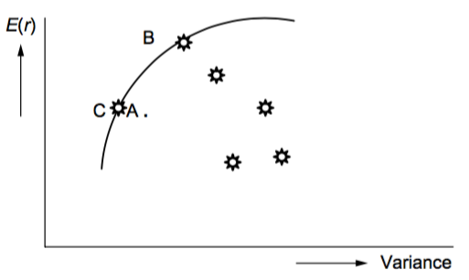
Markowitz Model

Slide 19
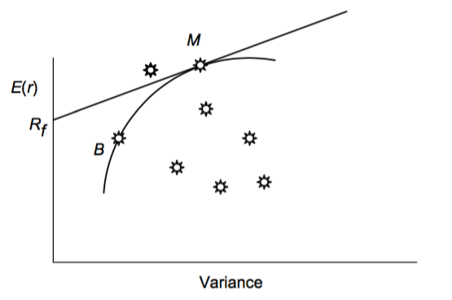
Capital Market Line

Slide 20
The Relationship Between Risk and Return
Return
.
Market return = r_{m}
Market portfolio
r_{f}
Risk

Slide 21
Security Market Line
Return
Security market line
(SML)
.
Market return = r_{m}
Market portfolio
r_{f}
1.0
BETA

Slide 22
The Relationship Between Risk and Return
Return
SML
r_{f}
BETA
1.0
SML Equation: r_{f} + β(r_{m} − r_{f})

Slide 23
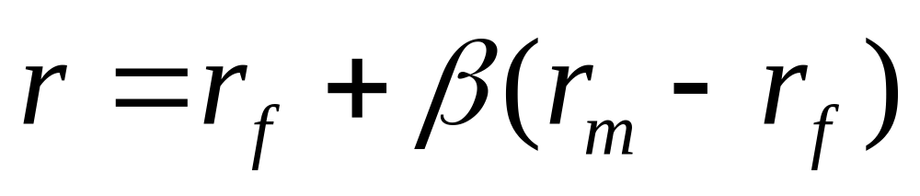
The Relationship Between Risk and Return
Capital Asset Pricing Model (CAPM)

Slide 24
Assumptions:
Investors make choices on the basis of risk (i.e., variance) and return.
Investors have homogeneous expectations of risk and return.
Investors have identical time horizons.
Information is freely available to investors.
There is a risk-free asset and investors can borrow and lend at risk-free rate.
There are no taxes or transaction costs.

Slide 25
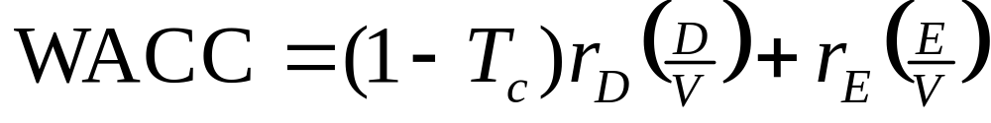
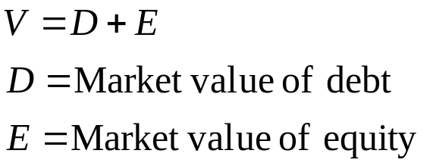
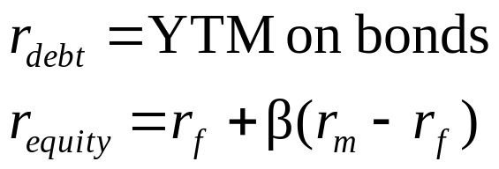
Company and Project Costs of Capital
Weighted Average Cost of Capital
  Traditional measure of capital structure, risk and return
Alternate representation: WACC = w_{d}r_{d}(1 – T) + w_{s}r_{s}

