Slide 1
Risk Pooling Strategies and Postponement
Milan Kumar
IIM Visakhapatnam

Slide 2
Uncertainty
Uncertainty is the bane of operations.
Operational performance is affected by
  Uncertain Demand
  Uncertain Supply
  Uncertain Quality
The risk is mitigated through risk-pooling strategies such as
  Location pooling
  Virtual pooling
  Product pooling
  Lead time pooling and
  Capacity pooling

Slide 3
Location Pooling
Assume there are two locations served using two different warehouses.
The warehouse must maintain a service level of 95%.
The locations are served with a lead time of 1 day, i.e., an order placed today will be fulfilled the next day.
Consider an alternate scenario where both locations are served from the same warehouse. What will be our inventory requirement to maintain the same service level?
Let us answer this question using data.

Slide 4
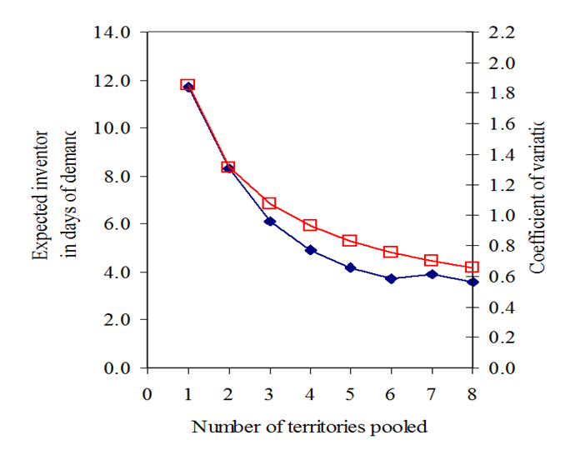
Location Pooling contd..

Slide 5
Location Pooling - Conclusion
Lesser inventory is needed for the same service level
Or, the same amount of inventory now provides a higher service level
Or, a combination of the two can be used to lower inventory and improve the service level.
Caution: Pooling a larger geographical area may result in a higher delivery cost.
  Thus, savings from lower inventory may be lost due to a higher delivery cost.
  Especially relevant in the case of E-commerce companies.

Slide 6
Product Pooling - O’Neill’s Dive Wetsuits
O’Neill sells two Hammer 3/2 wetsuits that are identical except for the logo silk screened on the chest.
Instead of having two Hammer 3/2 suits, O’Neill could consolidate its product line into a single Hammer 3/2 suit, that is, a universal design, which we will call the “Universal Hammer.”
Let's assume that the demand for both products is normally distributed with a mean of 3,192 and a standard deviation of 1181.
Also, each suit sells for $190, and the purchase cost is $110. If items are unsold at the end of the season, it is salvaged at $90.

Slide 7
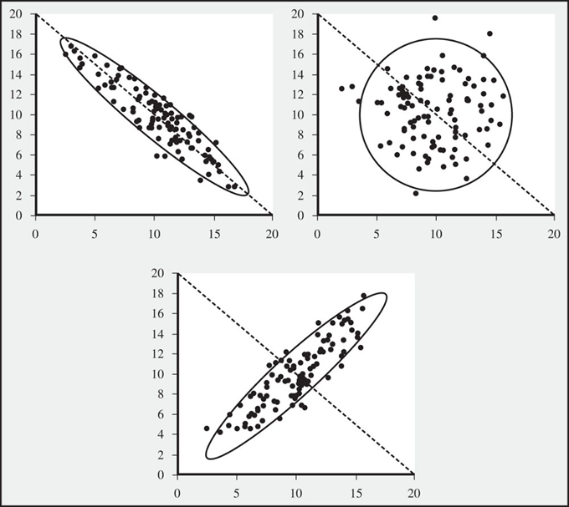
A detour -
Random Demand for Two Products

Slide 8
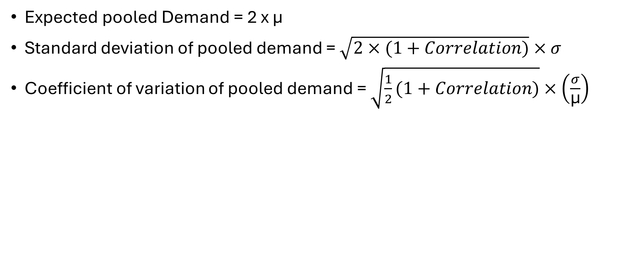
Characteristics of Pooled Demand
Expected pooled Demand = 2 x μ
Standard deviation of pooled demand = $\sqrt{2×(1+Correlation)}×σ$
Coefficient of variation of pooled demand = $\sqrt{\frac{1}{2}(1+Correlation)}×\left(\frac{σ}{\text{μ}}\right)$

Slide 9
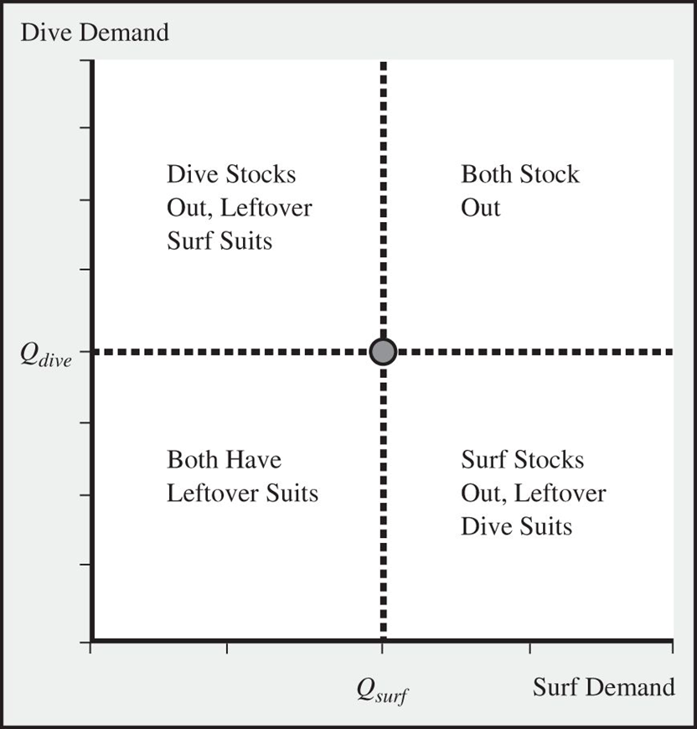
Inventory/Stockout Outcome Given the Order Quantities for Surf and Dive Suits

Slide 10
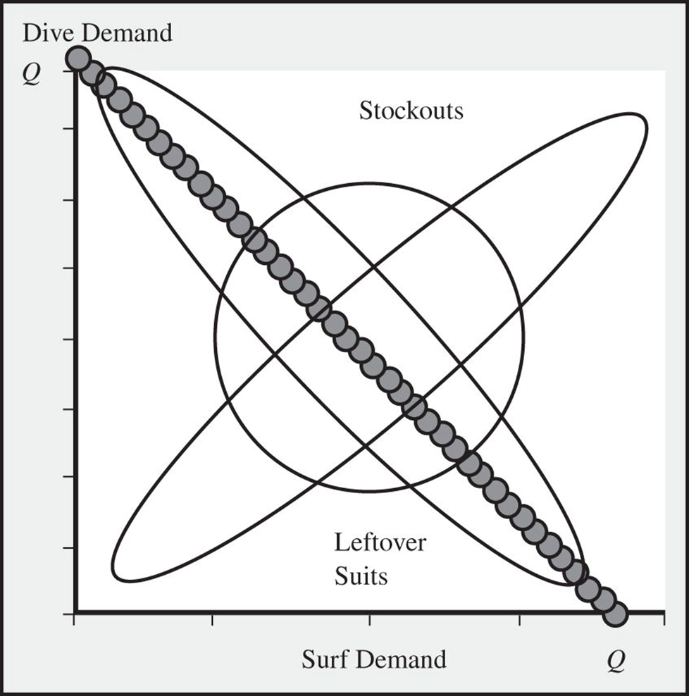
Outcomes for the Universal Hammer Given Q Units Purchased

Slide 11
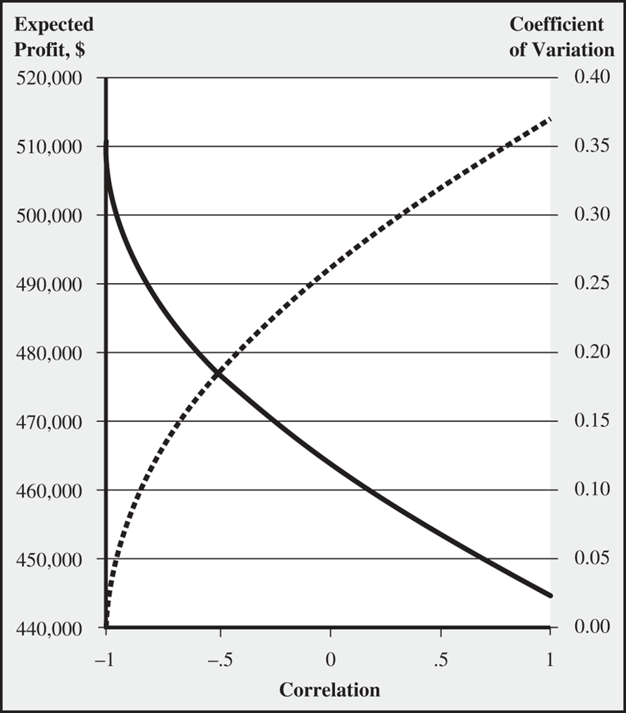
Expected Profit of the Universal Hammer Wetsuit (decreasing curve) and the Coefficient of Variation of Total Demand (increasing curve)

Slide 12
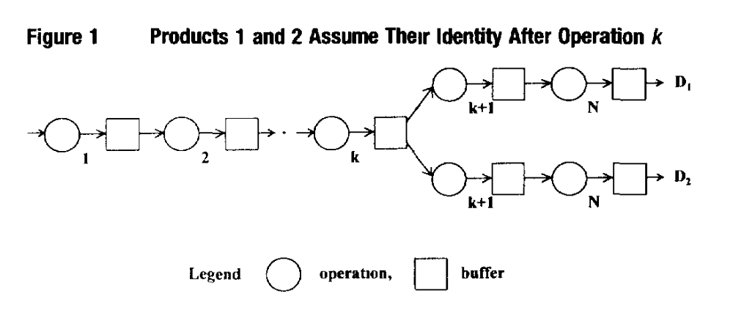
Differentiation

Slide 13
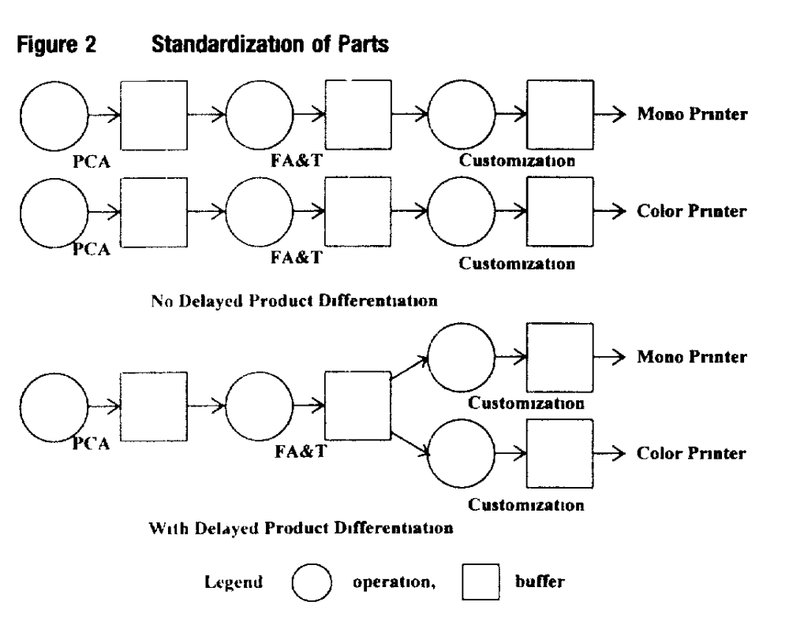
Standardization

Slide 14
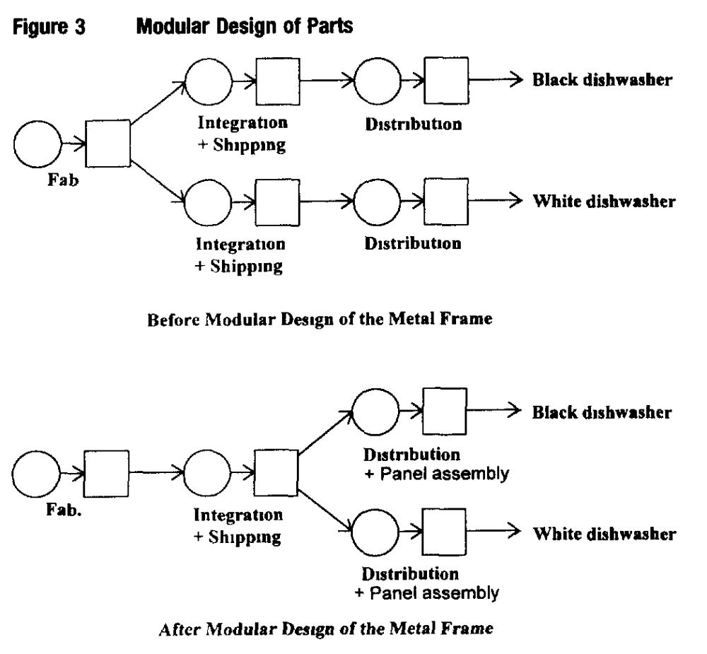
Modular Design

Slide 15
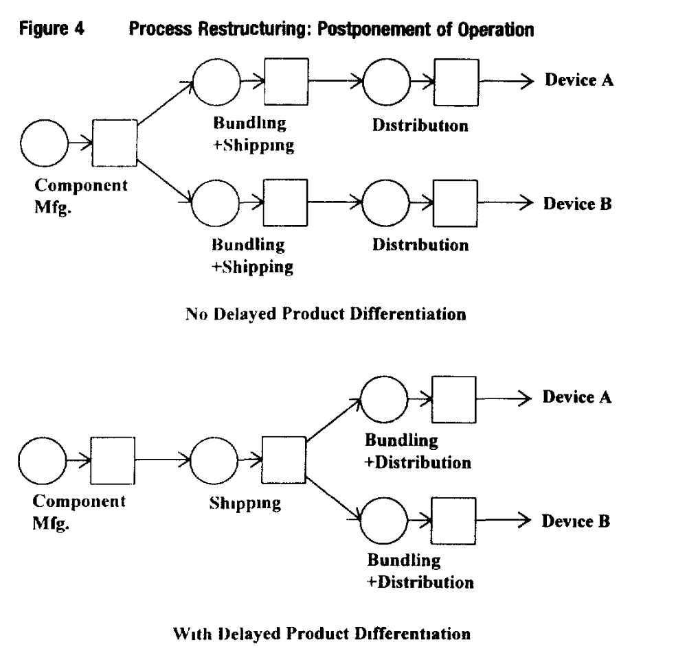
Delayed Differentiation

Slide 16
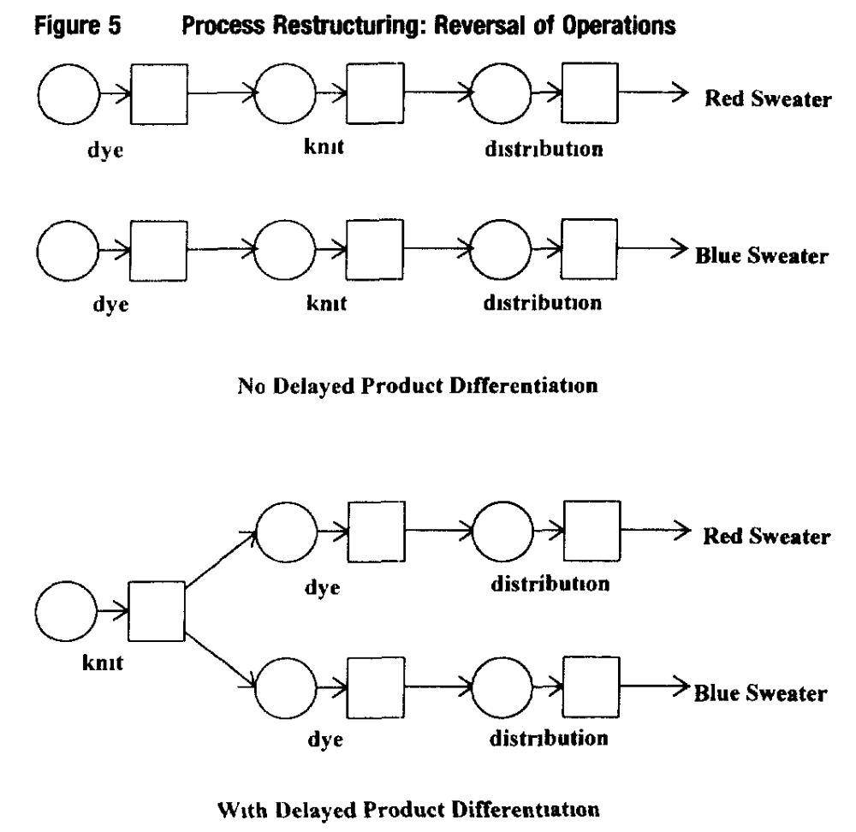
Process Restructuring

Slide 17
Summary of Differentiation Strategies
_{Basic Approach} | Redesign Process for Delaying Product Differentiation | _{Conditions for Effectiveness}
_{Standardization} | Design a part that is common to all products | Effective when the investment cost and incremental processing cost required for standardization are low
_{Modular Design} | Divide a part into 2 modules—the first module is a common part, and the assembly operation of the second module is deferred | The number of modules increases. However, this approach is effective when the incremental lead time, incremental processing cost, and unit inventory holding cost are low
Process Restructuring - Postponement of Operation | Divide an operation into 2 steps—the first step is common to all products, and the execution of the second step is postponed | Effective when the lead time of the common step is significantly longer than the second step that is being delayed. Additionally, this approach is effective when the second step is a high value-added activity
Process Restructuring - Reversal of Operations | Reverse the order of 2 operations. As a result, the first operation is common to all products | Effective when deferring the high value-added operation by reversing the operations

Slide 18
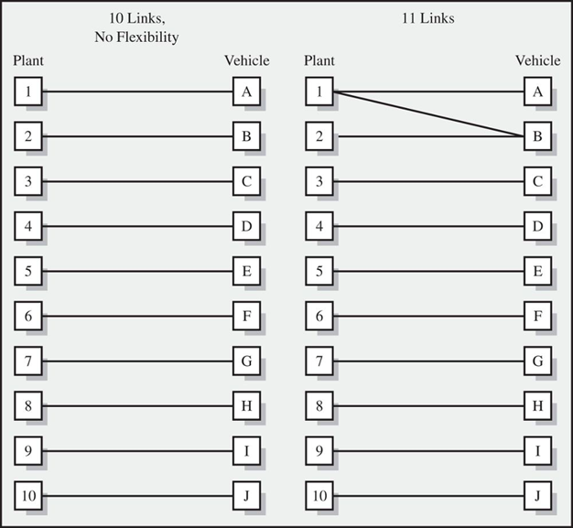
Capacity Pooling with Flexible Manufacturing

Slide 19
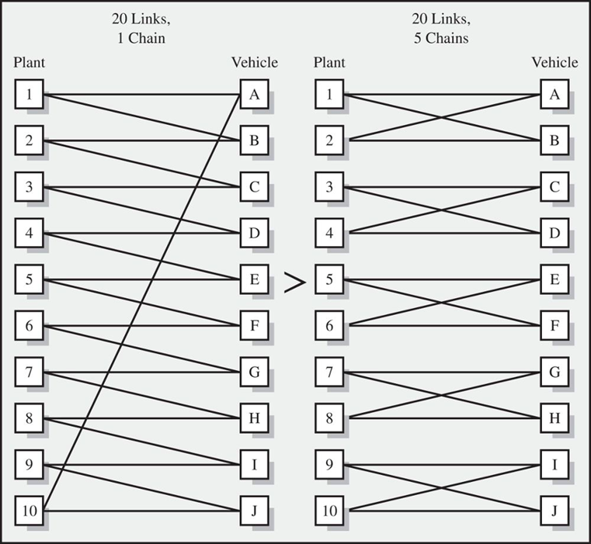
Flexibility Configurations with the Same Number of Links but Different Number of Chains
A chain is a group of plants and products connected via links.
Flexibility is most effective if it is added to create long chains.
A configuration with 20 links can produce nearly the results of total flexibility as long as it constructs one large chain:
Hence, a little bit of flexibility is very useful as long as it is designed correctly.

Slide 20
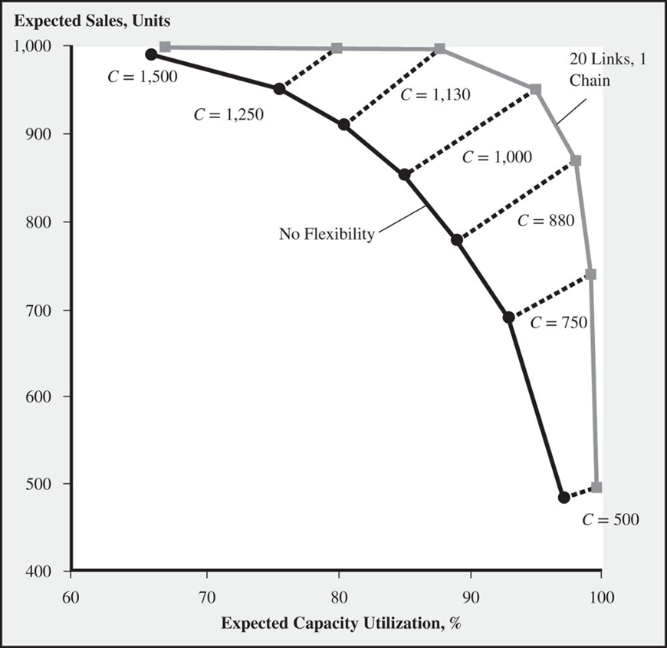
Expected Sales and Capacity Utilization

Slide 21
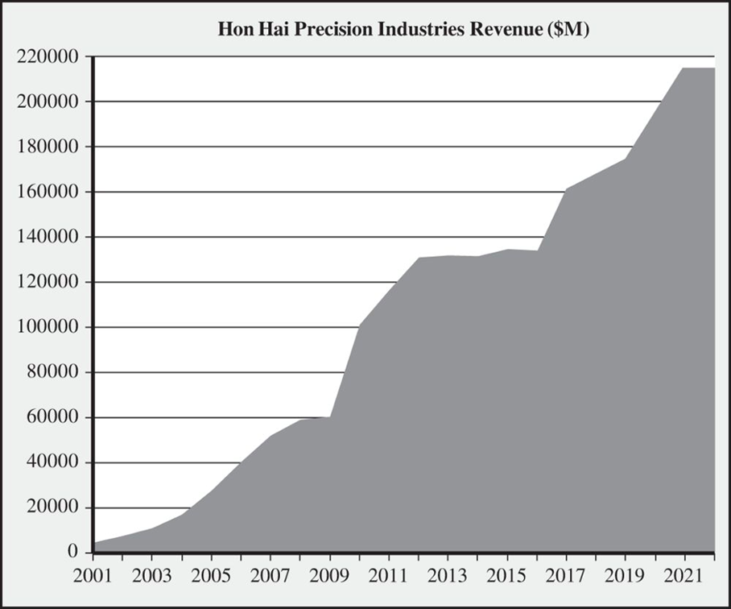
A Graph of Revenue Growth for Hon Hai

Slide 22
Summary
We discussed the strategies for leveraging risk pooling to balance supply and demand, with methods like location pooling, product pooling, and capacity pooling, each having unique benefits and limitations.
Location pooling is effective in reducing inventory but moves it away from customers, while consolidated distribution keeps inventory near customers.
Product pooling with a universal design can be beneficial but might reduce product functionality and may require redesign.
Capacity pooling can increase sales and capacity utilization but needs flexible, often costly, capacity.
Risk pooling is most effective when demands are negatively correlated; it becomes less effective as demand correlation increases.
Risk pooling does not reduce pipeline inventory; instead, it primarily aids in inventory management, helping to either reduce inventory or increase service levels.

Slide 23
References:
Reference: Lee, H. L., & Tang, C. S. (1997). Modelling the costs and benefits of delayed product differentiation. Management Science, 43(1), 40-53.
Cachon, G., & Terwiesch, C. (2023). Risk-pooling strategies to reduce and hedge uncertainties. In Matching supply with demand (4th ed). McGraw Hill.

