Slide 1
Resource Optimization Strategies in a Dynamic Business Environment
By Prof. Prashant Premkumar

Slide 2
To begin with LP: Example-1
Formulation-1 Product mix Problem:
A shop can make two types of sweets (A and B). They use two resources flour and sugar. To make one packet of A, they need 3Kg. of flour and 3Kg of sugar. To make one packet of B, they need 3Kg of flour and 4Kg of sugar. They have 21Kg of flour and 28Kg of sugar. These sweets are sold at Rs. 1000 and 900 per packet respectively. Find the best product mix to maximize the revenue.

Slide 3
What is the objective?
  To maximize the revenue
What decisions will influence the objective?
  Quantity of Sweet A to be produced
  Quantity of Sweet B to be produced
What resources do we have to implement the above decisions?
  Flour
  Sugar
Are the resources unlimited?

Slide 4








  Let X1 be the number of packets of sweet A made
  Let X2 be the number of packets of sweet B made
Decision Variables
  Resources
Ingredients | Sweet A | Sweet B
Flour | 3 Kg | 3 Kg
Sugar | 3 Kg | 4 Kg
  Flour
  Sugar
Constraints
Non-negative restriction
  Revenue
Objective Function

Slide 5
Characteristics of LP
Proportionality:
  If I make 1 packet of sweet A then I get 1000 rupees. If I make X1 packet of A then I will get 1000X1 rupees.
Additivity:
  Additivity property says that profit obtained by selling X1 packet and X2 packet can be added.
Certainty:
  We need deterministic values to formulate LP. E.g., 21Kg flour, 28 Kg sugar and so on.
Divisibility:
  Since we are using continuous variables, the LP model assumes that the decision variables can take on fractional values.

Slide 6
LP Problem formulation: Example-2
A company wants to advertise their product in four different media- TV, newspaper, website and radio. The reach per advertisement on these four platforms are 8000, 5000, 3000, 2000. The cost per advertisement is 4 lakhs, 3lakhs, 2 lakhs and 1.5 Lakhs. The maximum number of advertisements the company wishes to have in each media is 3, 4, 5, 4. The budget of the company for the advertisement is 32 lakhs. How many advertisements does the company decide in each media to maximize the reach?
  X1 be the number of advertisement on TV
  X2 be the number of advertisement on newspaper
  X3 be the number of advertisement on web
  X4 be the number of advertisement on radio

Slide 7
LP Problem formulation: Example-2 (Cont.)
Maximize 8000X1+5000X2+3000X3+2000X4
4X1+3X2+2X3+1.5X4 ≤32
X1 ≤3
X2 ≤4
X3 ≤5
X4 ≤4
X1, X2, X3, X4≥0

Slide 8
Do it on your own
The Mighty Silver Ball Company manufactures three kinds of pinball machines, each requiring a different manufacturing technique. The Super Deluxe Machine requires 17 hours of labor, 8 hours of testing, and yields a profit of $300. The Silver Ball Special requires 10 hours of labor, 4 hours of testing, and yields a profit of $200. The Bumper King requires 2 hours of labor, 2 hours of testing, and yields a profit of $100. There are 1000 hours of labor and 500 hours of testing available. In addition, a marketing forecast has shown that the demand for the Super Deluxe is no more than 50 machines, demand for the Silver Ball Special no more than 80, and demand for Bumper King no more than 150. The manufacturer wants to determine the optimal production quantities that will maximize his total profit.

Slide 9
Maximize
  Z = 300X₁ +200X₂ + 100X₃
Subject to
17X₁ + 10X₂ + 2X₃ < 1000
8X₁ + 4X₂ + 2X₃ < 500
X₁ ≤ 50, X₂ ≤ 80, X₃ ≤ 150
X₁ > 0, X₂ > 0, X₃ > 0

Slide 10
LP Problem formulation: Example-3
The daily requirements of nurses in a private nursing home is given by the following table:
Time of the day | Requirements
8 AM to 12 noon | 12
12 noon to 4PM | 15
4PM to 8PM | 10
8PM to 12 midnight | 8
12 midnight to 4 AM | 6
4 AM to 8 AM | 10
The nurses start work at the beginning of the shift (e.g. 8AM, 12 noon etc.) and work for 8 continuous hours. What is the minimum number of nurses required to meet the daily demand?

Slide 11











Let X1 to X6 be the number of nurses who start work at 8 AM, 12 noon , 4 PM, 8PM, 12 Mid-night and 4 AM respectively.
Time of the day | Requirements
8 AM to 12 noon | 12
12 noon to 4PM | 15
4PM to 8PM | 10
8PM to 12 midnight | 8
12 midnight to 4 AM | 6
4 AM to 8 AM | 10
Subject to:
Objective:

Slide 12
LP Problem formulation: Example-4
The demand for the products for two weeks is 800 and 1000. In a week, company can produce up to 700 units at regular time at 100 rupees/product. It can employ over time and produce up to an extra 300 units in a week at rupees 120/product. The cost of carrying the product from one week to the next is rupees 15/product/week. How that company should produce in order to meet the demand at minimum cost.
  Number of products made using regular time in week one - X1
  Number of products made using regular time in week two - X2
  Number of products made using overtime in week one - Y1
  Number of products made using overtime in week two - Y2
  Number of products carried from week1 to week2 - Z1

Slide 13









Subject to:
Or
Objective:

Slide 14




Subject to:
Objective:

Slide 15
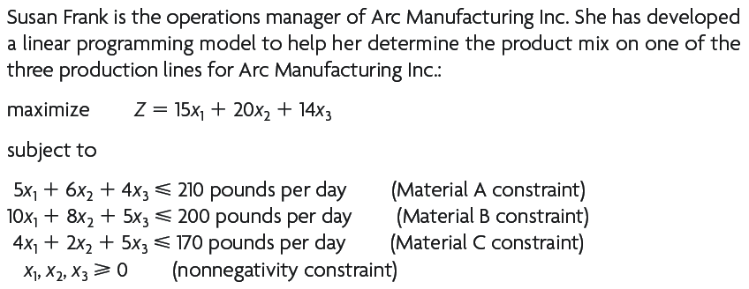
Example

Slide 16
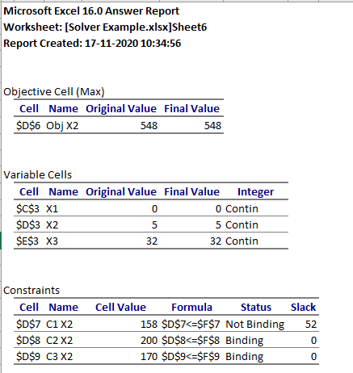
Example - Answer

Slide 17
Problem 1
Marketing manager of Arc manufacturing disagrees with Susan to go for a single pricing policy
He believes differential pricing policy – different prices for different set of customers - would help reap higher profits
So, instead of using a single number, the manager wants Susan to use a price range for every product
What issues does Susan face and help her address them

Slide 18
Problem 2
As per the optimal solution provided by Excel Solver, the optimal product mix consists of only Products 2 and 3. Product 1 does not form a part of the product mix
Susan deliberates on the following questions:
What should be the bare minimum profit coefficient of Product 1 for it to be a part of the optimal solution?
How much would the company loose if Susan decides to manufacture Product 1?

Slide 19
Problem 3
Forecasting team tells Susan that they can expect a surge in the demand of Products 2 and 3 (approx 25% of current production) in the coming days
Susan decides to ramp up the production and would need extra units of raw materials.
Upon request by Susan, the supplier who supplies B & C agrees to supply the extra quantity at the following pricing schedule. Should Susan accept it or not?
A: $1.2 per pound B: $3 per pound and C: $0.25 per pound

Slide 20
Sensitivity Analysis
  Enables the decision maker to determine how a change in one of the values of a model will impact the optimal solution and the optimal value of the objective function while holding all other parameters constant.
  Provides the decision maker with greater insights about the sensitivity of the optimal solution to changes in various parameters of a problem.
  Change(s) in the value of objective function coefficient(s)
  Change(s) in the right-hand-side(RHS) value of constraint(s)

Slide 21
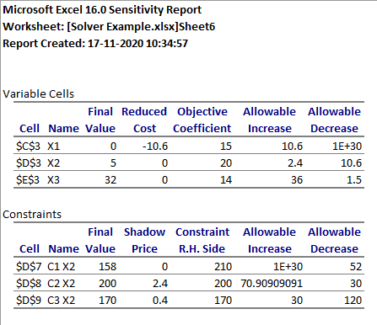

Slide 22
Range of Optimality
The range of objective function coefficient values for which the optimal values of the decision variables would not change
A value of the objective function coefficient that falls within the range of optimality will not change the optimal mix of the variables, although the optimal value of the objective function will change

Slide 24
Range of Feasibility
The range of values over which the right-hand-side (RHS) value can change without causing the shadow price to change
Within the range of feasibility, the same decision variables will remain optimal, although their values and the optimal value of the objective function will change
Analysis of RHS changes begins with determination of a constraint’s shadow price in the optimal solution

Slide 25
Shadow Price
Within the range of feasibility, the amount of change in the optimal value of the objective function per unit change of the RHS value of a constraint

Slide 26
Sensitivity Analysis…..
Maximization Problems
Minimization Problems
100% rule
  The 100 Percent Rule for Simultaneous Changes in Objective Function Coefficients: If simultaneous changes are made in the coefficients of the objective function, calculate for each change the percentage of the allowable change (increase or decrease) for that coefficient to remain within its allowable range. If the sum of the percentage changes does not exceed 100 percent, the original optimal solution definitely will still be optimal. (If the sum does exceed 100 percent, then we cannot be sure.)
Duality

Slide 28
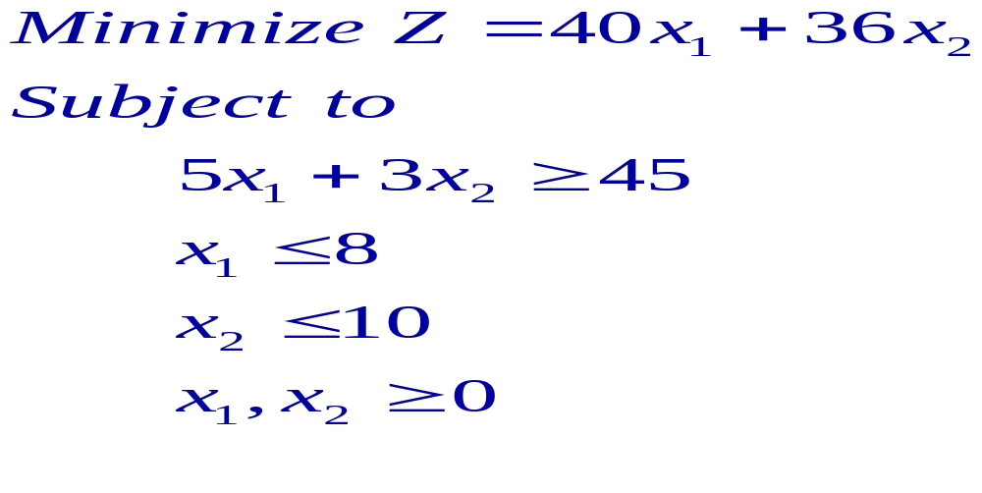
Example for demonstration

Slide 29
Change in ≤ constraint
15
X2
X2≤ 10
A (3, 10)
B (8, 10)
Optimal solution: x1 = 8, x2 = 5/3
Z = 380
5x1+3x2≥45
X1≤ 8
5
C (8, 5/3)
5
10
X1

Slide 30
15
X1≤ 8
X1≤ 9
X2
X2≤ 10
A (3, 10)
B (8, 10)
5x1+3x2≥45
5
C (8, 5/3)
5
10
X1

Slide 31
15
X1≤ 8
X1≤ 9
X2
X2≤ 10
A (3, 10)
B (9, 10)
Optimal solution:
x1 = 9, x2 = 0, Z’ = 360
Change = 360 – 380 = -20
5x1+3x2≥45
5
C (9, 0)
5
10
X1

Slide 32
While solving the problems…
Step 1: If it is a ≤ constraint:
- Increasing the RHS will relax the constraint and hence it may improve the objective function value
- Similarly, decreasing the RHS will tighten the constraint and hence may worsen the objective function value
Step 2(a): If it is a maximization problem:
- Improvement (Z’)=Z+Δb x Shadow price of the constraint
- Worsening (Z’)=Z-Δb x Shadow price of the constraint
Step 2(b): If it is a minimization problem:
- Improvement (Z’)=Z-Δb x Shadow price of the constraint
- Worsening (Z’)=Z+Δb x Shadow price of the constraint

Slide 33
Change in ≥constraint
15
X2
X2≤ 10
A (3, 10)
B (8, 10)
Optimal solution: x1 = 8, x2 = 5/3
Z = 380
5x1+3x2≥45
X1≤ 8
5
C (8, 5/3)
5
10
X1

Slide 34
20
5x1+3x2≥60
15
X2
A (6, 10)
B (8, 10)
X2≤ 10
Optimal solution:
x1 = 8, x2 = 20/3,
Z’ = 560
Change = 560 – 380 = +180
5
5x1+3x2≥45
C (8, 20/3)
5
10
12
X1
X1≤ 8

Slide 35
While solving the problems…
Step 1: If it is a ≥ constraint:
- Increasing the RHS will tighten the constraint and hence it may worsen the objective function value
- Similarly, decreasing the RHS will relax the constraint and hence it may improve the objective function value
Step 2(a): If it is a maximization problem:
- Improvement (Z’)=Z+Δb x Shadow price of the constraint
- Worsening (Z’)=Z-Δb x Shadow price of the constraint
Step 2(b): If it is a minimization problem:
- Improvement (Z’)=Z-Δb x Shadow price of the constraint
- Worsening (Z’)=Z+Δb x Shadow price of the constraint

Slide 36
While solving the problems…
Step 1: Check if it is a ≤ constraint or a ≥ constraint
Step 2(a): If it is a ≤ constraint:
- Increasing the RHS may improve the objective function
- Decreasing the RHS may worsen the objective function
Step 2(b): If it is a ≥ constraint:
- Increasing the RHS may worsen the objective function
- Decreasing the RHS may improve the objective function
Step 3: Check if the problem is a max/min problem
Step 3(a) If it is a maximization problem:
- Improvement (Z’)=Z+Δb x Shadow price of the constraint
- Worsening (Z’)=Z-Δb x Shadow price of the constraint
Step 3(b) If it is a minimization problem:
- Improvement (Z’)=Z-Δb x Shadow price of the constraint
- Worsening (Z’)=Z+Δb x Shadow price of the constraint

Slide 37
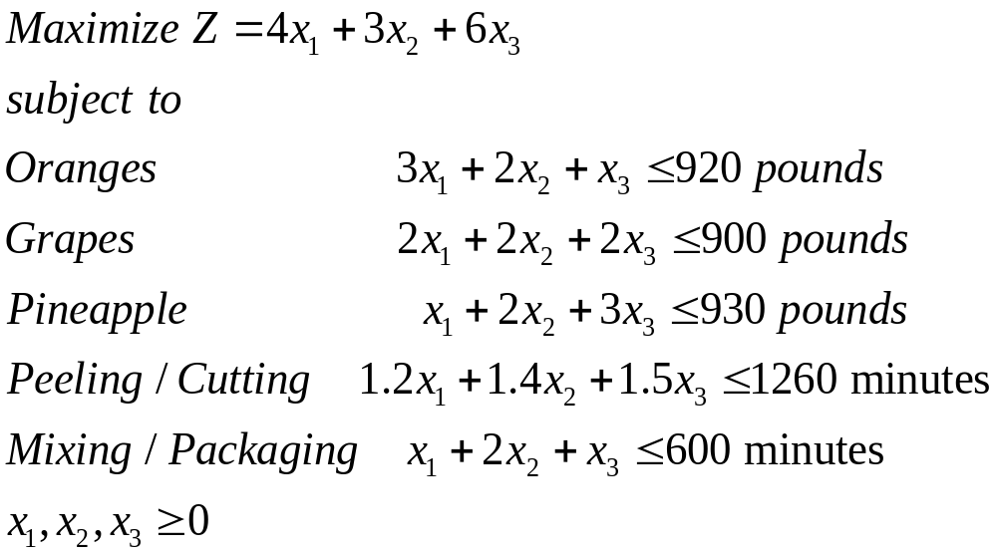
Sensitivity Analysis…..
X1- California mix
X2- Florida mix
X3 – Hawaiian mix

Slide 38
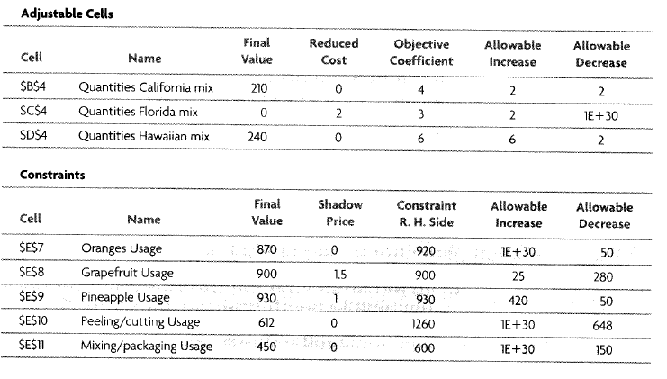
Sensitivity Analysis…..

Slide 39
Sensitivity Analysis…
The equipment used for peeling and cutting must be replaced. The new equipment will have a capacity of only 1200 minutes. What impact will this change have on the optimal values of the decision variables and on profit?
What would the unit profit on the Florida mix have to be before it would become profitable to produce?
If management had a choice of obtaining more oranges or more pineapples, which one should be chosen? Why?

Slide 40
Sensitivity Analysis…
Management has just learned that an additional 50 pounds of pineapples are on hand. What will be the change in the objective function?
Management is considering making changes that will cause the profit on the Hawaiian mix to be $8 per unit. Would this affect the solution? Will it affect the optimal value of the objective function?
Management is considering a change in equipment that would result in increasing the profit on the Hawaiian mix to $8 per unit but result in decreasing the profit on the California mix by $1. Would these changes be within the range of optimality? If so, how much would the optimal profit change?

Slide 41
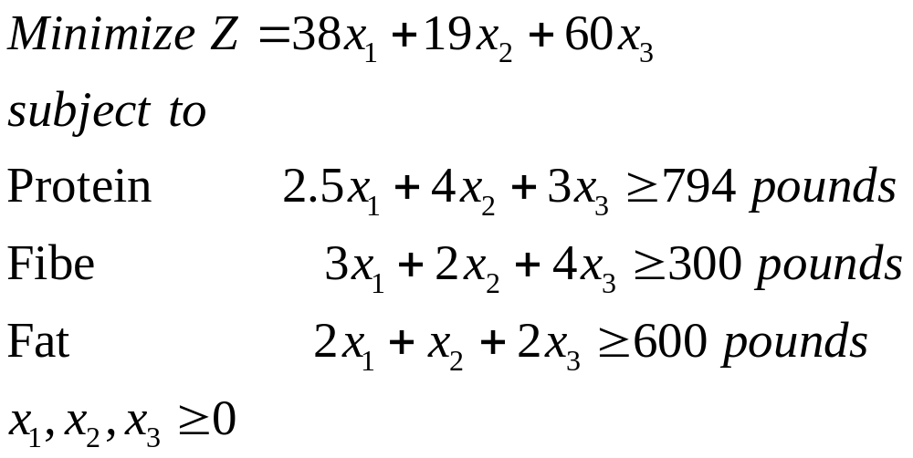
Sensitivity Analysis…
X1- Bags of raw material 1
X2- Bags of raw material 2
X3 – Bags of raw material 3

Slide 42
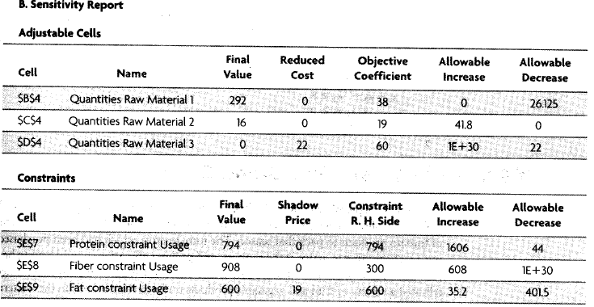
Sensitivity Analysis…

Slide 43
Sensitivity Analysis…
Which constraints are binding on the solution? How do you know?
What does the reduced cost of 22 indicate?
How do you interpret the 608 in the allowable increase section of the fiber constraint?
Determine the range of optimality for the objective function coefficients of x1 and x2
What does the shadow price of 19 reveal?
What is the range of feasibility for the fat constraint’s RHS?

Slide 44
Sensitivity Analysis…
Would a decrease to 575 for the RHS of the fat constraint affect the optimal value of the objective function? If so, by how much?
The manager is considering reducing each RHS by 9 percent and may ask you to provide information on how that would impact the total cost. What would you need to do? Why?

Slide 45
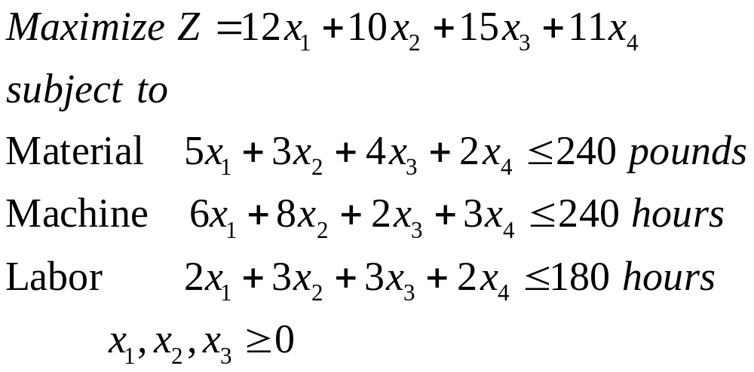
Sensitivity Analysis…

Slide 46
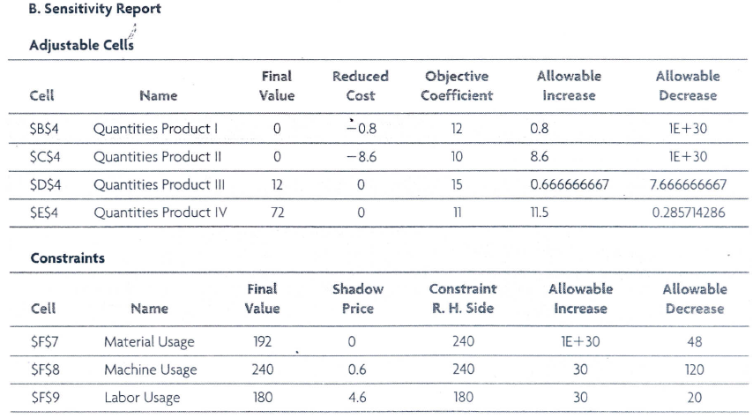
Sensitivity Analysis…

Slide 47
Sensitivity Analysis…
What is the optimal solution and its objective function value?
The manager is concerned because none of Product 1 is called for in the optimal solution. At what profit per unit would Product 1 come into solution?
Determine the range of optimality for Products 1 and 2
What is the marginal value of an hour of machine time? Over what range of machine time is this amount valid?
Why the shadow price of material constraint is 0?

Slide 48
Sensitivity Analysis…
Manager can secure additional labor hours by the use of overtime. This involves paying a premium of $2 per hour. How much overtime can be effectively used, and what will the net total profit be if that amount of overtime is scheduled?
If the manager can obtain extra machine hours and labor hours, which one should be chosen and how much should be obtained?

Slide 49
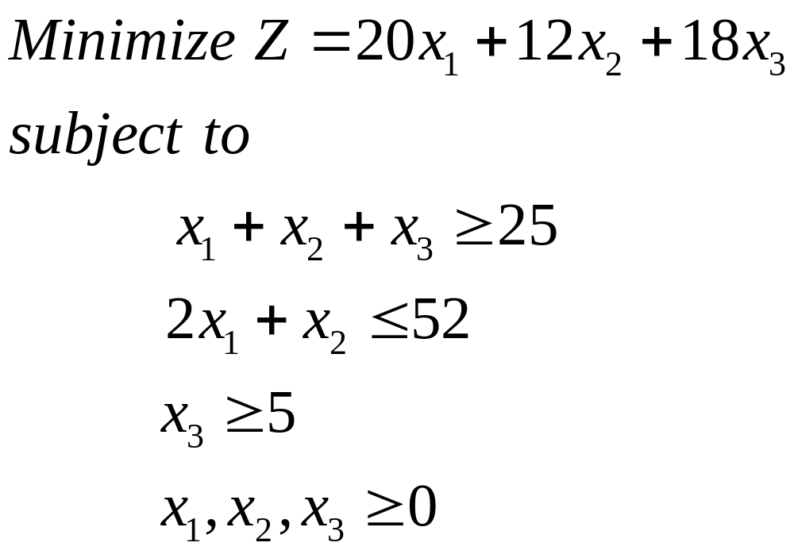
Sensitivity Analysis…

Slide 50
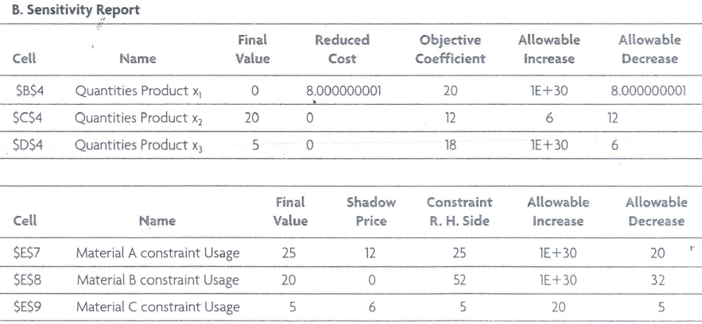
Sensitivity Analysis…

