Slide 1
Pricing (relative valuation) of assets

Slide 2
Why relative valuation?
I purchased a land near to IIM Raipur, paid Rs. 10,000,00 for 1000 sqrt ft land. Now, you want to buy 2000 sqrt ft land, how much would you pay?
It is easy to convey. It is easy to sell pricing than valuation.
If you are wrong with relative valuation, there are others to be wrong along with you but, in DCF, you are alone.
Most of times, portfolio managers’ performance is evaluated based on relative basis.

Slide 3
The essence of relative valuation
In DCF, the objective is to find the value of assets, given their cash flows, growth, and risk characteristics.
In relative valuation, the objective is to price assets based on how similar assets are currently priced in the market. Therefore, the relative valuation is much more likely to reflect the current mood of the market.
To do relative valuation then,
  Convert market values into standardized value, since the absolutes prices cannot be compared. This process of standardizing creates price multiples.
  Compare the standardized value or multiple for assets being analyzed to the standardized value for comparable asset, controlling for any differences between firms that might affect the multiple, to judge whether the asset in under or over valued.

Slide 4
Basic steps to using multiples
Market value of equity
Market value of Firm=Debt + equity
Enterprise value (EV)=Debt + Equity-Cash
$$Multiple=\frac{Numerator=What you are paying for the assets (Should be marekt based)}{Denominator=What you are getting in return}$$
Revenues
Accounting revenues
Drivers
  Customers
  Subscribers
  units
Earnings
To equity investors
  PAT
  EPS
To firm
  Operating income (EBIT)
Book value
BV of Equity
Firm
  BV of equity + BV of debt

Slide 5
Definition tests
Is the multiple consistently defined?
  Proposition 1: Both the value (the numerator), and the standardizing variable (the denominator) should be to the same claimholders in the firm. For instance, the value of equity should be divided by equity earnings or equity book value, and firm value should be divided by firm earnings or book value.
Is the multiple uniformly estimated?
  The variables used in defining the multiple should be estimated uniformly across assets in the “ comparable firms” list.
  If earnings-based multiples are used, the accounting rules to measure earnings should be applied consistently across assets.

Slide 6
Definition tests: PE ratio
Price to earning ratio=Market price/EPS
  Usually, the current price (some like to use average price over last 6 months or year EPS)
  Time variants: EPS in most recent financial year (current), EPS in most recent four quarters (trailing), EPS expected in next fiscal year or next four quarters (forward)
TCS March 2019 EPS=Rs 80.17
Market price of TCS (Nov 29, 2019)=Rs 2051.65
Current price to earning ratio=$\frac{\text{2051.65}}{\text{80.17}}$=25.59 x
Industry PE ratio=20.03 x
Trailing PE ratio=Current market price/TTM EPS= 2051.65/ 87.85=23.35x
Mar-19 | Sep-19 | Jun-19 | Sep-18 | Jun-18 | TTM EPS
80.17 | 23.02 | 23.22 | 19.92 | 18.64 | 87.85

Slide 7
Definition tests: PE ratio
Forward EPS=Rs 87.3
Forward PE ratio= Current market price/Forward EPS= 2051.65/ 95.7=21.43x
A period of rising earnings, as a bullish analyst will use forward PE ratio, whereas a bearish analyst will use current PE ratio.
You can take any firm; you can create n number of PE ratio. Hence, you should same ratio for your sample.
PE ratio | Current | TTM | Forward
 | 25.59 | 23.35 | 21.43

Slide 8
Descriptive test: Understand your multiple
What is the average and standard deviation of your multiple across the universe (market)?
What is the median for this multiple?
  The median for this multiple is often a more reliable comparison point.
How large are the outliners to the distribution, and how do we deal with outliers?
  Throwing out the outliners may seem like an obvious solution, but if the outliners all lie on one side of the distribution (they usually are large positive numbers), this can lead to a biased estimate.
How has this multiple changed over time?

Slide 9
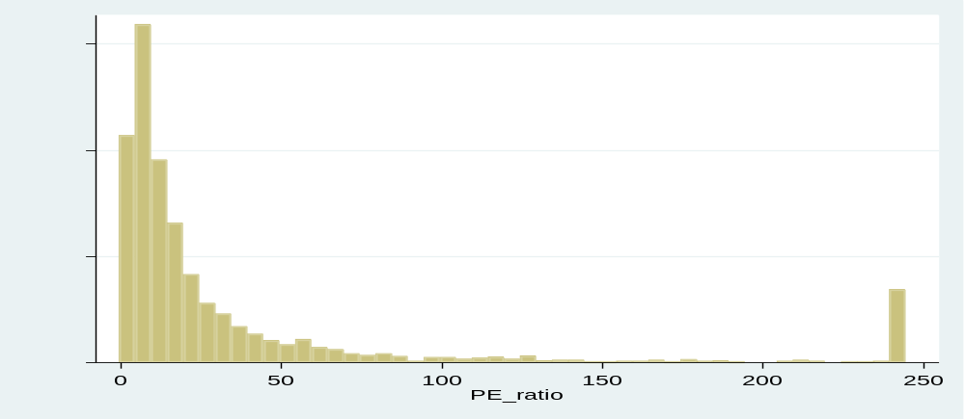
PE ratio of Indian Firm (May 2020)

Slide 10
PE ratio Based on size(May 2020)
Size decile | Number of firms | PE ratio
Decile 1 | 641 | 25.454
Decile 2 | 353 | 18.828
Decile 3 | 276 | 25.259
Decile 4 | 255 | 21.379
Decile 5 | 240 | 31.227
Decile 6 | 260 | 44.424
Decile 7 | 263 | 56.124
Decile 8 | 231 | 56.949
Decile 9 | 151 | 68.011
Decile 10 | 33 | 76.987

Slide 11
Determinants of PE ratio
$$\frac{Value of stock}{EPS}=\frac{1−Growth rate/ROE}{Cost of equity−growth rate}$$
Higher the growth, and dividend payout ratio, higher the PE ratio, Given ROE is more than cost of equity.
More risky firms, lower PE ratio.

Slide 12
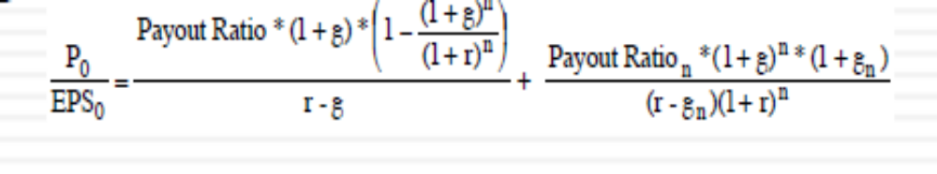
Firm with high growth period
The PE ratio for a high growth firm with two stage model:
gn=growth rate for stable period
g=growth rate in high growth period
Payout Ration=payout ratio for stable period
Payout ratio=payout for high growth period
r=cost of equity
n=number of years for high growth period

Slide 13
Firm with high growth period
Variable | High growth period | Stable-growth rate
Expected growth rate | 25% | 8%
Payout ratio | 20% | 50%
beta | 1 | 1
Number of years | 5 years | Forever after 5 years
Risk-free rate=6%
Required rate of return=6%+5.5%*1=11.5%
$Implied PE=\frac{20∗1.25∗\left(1−\frac{{1.25}^{5}}{{1.115}^{5}}\right) }{0.115−0.25}+\frac{0.50∗{1.25}^{5}∗1.08}{\left(0.115−0.08\right)∗{0.115}^{5}}$=28.55

Slide 14
PE, growth, and risk relationship

Slide 15
Determinants of PE ratio for Indian firms
PE ratio | Coef. | Std. Err. | t-value
Growth | 5.88 | 0.39 | 6.64
Beta | -16.95 | 1.82 | -13.39
Constant | 36.79 | 2.15 | 40.99
Adj R-squared = 0.1355
Number of firms=2138

Slide 16
Time series of NSE 500 PE ratio

Slide 17
Can we compare multiples across markets?
Countries with higher real interest rates should have lower multiples than countries with lower real interest rate.
Countries with higher expected growth rate should have higher multiples than countries with lower expected growth rate.
Countries that are viewed as riskier should have lower multiples than countries that are viewed less risky.
Countries where firms are more efficient in investments ( and earn a higher return on these investments) should have higher multiples.

Slide 18
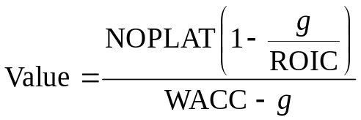
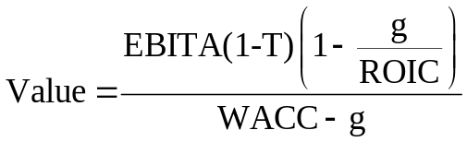
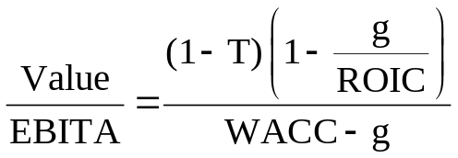
EV/EBITA
Enterprise value=Market value of equity + Market value of debt – Cash
When computing and comparing industry multiples, always start with enterprise value to EBITA. It tells more about a company’s value than any other multiple. To see why, consider the key value driver formula developed earlier:
Start with the key value driver formula.
Terminal value formula
Substitute EBITA(1 − T) for NOPLAT.
Divide both sides by EBITA to develop the enterprise value multiple.

Slide 19
TCS: EV/ EBITDA
Market Capitalization (on May 29, 2020) | 752,428.18
Book value of debt | 6,906.00
Less Cash | 9,666.00
Enterprise value | 749,668.18
Operating profit (EBIT) | 46,701.00
EV/Operating Profit | 16.05

Slide 20
Large-Software firms: EV/ EBITDA
Mean | 12.15
Median | 11.89
Standard Deviation | 7.53
Minimum | 2.31
Maximum | 33.30
Count | 20.00

Slide 21
TCS (EV/EBDITA) over time
Year | EV/EBITA
Mar 19 | 17.42
Mar 18 | 16.13
Mar 17 | 15.1
Mar 16 | 15.94
Mar 15 | 18.55
Mar 14 | 16.41
Mar 13 | 18.37
Mar 12 | 16.02
Mar 11 | 24.67
Average | 17.368

Slide 22
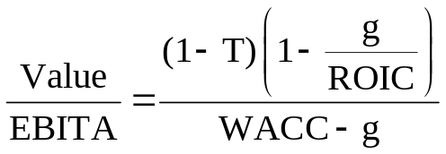
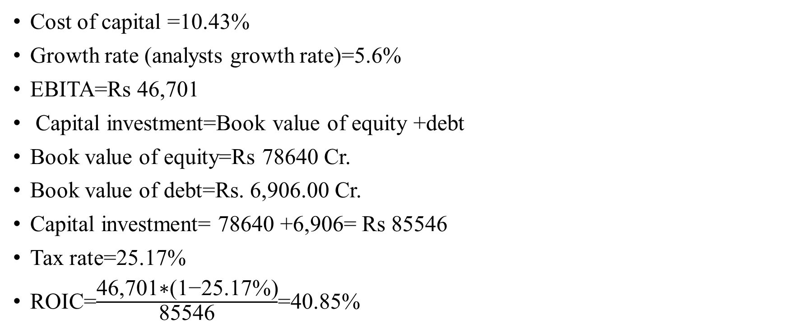
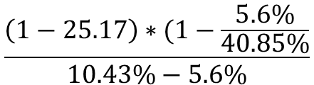
Fundamental EV/EBITA
Cost of capital =10.43%
Growth rate (analysts growth rate)=5.6%
EBITA=Rs 46,701
Capital investment=Book value of equity +debt
Book value of equity=Rs 78640 Cr.
Book value of debt=Rs. 6,906.00 Cr.
Capital investment= 78640 +6,906= Rs 85546
Tax rate=25.17%
ROIC=$\frac{\text{46,701}\text{∗(1−25.17\%)}}{\text{85546}}$=40.85%
$$\frac{\left(1−25.17\right)∗(1−\frac{5.6\%}{40.85\%}}{10.43\%−5.6\%}$$
EV/EBIT =13.36

Slide 23
Sensitivity analysis
Long-term growth | EV/EBIT
4% | 10.50
5% | 12.09
6% | 14.41
7% | 18.08
8% | 24.76
9% | 40.80

Slide 24
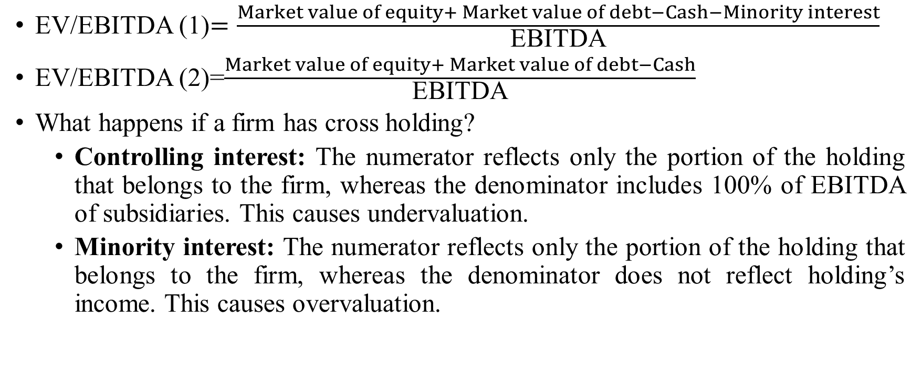
Enterprise value/EBITDA multiple: issues
EV/EBITDA (1)$=\frac{Market value of equity+ Market value of debt−Cash−Minority interest}{\text{EBITDA}}$
EV/EBITDA (2)=$\frac{Market value of equity+ Market value of debt−Cash}{\text{EBITDA}}$
What happens if a firm has cross holding?
  Controlling interest: The numerator reflects only the portion of the holding that belongs to the firm, whereas the denominator includes 100% of EBITDA of subsidiaries. This causes undervaluation.
  Minority interest: The numerator reflects only the portion of the holding that belongs to the firm, whereas the denominator does not reflect holding’s income. This causes overvaluation.

Slide 25
Enterprise value/EBITDA multiple: issues
Firm A has two cross-holdings: Firm B(51%) and Firm C(15%)
The market value of equity at Firm A is $1,529 million and the consolidated debt outstanding at the firm is $500 million. Consolidated EBITDA is $500 million. A portion of EBITDA ($180 million) and debt outstanding ($150) represent Firm A holding in Firm B.
The market value of Firm B = $459 million
Firm C (private firm): EBITDA=$120 million on capital invested of $250 million with $100 million outstanding debt. Similar firms are trading at 1.48 PB multiples
The market value of Firm C=1.48*250=$370.25 million

Slide 26
Enterprise value/EBITDA multiple
Analysts generally do: EV/EBITDA= equity (1,529) + debt (500) /EBITDA(500)=4.06
The market value of Firm A is likely to reflect 51% value of Firm A and 15% value of Firm B, where as EBITDA would reflect 100% profit of Firm B and none of portion of Firm A.
Adjustment of cross-holding
Method 1: Multiples of standalone firm
EV/EBITDA=EV of firm A, without subsidiary/EBITDA of firm A, without subsidiary.
Standalone firm value of Firm A=1529-(0.51*459)-(0.15*370.25)) + (500-150)=Rs 1589.373 million
EBITDA of Firm A=500-180=320
EV/EBITDA( Standalone)= 1589.373/320= 4.96
51% value of Firm B
15% value of Firm C
Debt value of Firm A
100% profit of Firm B

Slide 27
Enterprise value/EBITDA multiple
Method 2: Consolidated multiples
EV=Market equity value of parent firm +debt value of parent firm
Market value=1529+(500-150)=Rs 1879 million
However, while calculating EBITDA includes the portion of profit from subsidiary that really belong to the parent firm.
EBITDA=500-(0.49*180)+(0.15*120)=Rs 429.8 million
EV/EBITDA= 1879/ 429.8=4.37

Slide 28
Adjusted Enterprise value/EBIT multiple
March 2020 | (in crores, expect ratio)
Operating profit (standalone firm) | 45,435.00
Operating profit (consolidated firm) | 46,701.00
Minority Interest (after tax) | 107.00
Effective tax rate (10378.00/42248) | 24.6%
Minority Interest before tax | 141.84
Operating profit (consolidated firm without minority interest) | 46,559.16
Market Capitalization (on May 29, 2020) | 752,428.18
Less Market value of minority interest (623.00*12.15) | 7569.45
Market Capitalization, without minority interest | 744,858.73
Add Book value of debt | 6,906.00
Less Cash | 9,666
Adjusted Enterprise value | 742,098.73
Adjusted EV/EBIT | 15.93

Slide 29
Book value multiples
Price to book ratio=Market value of equity/ Book value of equity (without minority interest)
Normally, if a firm is trading below the book value has been considered undervalued.
PB ratio (TCS May 2020)= 752,42/ 6,906= 10.89
Would TCS stock buyback have any impact on PB ratio?
On 2017, TCS repurchased Rs 16000 crore stocks
Adjusted Market value of equity= Rs 7854896-160000=Rs. 7694896
Adjusted book value of equity=851280 – 160000=Rs. 691280
TCS PB ratio= 7694896/691280=11.13
To compare price to book ratio across firms when some firms in the sample buyback stocks and some do not, is problematic.

Slide 30
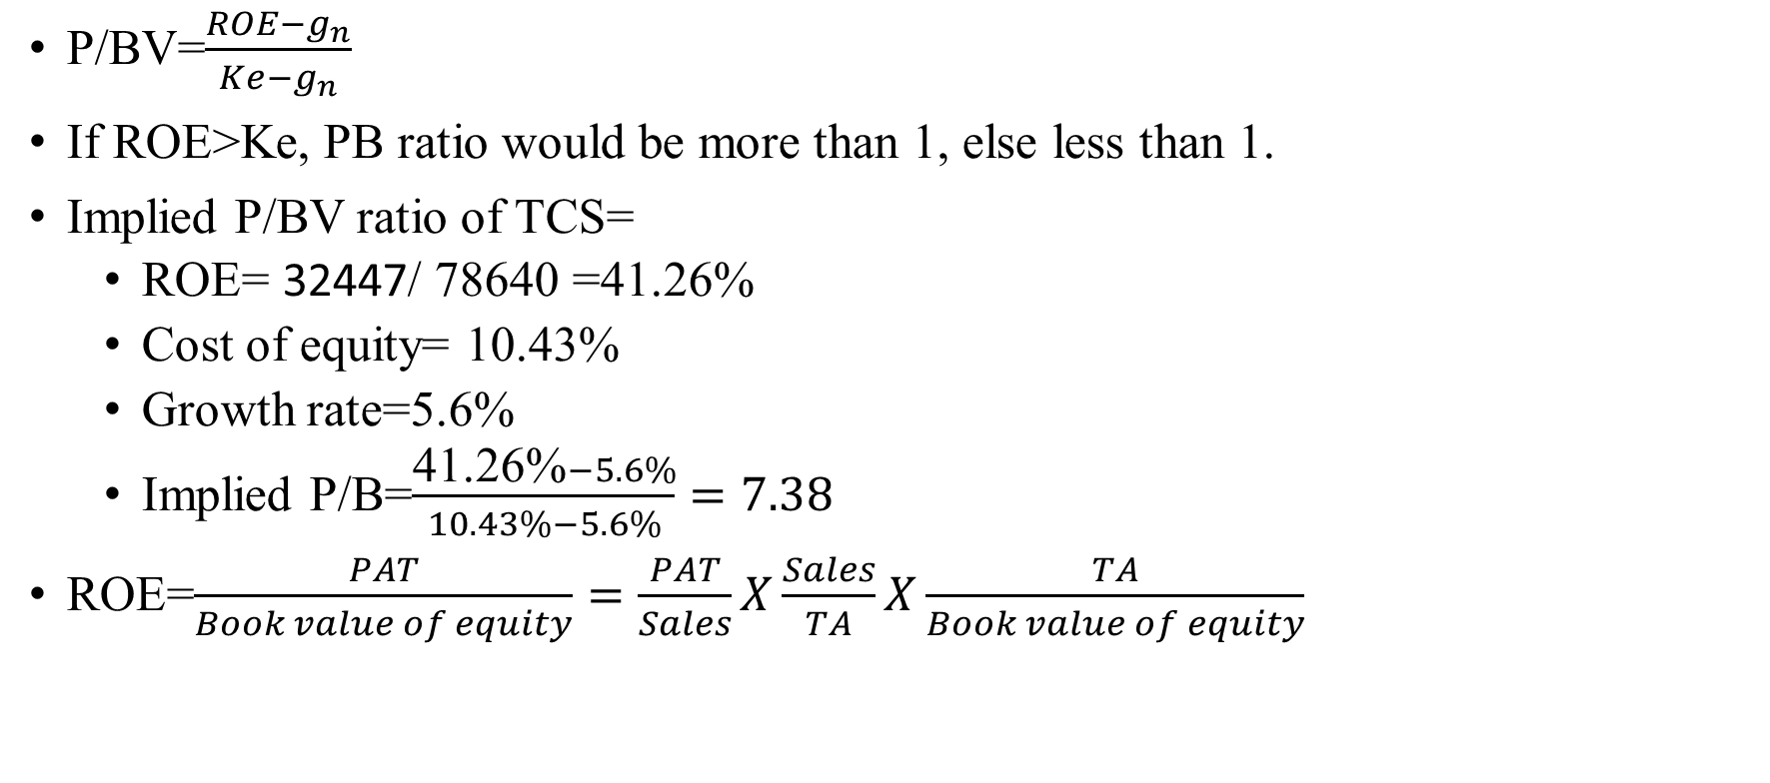
Determinants of PB ratio
P/BV=$\frac{ROE−g_{n}}{Ke−g_{n}}$
If ROE>Ke, PB ratio would be more than 1, else less than 1.
Implied P/BV ratio of TCS=
  ROE= 32447/ 78640 =41.26%
  Cost of equity= 10.43%
  Growth rate=5.6%
  Implied P/B=$\frac{\text{41.26\%}−5.6\%}{10.43\%−5.6\%}=7.38$
ROE=$\frac{PAT}{Book value of equity}=\frac{PAT}{Sales}X\frac{Sales}{TA}X\frac{TA}{Book value of equity}$

Slide 31
PB ratio
 | Equity returns spread (ROE-Ke)
 | Low | High
PB ratio High Low | Overvalued High PB ratio Low Equity return spread | High PB ratio High Equity returns spread
 | Low PB ratio Low equity return spread | Undervalued Low PB ratio High equity return spread

Slide 32
PB ratio
You are looking at three firms in the same business, all with a cost of equity 10%. Firm A has of 12%, Firm B has a ROE 10%, and Firm C a ROE of 8%. Which one is most likely to be trading at below book value.

Slide 33
Why PB ratio
Firms with negative earnings can be evaluated by PB ratio
When accounting standards vary widely across firms (countries), PB ratio may not be comparable (would IFRS resolve this issue?)
Book value may not carry much meaning for service, and technology firms that do not have significant tangible assets.
Current PB ratio would be more meaningful if the firm can sustain current ROE in future as well.

Slide 34
Revenue multiples
Revenue multiples
  EV/Sales
  Mcap/Sales
TCS: EV=8282516, Sales=1277810
  EV/Sales= 8282516/ 1277810=6.48
  Mcap/Sales= 7854896 / 1277810= 6.14

Slide 35
Revenue Multiples
You are comparing the revenues multiples of retail firms. If you pick firms based just on the revenue multiple (low is good), which of the following is most likely to look cheap to you?
  Department stores
  Discount retailers
  Luxury retailers
  None of the above

Slide 36
Sector-Specific multiples
Sector specific multiples can be used based on the value driver of the firm.
  For instance, for telecom industry, =EV/number of subscribers
  For LinkedIn= EV/Number of members
Limitation: It is difficult to link sector-specific multiples with a firm’s fundamental. At the end, the firm value depends on it cashflows, expected growth, and riskiness of cashflows. However, sector-specific multiples do not provide conviction of profitability.
  The highly used multiple of Internet portal firms is EV/number of site visitors

Slide 37
In nutshell..
EV/ | Sales EBIDTA EBIT
Price/ | Book value per share EPS
1. While we move from top to down, we achieve operation and financial efficiency, our multiples become less comparable across markets, and firms, because differences in accounting standards, and multiples can be distorted because of accounting manipulation.
2. When using multiples use, the denominator should use a forecasted, rather than historical.
3. Including value in the numerator without including its corresponding income in denominator will systematically distort the multiple upward, vica-versa.

