Slide 1
Variables Types refresher

Slide 2
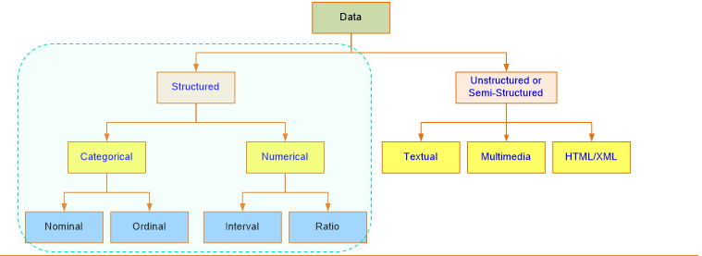
Variables Types refresher

Slide 3
Nominal
Nominal - used for labeling variables, without any quantitative value. “Nominal” scales could simply be called “labels.”
Gender , Color ,

Slide 4
Ordinal
Ordinal - the order of the values is what’s important and significant, but the differences between each one is not really known.
Very Unhappy , Unhappy, Happy , Very Hunhappy

Slide 5
Interval
Interval - Scales in which we know both the order and the exact differences between the values.
They don’t have a “true zero.”
Temperature

Slide 6
Ratio
Ratio : They tell us about the order, they tell us the exact value between units, AND they also have an absolute zero.
height, weight

Slide 7
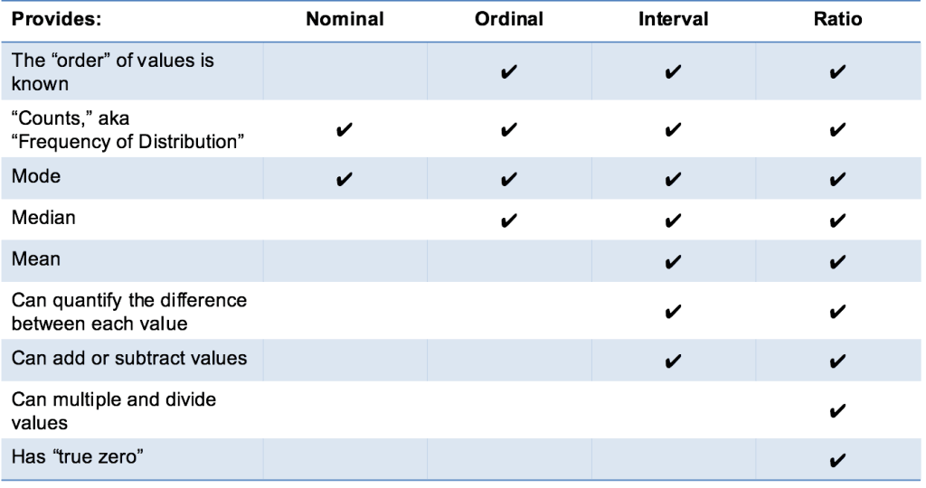
Notes:
In Ratio – GM Also

Slide 8
Introduction to Dummy Variable Regression
Regression analysis treats all independent (X) variables in the analysis as numerical.
Dummy variables are created in this situation to ‘trick’ the regression algorithm into correctly analyzing attribute variables.
A Dummy variable or Indicator Variable is an artificial variable created to represent an attribute with two or more distinct categories/levels.

Slide 9
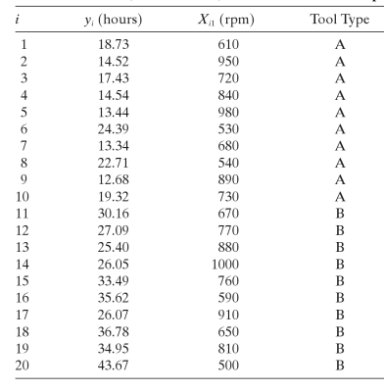
One dummy Variable with two levels

Slide 10
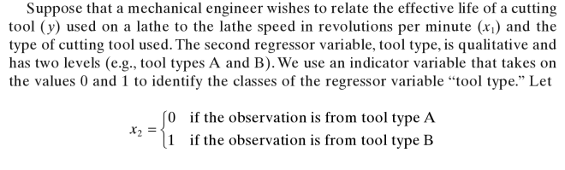
One dummy Variable with two levels

Slide 11
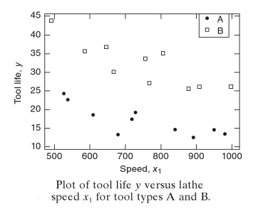

Slide 12
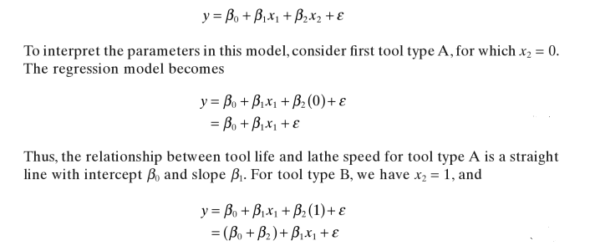
One dummy Variable with two levels

Slide 13
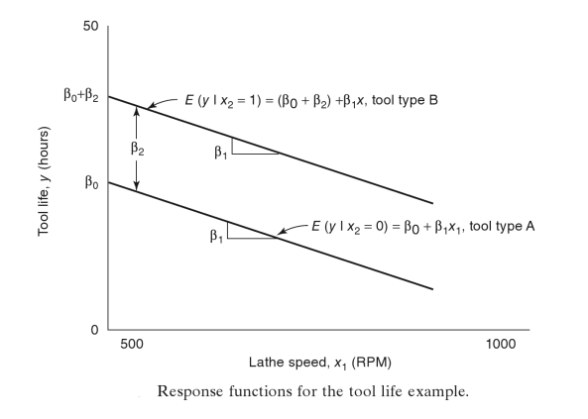
One dummy Variable with two levels

Slide 14
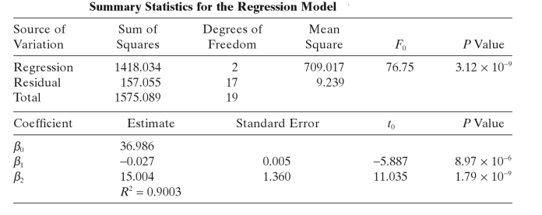

One dummy Variable with two levels

Slide 15
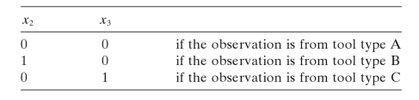
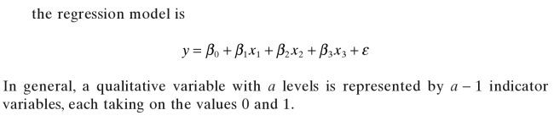
One dummy Variable with three levels
If tool type is A , B , C then take two dummy variables .

Slide 16
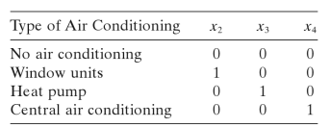

One dummy Variable with four levels
Electricity consumption as dependent variable on , size of house (x₁ and type of air conditioning ( which is of four types )

Slide 17
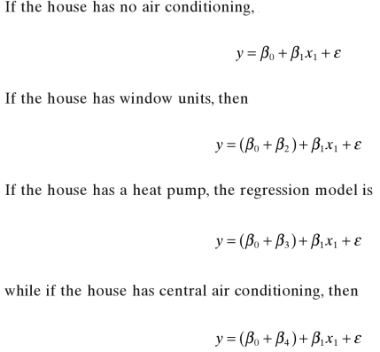
One dummy Variable with four levels

Slide 18
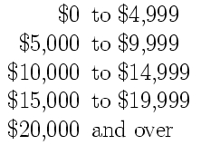
Dummy Variable as a proxy for continuous regressors
Can you be useful when accurate data for continuous variables is not available
In Electricity consumption example , add another regressor as income

