Slide 2
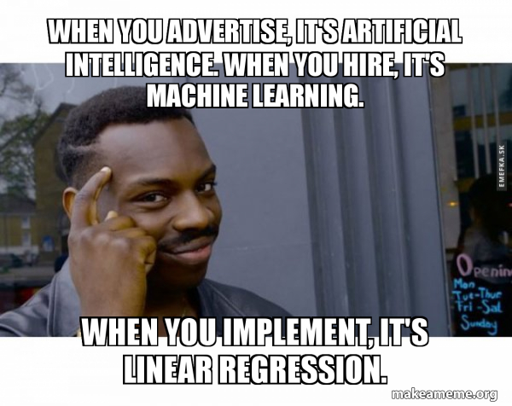
Regression …

Slide 3
Regression comes under Supervised ML technique

Slide 4
Regression analysis
is a set of statistical processes for estimating the relationships between a dependent variable (often called the 'outcome' or 'response' variable) and one or more independent variables (often called 'predictors', 'covariates', 'explanatory variables' or 'features').

Slide 5
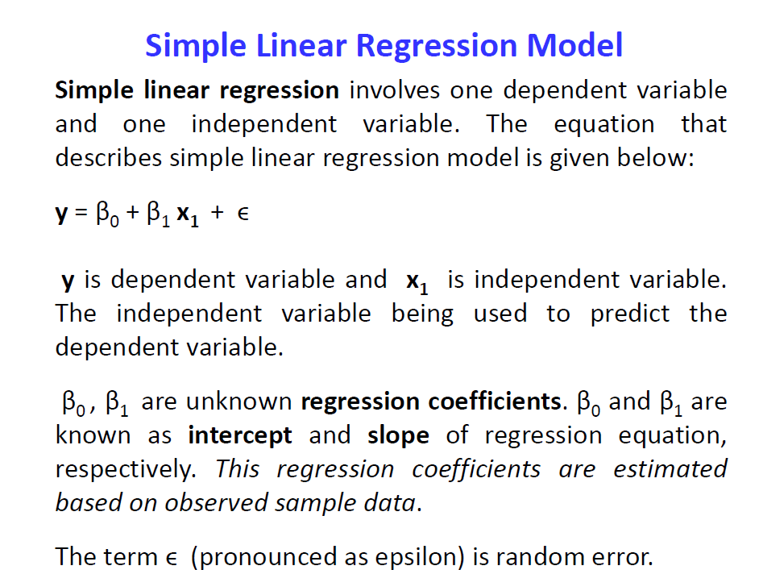

Slide 6
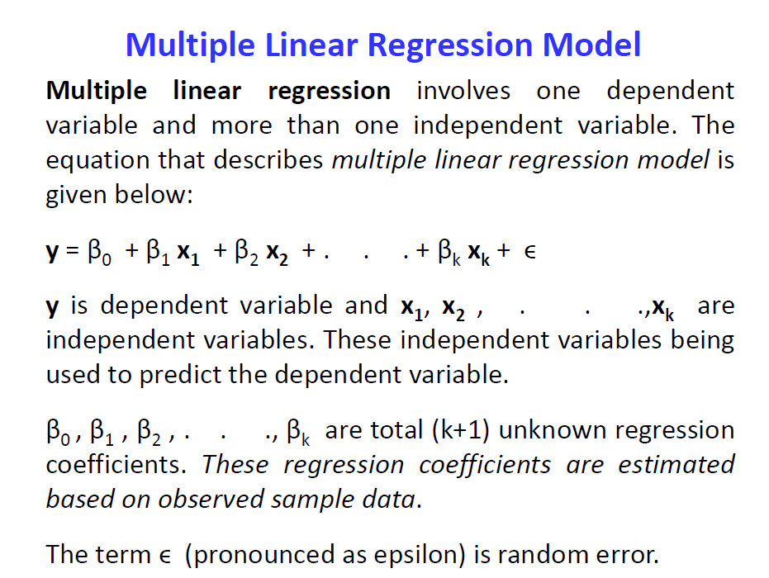

Slide 7
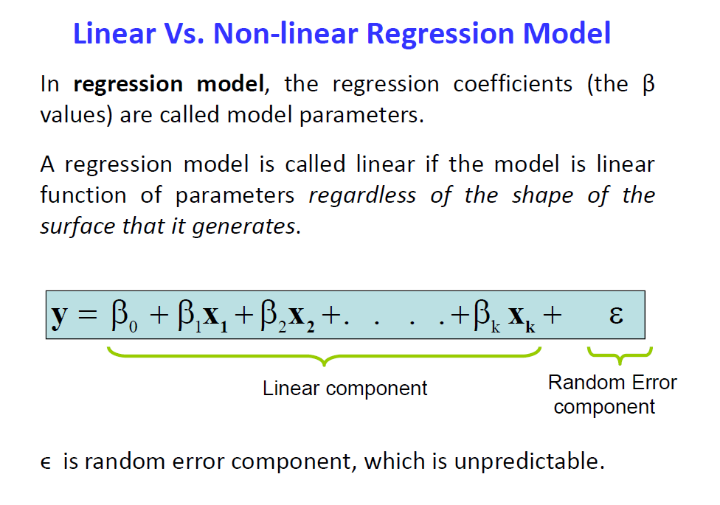

Slide 8



Slide 9
Notes:
2’nd order

Slide 11
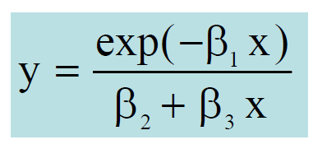
Non Linear because parameters are non linear

Slide 12
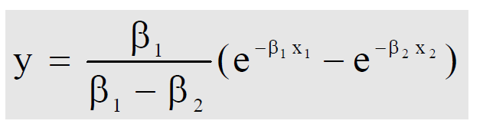
Non Linear because parameters are non linear

Slide 13
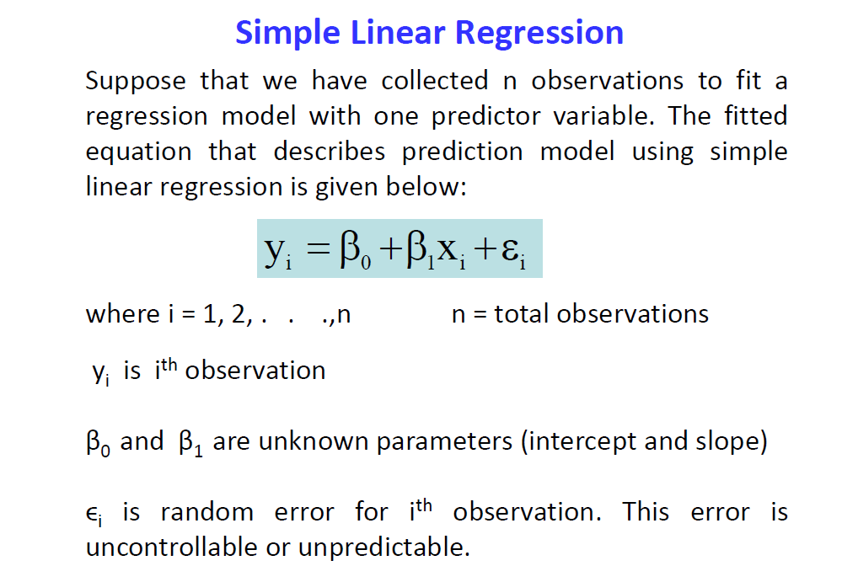

Slide 14
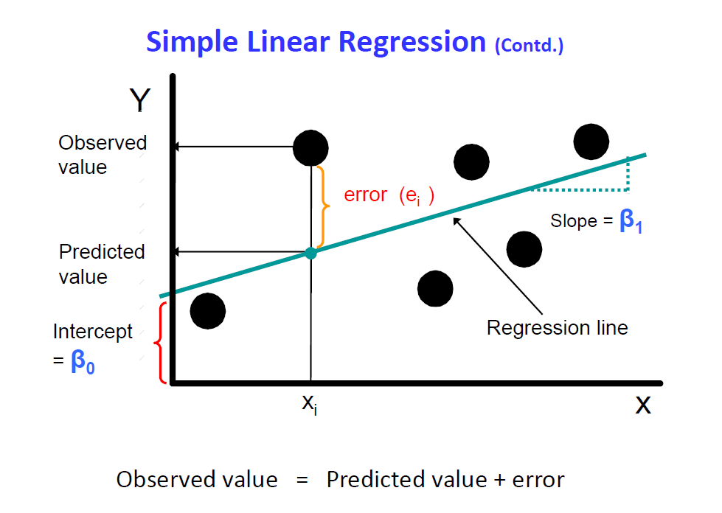

Slide 15
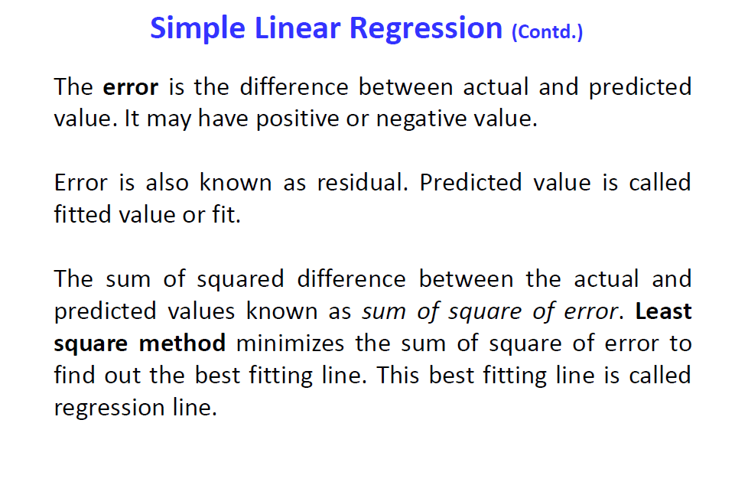

Slide 16
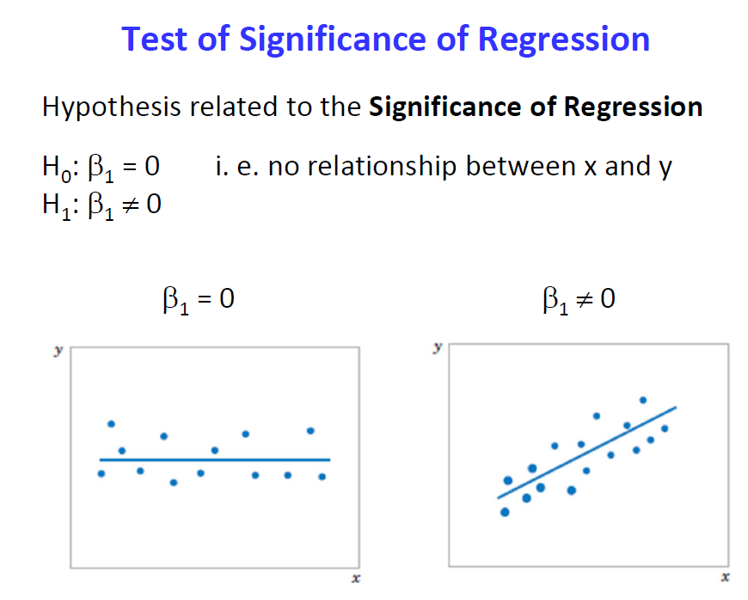

Slide 17
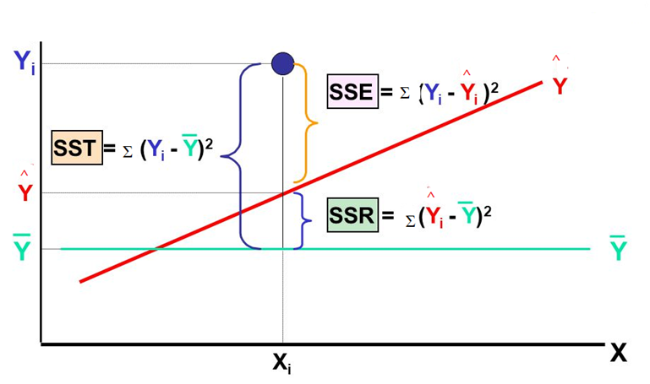
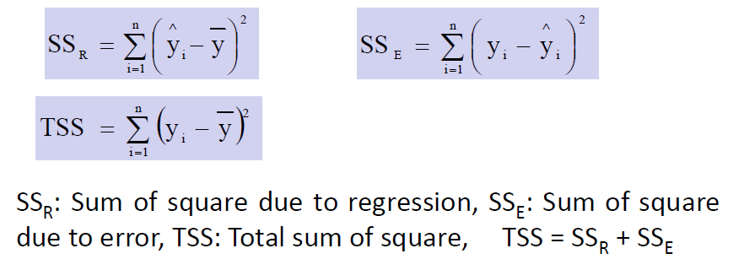

Slide 18
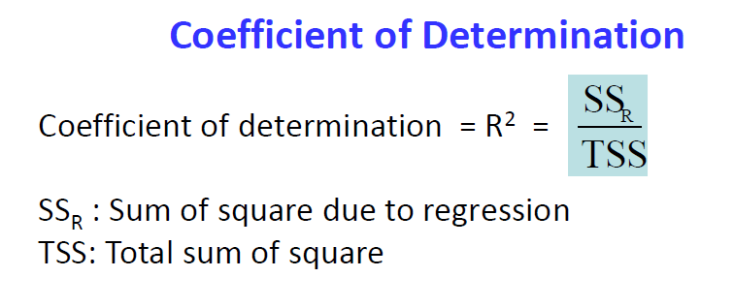
Physical interpretation : It is the fraction of variation of the dependent variable that is explained by the Regression line .
Also expressed in %
Higher value indicates better fit.

Slide 19
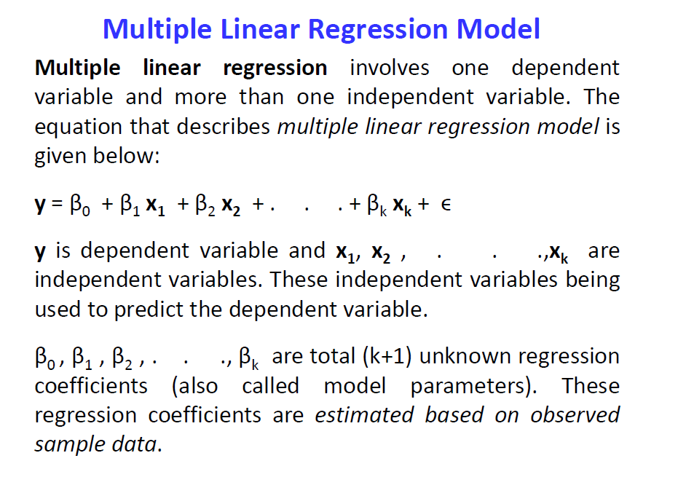

Slide 20
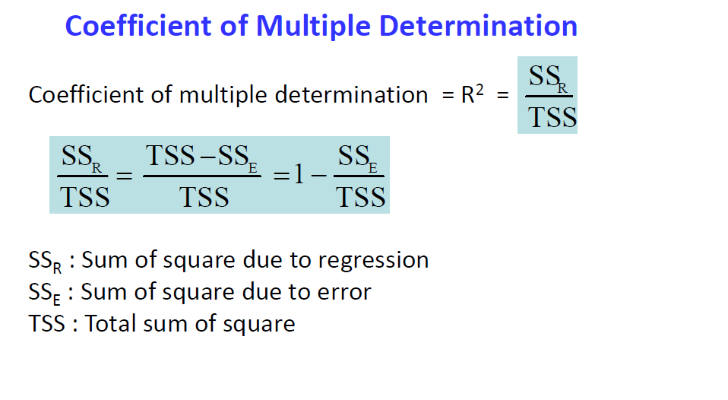
Physical interpretation : It is the fraction of variation of the dependent variable that is explained by the Regression line .
Also expressed in %
Higher value indicates better fit.

Slide 21
