Slide 2
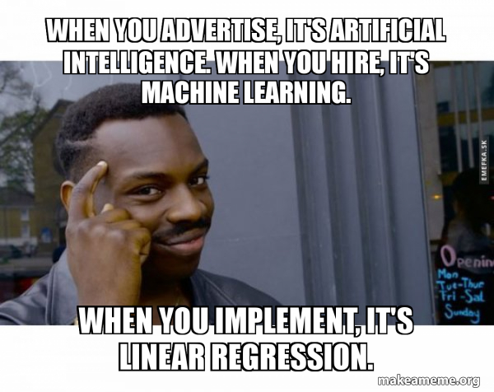

Regression …

Slide 3






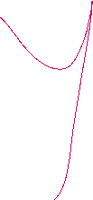
Regression comes under Supervised ML technique

Slide 4























Regression analysis
is a set of statistical processes for estimating the relationships between a dependent variable (often called the 'outcome' or 'response' variable) and one or more independent variables (often called 'predictors', 'covariates', 'explanatory variables' or 'features').

Slide 5
Sample Use cases

Slide 6






Energy
Consumption Forecasting:
Independent Variables: Historical energy usage, weather conditions, economic activity.
Dependent Variable: Future energy consumption.
Renewable Energy Production:
Independent Variables: Weather conditions, historical performance data.
Dependent Variable: Energy output.

Slide 7












Real Estate
Property Valuation:
Independent Variables: Location, size, amenities, market trends, historical sales data.
Dependent Variable: Property value.
Rent Prediction:
Independent Variables: Location, property features, market conditions.
Dependent Variable: Rental price

Slide 8


















Marketing
Customer Lifetime Value (CLV):
Independent Variables: Purchase history, engagement metrics, demographic data.
Dependent Variable: Customer lifetime value.
Marketing Campaign Effectiveness:
Independent Variables: Pre-campaign metrics, campaign characteristics.
Dependent Variable: Post Campaign Sales

Slide 9









Healthcare
Disease Progression:
Independent Variables: Age, lifestyle, genetic factors, treatment history.
Dependent Variable: Disease progression rate.
Medical Costs:
Independent Variables: Medical history, demographics, treatment plans.
Dependent Variable: healthcare costs.

Slide 10








Economics and Finance
Stock Price Prediction:
Independent Variables: Historical stock prices, market indices, economic indicators, company performance metrics.
Dependent Variable: Future stock price.
Demand Forecasting:
Independent Variables: Historical sales data, pricing, marketing efforts, economic conditions.
Dependent Variable: Future demand for products/services.

Slide 11
Performance predictions
Dependent Variable: Performance Score
Independent Variables: Years of Experience, Education Level, Training Hours, Job Role, Age, Department, Number of Projects

Slide 12
Regression class task
https://forms.gle/ijNCwa6xXuSuBawu9

Slide 13
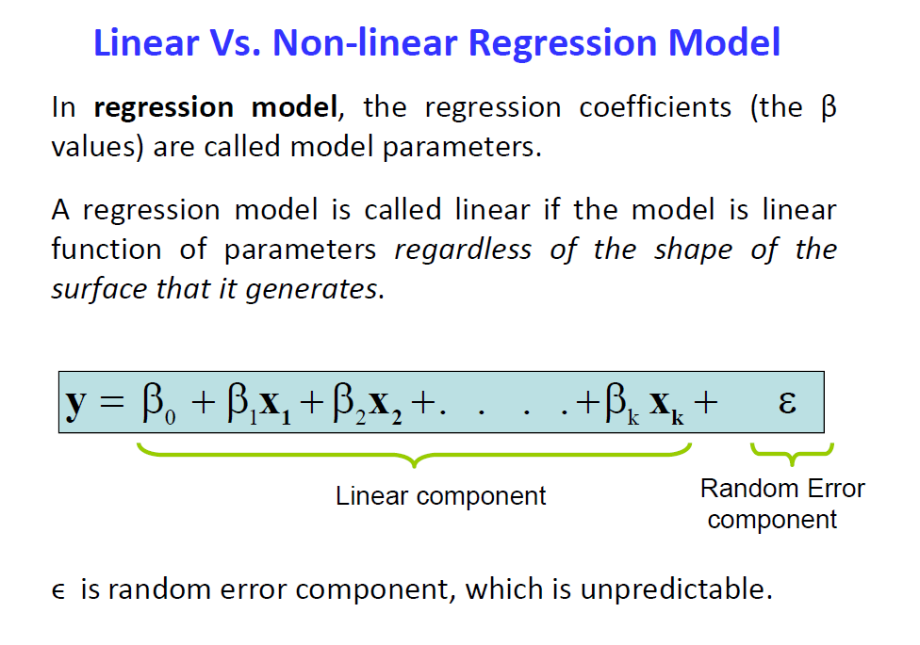

Slide 14



Slide 16
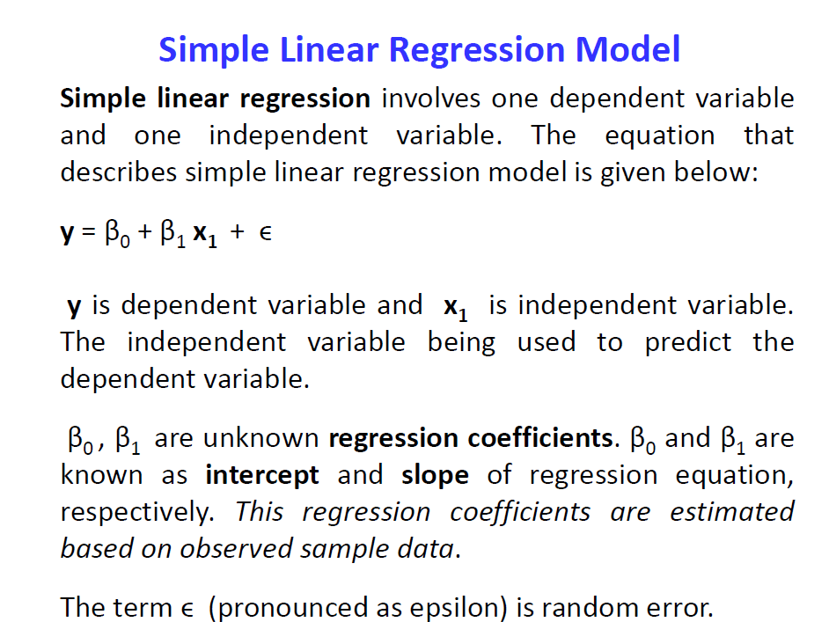

Slide 17
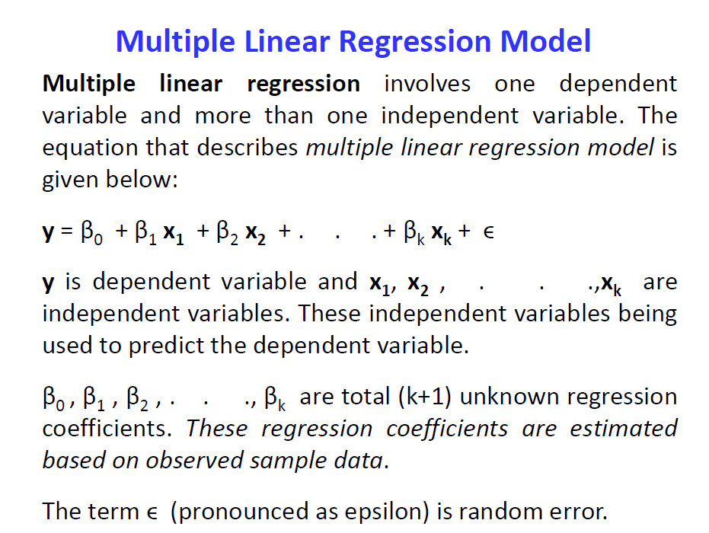

Slide 18
Notes:
2’nd order

Slide 20
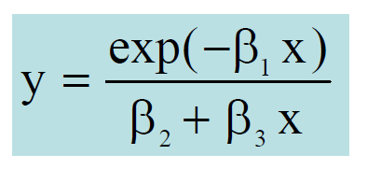
Non Linear because parameters are non linear

Slide 21
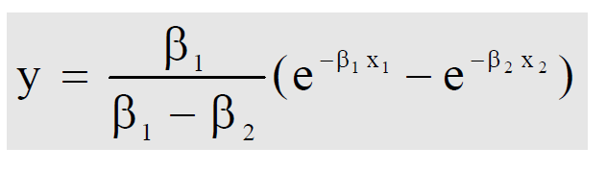
Non Linear because parameters are non linear

Slide 22
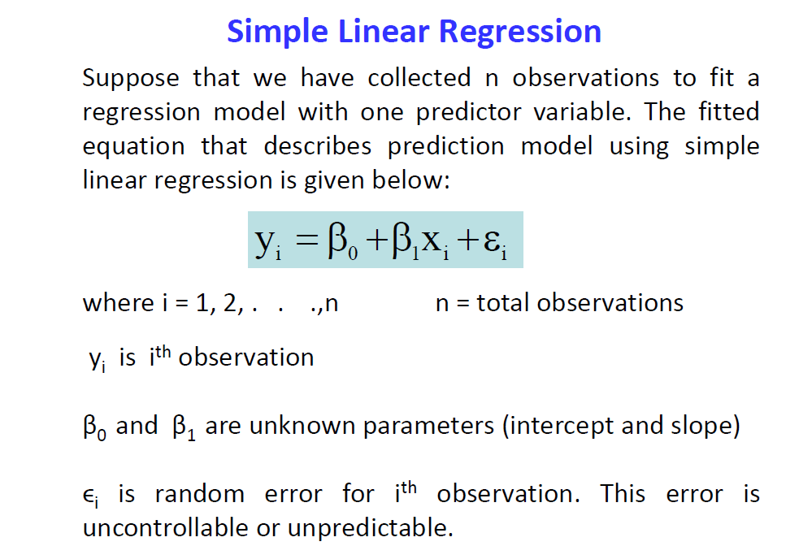

Slide 23
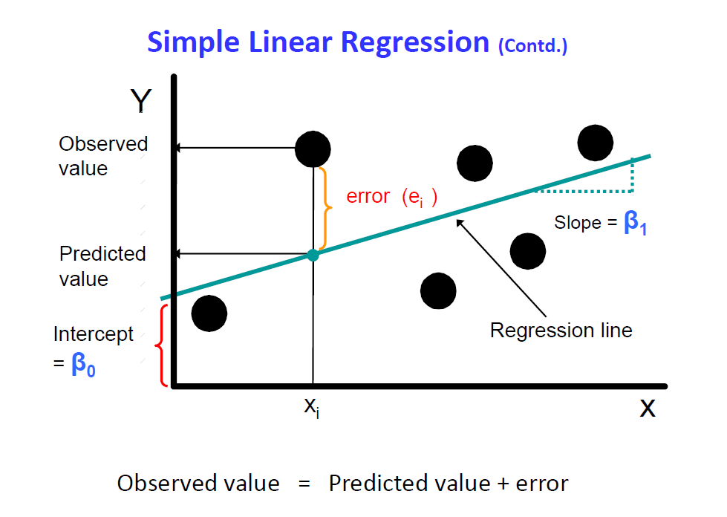

Slide 24
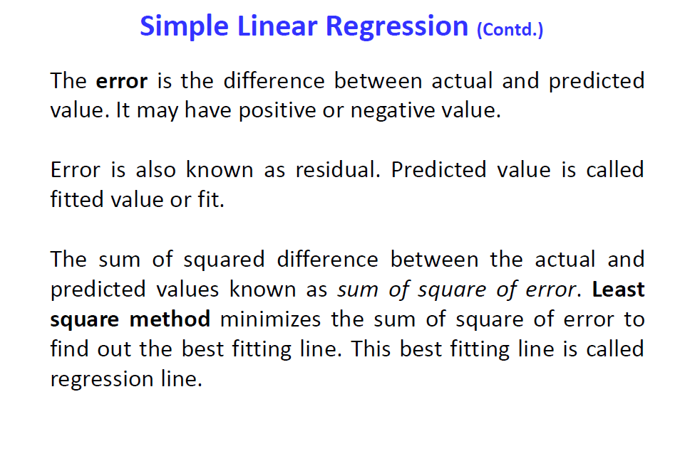

Slide 25
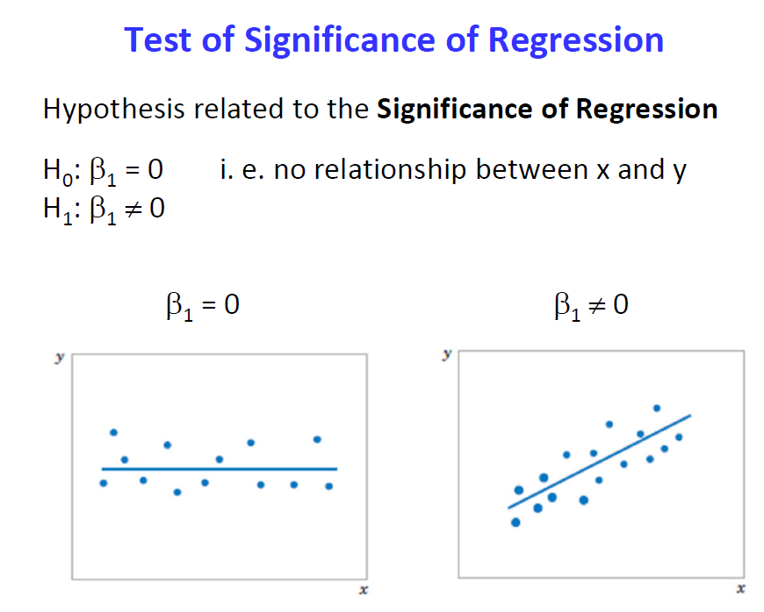

Slide 26
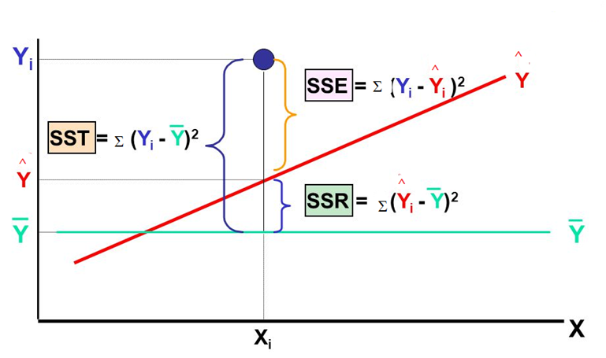
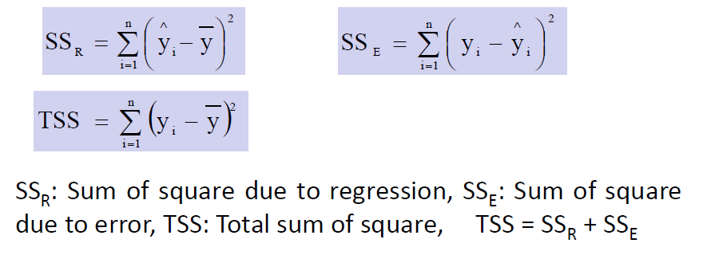

Slide 27
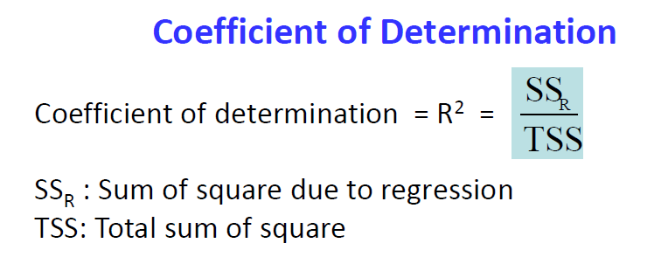
Physical interpretation : It is the fraction of variation of the dependent variable that is explained by the Regression line .
Also expressed in %
Higher value indicates better fit.

Slide 28
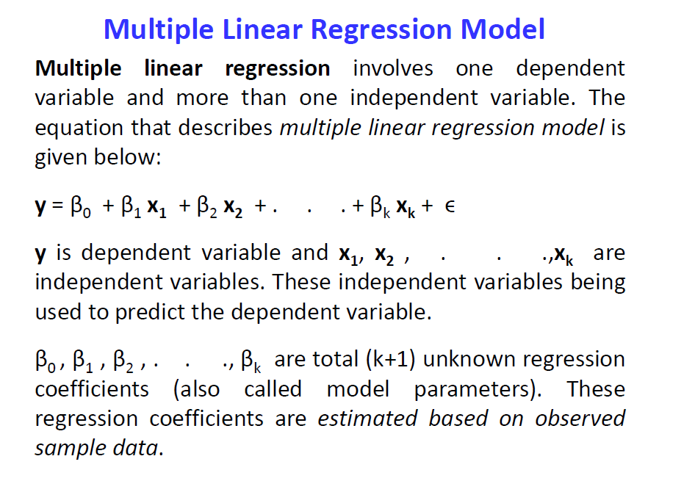

Slide 29
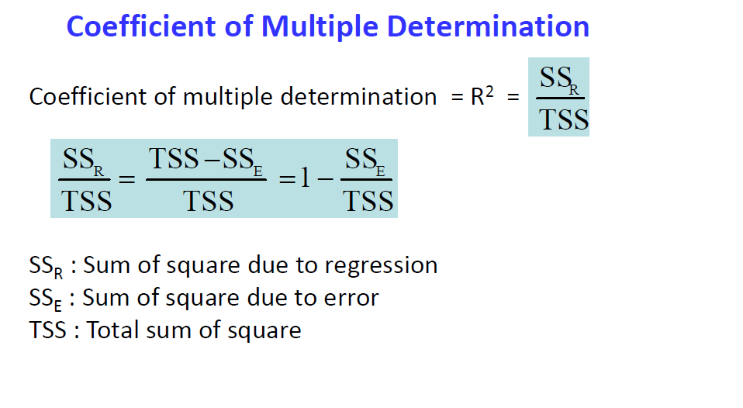
Physical interpretation : It is the fraction of variation of the dependent variable that is explained by the Regression line .
Also expressed in %
Higher value indicates better fit.

Slide 30
