Slide 1



Slide 2
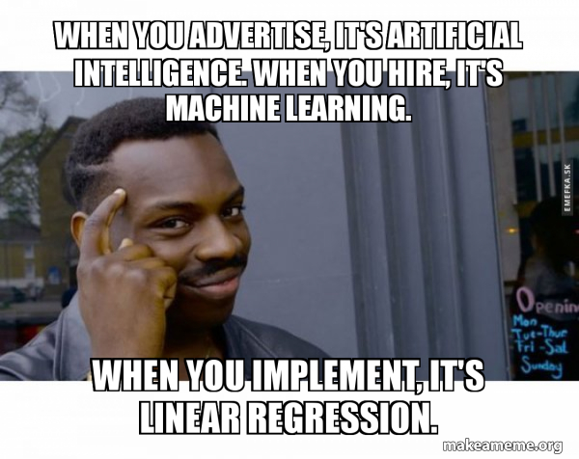
Regression …

Slide 3
Regression comes under Supervised ML technique

Slide 4
Regression analysis
is a set of statistical processes for estimating the relationships between a dependent variable (often called the 'outcome' or 'response' variable) and one or more independent variables (often called 'predictors', 'covariates', 'explanatory variables' or 'features').

Slide 5
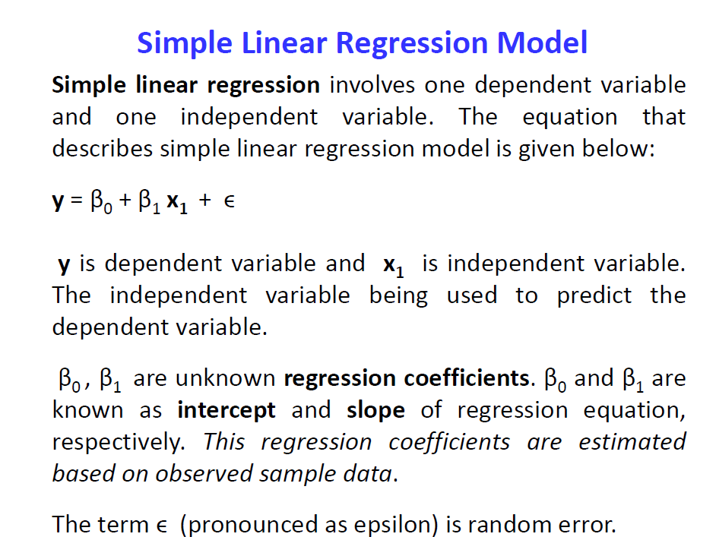

Slide 6
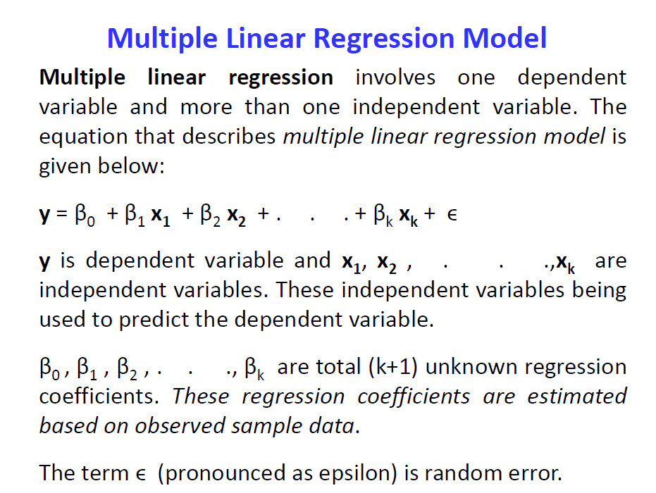

Slide 7
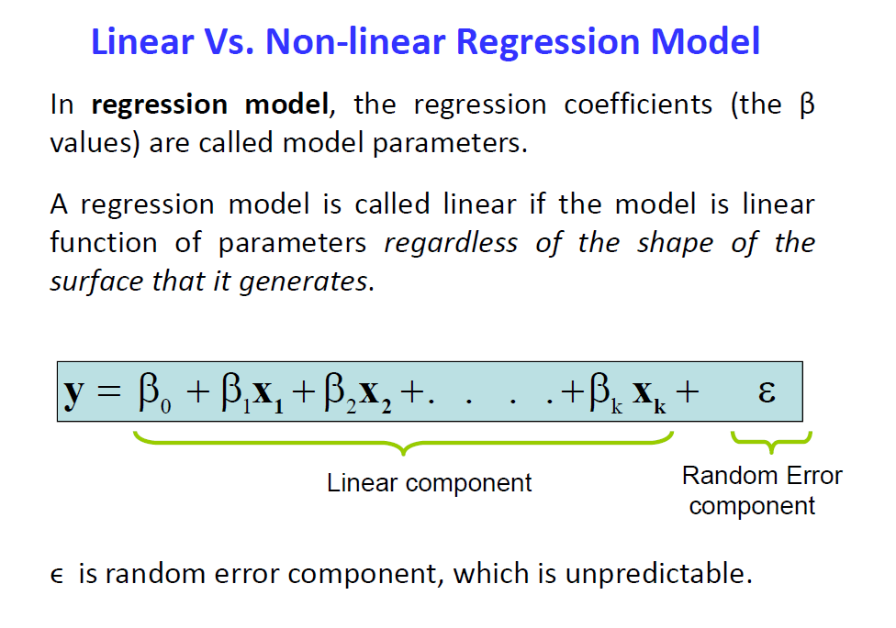

Slide 8



Slide 9
Notes:
2’nd order

Slide 11
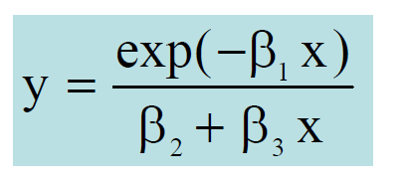
Non-Linear because parameters are non-linear

Slide 12
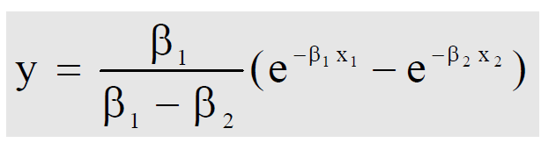
Non-Linear because parameters are non-linear

Slide 13
Applications

Slide 14
Marketing
  Sales Forecasting: Predicting sales based on marketing spend, seasonality, and other factors.
  Customer Lifetime Value: Estimating the lifetime value of a customer based on past behavior.

Slide 15
Finance:
  Stock Price Prediction: Regression can be used to model the relationship between various financial indicators and stock prices.
  Credit Scoring: Predicting credit scores based on financial and demographic variables.

Slide 16
Healthcare:
Disease Prediction: Modeling the relationship between risk factors and the likelihood of developing certain diseases.
Drug Dosage Optimization: Determining optimal drug dosages based on patient characteristics.

Slide 17
Economics:
GDP Forecasting: Modeling the relationship between economic indicators and the Gross Domestic Product (GDP).
Inflation Prediction: Analyzing factors influencing inflation rates.

Slide 18
Education:
Student Performance Prediction: Predicting academic performance based on study time, attendance, and other factors.
Educational Resource Allocation: Modeling the relationship between resource allocation and student outcomes.

Slide 19
Environmental Science:
  Climate Change Analysis: Studying the relationship between greenhouse gas emissions and temperature changes.
  Air Quality Prediction: Predicting air quality based on environmental variables.

Slide 20
Retail:
  Demand Forecasting: Predicting product demand based on historical sales data and external factors.
  Price Optimization: Analyzing the relationship between pricing strategies and sales.

Slide 21
Human Resources:
Manpower requirement prediction : based on company growth , attrition etc
Employee Performance Prediction: Predicting employee performance based on various HR metrics.

Slide 22
Sports Analytics:
  Player Performance Prediction: Modeling the relationship between player statistics and performance.
  Outcome Prediction: Predicting game outcomes based on team statistics.

Slide 23
Supply Chain Management:
  Inventory Management: Predicting optimal inventory levels based on demand and lead times.
  Supply Chain Optimization: Analyzing factors influencing the efficiency of the supply chain.

Slide 24
Telecommunications
  Network Performance: Analyzing the relationship between network parameters and call quality.
  Customer Churn Prediction: Predicting customer churn based on usage patterns.

Slide 25
Real Estate
  Property Price Prediction: Modeling the relationship between property features and prices.
  Housing Market Analysis: Analyzing factors influencing the real estate market.

Slide 26
Warfare
Weapon System Operational Readiness
https://proceedings.stis.ac.id/icdsos/article/download/58/33/2102#:~:text=In%20our%20research%2C%20we%20propose,of%20the%20weapon%20system%20circulation.
https://www.youtube.com/watch?v=emn28FrJ6CI

Slide 27
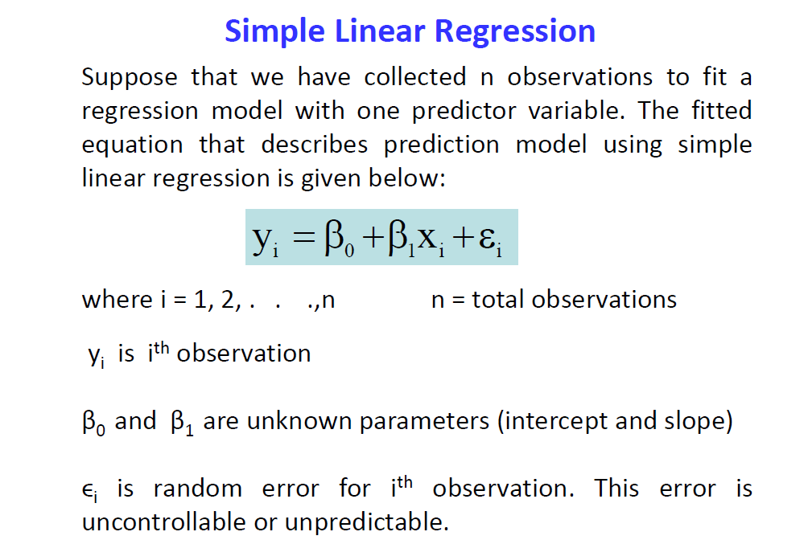

Slide 28
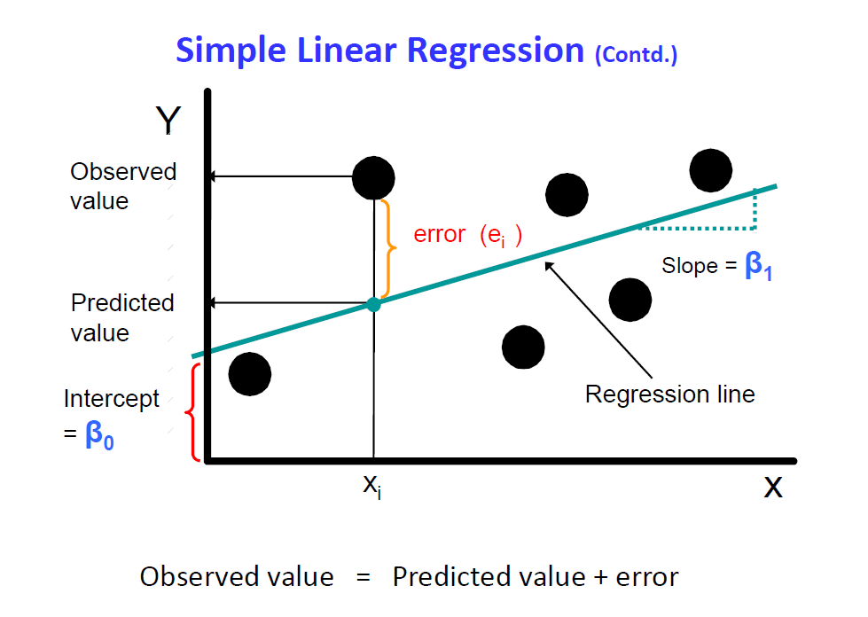

Slide 29
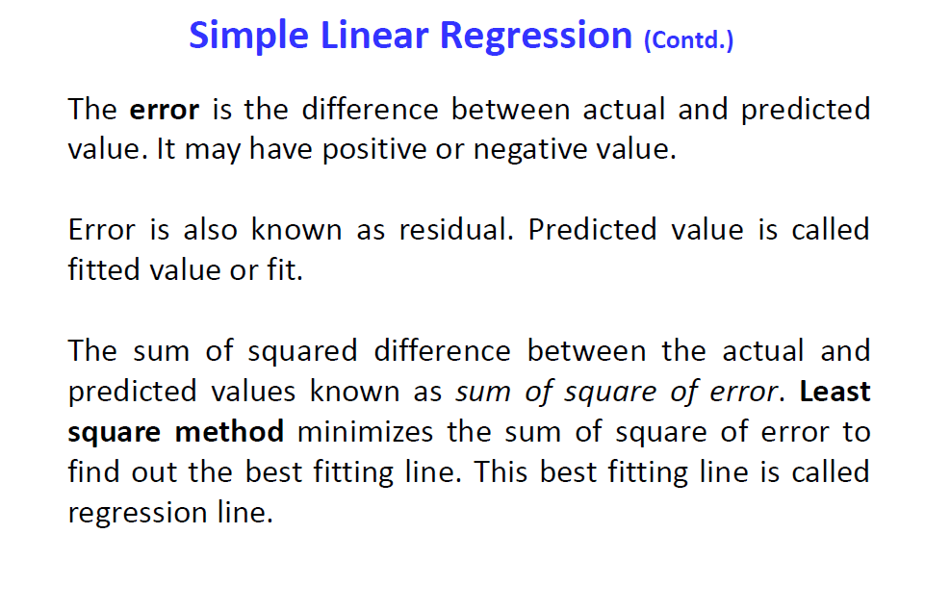

Slide 30
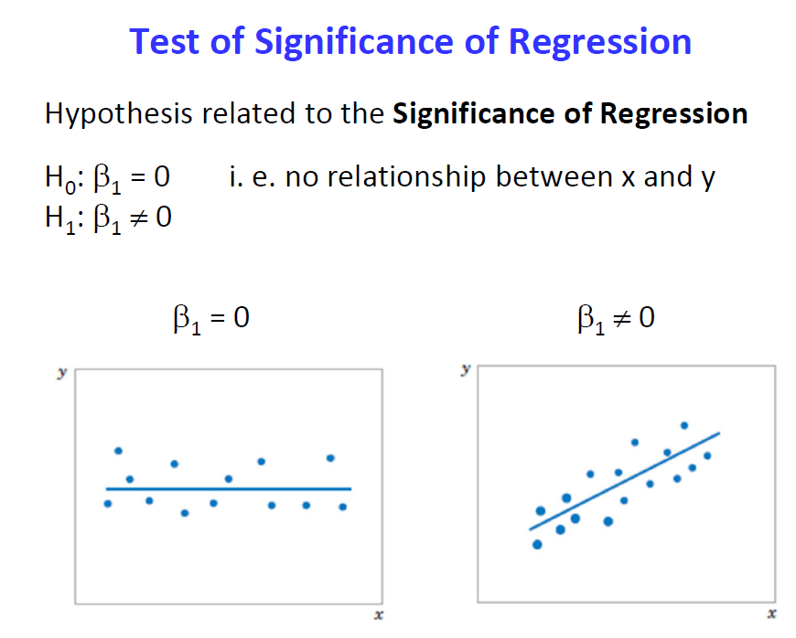

Slide 31
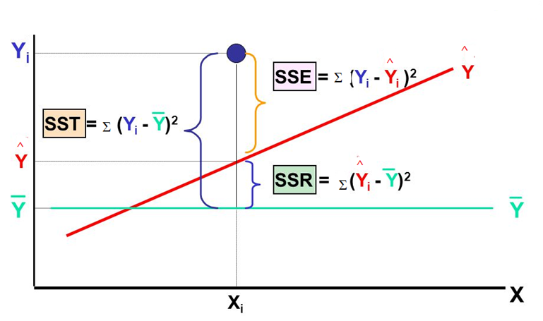
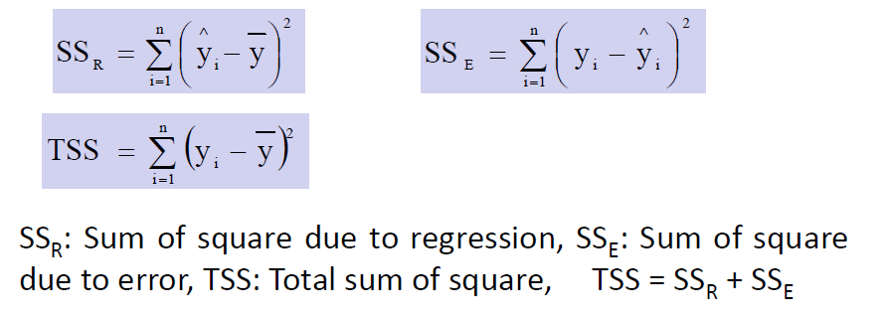

Slide 32
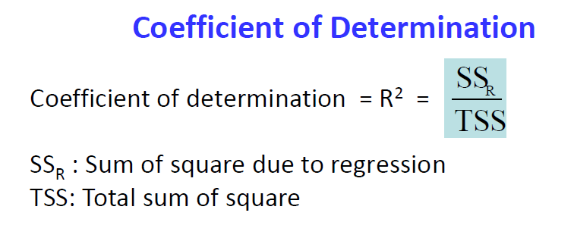
Physical interpretation : It is the fraction of variation of the dependent variable that is explained by the Regression line .
Also expressed in %
Higher value indicates better fit.

Slide 33
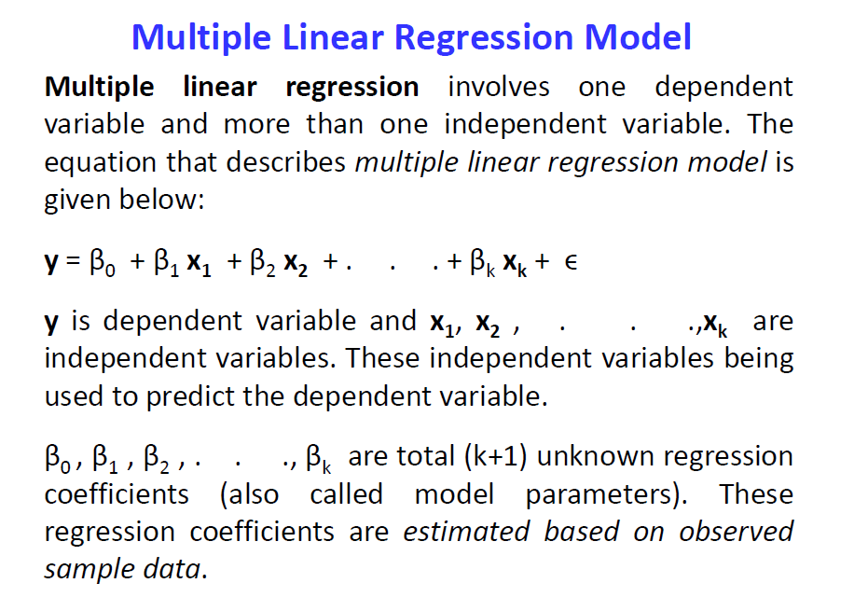

Slide 34
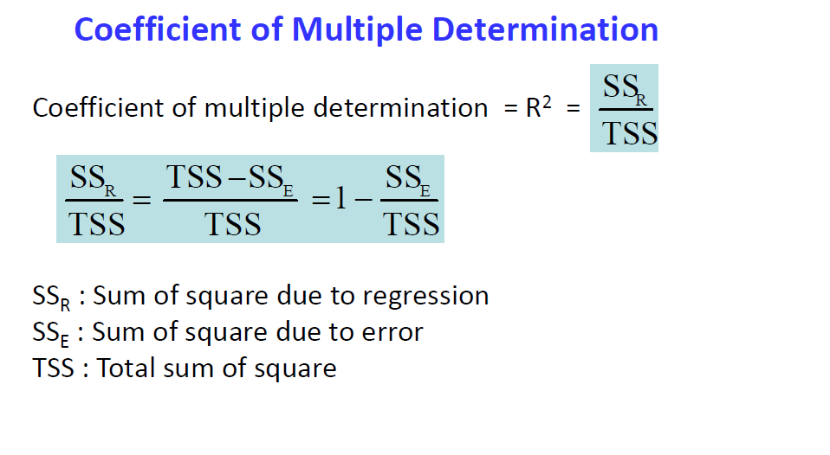
Physical interpretation : It is the fraction of variation of the dependent variable that is explained by the Regression line .
Also expressed in %
Higher value indicates better fit.

Slide 35
