Slide 1
REFERENCE
6 Sep 2020

Slide 2
Career Stages
1. Exploration :
It represents pre employment stage
Start in mid twenties – influenced by our family, teachers and friends
We develop a lot of expectation related to a job
The problem arises in mid 30’s when our earlier choices are tested

Slide 3
Career Stage
2. Establishment
This stage covers 10 years from 25 years onwards
This stage begins with anxiety, mistakes, learning and recovery
In this stage an individual tries to get settled on a job in some organisation
Everyone tries to establish himself/herself in society
In the earl part of the stage individual has junior status with relevant job skills
By the end of the stage, Individual gets settled and all set to accelerate

Slide 4
Career Stages
3. Maintenance (Mid Career)
This stage ranges from 35 to 45 years
You are no longer a learner, you are counted as seniors
In this stage, individual suffers from mid life crisis
The crisis is all about getting into critical evaluation with spouse, kids and parents around one always face difficulty is maintaining a good work life balance.
One must invest time and efforts in the right direction in terms of career

Slide 5
Career Stages
4. Late Career
This stage continues for 20 years from mid forties
From this stage either you will maintain growth or you may stagnate
Individual has varied experiences and even mentor new people as well
Individuals get locked into their current job in this stage

Slide 6
Career Stages
5. Decline
In this stage individuals mostly retire or they are forced to step out of limelight
It is the hardest stage, for those who are high achievers in earlier stages
This may create frustration as so many jobs left behind
One must be ready for this retired life and try to engage in various other activities
One must give chance to others.

Slide 7
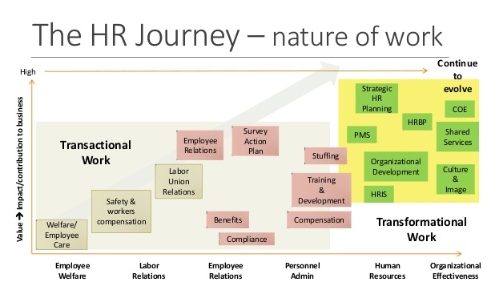
The HR Journey

Slide 8
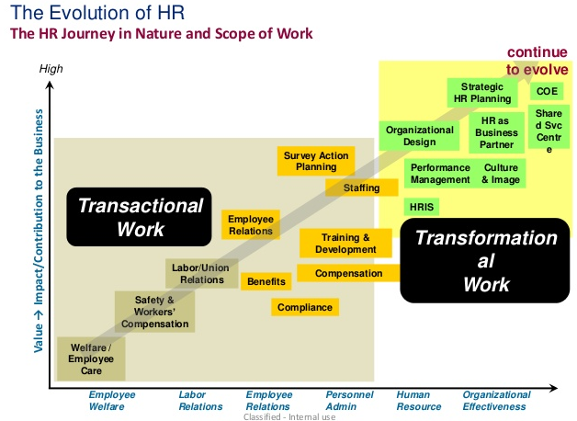
Evolution of HR

Slide 9
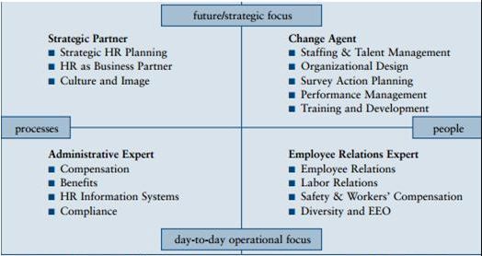
HR Value Proposition Model

Slide 10
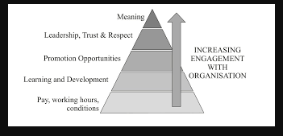
Engagement with Organisation

Slide 11
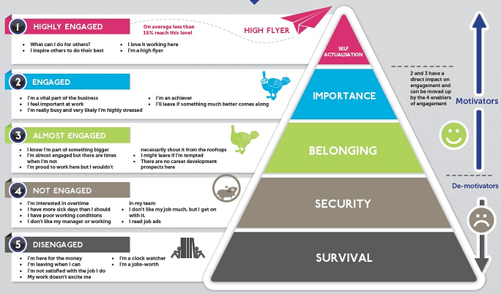
Maslow Hierarchy applied to Employee Engagement

Slide 12
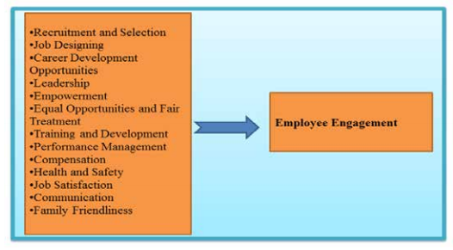
Factors Influencing Employee Engagement

Slide 13
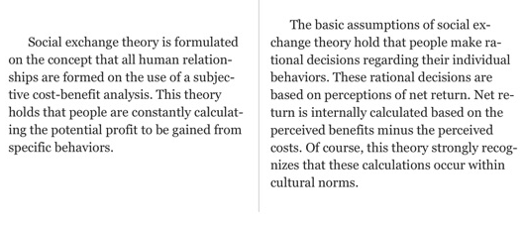
Social Exchange Theory

Slide 14
Propositions - Social Exchange Theory
Success proposition: When one finds they are rewarded for their actions, they tend to repeat the action.
Stimulus proposition: The more often a particular stimulus has resulted in a reward in the past, the more likely it is that a person will respond to it.
Deprivation–satiation proposition: The more often in the recent past a person has received a particular reward, the less valuable any further unit of that reward becomes.

