Slide 1
REFERENCE
5th Sep 2020

Slide 2
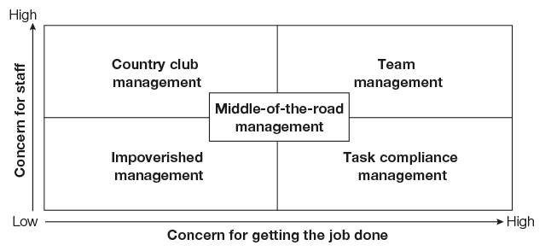
Leadership Grid

Slide 3
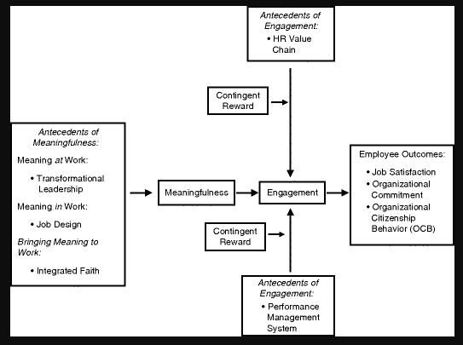
Meaning at Work

Slide 4
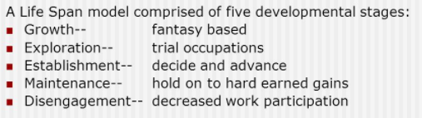
Donald Super’s Development Theory

Slide 5
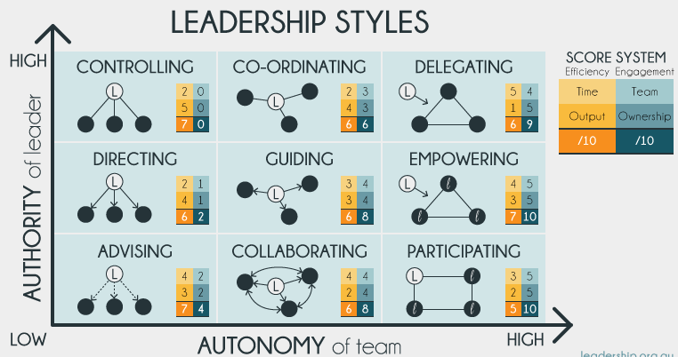
Leadership Styles

