Slide 1
REFERENCE
30th Aug 2020

Slide 2
Concept of Justice
Procedural justice: Employees consider an outcome acceptable if they believe the procedure used to make the decision is fair. For example, differences in pay are acceptable if the employees perceive the process to arrive at the disparity is both clear and reasonable or a performance rating is fair if the right criteria was used to arrive at the final rating.
Distributive justice: Distributive justice refers to the perception of fairness in the distribution of outcomes. If employees feel like their performance review was fair in comparison with how their peers did, their satisfaction with the outcome is likely to be perceived as acceptable. In compensation, distributive justice refers to the perception that the employees got the proper reward when compared to their effort.

Slide 3
Rater Errors I
The recency effect — where raters allow recent events to drive the
feedback without looking at performance for the whole rating
period — is especially prevalent, generally because most
supervisors are crunched for time and often haven’t properly
documented employee performance for the entire year or quarter,
thus being held hostage by their own memory.
Another problem can be the error of central tendency, in which all
employees are rated as average — no highs, no lows. Central
tendency is the middle child of “all my employees are amazing”
and “everybody needs to improve” — two other rater issues that
HR must be on the lookout for when managing the process.

Slide 4
Rater Error II
Another error is the primacy effect, when raters allow first events to drive ratings. For example, when interviewing ten people in a row there is often the tendency for raters to remember the first person that they interviewed more clearly than others.
The halo effect refers to assuming that there are many positive things about a person based on one positive thing, such as a person with excellent attendance must also be productive.
The horn effect refers to assuming many negative things
about a person because there is an area in need of improvement.

Slide 5
Adult Learning Styles
All trainers should take into account the learning styles of their employees. Many of them haven’t been in a formal classroom in years, and yet HR professionals often hustle them into a conference room for the latest PowerPoint presentation without regard to how well they will absorb the material. Effective trainers know that people learn with their senses, and some senses are more dominant than others. Imagine for example, that a child enters a playground with his mother.
A visual learner will watch how the other kids are playing and then mirror their behavior.
An auditory learner may ask his mother what he should do, seeking verbal direction.
A tactile or kinesthetic learner is likely to jump right in, grabbing a ball or digging his hands in the sand.
The visual learner will be most comfortable using a reference chart or reading the training manual. The auditory learner would benefit from watching a video on the key program features, listening to the trainer’s voice. And the tactile learner just wants to get started, tap,tap, tapping away on the keyboard or clicking his way through the demo.

Slide 6
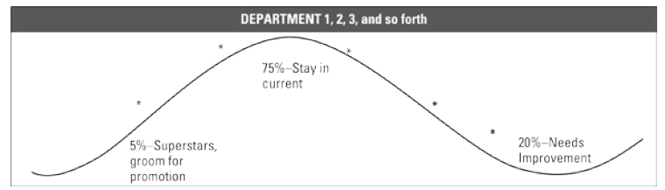
Forced Distribution Curve

Slide 7
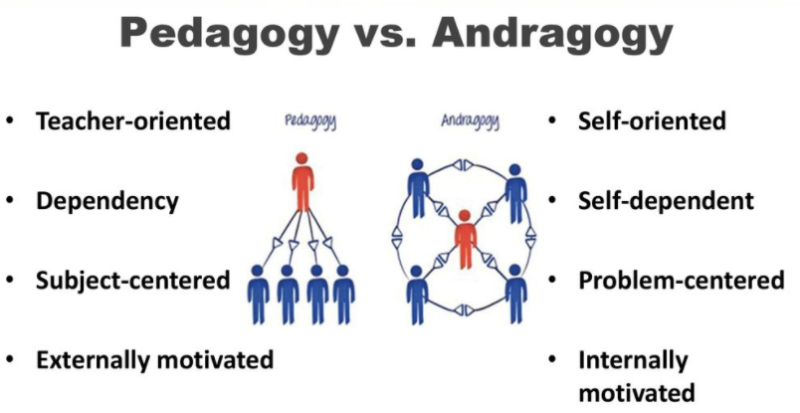
Two Models of Learning

Slide 8
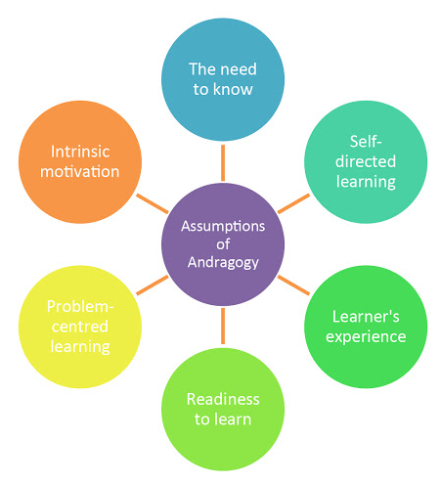
Andragogy Model

Slide 9
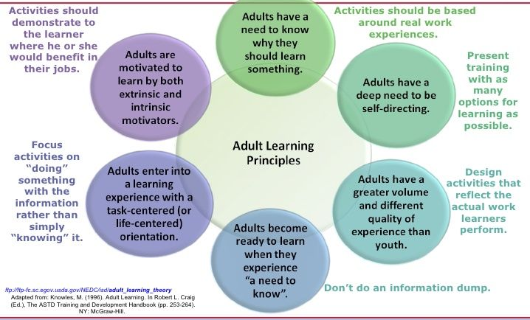
Adult Learning Principles

Slide 10
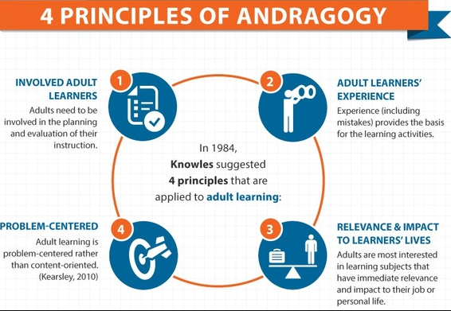
Principles of Andragogy

Slide 11
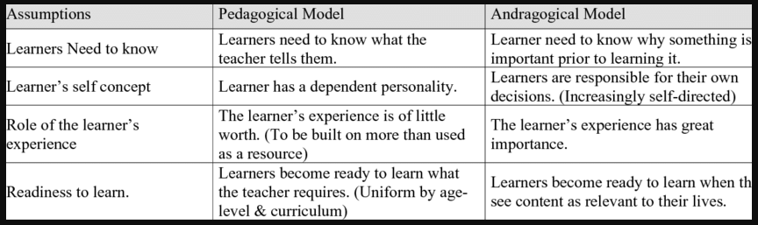
Difference Pedagogical and Andragogical Model

Slide 12
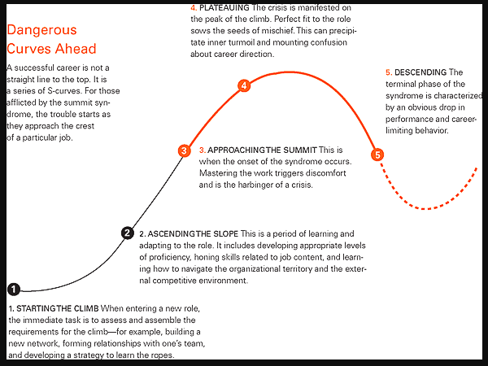
Career Slope

Slide 13

Difference between Training, Education and Development

Slide 14

The Five Phases of ADDIE

Slide 15
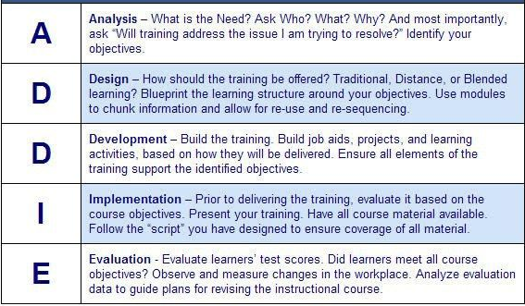
ADDIE Instructional Design Model

Slide 16
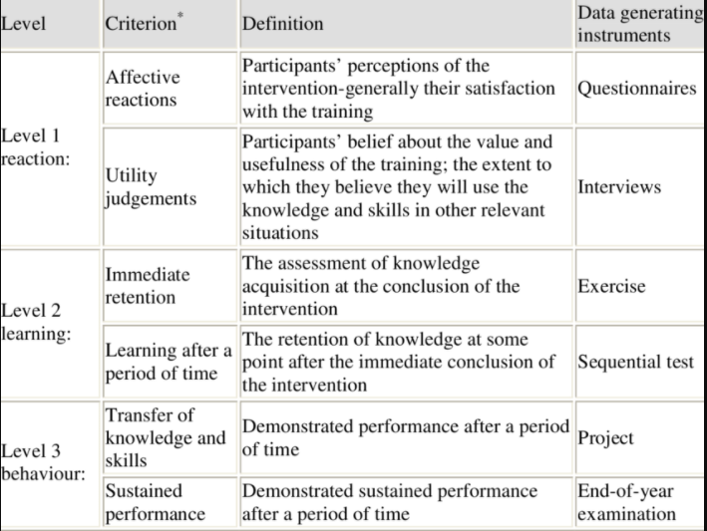
Kirkpatrick Table for evaluation

Slide 17
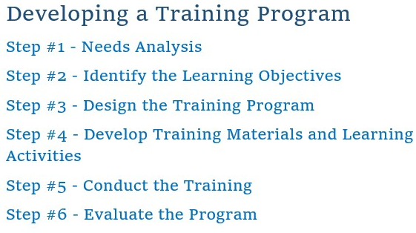
Developing a Training program

Slide 18
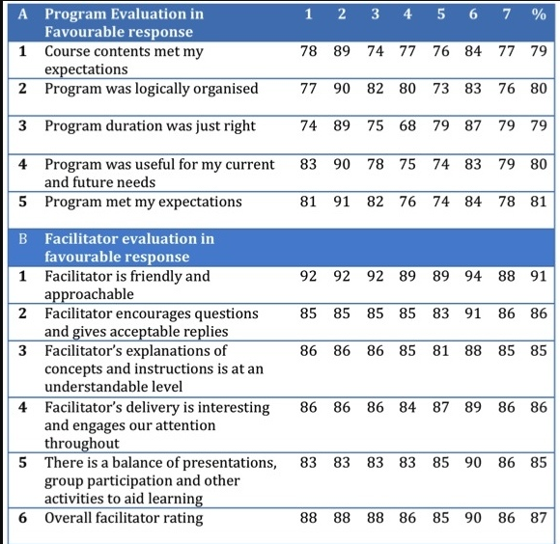
Evaluation Form

