Slide 1
REFERENCE
29 Aug 2020

Slide 2

Employee Motivation Factors

Slide 3
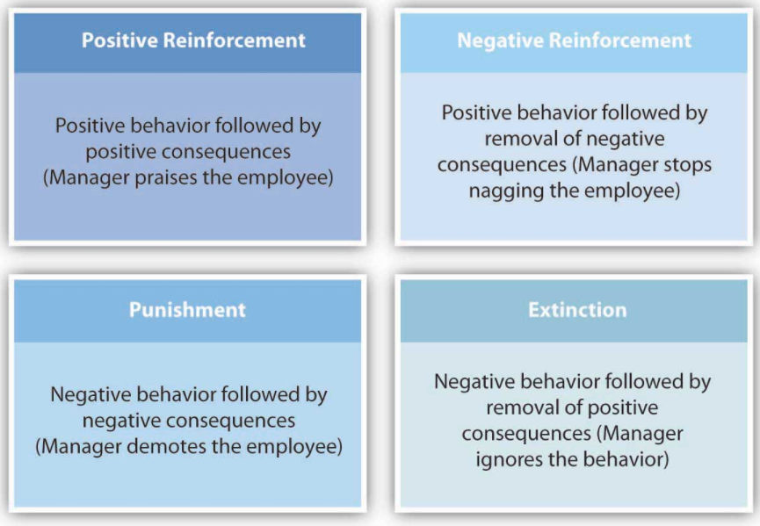
BF Skinner Reinforcement Theory

Slide 4
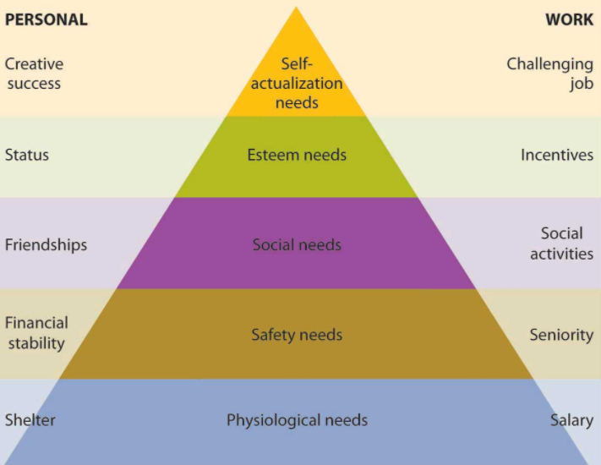
Maslow Need Hierarchy

Slide 5
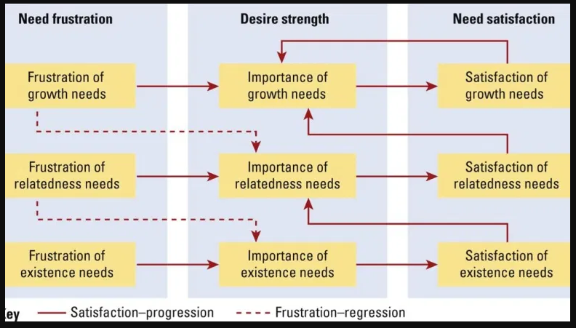
Alderfer’s ERG Theory

Slide 6
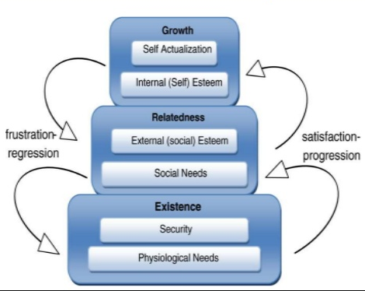
Relation between Need Hierarchy and ERG Theroy

Slide 7
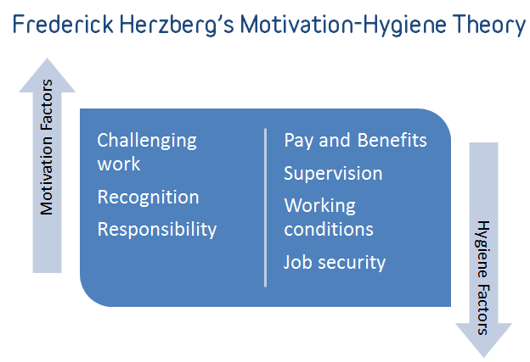
Herzberg’s Motivation Hygiene Theory

Slide 8
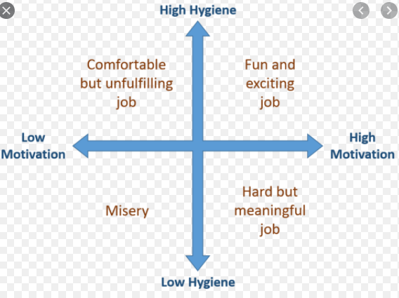
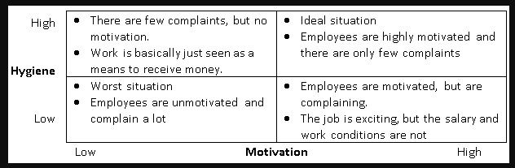
Herzberg Theory

Slide 9
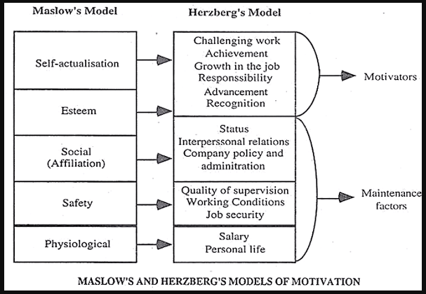
Comparison of Maslow and Herzberg Model

Slide 10
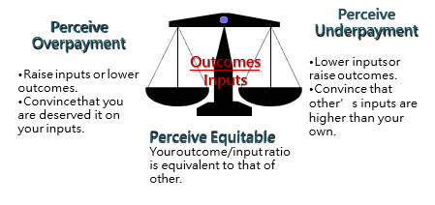
Adam’s Equity Theory

Slide 11
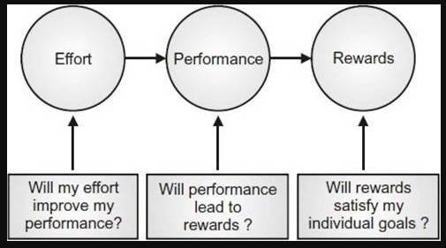
Vroom Expectancy Theory

Slide 12
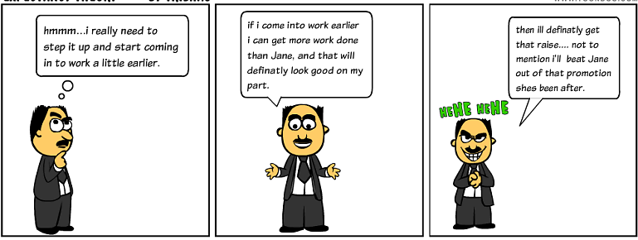
Expectancy Theory

Slide 13
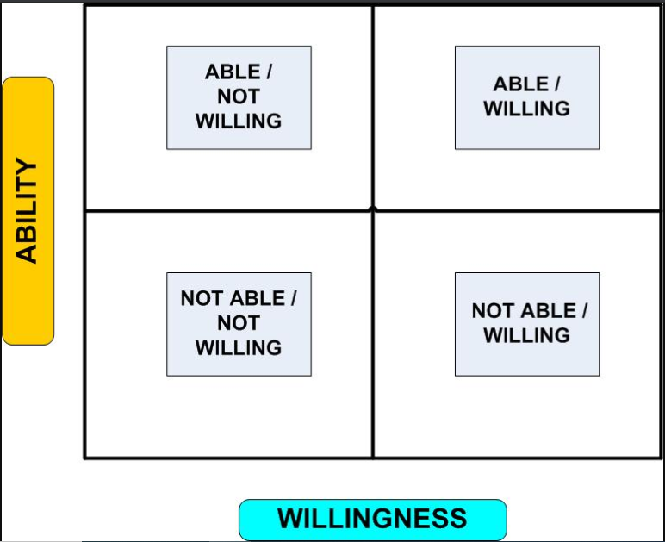
Usage of Vroom Theory

Slide 14
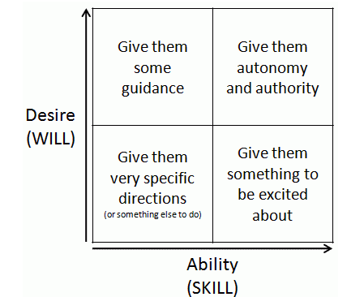
Usage of Vroom Theory

Slide 15
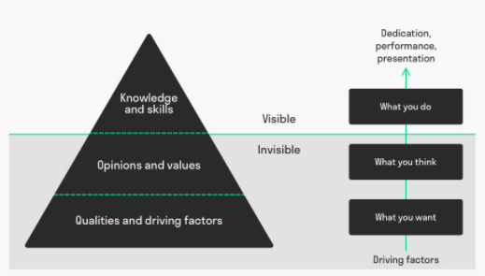
McClelland Motivation Theory

Slide 16

David McClelland’s Theory of Needs

Slide 17
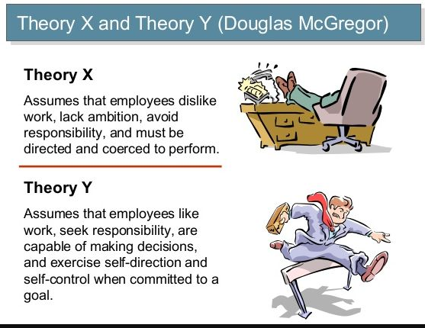
Theory X and Y

Slide 18

Difference Coaching, Counseling, Mentoring

Slide 19
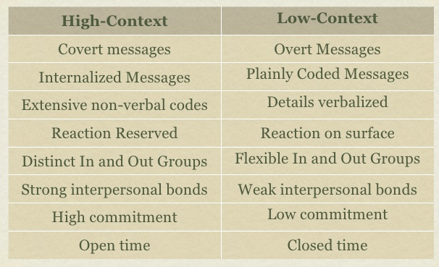
Hall’s Culture Context

