Slide 1
Reference
13 Sep 2020

Slide 2
Strategy Implementation vs Execution
These two words are often used interchangeably in many organisations and in business articles and books. However they have two very different connotations especially in terms of strategy.
If a strategy is implemented then it implies that it was not in the business previously i.e. either the business didn’t have a strategy or this is a new strategy. Also it implies that there will be a ‘start date’ and ‘end date of the implementation. That is at some point it will be in and working.
Implementing a strategy also often means that there is an implementation team. Implementation is better suited to change management or new IT / operating systems.
Execution on the other hand implies task level actions. There are several opportunities every day or every hour for an employee to execute. To achieve “execution excellence” is to realize the best possible results a strategy and its implementation will allow

Slide 3
Example
Netflix has made a corporate strategy choice to enter the content business and to exit the mail order business. Once Netflix is in the content business and out of the mail order business, that “strategy” (or that part of its strategy) is implemented. Now, they must do things such as set goals and plans for the content business, establish the right incentives, create a motivational, purpose-redolent mission statement, and other such things that leaders do to get results from their companies. Those are all activities needed to produce results within the context of an implemented strategy. This is execution.

Slide 4
Balance Scorecard
A new approach to strategic management was developed in the early 1990's by Drs. Robert Kaplan (Harvard Business School) and David Norton. The balanced scorecard approach provides a clear prescription as to what companies should measure in order to 'balance' the financial perspective.
Balanced Scorecard is the Management System that enables organisation to clarify their vision and strategy and translate them into action.It provides feedback on both internal process abd external outcomes in order to continously improve strategic performance and results.
“ Balanced scorecard retains traditional financial measures. But financial measures tell the story of past events, an adequate story for industrial age companies for which investments in long-term capabilities and customer relationships were not critical for success. These financial measures are inadequate, however, for guiding and evaluating the journey that information age companies must make to create future value through investment in customers, suppliers, employees, processes, technology, and innovation.”

Slide 5
Balance Scorecard
the greatest challenge for organizations
Vision
- only 5% of workforce gets it!
People
– 25% of managers have incentives linked to strategy
Management
– 85% of executive teams spend less than 1 hour/mo discussing strategy
Resource
– 60% of organizations don’t link budgets to strategy
Bad execution, not bad strategy is the cause of 70% of CEO failures
Execution is not just tactics—it is a discipline and a system

Slide 6
Challenges in Executing Strategy
Financial Management
Tools
Balance Sheets
Income Statements
Statement of Cash Flow
Process Management
Tools
Six Sigma
Supply Chain Management
TQM
Strategy Management
Tools
???
Customer Management
Tools
C R M
Customer Segment Analysis
Customer Surveys
People Management
Tools
MBO
Training Programs
HRIS
360 Feedback

Slide 7
Balance Scorecard
Train and Communicate Strategy
Set goals, select performance measures and link
measures to incentives
Feed
Forward
Learning
Set target for each goal and re-deploy resources to
activities and initiatives to achieve targets
Provide feedback on performance and
learn from results

Slide 8
Balance Scorecard
A robust tool – but keep it simple!
Makes strategy tangible –everyone’s job!
Tracks what’s important – hits and misses
Measurement-lead management
Provides feedback for short-term course corrections and long-term learning

Slide 9
Balance Scorecard
Financial
How do we succeed financially?
Customer
How do we appear to our customers?
Internal Process
At what processes must we excel?
Learning and Growth
How do we sustain our ability to change and grow?

Slide 10
Summary - BSC
Financial
Perspective
Revenue
Customer
Loyalty
Customer
Perspective
On Time
Delivery
Internal
Process
Process Quality
Process Cycle
Time
Learning and
Growth
Employee Competitiveness

Slide 11
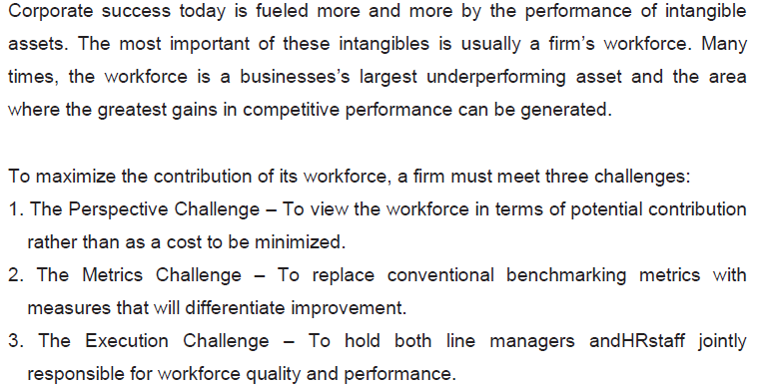
Main Idea

Slide 12
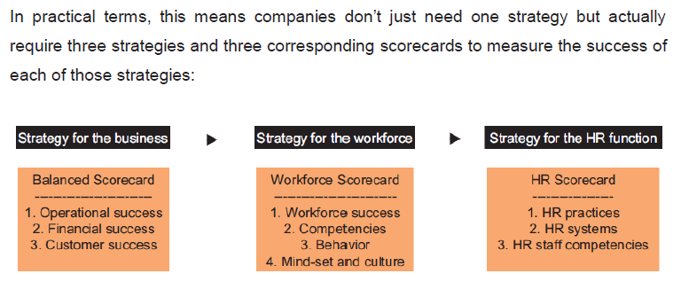
Three Scorecards

Slide 13
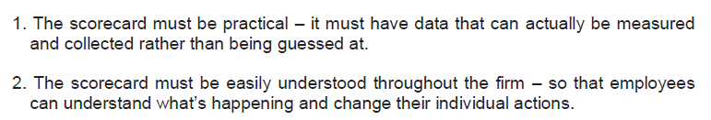
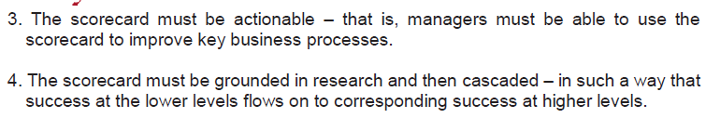
Elements of a Scorecard

Slide 14
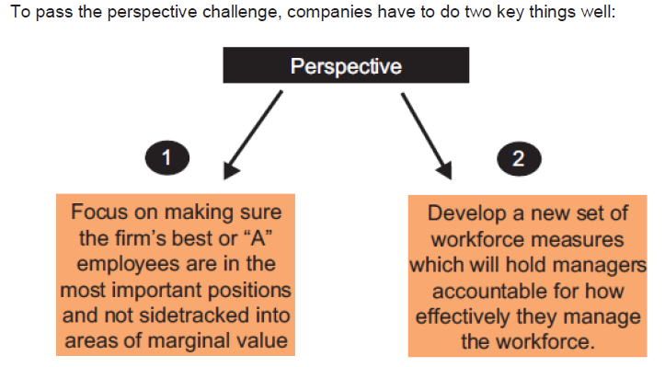
Perspective Challenge

Slide 15
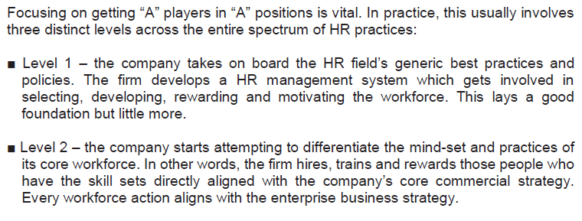
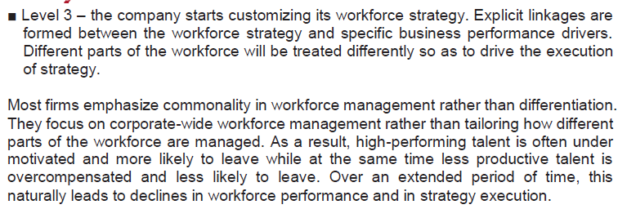
HR workforce

Slide 16
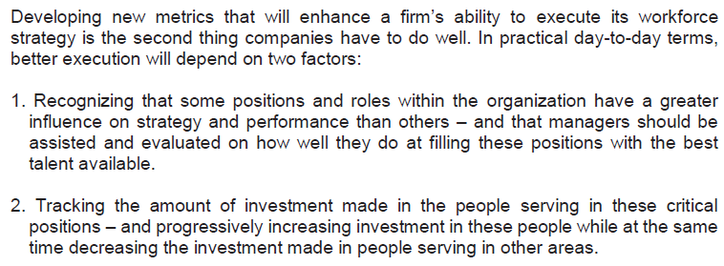
Workforce Metrics

Slide 17
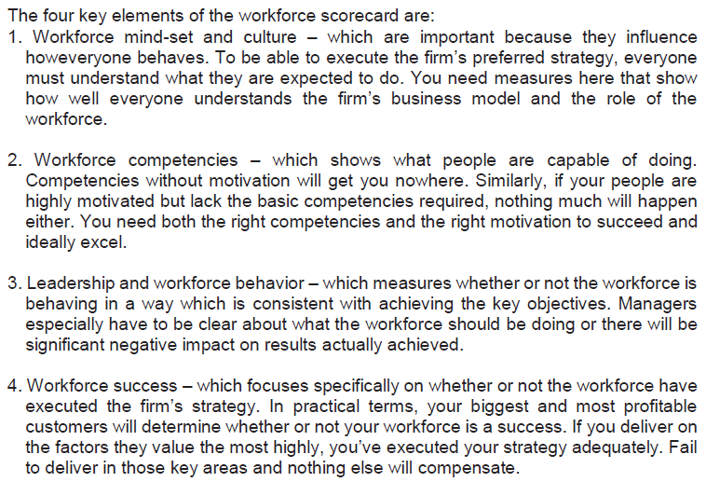
Workforce Scorecard

Slide 18
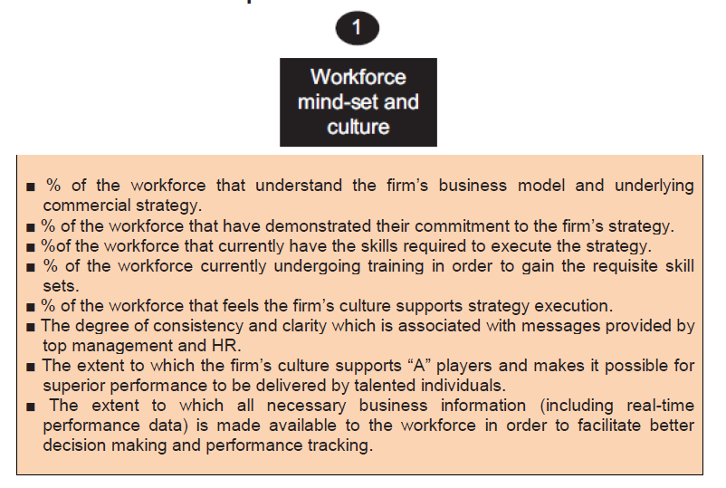
1.Workforce Mindset and Culture

Slide 19
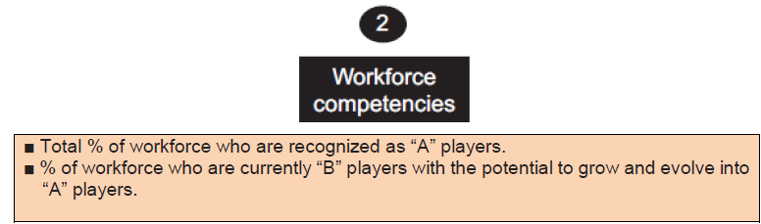
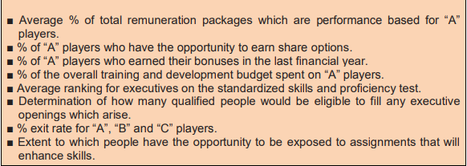
2. Workforce Competencies

Slide 20
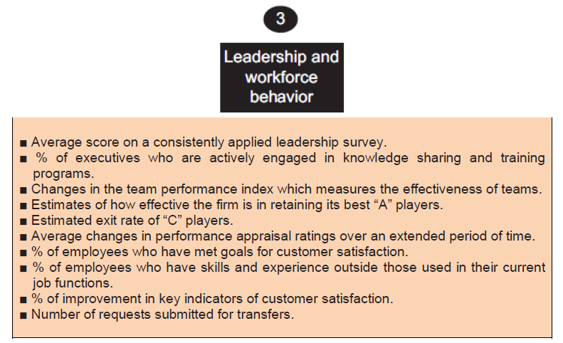
3. Leadership and Workforce Behaviour

Slide 21
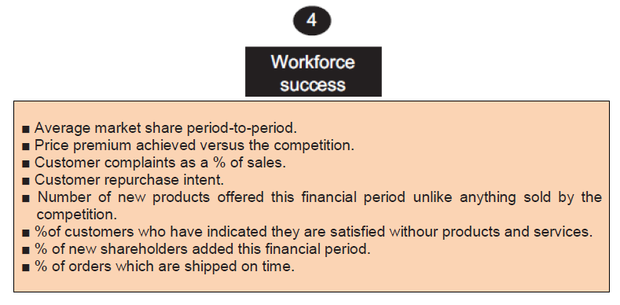
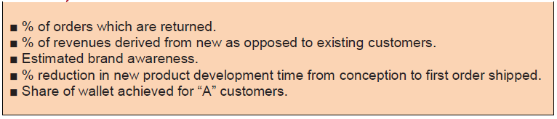
4. Workforce Success

Slide 22
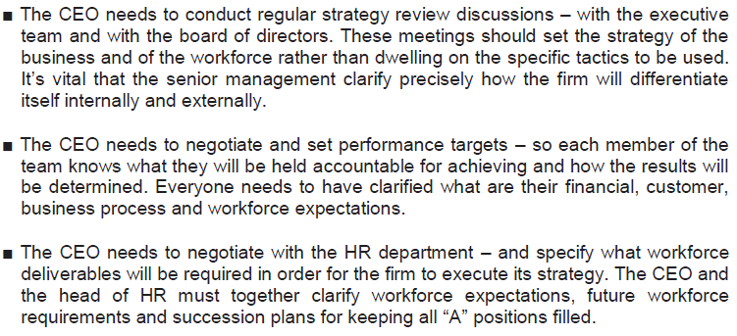
Execution Challenge : Role of CEO

Slide 23
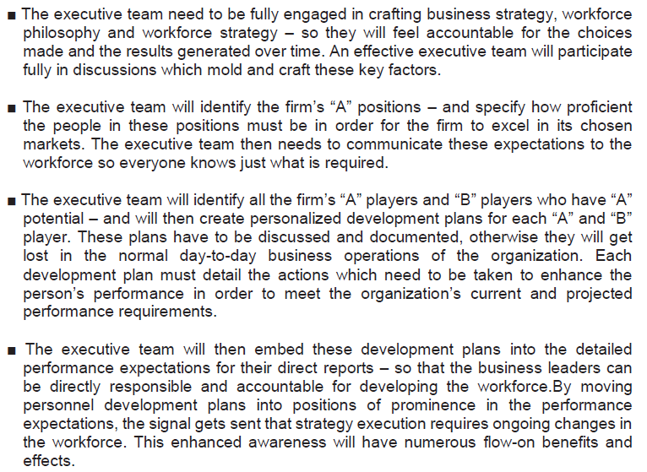
Role of Executive Team

Slide 24
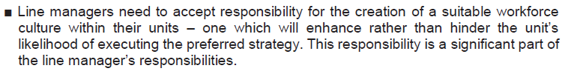
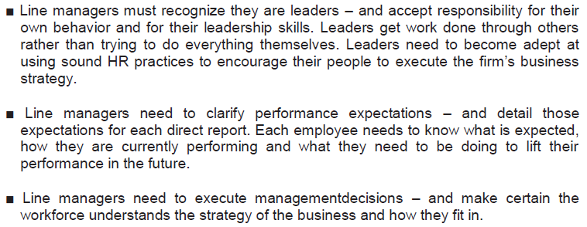
Role of Line Manager

Slide 25
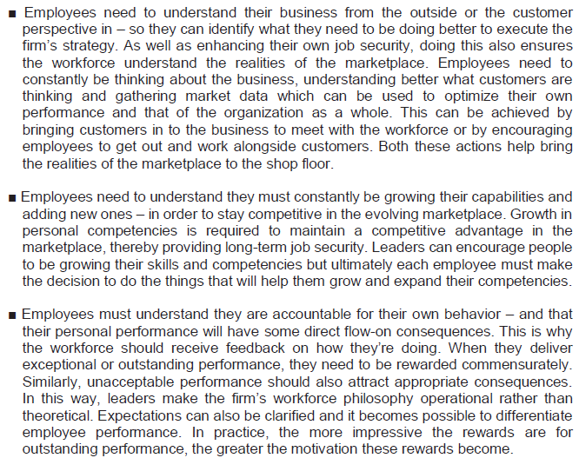
Role of the Workforce

Slide 26
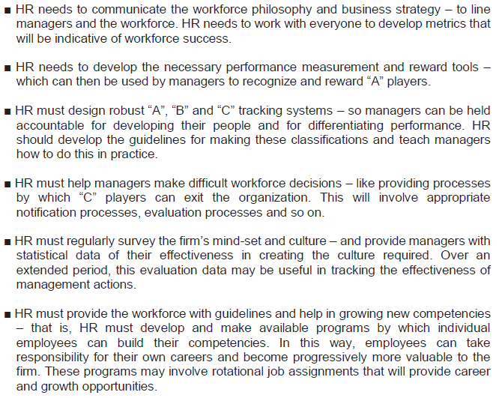
Role of the HR Function

Slide 27
HR Scorecard
Strategic Objectives
Key Performance Indicators
Drive Long term
Shareholder Value
Shareholder value
Shareholder value growth
ROI of HR Strategic Programs and Initiatives
Enhance ROI of HR Strategic Initiatives
Enhance Employee
Productivity
Profit per Employee
Revenue per Employee

Slide 28
HR Scorecard
Strategic Objectives
Key Performance Indicators
Create Positive Work Environment
Enhance “Internal Customer” (Employee) Satisfaction
Employee Satisfaction Index

Slide 29
HR Scorecard
Strategic Objectives
Key Performance Indicators
Apply Excellent Recruitment Process
Average lead time to recruit employees
Recruiting cost per employee
Performance of New Recruits during the First Two Years of Employment
Average Lead Time to Develop Strategic Competencies
Average Lead Time to Close Strategic Competencies Gap
% of Strategic Competencies Available within the Organization
Develop Strategic Competencies

Slide 30
HR Scorecard
Strategic Objectives
Key Performance Indicators
Number of Qualified Talents per Strategic Positions
Progress of Talent Development Plan (actual vs. plan)
% of Senior Managers who Have Been Promoted Internally
Implement Best Talent Management Practices
Average Competency Assessment Scores
Number of Performance Feedback Session Conducted per Year
Optimize Performance Management System

Slide 31
HR Scorecard
Strategic Objectives
Key Performance Indicators
% of HR Employees who Develop Individual Development Plan
% of HR Employees who Fully Execute Their Individual Development Plan
Develop Internal HR Capabilities
Progress of HR Portal Implementation (actual vs. plan)
Accuracy Level of HR Database
Deploy HRIS System

Slide 32
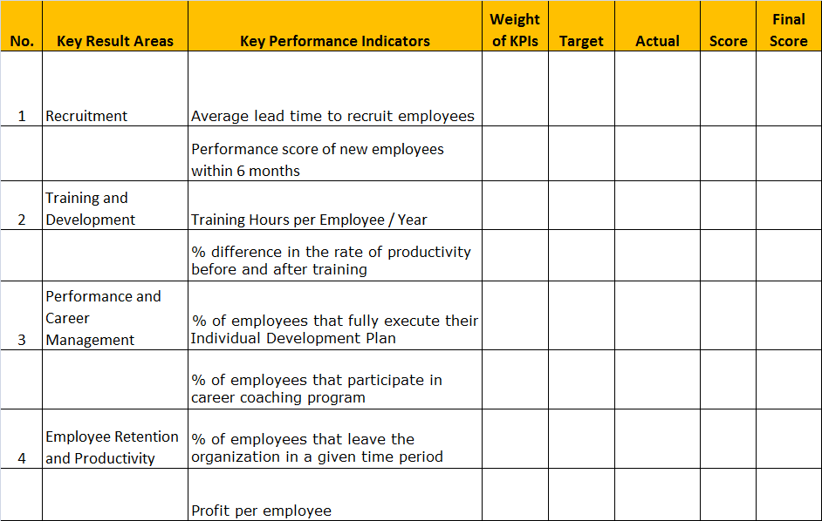
Template : KPI Table for HR Manager

Slide 33
Template : KPI Table for HR Manager
Key result areas are the main goals that HR manager needs to accomplish. In this sample, we have four key result areas.

Slide 34
Template : KPI Table for HR Manager
Key performance indicators are measurable indicators used to evaluate your performance level
Every Key Result Areas must have at least one KPI.
Total number of KPIs shoud be 8 – 10 items.

Slide 35
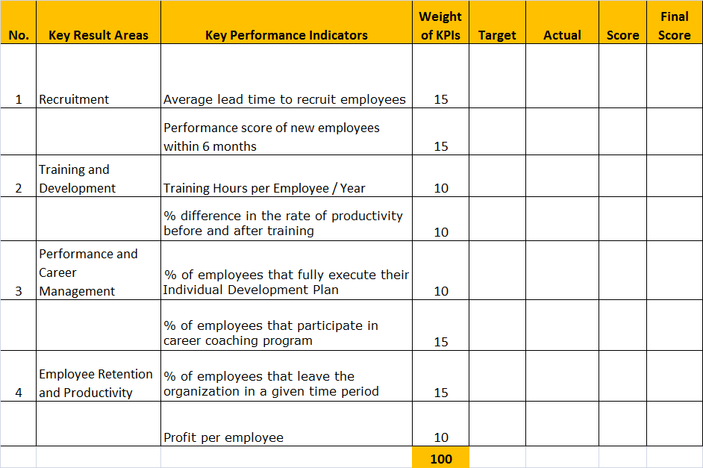
Template : KPI Table for HR Manager
Weight of each KPI should be defined.
Weight of KPI is determined based on the scale of priority. Total weight should be 100.

Slide 36
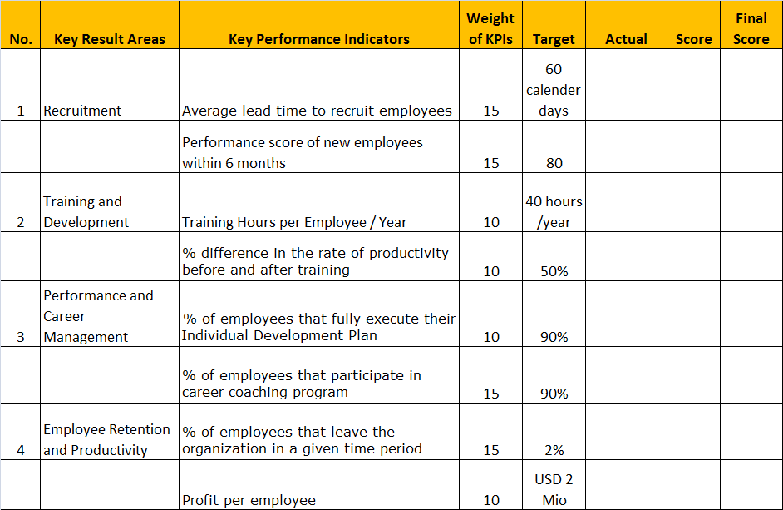
Template : KPI Table for HR Manager
Targets are defined based on historical data and future expectations.
Targets can be percentage, number, or score – depending on the type of KPIs.

Slide 37
HR Strategy Map
Drive Long term
Shareholder Value
Enhance ROI of HR Strategic Initiatives
Enhance Employee
Productivity
Financial
Create Positive Work Environment
Enhance “Internal Customer” (Employee) Satisfaction
Internal
Customers
Apply Excellent Recruitment Process
Develop Strategic Employee Competencies
Implement Best Talent Management Practices
Optimize Performance Management System
HR Internal Process
Learning
Develop Internal HR Capabilities
Deploy HRIS System

Slide 38
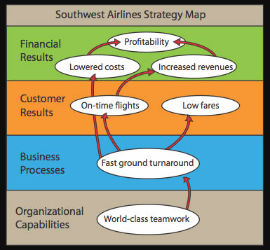
HR Strategy Map

Slide 39
Strategy Map
Strategy Map: Diagram of the
cause-and-effect relationships
between strategic objectives
Strategic Theme:
Operating Efficiency
Statement of what strategy must achieve and what’s critical to its success
How success in achieving the strategy will be measured and tracked
The level of performance or rate of improvement needed
Key action programs required to achieve objectives
Financial
Profitability
Fewer planes
More
customers
Customer
Flight
Is on time
Lowest
prices
Objectives
Measurement
Target
Initiative
Internal
Fast ground
turnaround
Fast ground turnaround
On Ground Time
On-Time Departure
30 Minutes
90%
Cycle time optimization
Learning
Ground crew
alignment

Slide 40
HR Strategy Map Template
Drive Long term
Shareholder Value
Optimize HR Efficiency
Enhance People & Organizational Effectiveness
Financial
Create Positive Work Environment
Provide Quality HR Service
Provide High Performance People
Customer
Achieve HR
Process
Excellence
Build Strategic Employee Competencies
Drive
Organizational
Performance
HR Internal Process
Learning & Growth
Develop Strategic & Functional HR Competencies
Enhance Technology
for HR
Create Climate for
HR Action

Slide 41
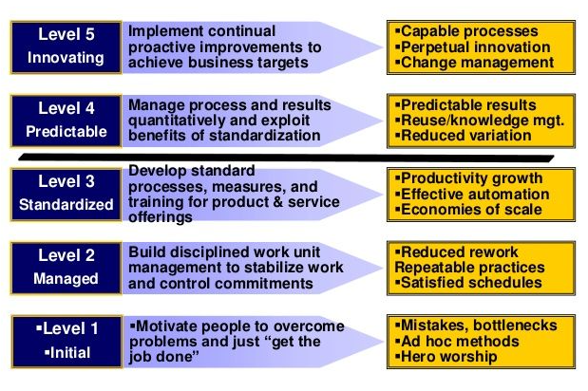
PCCM Model

