Slide 1
Reference
12 Sep 2020

Slide 2
Usage of Metrics
We are trying to change human behaviour, i.e influence the business to do something important
We are trying to show something or someone (program/person) that is gaining revenue for them

Slide 3
Analytics
Using facts to help make decisions
Identify an outcome you want to predict
Look at data around the outcome (inputs)
Use techniques to find and validate patterns in the data that predict outcome
Deploy the model into daily decision making
Model learn based on how it does in real life

Slide 4
Predictions
Outcome to predict
  - is it going to rain
Inputs
  Grey Clouds : yes/no
  Thunder : yes/no
  - Weather forecast : yes/no

Slide 5
Predictions about Human Behaviour
Paying a mortgage
Performing well in a job
Being a high value customer
Performing as an athlete
Compliance taking medicine

Slide 6
Better Results than Intuition
Intuition favours :
  - Those we like
  - Those with common experience
Human bias often not backed by data or experience
  -Inconsistent set of rules
Intuition based decisions are hard to :
  - Track results
  - Show accountability
Don't learn and improve decisions over time

Slide 7
Case Study : Blind Auditions
“Blind” auditions for symphony orchestras reduced sex-biased hiring and improved female musicians’ likelihood of advancing out of preliminary rounds, which often leads to tenured employment.
Using a screen to conceal candidates from the jury during preliminary auditions increased the likelihood that a female musician would advance to the next round by 11 percentage points. During the final round, “blind” auditions increased the likelihood of female musicians being selected by 30%.
According to analysis using roster data, the transition to blind auditions from 1970 to the 1990s can explain 30 percent of the increase in the proportion female among new hires and possibly 25 percent of the increase in the percentage female in the orchestras.
In short, “blind” auditions significantly reduced gender-biased hiring and the gender gap in symphony orchestra compositions.

Slide 8
Mortgage Example
Outcome : Probability of defaulting on payment
A. Gather (Input) data points :
  - Credit history, credit activity, collections activity, bankruptcy
B. Machine Learning looks for patterns
C. What is it about who pays and who defaults
Ideal Predictive Analytics Outcome
Minimise expensive mistakes
Maximise business outcomes

Slide 9
Aggregate vs Individual Predictions
Aggregate Level
Workforce Planning
Staffing levels
Best time to contact candidates
Ideal times for reviews/Promotions/Raises
Which training delivers best results
Individual Level
Candidates/Employee
  - Hiring/layoff
  - Succession planning
  - Predictive job pathing
  - Predictive employee lifetime value
  - What and whom to invest in

Slide 10
Organisational Behaviour Change
Move from “what do we think” to “what data tell us”
Openness to data challenging some widely held beliefs
Openness to moving beyond softer indicators like engagement or performance reviews to actual business performance

Slide 11
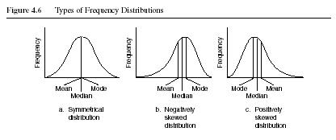
Distribution Shape

Slide 12
Considerations for Choosing a Measure of Central Tendency
For a nominal variable, the mode is the only measure that can be used.
For ordinal variables, the mode and the median may be used. The median provides more information (taking into account the ranking of categories.)
For interval-ratio variables, the mode, median, and mean may all be calculated. The mean provides the most information about the distribution, but the median is preferred if the distribution is skewed.

Slide 13
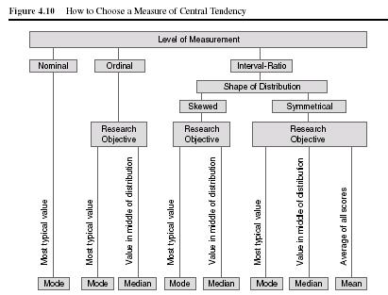
Which measure to choose

Slide 14
Factor Analysis
Factor Analysis identifies correlations between and among variables to bind then into one underlying factor driving their values

Slide 15
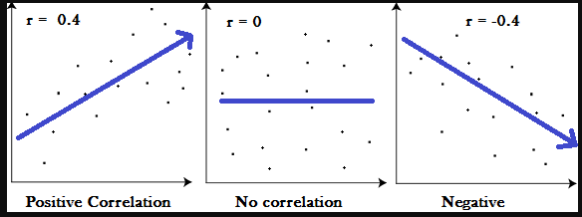
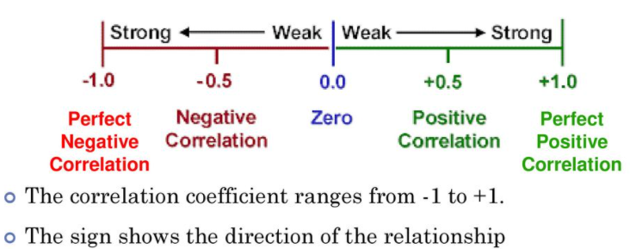
Correlation Coefficient

Slide 16
Monte Carlo Simulation
A method of estimating the value of an unknown quantity using the principles of inferential statistics
Inferential Statistics
  Population : A set of examples
  Sample : A proper subset of a population
  Key facts : a random sample tends to exhibit the same properties as the population from which it is drawn

Slide 17
Monte Carlo Method
In the late 1940s, Stanislaw Ulam invented the modern version of the Markov Chain Monte Carlo method while he was working on nuclear weapons projects at the Los Alamos National Laboratory. Immediately after Ulam's breakthrough, John von Neumann understood its importance. Von Neumann programmed the ENIAC computer to perform Monte Carlo calculations.

