Slide 1
Recruitment and Selection Analytics

Slide 2
Major Sub-Functions oRecruitment and Selection
Job analysis,
HRP,
Posting of jobs/job advertisements,
Screening of applications,
Selection process, and
Induction/socialization process.

Slide 3
Analytics in Human Resource Planning
Objective – Getting the 4 R’s right
Method
  Regression analysis: This technique tries to predict the number of labour based on several factors such as
  Sales target,
  New customer acquisition target,
  Customer attrition, and
  Employee attrition.

Slide 4
Analytics in Human Resource Planning
Regression Analysis: Predict (N)
Refer excel for problem

Slide 5
Usage of HR Analytics in Recruitment Process
3 Major Objectives of Recruitment
Attract applicants
  Generating applicants (How many ways?)
Maintain data pool of applicants
  What for?
Influence eligible candidate to join
  Why will one join?

Slide 6
How will you conclude whether recruitment did a fine job?
For that we need to understand
KPI

Slide 7
Important Recruitment KPIs
Table 4.3 Showing various ratio/metrics about recruitment channel selection
S.No | Ratio/Metrics | Formula
1. | Sourcing channel effectiveness | SE = Number of hired candidates through the channel/Number of applications generated through the channel/
 | Channel selection for placing advertisement | CS = Minimum number of impressions/day
 | Sourcing channel cost | CC = Amount of money spent on the advertising on a channel/Number of eligible candidates applied on that channel

Slide 8
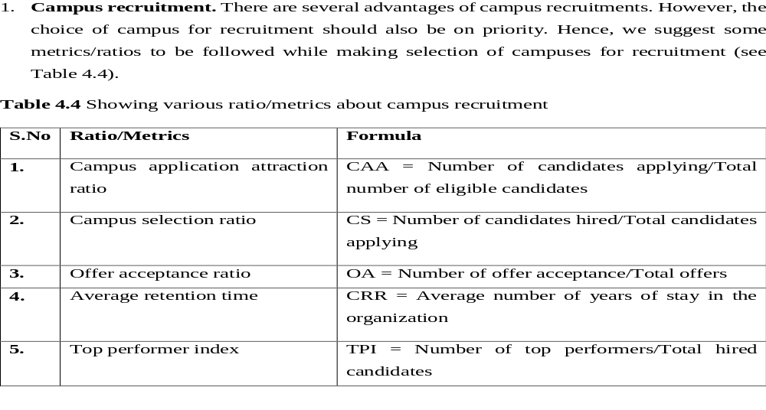
Important Recruitment KPIs

Slide 9


Slide 10


Slide 11
HCL Technology

