Slide 1
Personalization

Slide 2
Personalization is the central tenet of modern Ecommerce/online experience.
Agree / Disagree ?

Slide 3
Achieved via ?

Slide 4
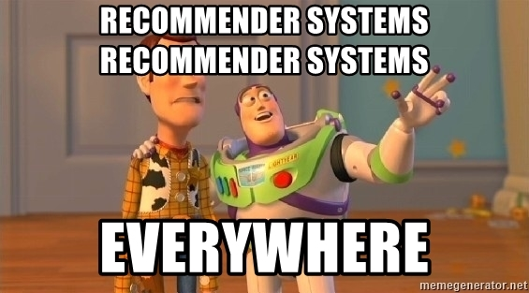
Recommender Systems (RecSys)

Slide 5


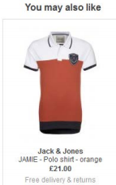
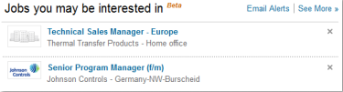
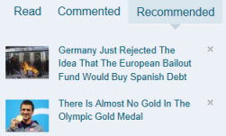
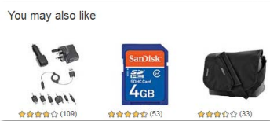

Once you see them, it’s every where !

Slide 6
Everything is a Recommendation !

Slide 7






Recommender Systems
Recommender systems predicts the level of preference of a given item by a user, and are used to provide a list of recommended items a user might be interested in.
E-commerce systems employ recommender systems to enhance the customer loyalty and helps in cross-selling and upselling of products
Approaches
Transfer learning
Cross Domain RS
Special kind of users
Context Aware RS
User Modeling

Slide 8
Preferences
Explicit feedback – Where users directly report on their interest in products ( One-Five Stars Ratings, Thumbs up/down, Like/Dislike )
Implicit Feedback - indirectly collect opinion by observing user behavior. Types of implicit feedback include purchase history, browsing history, search patterns.

Slide 9
Netflix Prize 2006
Offered a $1 million prize to whomever came up with a solution that reduced RMSE by 10% beyond what was obtained by Cinematch.
Changed the world forever !

Slide 10
RecSys challenges
https://recsys.acm.org/recsys24/challenge/

Slide 11
Approaches
Content Based approach
Collaborative Filtering
Hybrid ☺

Slide 12
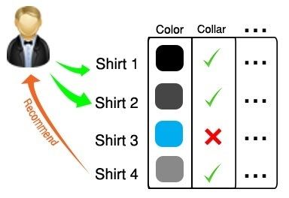
Content Based Approach
Makes recommendations to a user by analyzing the description of the items previous consumed by the user and the description of items to be recommended

Slide 13
Homophily !
Birds of a Feather, Flock together…

Slide 14
Collaborative Filtering
Collaborative filtering is an approach to making recommendations by finding correlations / similarities among users of a recommendation system, one of the most successful approaches, continues to attract interest of industry and academicians .
Collaborative filtering algorithm works on the basic assumption that if two individuals A and B like similar items or give similar rating to n items, then they will do similarly for other items too

Slide 15
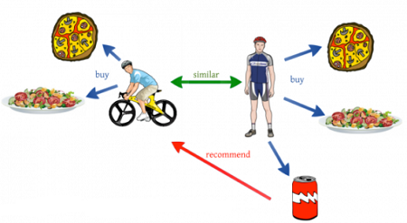

Slide 16
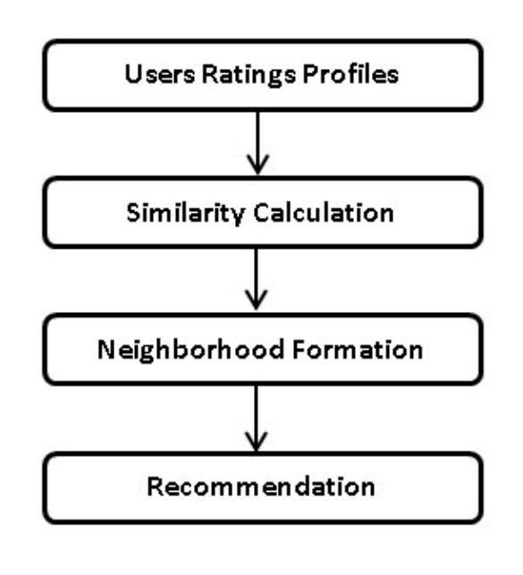






Slide 17
k-Nearest Neighbors (kNN)

Slide 18
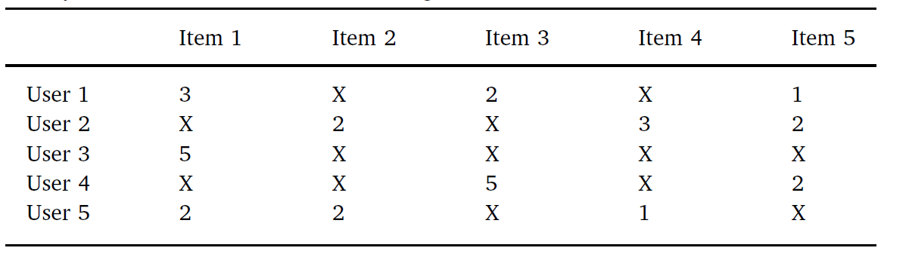
Utility matrix based on 1–5 star ratings scale

Slide 19
Sparsity Problem
Despite the huge size of the utility matrix, most of the cells in it are blank as those user-item pairs are unrated in the real world scenario
This happens because out of the thousands of available items, a typical user might have explored and rated only few of them.
𝑆𝑝𝑎𝑟𝑠𝑖𝑡𝑦 𝐿𝑒𝑣𝑒𝑙=1− (𝑛𝑜𝑛 𝑧𝑒𝑟𝑜 𝑒𝑛𝑡𝑟𝑖𝑒𝑠 / 𝑡𝑜𝑡𝑎𝑙 𝑒𝑛𝑡𝑟𝑖𝑒𝑠 )
Real world systems could be up 99% sparse !

Slide 20
Cold Start problem
New user with no interaction history with the system

Slide 21
Collaborative Filtering
M users, U = {u₁, …, u_{M}}, having preferences for certain items
Each user, u_{i} rates a subset of items S_{i} from the K items, S = {s₁, ⋯, s_{K}} of the system.
The declared rating of user u_{c} for an item s_{k} is denoted by r_{c,k}
N_{x} denotes the set of neighbors for active user u_{x} who have rated item s_{k}
The user’s average rating is denoted by r̂_{c}.
The set of users cross the set of items form a user-item matrix or a utility matrix

Slide 22
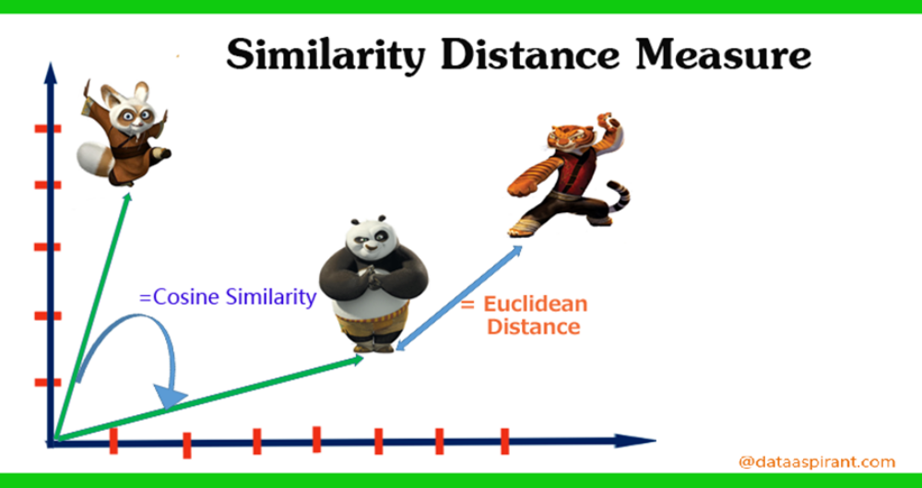

Slide 23
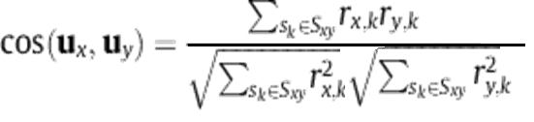
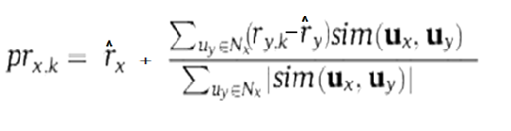
Collaborative Filtering
The cosine similarity measure treats each user as a vector in the items’ space and then takes the cosine of the angle between the two vectors as a similarity measure between the two users
Prediction formula

Slide 24
Evaluation
MAE
RMSE
Precision
Recall
F1

Slide 25
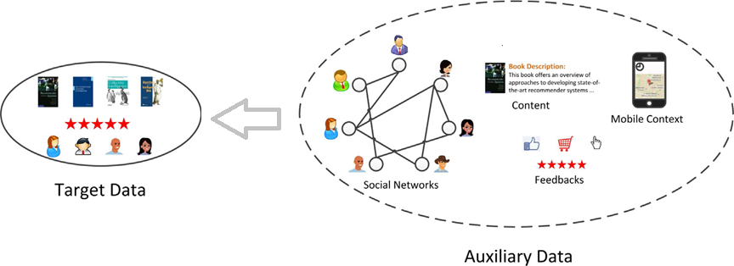
Transfer learning
Transfer learning is motivated by the fact that people can intelligently apply knowledge learned previously to solve new problems faster or with better solutions .

Slide 26
Context Aware RS (CARS)
“Context is any information that can be used to characterize the situation of entities”.
Applying this to a recommendation scenario, context can be considered as any feature that affects a user’s or an item’s situation, such as the time of day, day of the week, location, weather, mood, presence of other users, and many others .
Context aware RS helps in implementing the organization's digital marketing strategy by providing personalized recommendations in real time, depending on the context of individuals

Slide 27
Cross Domain RS ( CDRS)
If I knew you liked Harry Potter Books , Should I recommend you Avenger End Game movie !
There could be dependencies and correlations between preferences in different domains and instead of treating each type of items independently, user knowledge acquired in one domain could be transferred and exploited in several other domains.
Helps in solving cold start problems and sparsity problems , though it is a direct threat to privacy

Slide 28



Gray Sheep users
GS are the users who partially agree/disagree with other users and have low correlation coefficient with almost all users
These GS users themselves do not benefit much from the system but their presence also diminishes the quality of the recommendations made to the rest of the users in the system
Identification of GS is important to improve the quality of recommendation for rest of the user. It can also help in intervention for making better recommendations to GS users

Slide 29
Influential Users
In RecSys, there might be a set of users who help a large number of other users to receive recommendations. These users are known as most influential users
Shilling attacks !

Slide 30
product/productId: B003AI2VGA
review/userId: A141HP4LYPWMSR
review/profileName: Brian E. Erland "Rainbow Sphinx"
review/score: 3.0
review/time: 1182729600
review/text: On the daily trek from Juarez, Mexico to El Paso, Texas an ever increasing number of female workers are found raped and murdered in the surrounding desert. Investigative reporter Karina Danes (Minnie Driver) arrives from Los Angeles to pursue the story and angers both the local police and the factory owners who employee the undocumented aliens with her pointed questions and relentless quest for the truth.<br /><br />Her story goes nationwide when a young girl named Mariela (Ana Claudia Talancon) survives a vicious attack and walks out of the desert crediting the Blessed Virgin for her rescue. Her story is further enhanced when the "Wounds of Christ" (stigmata) appear in her palms. She also claims to have received a message of hope for the Virgin Mary and soon a fanatical movement forms around her to fight against the evil that holds such a stranglehold on the area.<br /><br />Critique: Possessing a lifelong fascination with such esoteric matters as Catholic mysticism, miracles and the mysterious appearance of the stigmata, I was immediately attracted to the '05 DVD release `Virgin of Juarez'. The film offers a rather unique storyline blending current socio-political concerns, the constant flow of Mexican migrant workers back and forth across the U.S./Mexican border and the traditional Catholic beliefs of the Hispanic population. I must say I was quite surprised by the unexpected route taken by the plot and the means and methods by which the heavenly message unfolds.<br /><br />`Virgin of Juarez' is not a film that you would care to watch over and over again, but it was interesting enough to merit at least one viewing. Minnie Driver delivers a solid performance and Ana Claudia Talancon is perfect as the fragile and innocent visionary Mariela. Also starring Esai Morales and Angus Macfadyen (Braveheart).

Slide 31
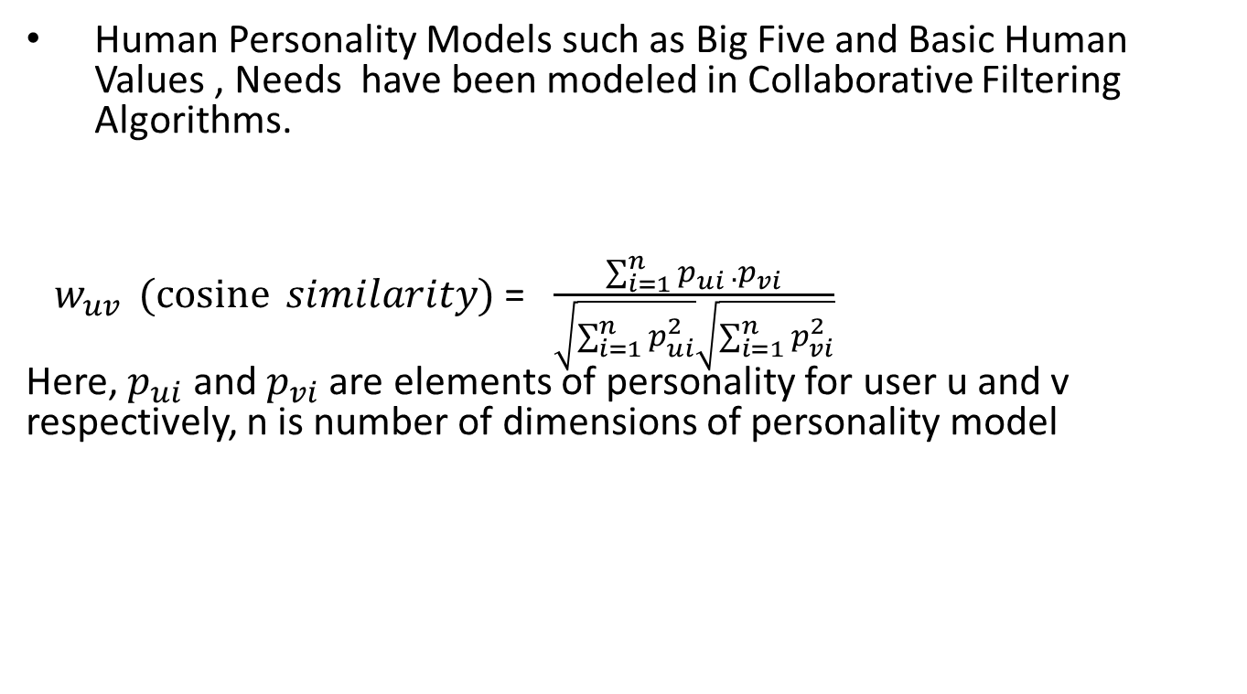
User Modeling
Human Personality Models such as Big Five and Basic Human Values , Needs have been modeled in Collaborative Filtering Algorithms.
${ w}_{uv } (\operatorname{cosine}{ similarity)}$=$\frac{\sum_{i=1}^{n}{p_{ui }.p_{vi}}}{\sqrt{\sum_{i=1}^{n}{p_{ui}^{2}}}\sqrt{\sum_{i=1}^{n}{p_{vi}^{2}}}}$ Here,${ p}_{ui}$ and $p_{vi}$ are elements of personality for user u and v respectively, n is number of dimensions of personality model

Slide 32








User Modeling
Five Factor Model (Big Five) defines five personality traits ,
Openness | Curious , open to new ideas
Conscientiousness | Organized, Systematic , self-discipline,
Extraversion | Outgoing , Sociable
Agreeableness | general concern for social harmony, generous
Neuroticism | tendency to experience negative emotions, like anger, anxiety, or depression

Slide 33
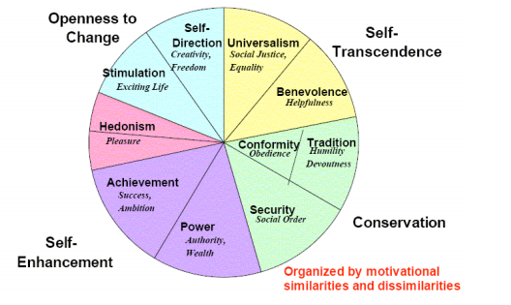
User Modeling
Basic Human Values - As defined by Schwartz values are “desirable, transsituational goals, varying in importance, that serve as guiding principles in people's lives” (Schwartz et al 1995)( Schwartz, 2012).
Five dimensions of basic human values - the circumplex structure in Schwartz’ Value Theory indicates relations of conflict and congruity across values. The closer any two values are to one another, the more similar their underlying motivations, and vice versa.,
Schwartz, S., and Huismans, S. (1995). Value priorities and religiosity in four western religions. Social Psychology Quterly.
Schwartz, S. H. (2012). An Overview of the Schwartz Theory of Basic Values. Online Readings in Psychology and Culture, 2(1).

Slide 34
Value | Defining Goal
Self-Direction | independent thought and action--choosing, creating, exploring
Stimulation | excitement, novelty, and challenge in life
Hedonism | pleasure or sensuous gratification for oneself
Achievement | personal success through demonstrating competence according to social standards
Power | Social status and prestige, control or dominance over people and resources.
Security | Safety, harmony, and stability of society, of relationships, and of self.
Conformity | restraint of actions, inclinations, and impulses likely to upset or harm others and violate social expectations or norms
Tradition | respect, commitment, and acceptance of the customs and ideas that one's culture or religion provides
Benevolence | preserving and enhancing the welfare of those with whom one is in frequent personal contact
Universalism | Social justice , Equality , Welfare for all
Basic Human Values and their defining goal

Slide 35
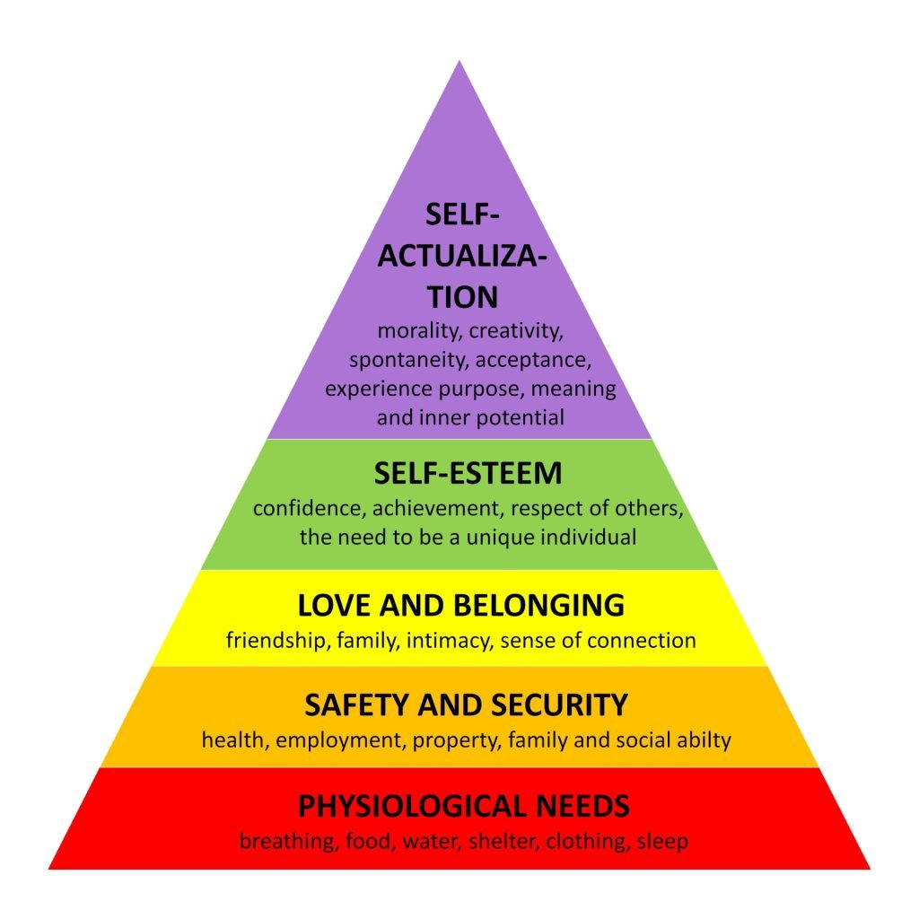

Slide 36
Structure | This need is about routine, consistency, system-aticity, and predictability. It is “the need for things to be well organized and under control”.
Practicality | This need is about getting the job done, skill and efficiency. It also covers physical expression and experience, a celebration of the senses and the physical world
Challenge | This need includes: (1) the urge for a personal sense of achievement by voluntarily taking up a challenge; (2) the urge for victory over an opponent; and (3) the urge for “authority and status or prestige .
Self-expression | This need is about expressing one’s “ego,strength and independence” through external actions
Excitement | This need is about getting out there and living life, upbeat emotions, high energy, having fun
Curiosity | This need is about the desire to discover and learn,“curiosity for its own sake”.
Liberty | This need is about the thirst to have control over one’s own actions without constraints, “a sense of total possibility and new things”.
Ideals | This need includes: (1) the desire for refinement of style: “glamour and seduction, sophistication and elitism”; (2) the desire for refinement of principle, “a sense of community and responsible progress”; (3) the desire for refined spiritual development.
Harmony | This need is about appreciating and respecting “other people, their viewpoints and their feelings”.
Love | “This need is all about social contact, whether one to one or one to many”.
Closeness | This need is about the desire to nurture and to be nurtured, the sense of belonging.
Stability | This need is about physical security and control,reliability. “It has the sense of something sensible, tried and tested, with a good track record and a known history.”
User Modeling using User Needs ( desires that a person hopes to fulfill when considering a product or service) .

Slide 37
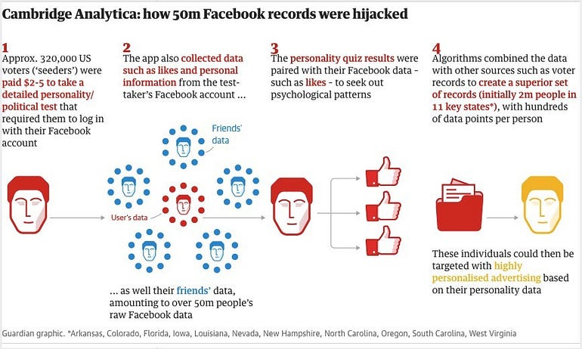
https://www.vice.com/en/article/mg9vvn/how-our-likes-helped-trump-win

Slide 38
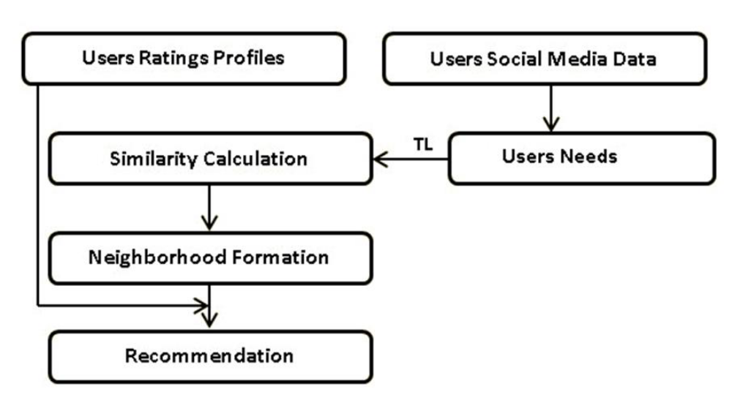

Slide 39
How to do it practically at commercial level ?

Slide 40
Shopify
https://apps.shopify.com/recommendation-kit

Slide 41
Woocommerce (WordPress)
https://wordpress.org/plugins/warp-driven-visual-search/
https://wordpress.org/plugins/perzonalization/

Slide 42
Prestashop
https://addons.prestashop.com/en/cross-selling-product-bundles/89262-frequently-bought-together.html
https://addons.prestashop.com/en/cross-selling-product-bundles/51890-recommendation-of-similar-looking-products.html

Slide 43
Amazon
https://aws.amazon.com/personalize/

Slide 44


Slide 45
Filter Bubble
Potential for online personalization to effectively isolate people from a diversity of viewpoints or content.
A self-reinforcing pattern of narrowing exposure that reduces user creativity, learning, and connection (Eli Pariser).
More than 80% of content viewed on the platform is discovered through personalized recommendations.
RecSys no doubt reduces lower users’ decision effort, (also improve users’ decision quality!)

Slide 46
Beyond Accuracy

Slide 47
Privacy concerns
information
Privacy Paradox !

Slide 48
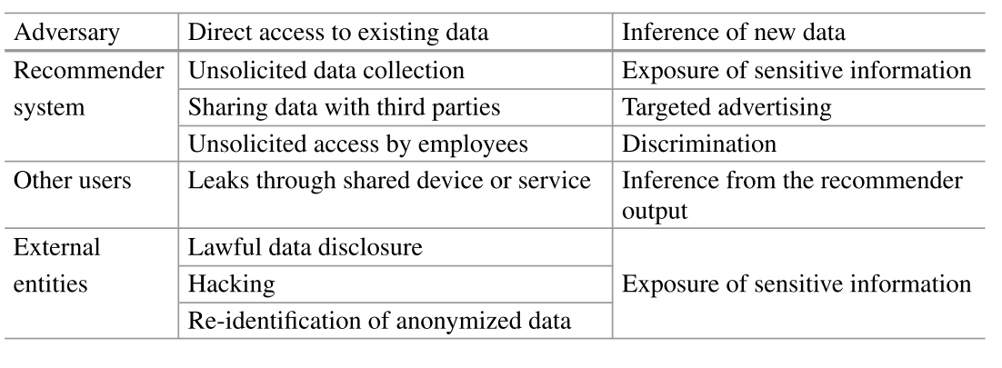


Slide 49
Fair Information Practices (FIPS)
Collection Limitation: Data should be collected within limits, by lawful and fair means and with consent (where appropriate).
Data Quality: Data should be relevant, accurate, complete and kept up-to-date.
Purpose Specification: The purposes of collection should be specified at the time of collection.
Use Limitation: Data should not be used or disclosed for other purposes except with consent or by the authority of law.
Security Safeguards: Personal data should be protected against unauthorized access, destruction, use, modification or disclosure.
Openness: Users should be able to know what data is being collected, who controls the data, and for what purposes they are used.
Individual Participation: An individual should be allowed to inspect the collected data about themselves, and have them erased, rectified, completed or amended.
Accountability: The collector of the data should be accountable for complying with the above measures.

