Slide 1
How to learn any tool ?

Slide 2
Purpose & Use cases
Desktop / Web based / hybrid
GUI / Command line / Script / Hybrid
Who made it (esp. if it’s opensource)
Input
Process
Output
Data types & Structures ( default , user defined)
Documentation / Help/ Forums
ChatGPT / Copilot

Slide 4
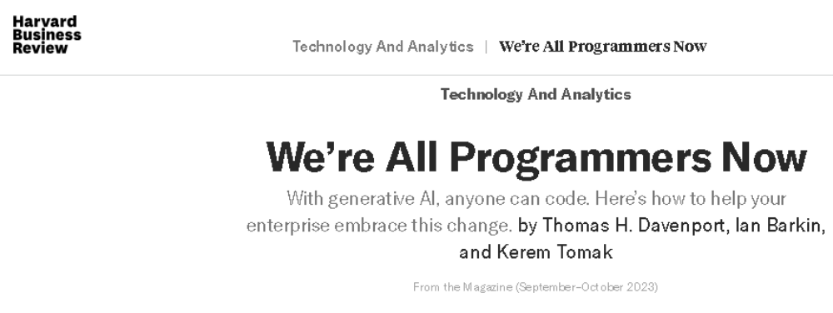
https://hbr.org/2023/09/were-all-programmers-now

Slide 6
INPUT
PROCESS
OUTPUT

Slide 7
Input
Read different kind of data from different types of files, locations, devices, other programs.
Take Input from user

Slide 8
Process
Use various expressions for calculations.
Write your own function which can be called whenever required
Use third party libraries/packages for readily available functions.
Use loops for iterating some task.
Use Control statements for taking decisions

Slide 9
Output
Save the calculated results in different types of files, locations, send to other programs.
Show the results on screen
Send it to printer or any other devices.

Slide 10
R101
R Base
R Studio
R as a calculator
Data Types
Data Structures
Flow Control (Conditions and Loops)
Packages
Descriptive Stats

Slide 11
Before diving in…
It is case sensitive
<- used for assignment
+ prompted by by R, after giving a command means that R is still waiting for your input
R is interpreted language
help.start() is good to go to home page of documentation , while help(“functionname”) / ? Function name, takes you directly to that function’s help
Ctrl + L , gives you a fresh start ☺
q() to quit !

Slide 12
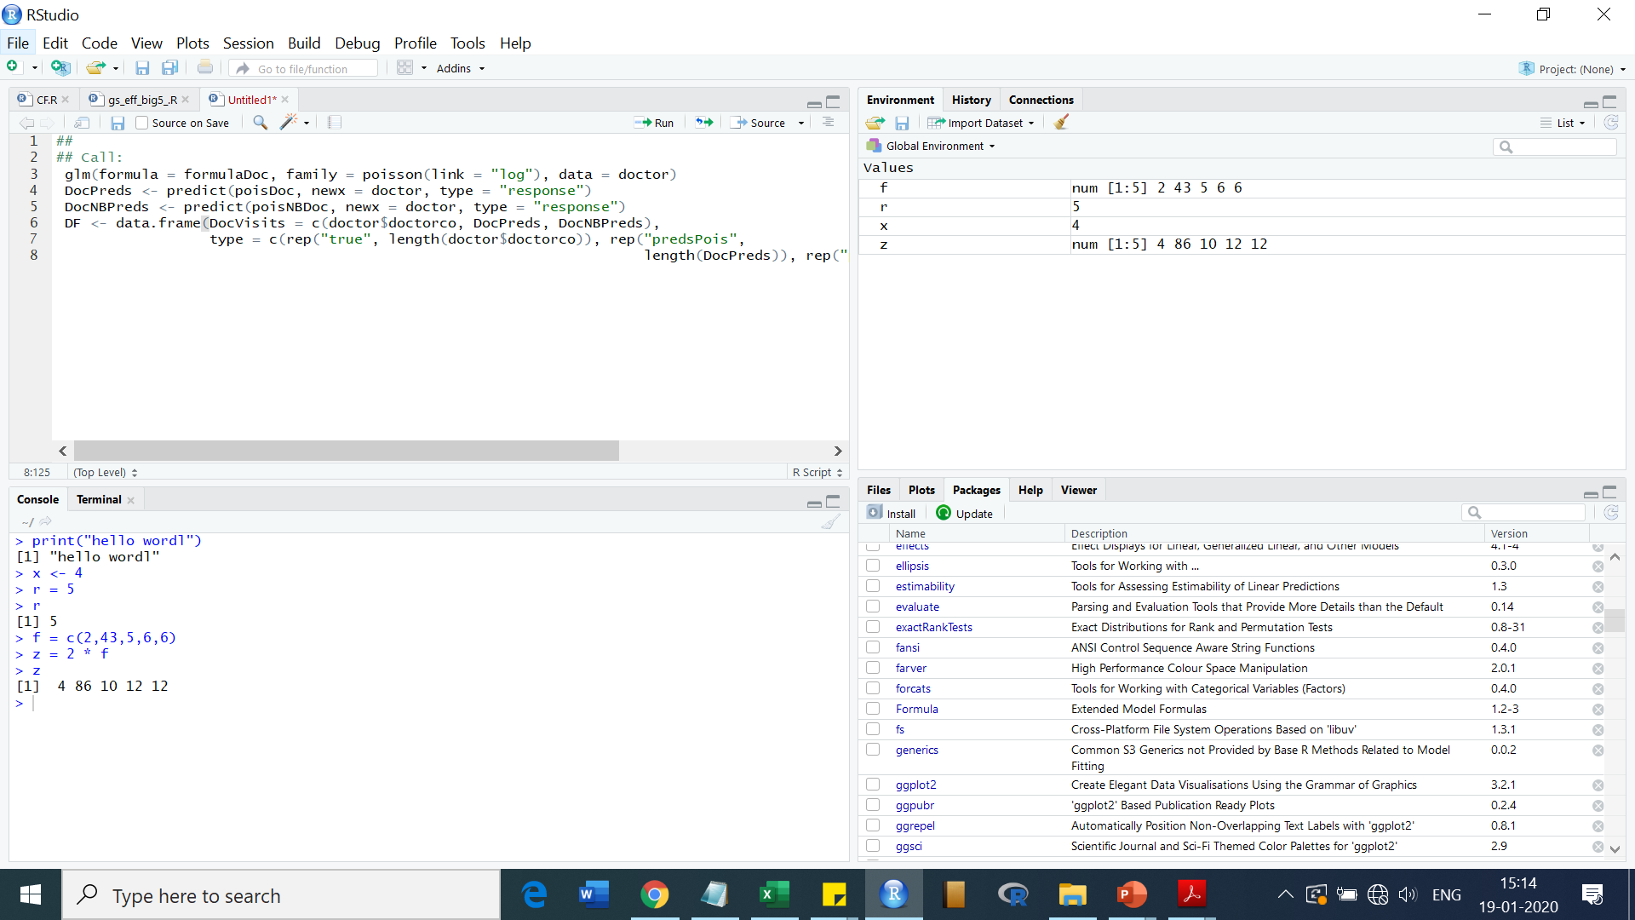
(Script section)
(Data section)
(Plot, Packages and Help Section)
(Console section)

Slide 13
R Studio has four main window sections:
Top-Left Section: To write and save R code (Script section)
Bottom-Left Section: To execute R code and doing calculations. The nature and values of all variables and objects appear here (Console section)
Top-Right Section: To manage datasets and variables (Data section)
Bottom-Right Section: To display plots ,installed packages and seek help on R functions (Plot, Packages and Help Section)

Slide 14
R as a calculator
# Basic mathematical operation
6546+7657-759
#power function(^)
12^3
#square root
sqrt(64)
sqrt(-54)
#factorial function
factorial(5)
Notes:
In RGui

Slide 15
R as a calculator…
#Absolute function (+ve)
abs(54+76-54/43)
#Round function
round(43.8)
#Floor Function
floor(43.8)
#Ceiling function
ceiling(43.8)

Slide 16
R as a calculator…
#Trigonometric function
sin(30)
cos(30)
tan(45)
#Logarithmic function log(x,base)
log10(2)
log(100,5)
log2(42)
log(25)
Notes:
sin(30*pi/180)

Slide 17
R as a calculator…
#Date and time
Sys.time()
Sys.Date()
#date diff
startdate <- as.Date("2022-03-01")
Sys.Date()- startdate
startdate +45
Notes:
Code to calculate difference !

Slide 18
Data Types
Different kinds of values are assigned different data types that help differentiate them.
They have certain characteristics and rules associated with them that define their properties.
Numeric
Integers
Complex
Logical
Characters

Slide 19
Numeric Data Type
Default data type for numbers in R.
Double
# this is a comment
num1 <- 45
num1
class(num1)
Notes:
R provides class() functions to find out what is the class any variable.
When R stores a number in a variable, it converts the number into a ‘double’ value or a decimal type with at least two decimal places. This means that a value such as ’1’ is stored as 1.00 with a type of double and a class of numeric.

Slide 20
Integers Data Type
Used for integer values
Discrete
Int1 <- as.integer(12)
class(int)
Converting numeric to integer
num1 <-37.54
int2 <- as.integer(num1)
int2
class(int2)
We can also use L to indicate as integer
Int3 <- 47L

Slide 21
Complex Data Type
comp1 <- 34+6i
comp1
class(comp1)

Slide 22
Logical Data Type
TRUE / FALSE
logi1 <- TRUE
class(logi1)

Slide 23
Character Data Type
stores character values or strings.
alphabet, numbers, and symbols “abhi32@”
wrap the value inside single or double inverted commas.
char1 <- “testabcd123“
class(char1)

Slide 24
Conversion into Numeric
We can use the as.numeric function to convert the values of other data types into numerical values. The conversion follows a few rules, which are:
To convert an integer value into a numeric, we can use the as.numeric function.
We can convert a complex value into numeric by using the function. This removes the imaginary part of the number.
Logical values can be converted into numeric as well by the function. The TRUE value is converted to 1, and FALSE is converted to 0.
Character values can similarly be converted into numerical values but if the string contains letters, alphabets, and symbols then the numeric value becomes NA.

Slide 25
Conversion into Integer
Numeric values can be converted into an integer using the function. This removes any decimal values from the number.
Complex values can also be converted into integers. The function removes the imaginary parts of the number.
The conversion from logical values to integers is similar to the conversion of logical values to numerics. TRUE is converted to 1, and FALSE is converted to 0.
Character values can be converted into integers as well by using the as.integer function. This conversion follows the same rules as the character to numeric conversion.

Slide 26
Conversion into Complex
Using the as.complex function, we can convert other values into the complex data types. The conversion takes place according to the following rules:
Numeric values can be converted into complex by using the as.complex function or by adding an imaginary part to it.
Integer value can also be converted into complex values similarly.
Logical values become 0+0i for FALSE and 1+0i for TRUE when converted into complex values using the as.complex function. We can also convert a logical value into a complex value by adding an imaginary part to it.
The conversion from a character to a complex is the same as the conversion from character to numeric or an integer with 0i added to the converted value if it is not NA.

Slide 27
Conversion into Logical
Numeric, integer, and complex values can be converted into logical values, but the function returns FALSE if the value is zero and TRUE if it is anything else.
Character values when converted by the as.logical function, always return NA.

Slide 28
Conversion into character
convert a value of any data type into character data type using the as.character function
converts the original value into a character string.
Notes:
NA values have no type and therefore stay as such when converted to any type.

Slide 29
I/O
# string input
var1 = readline(prompt = "Enter your name : ");
print(var1)
# numeric input
var2 = readline("Enter any number : ");
var2 = as.integer(var2);
print(var2)

Slide 30
Take age as input from user and print age that will be after 10 years

Slide 31
my.age <- readline(prompt="Enter age: ")
# convert character into integer
my.age <- as.integer(my.age)

Slide 32
Flow Control (Conditions and Loops)
x <- -10
if(x > 0){
print("Non-negative number")
} else {
print("Negative number")
}

Slide 33
For loop
x <- c(5,3,6,8,14,19,23)
count <- 0
for (val in x) {
if(val %% 2 == 0) count = count+1
}
print(count)

Slide 34
While…
i <- 1
while (i < 6) {
print(i)
i = i+1
}

Slide 35
Write a program to accept a number from user and print it’s multiplication table

Slide 36
# R Program to find the multiplication table (from 1 to 10)
# take input from the user
num = as.integer(readline(prompt = "Enter a number: "))
# use for loop to iterate 10 times
for(i in 1:10) {
print(paste(num,'x', i, '=', num*i))
}

Slide 37
Data Structures

Slide 38
Vectors
R operates on named data structures. The simplest such structure is the vector, which is a single entity consisting of an ordered collection of different atomic vectors, also termed as six classes of vectors.
lists of same type of data
R is also called Vectorized language

Slide 39
Hands on Vector

Slide 40
Data frame
A data frame is a table or a two-dimensional array-like structure in which each column contains values of one variable and each row contains one set of values from each column. Unlike a matrix in data frame each column can contain different modes of data.
Data frames are generally created by reading in a dataset using importing of different files from other software’s.
We can extract specific column from a data frame using $ sign succeeded by column name or by a column number, while a row can be extracted by specifying the row numbers only.
Different functions like str, colnames, rownames, summary etc. can be used on a data frame to view the details.

Slide 41
Hands on Data Frames

Slide 42
Other data structures
Lists ( can have different data types)
Matrices ( 2 dimensional, Usually same data types)
Arrays( multiple dimensional , same data type)

