Slide 1
How to learn any tool ?

Slide 2
Purpose & Use cases
Desktop / Web based / hybrid
GUI / Command line / Script / Hybrid
Who made it (esp. if it’s opensource)
Input
Process
Output
Data types & Structures ( default , user defined)
Documentation / Help/ Forums
ChatGPT / Copilot

Slide 3
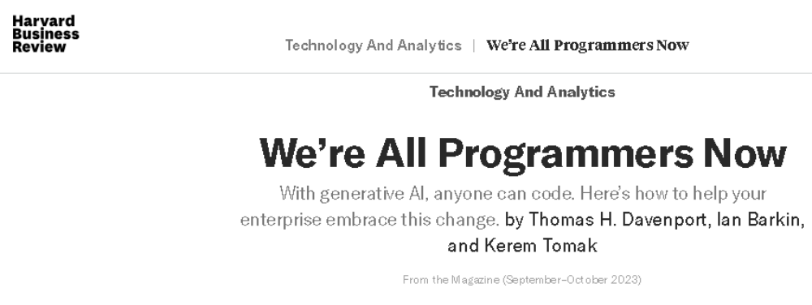
https://hbr.org/2023/09/were-all-programmers-now

Slide 4
R101
R Base
R Studio
R as a calculator
Data Types
Data Structures
Flow Control (Conditions and Loops)
Packages
Descriptive Stats

Slide 5
Before diving in…
It is case sensitive
<- used for assignment
+ prompted by by R, after giving a command means that R is still waiting for your input
R is interpreted language
help.start() is good to go to home page of documentation , while help(“functionname”) / ? Function name, takes you directly to that function’s help
Ctrl + L , gives you a fresh start ☺
q() to quit !

Slide 6
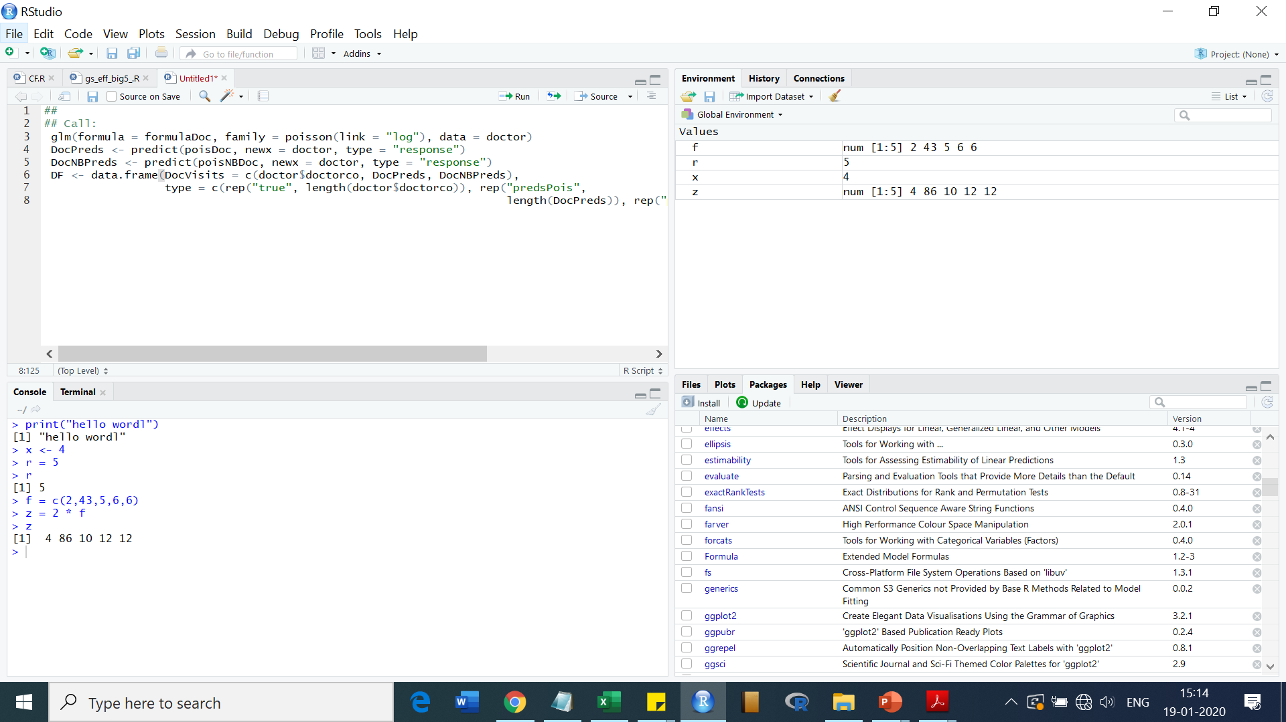
(Script section)
(Data section)
(Plot, Packages and Help Section)
(Console section)

Slide 7
R Studio has four main window sections:
Top-Left Section: To write and save R code (Script section)
Bottom-Left Section: To execute R code and doing calculations. The nature and values of all variables and objects appear here (Console section)
Top-Right Section: To manage datasets and variables (Data section)
Bottom-Right Section: To display plots ,installed packages and seek help on R functions (Plot, Packages and Help Section)

Slide 8
R as a calculator
# Basic mathematical operation
6546+7657-759
#power function(^)
12^3
#square root
sqrt(64)
sqrt(-54)
#factorial function
factorial(5)
Notes:
In RGui

Slide 9
R as a calculator…
#Absolute function (+ve)
abs(54+76-54/43)
#Round function
round(43.8)
#Floor Function
floor(43.8)
#Ceiling function
ceiling(43.8)

Slide 10
R as a calculator…
#Trigonometric function
sin(30)
cos(30)
tan(45)
#Logarithmic function log(x,base)
log10(2)
log(100,5)
log2(42)
log(25)
Notes:
sin(30*pi/180)

Slide 11
R as a calculator…
#Date and time
Sys.time()
Sys.Date()
#date diff
startdate <- as.Date("2022-03-01")
Sys.Date()- startdate
startdate +45
Notes:
Code to calculate difference !

Slide 12
Data Types
Different kinds of values are assigned different data types that help differentiate them.
They have have certain characteristics and rules associated with them that define their properties.
Numeric
Integers
Complex
Logical
Characters

Slide 13
Numeric Data Type
Default data type for numbers in R.
Double
# this is a comment
num1 <- 45
num1
class(num1)
Notes:
R provides class() functions to find out what is the class any variable.
When R stores a number in a variable, it converts the number into a ‘double’ value or a decimal type with at least two decimal places. This means that a value such as ’1’ is stored as 1.00 with a type of double and a class of numeric.

Slide 14
Integers Data Type
Used for integer values
Discrete
Int1 <- as.integer(12)
class(int)
Converting numeric to integer
num1 <-37.54
int2 <- as.integer(num1)
int2
class(int2)
We can also use L to indicate as integer
Int3 <- 47L

Slide 15
Complex Data Type
comp1 <- 34+6i
comp1
class(comp1)

Slide 16
Logical Data Type
TRUE / FALSE
logi1 <- TRUE
class(logi1)

Slide 17
Character Data Type
stores character values or strings.
alphabet, numbers, and symbols “abhi32@”
wrap the value inside single or double inverted commas.
char1 <- “testabcd123“
class(char1)

Slide 18
Conversion into Numeric
We can use the as.numeric function to convert the values of other data types into numerical values. The conversion follows a few rules, which are:
To convert an integer value into a numeric, we can use the as.numeric function.
We can convert a complex value into numeric by using the function. This removes the imaginary part of the number.
Logical values can be converted into numeric as well by the function. The TRUE value is converted to 1, and FALSE is converted to 0.
Character values can similarly be converted into numerical values but if the string contains letters, alphabets, and symbols then the numeric value becomes NA.

Slide 19
Conversion into Integer
Numeric values can be converted into an integer using the function. This removes any decimal values from the number.
Complex values can also be converted into integers. The function removes the imaginary parts of the number.
The conversion from logical values to integers is similar to the conversion of logical values to numerics. TRUE is converted to 1, and FALSE is converted to 0.
Character values can be converted into integers as well by using the as.integer function. This conversion follows the same rules as the character to numeric conversion.

Slide 20
Conversion into Complex
Using the as.complex function, we can convert other values into the complex data types. The conversion takes place according to the following rules:
Numeric values can be converted into complex by using the as.complex function or by adding an imaginary part to it.
Integer value can also be converted into complex values similarly.
Logical values become 0+0i for FALSE and 1+0i for TRUE when converted into complex values using the as.complex function. We can also convert a logical value into a complex value by adding an imaginary part to it.
The conversion from a character to a complex is the same as the conversion from character to numeric or an integer with 0i added to the converted value if it is not NA.

Slide 21
Conversion into Logical
Numeric, integer, and complex values can be converted into logical values, but the function returns FALSE if the value is zero and TRUE if it is anything else.
Character values when converted by the as.logical function, always return NA.

Slide 22
Conversion into character
convert a value of any data type into character data type using the as.character function
converts the original value into a character string.
Notes:
NA values have no type and therefore stay as such when converted to any type.

Slide 23
I/O
# string input
var1 = readline(prompt = "Enter your name : ");
print(var1)
# numeric input
var2 = readline("Enter any number : ");
var2 = as.integer(var2);
print(var2)

Slide 24
Take age as input from user and print age that will be after 10 years

Slide 25
my.age <- readline(prompt="Enter age: ")
# convert character into integer
my.age <- as.integer(my.age)

Slide 26
Flow Control (Conditions and Loops)
x <- -10
if(x > 0){
print("Non-negative number")
} else {
print("Negative number")
}

Slide 27
For loop
x <- c(5,3,6,8,14,19,23)
count <- 0
for (val in x) {
if(val %% 2 == 0) count = count+1
}
print(count)

Slide 28
While…
i <- 1
while (i < 6) {
print(i)
i = i+1
}

Slide 29
Write a program to accept a number from user and print it’s multiplication table

Slide 30
# R Program to find the multiplication table (from 1 to 10)
# take input from the user
num = as.integer(readline(prompt = "Enter a number: "))
# use for loop to iterate 10 times
for(i in 1:10) {
print(paste(num,'x', i, '=', num*i))
}

Slide 31

Inbuilt Datasets
Sir Ronald Aylmer Fisher

Slide 32
# Store the data in the variable my_data
my_data <- iris
head(my_data, 6)
tail(my_data,21)

Slide 33
# Compute the mean value
mean(my_data$Sepal.Length)
# Compute the median value
median(my_data$Sepal.Length)
# Compute the mode # install.packages("modeest") require(modeest)
mfv(my_data$Sepal.Length)
# Compute the minimum value
min(my_data$Sepal.Length)
# Compute the maximum value
max(my_data$Sepal.Length)
# Range
range(my_data$Sepal.Length)
#Inter quantile range
IQR(my_data$Sepal.Length)

Slide 34
quantile(my_data$Sepal.Length)
0% 25% 50% 75% 100%
4.3 5.1 5.8 6.4 7.9
Deciles
quantile(my_data$Sepal.Length, seq(0, 1, 0.1))
# Compute the variance
var(my_data$Sepal.Length)
# Compute the standard deviation =
# square root of th variance
sd(my_data$Sepal.Length)
The median absolute deviation (MAD) measures the deviation of the values, in the data, from the median value.
# Compute the median
median(my_data$Sepal.Length)
# Compute the median absolute deviation
mad(my_data$Sepal.Length)

Slide 35
summary(my_data$Sepal.Length)
summary(my_data, digits = 1)

Slide 36
Data Structures

Slide 37
Vectors
R operates on named data structures. The simplest such structure is the vector, which is a single entity consisting of an ordered collection of different atomic vectors, also termed as six classes of vectors.
lists of same type of data
R is also called Vectorized language

Slide 38
Hands on Vector

