Slide 1
Story of Work

Slide 3
What is RPA !
RPA is a category of software tools that enable complex digital processes to be automated by performing them in the same way a human user might perform them, using the user interface and following a set of predefined rules
What sets RPA apart from other automation technologies is that its ability to imitate a human user of one or more information systems reduces development time and extends the range of functions that can be automated across a much wider range of business activities.

Slide 4
Some example
automate financial processes, such as comparing invoices with shipment notices, or
transferring data from email and call center speech-to-text systems into transactional systems of record.

Slide 5
RPA in Actions – IBM

Slide 7
Observations

Slide 8
RPA in Actions for even more complicated task through UIPath

Slide 10
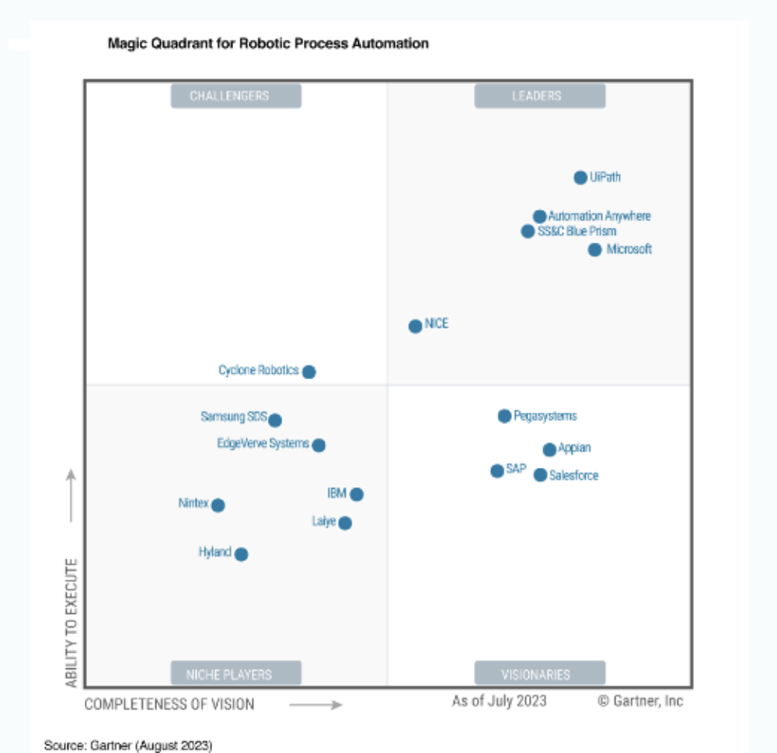

Slide 11

Citizen developer!
A citizen developer is a business user who can automate tasks without being a coding expert.
They have a good understanding of business processes and can pinpoint areas suitable for automation
https://www.uipath.com/rpa/what-is-citizen-development.

Slide 12
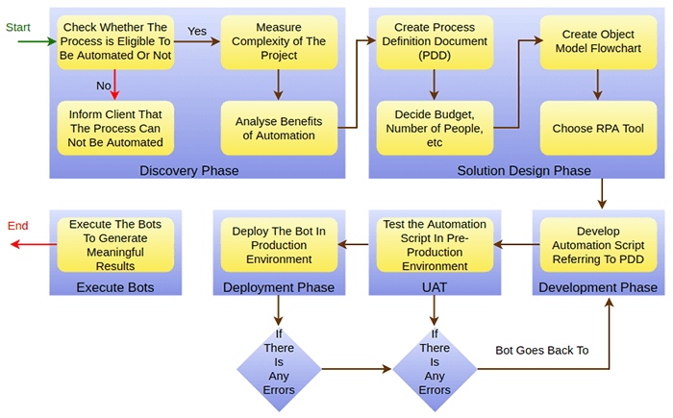
© www.javatpoint.com

Slide 13
RPA Process Assessment Checklist
To ensure that the business process is not overly complicated, limiting the potential of a fragile bot prone to outages and errors.
To verify that the bot isn’t vulnerable with too many system dependencies that increase complexity and the potential for downtime
or is tied to a system that is on the roadmap to be changed or upgraded in the near-term.
Increased operational efficiency, cost reduction, improved compliance, and a better customer and employee experience

Slide 14
Technical Suitability
he process is well-defined, standardized, and documented.
The process is repetitive. The same steps are completed every time the process is executed with little variance, regardless of who is performing it.
The process is mechanical, based on a clear set of rules, and requires minimal discretionary human decision-making.
The process is executed completely digitally by employees.

Slide 15
System Dependencies
The process does not interact with systems that will be changed in the near-term.
The process does not interact with more than four systems. Processes with increased dependency complexities increase the risk of break-fix cycles and RPA downtime.

Slide 16
Regulatory Compliance Impact
The process is tied to regulatory requirements and constraints. Automating the process would decrease the risk of non-compliance.

Slide 17
Return-on-Investment (ROI) Impact
The process is a high-volume, common process that is executed repeatedly by employees today.
The process is executed by multiple full-time employees (FTE). Automating the process would enable these employees to dedicate their time to more value-added, critical activities.
Automating the process ensures process velocity would increase. The bot would execute the process much quicker than an employee takes to perform it.
The process is error-prone when executed by humans. Automating the process would lead to a higher quality of output and significantly reduce errors.
The process can be executed 24/7, maximizing utilization.

Slide 18
Cognitive RPA
term for Robotic Process Automation (RPA) tools and solutions that leverage Artificial Intelligence (AI) technologies such as Optical Character Recognition (OCR),Computer Vision, Text Analytics, and Machine Learning to improve the experience of your workforce and customers.

Slide 19
mimics human actions while the humans are executing various tasks within a process. Such processes include :
learning (acquiring information and contextual rules for using the information),
reasoning (using context and rules to reach conclusions) and
self-correction (learning from successes and failures).

Slide 20
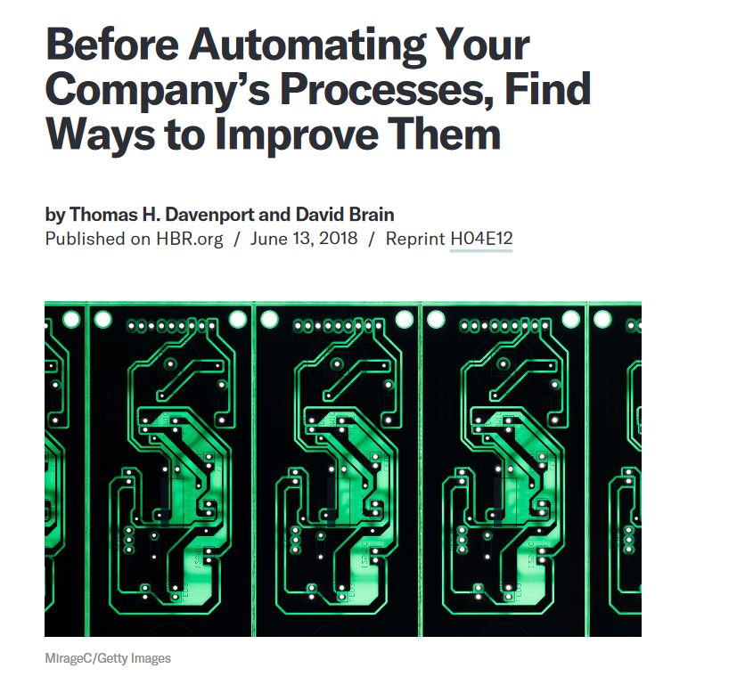

Slide 21
RPA does not redesign anything. It doesn’t ask whether we need to do this activity at all. It operates at the task level.

Slide 22
But RPA can be combined with changes in the relevant business process
The existing business process is often overly complex, with unnecessary steps that could be eliminated before RPA is implemented. RPA involves the codification of business rules, but in many cases, business rules haven’t been examined for many years and don’t make sense in the current environment.
The company may have collections of standard operating
procedures, but they are often poorly documented and out of date.

Slide 23
Is human judgment actually required in many rules ?

Slide 24
At a leading global logistics company, for example, the
business rules in a claims process suggested that decisions on tolerances for refunds required the judgment of a manager.
But when interviewed, the manager was able to clearly articulate rules of thumb he followed, which could be defined as rules for the RPA process to follow.

Slide 25
Future of Work

Slide 26



In-person service jobs are relatively safe

Slide 27

But maybe not this guy

