Slide 2
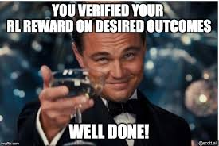
Reinforcement Learning(RL)

Slide 3
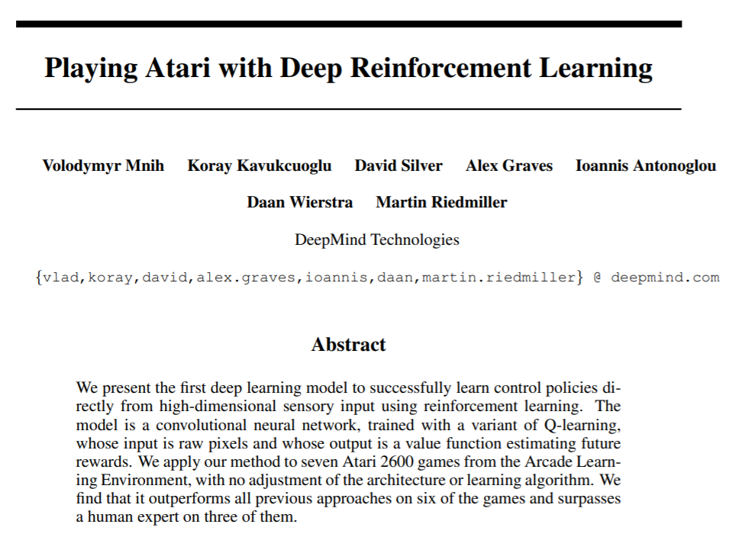

Slide 4
ML to make a sequence of decisions.
It’s about taking suitable action to maximize reward / minimize penalty in a particular situation.
Used in Self driving cars , games

Slide 5
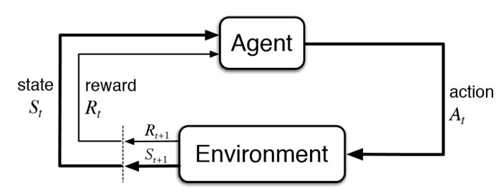

Slide 6
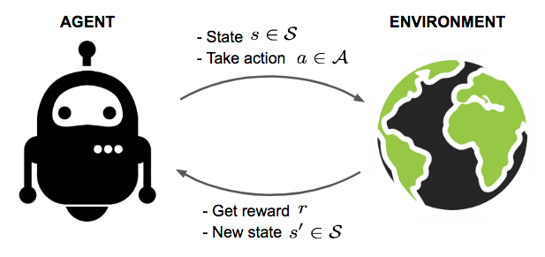
PacMan
Goal of the agent (PacMan) is to eat the food , avoid the ghosts and achieve maximum available points.
The grid world is the interactive environment for the agent.
Agent receives a reward for eating food (gets point) and punishment if it gets killed by the ghost .
The states are the location of PacMan in the grid world
Total cumulative reward is PacMan winning the game.
Deep Q-Network

