Slide 1

Questions and solutions on various aspects of working capital management

Slide 2
Working capital cycle
Example: X Company plans to attain a sales of Rs 5 crores. It has the following information for production and selling activity. It is assumed that the activities are evenly spread through out the year.
(a) Average time raw materials are kept in store prior to issue for production 2months
(b) Production cycle time or work-in-progress cycle time. 2months
(c) Average time finished stocks are kept in sale in unsold condition 0.5 months
(d) Average credit available from suppliers 1.5 months
(e) Average credit allowed to customer 1.5months
(f) Analysis of cost plus profit for above sales:
% Rs. In Crores
Raw Materials 50 2.50
Direct Labour 20 1.00
Overheads 10 0.50
Profit 20 1.00
Total 100 5.00

Slide 3
Working capital cycle - Calculation of Working Capital Requirement:
1. Total months to be financed to Raw Material Months
Time in raw material store 2
Working progress cycle 2
Finished goods store 0.5
Credit given to customer 1.5
6
Less: Credit available from suppliers 1.5 Total months to be financed to Raw Materials 4.5
2. Total months to be financed to Labour
Production cycle 2
In Finished stock store ½
Credit to customer 1 ½
Total Months to be financed 4

Slide 4
Working capital cycle - Calculation of Working Capital Requirement:
3. Total months to be financed to overhead
Production cycle 2
In finished goods stores ½
Credit to customer 1½
4
Less: Credit from suppliers 1½
Total months to be financed 2 ½
4. Maximum working capital required Rs in crores
Raw Materials 4 ½ / 12 × 2.50 0.94
Direct Labour 4 / 12 × 1.00 0.33
Overheads 2 ½ × 0.50 0.10
Maximum Working Capital 1.37

Slide 5
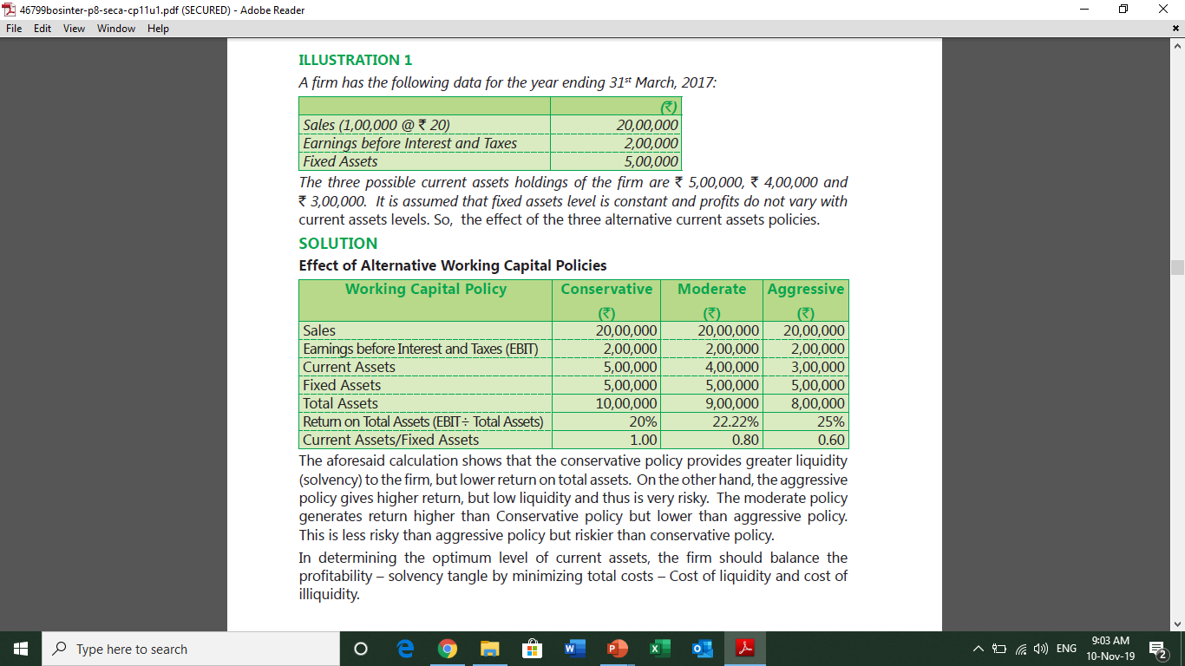
Question 1

Slide 6
Solution 1

Slide 7
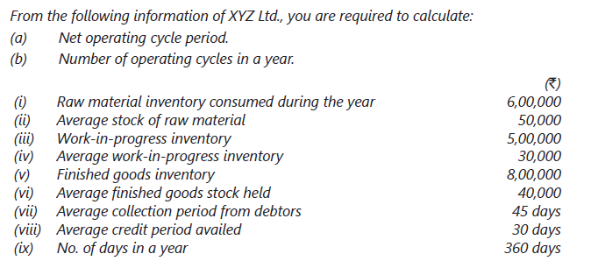
Question 2

Slide 8
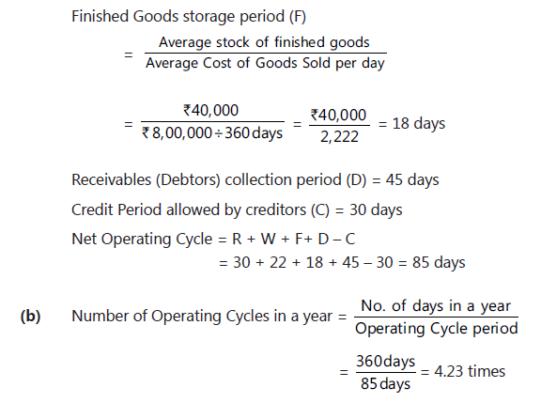
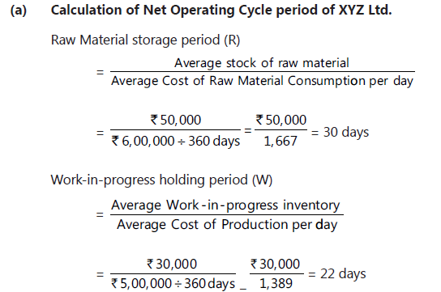
Solution 2

Slide 9
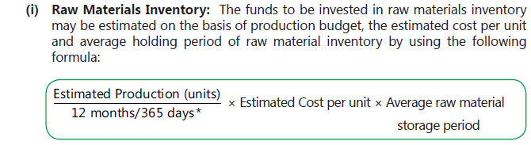
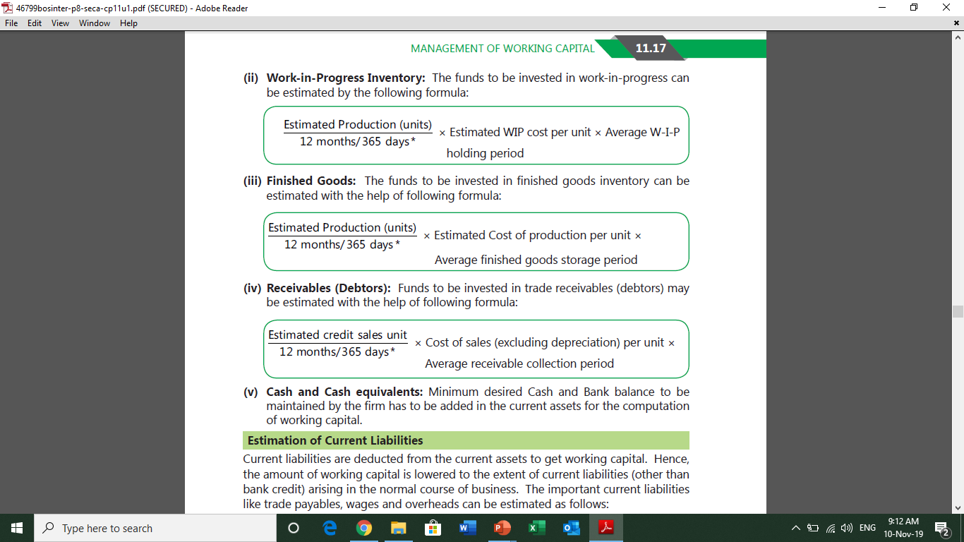
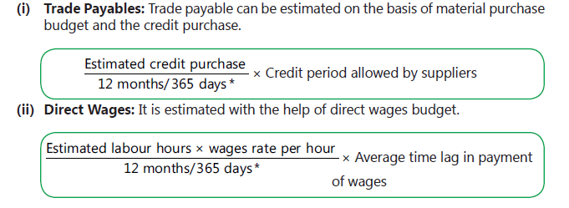
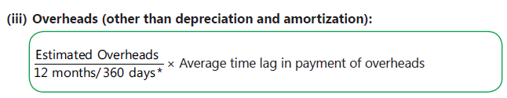
The estimates of various components of working capital may be made as follows

Slide 10
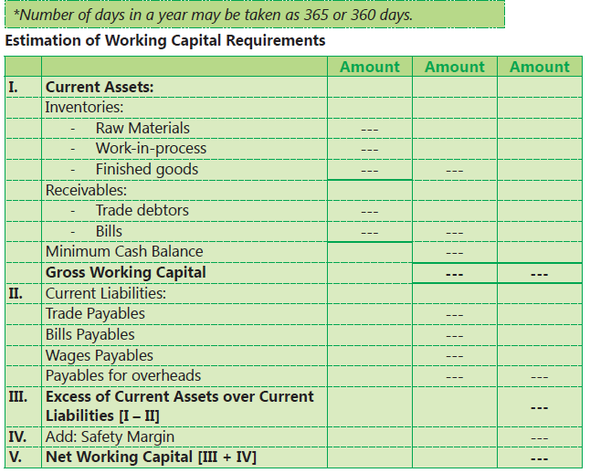

Slide 11
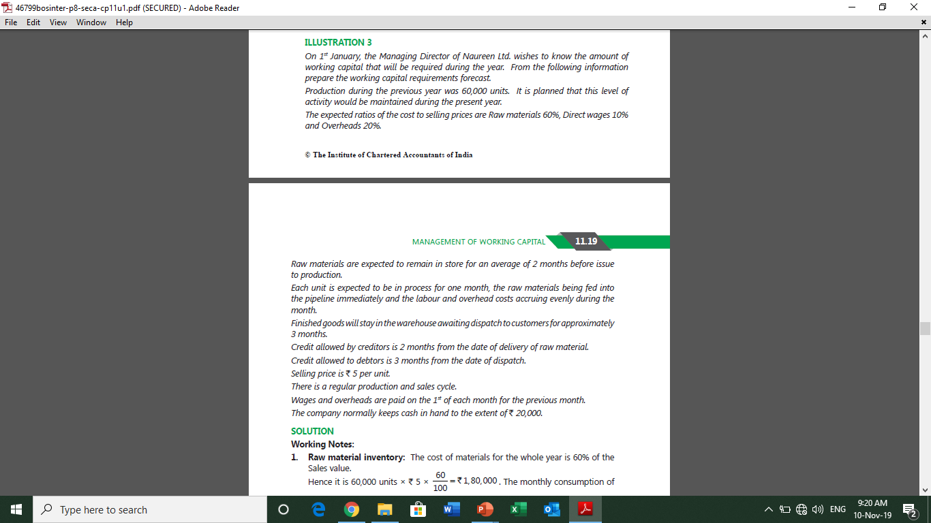
Question 3

Slide 12
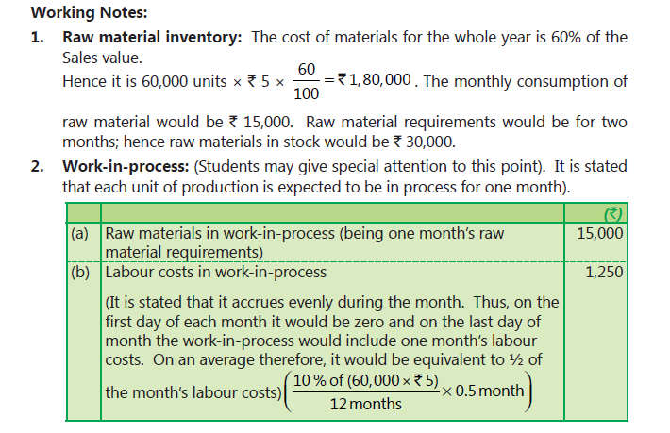
Solution 3

Slide 13
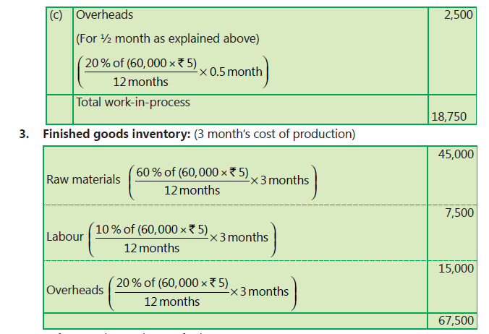

Slide 14
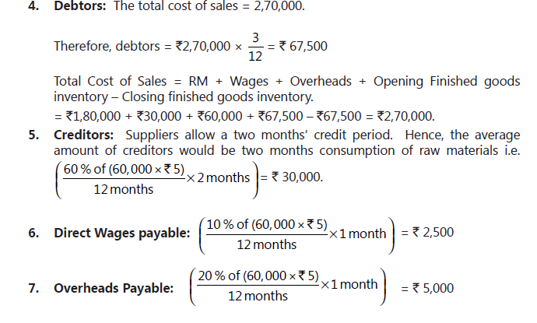

Slide 15
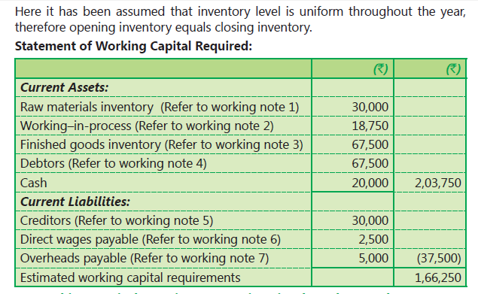

Slide 16
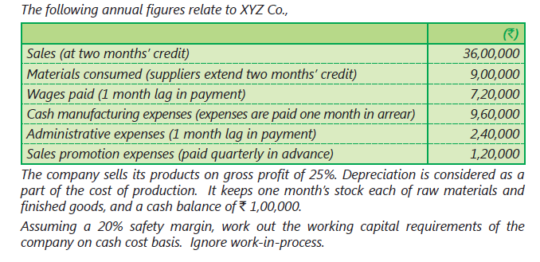
Question 4

Slide 17
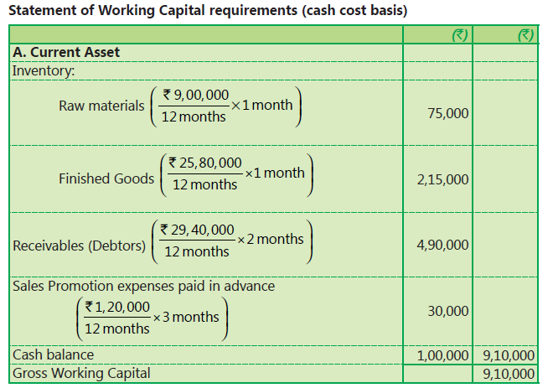
Solution 4

Slide 18
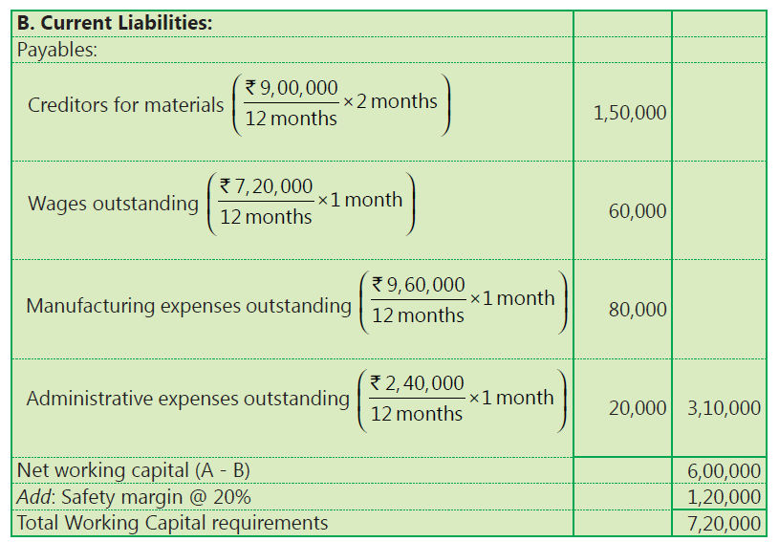

Slide 19
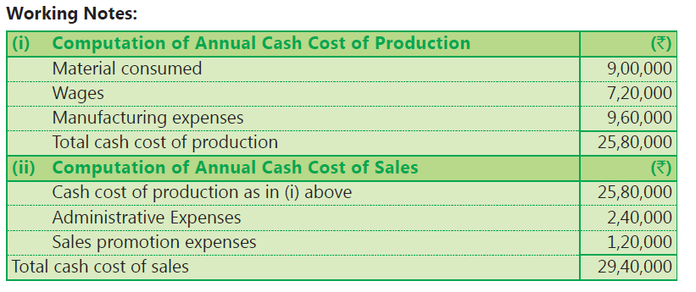
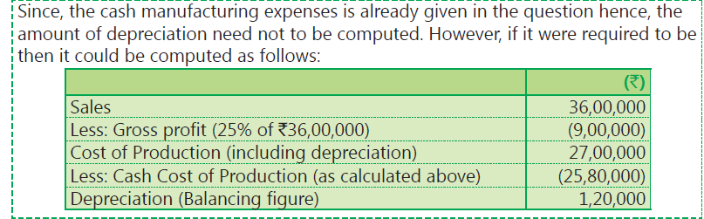

Slide 20
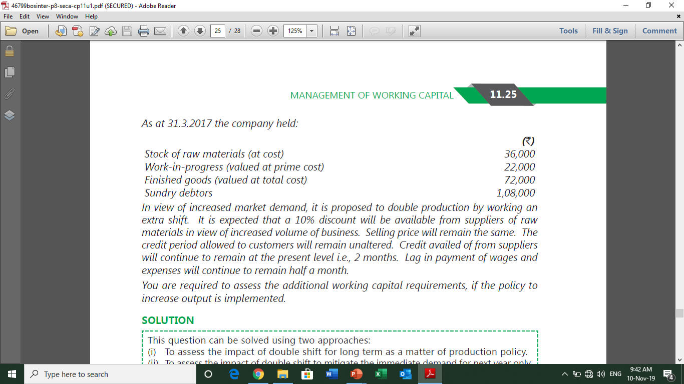
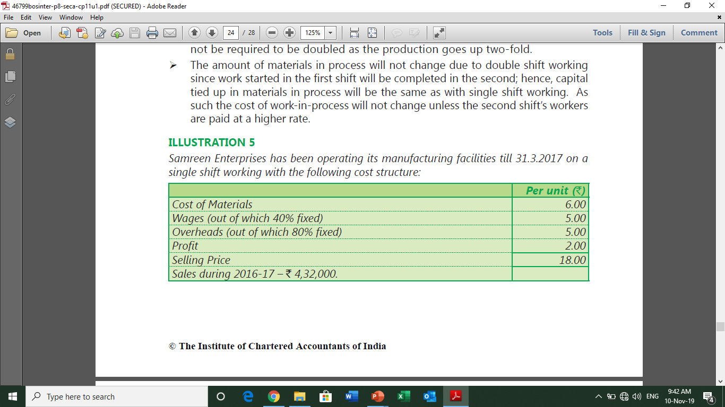
Question 5

Slide 21
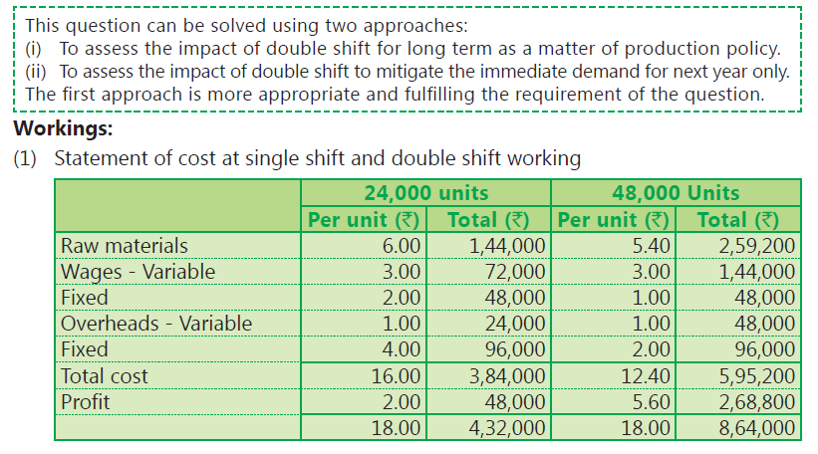
Solution 5

Slide 22
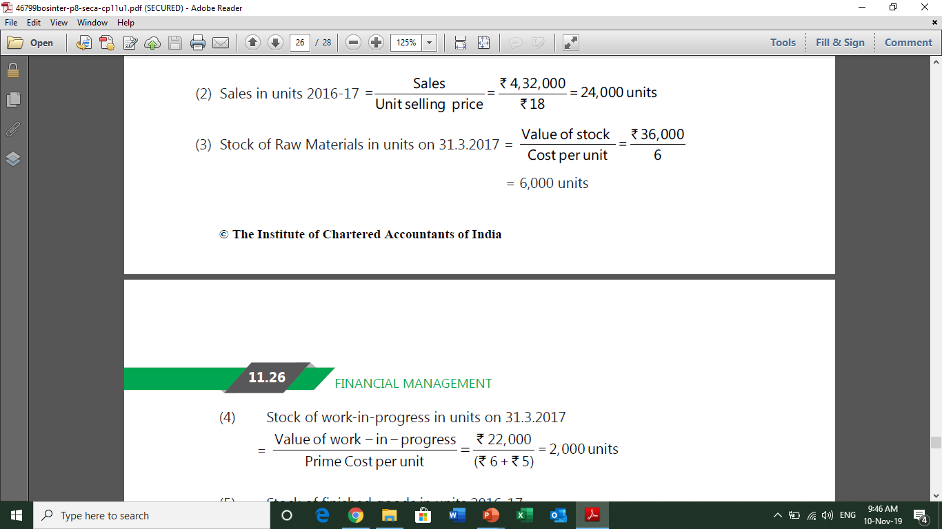
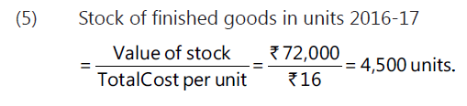

Slide 23
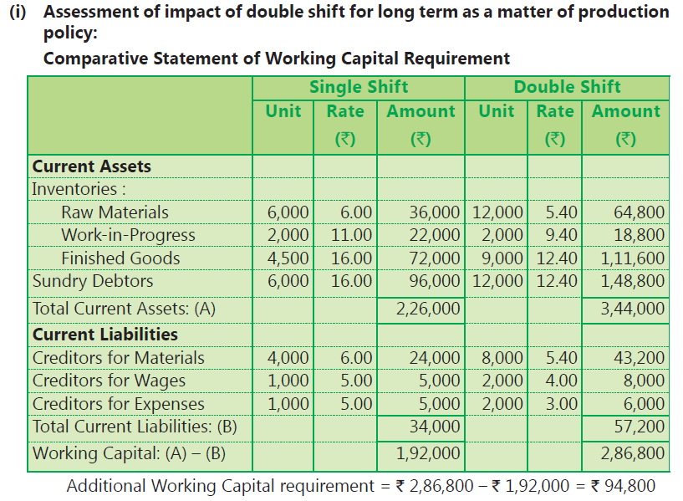

Slide 24
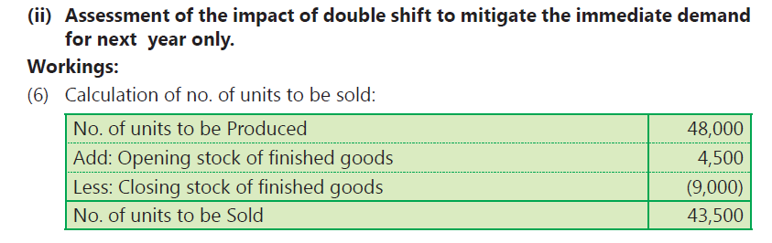
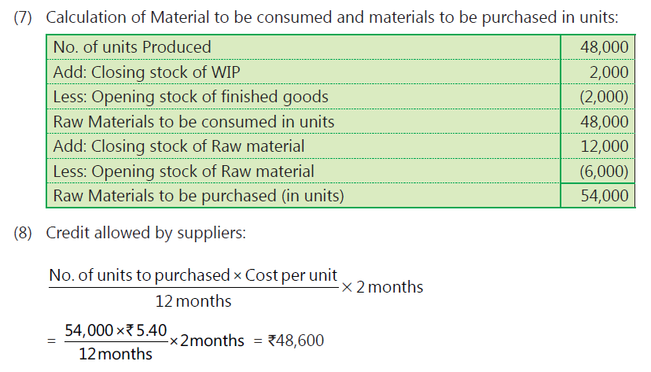

Slide 25
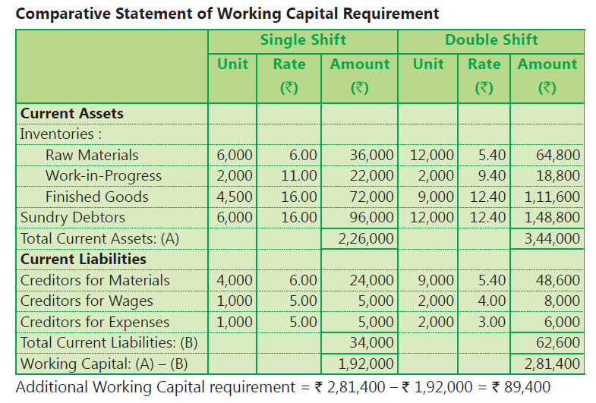

Slide 26
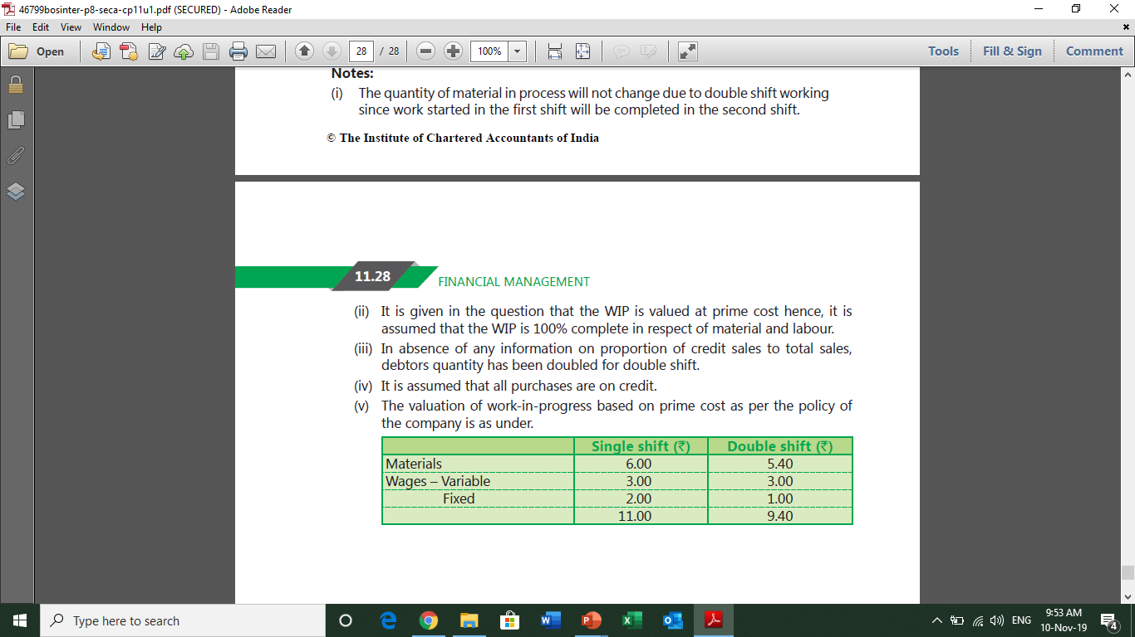

Slide 27
Cash Budget

Slide 28
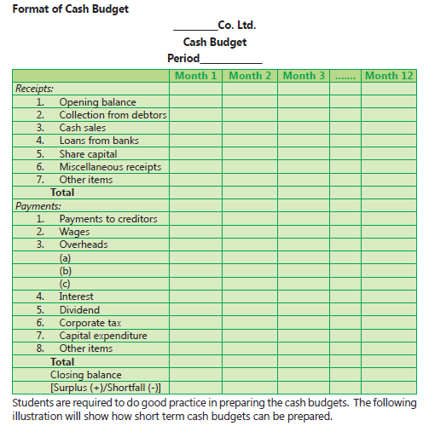

Slide 29
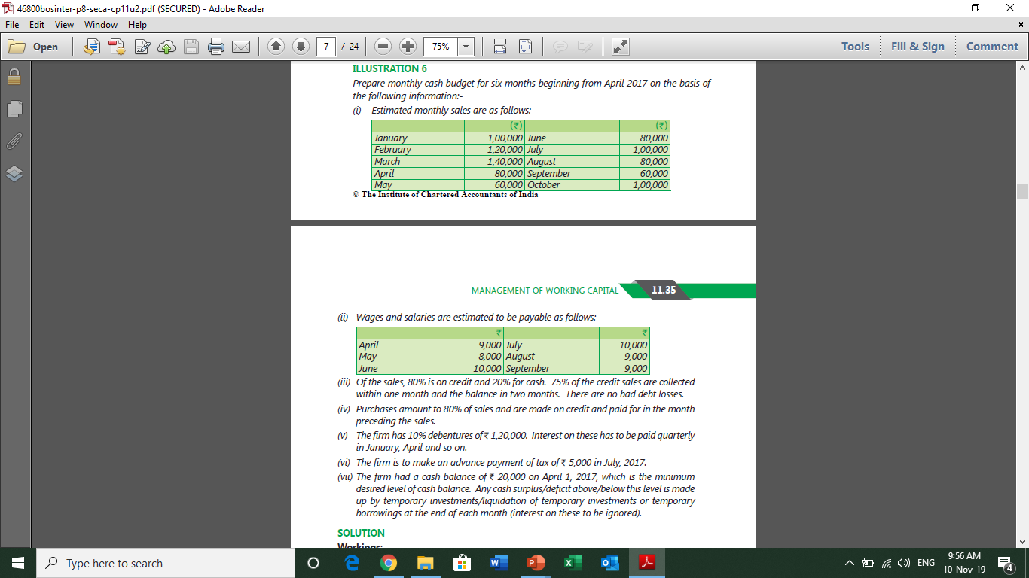
Question 6

Slide 30
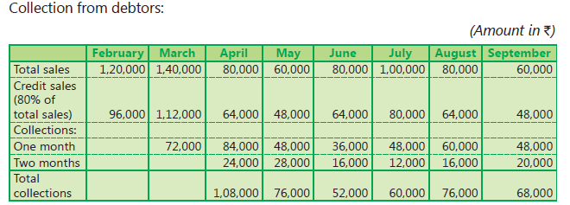
Solution 6

Slide 31
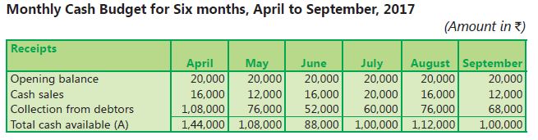
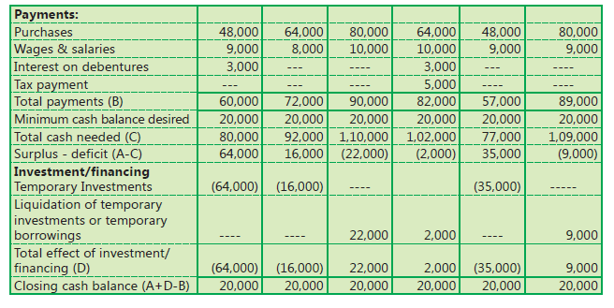

Slide 32
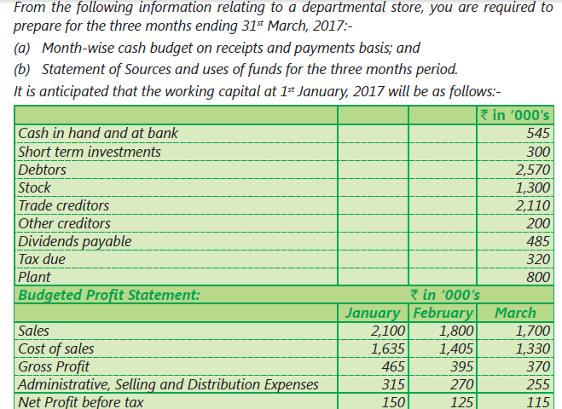
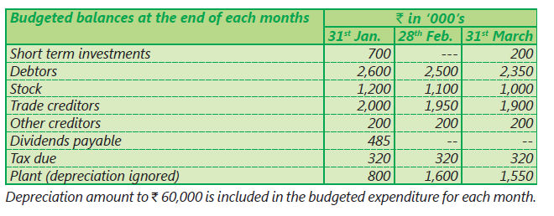
Question 7

Slide 33
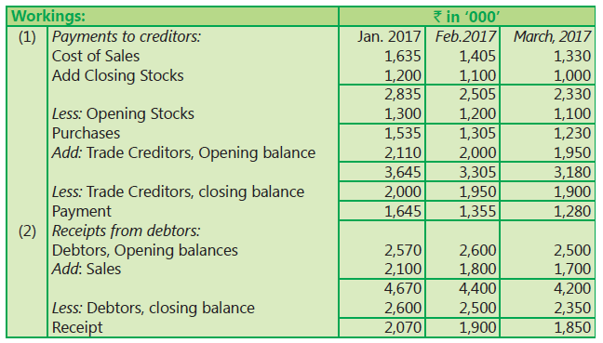
Solution 7

Slide 34
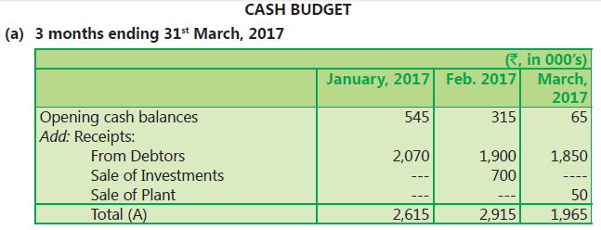
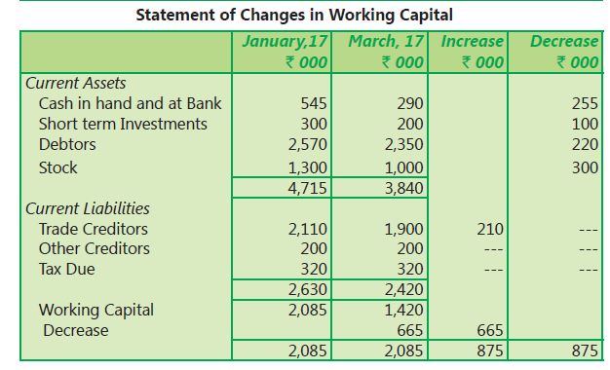
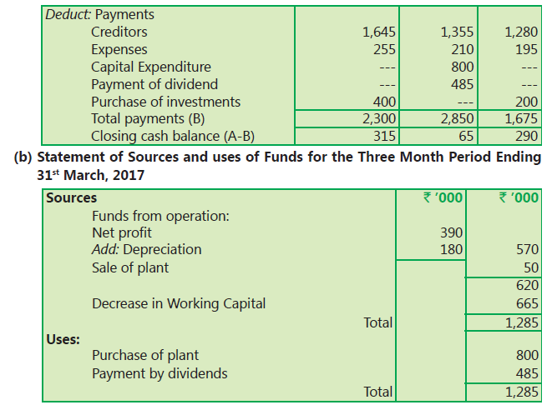

Slide 35
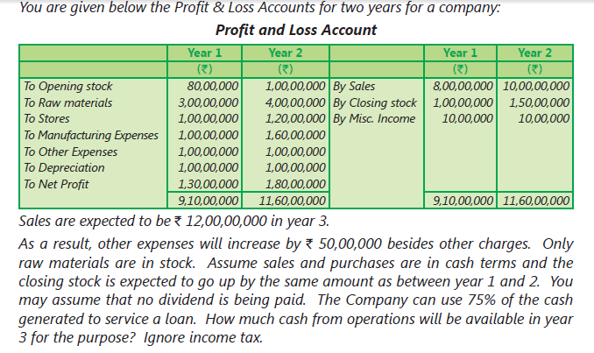
Question 8

Slide 36
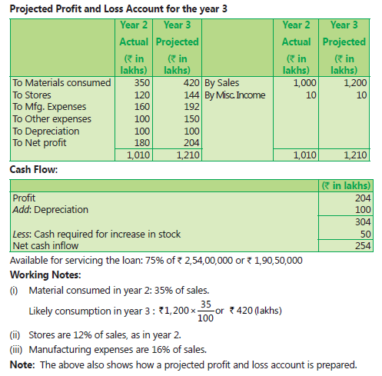
Solution 8

Slide 37
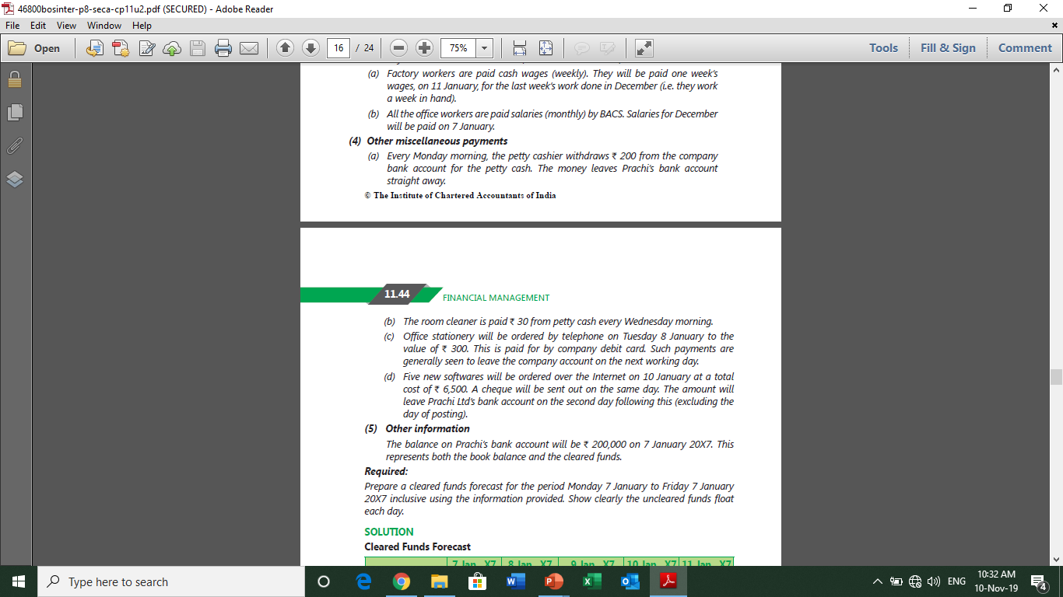
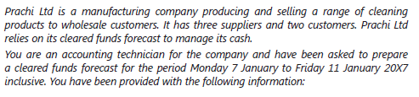
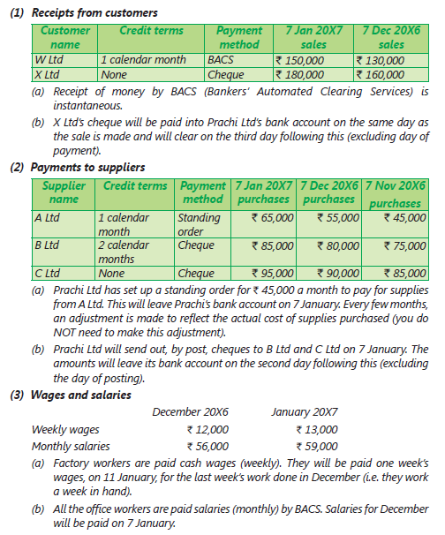
Question 9

Slide 38
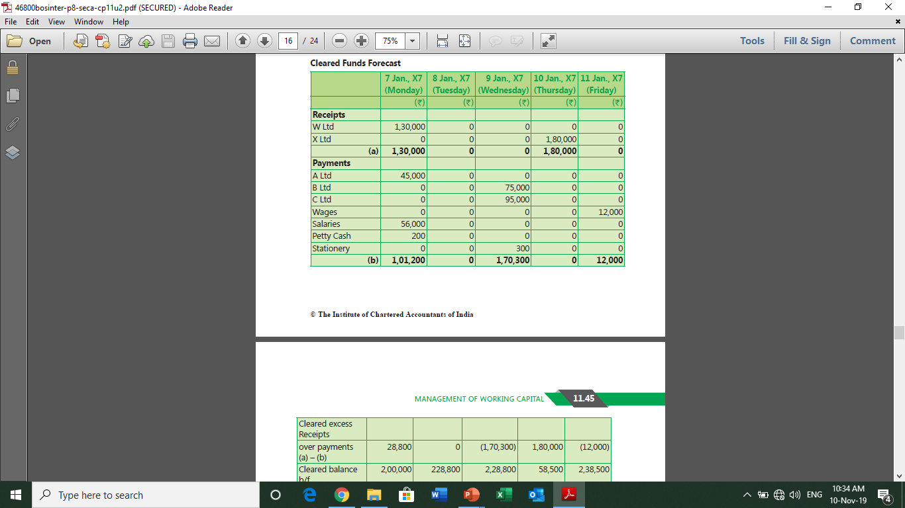
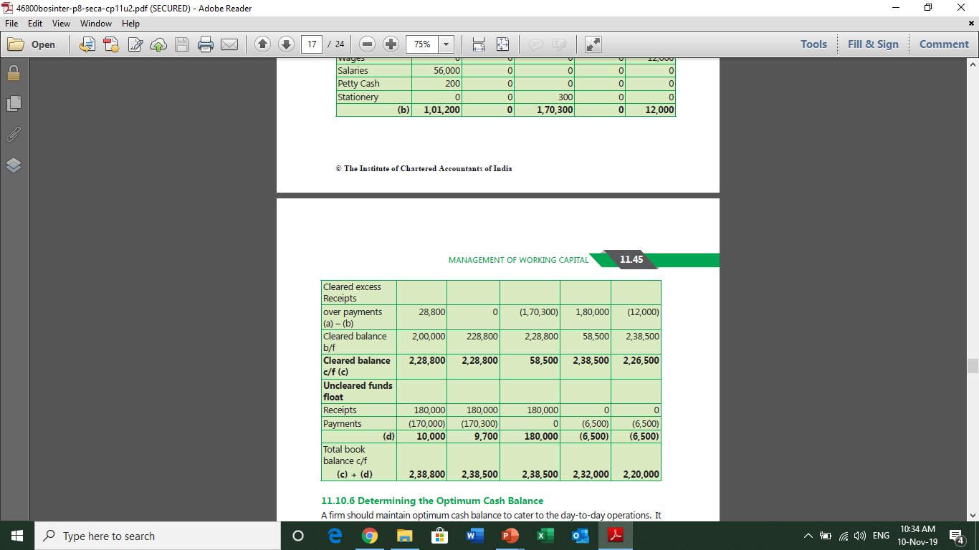

Slide 39
Optimum cash balance
Cash management modules

Slide 40
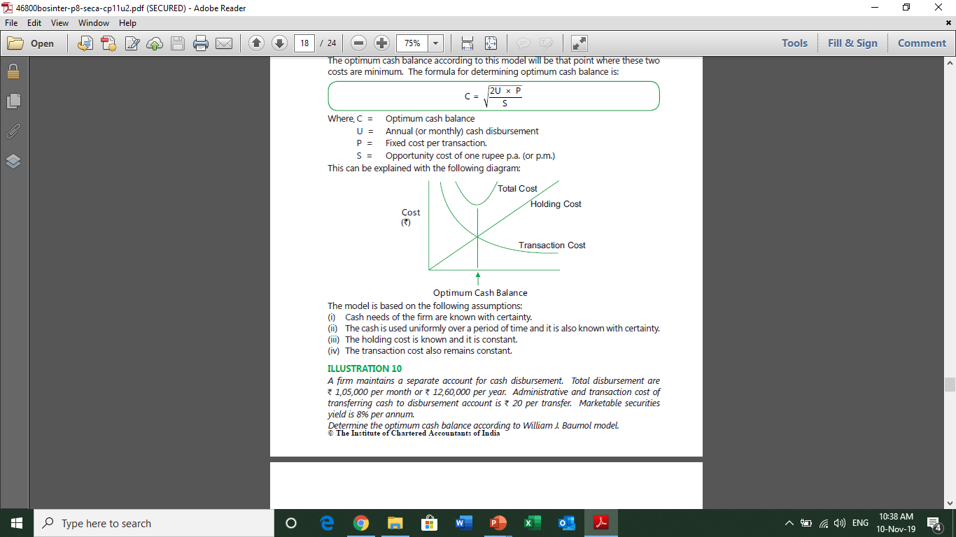
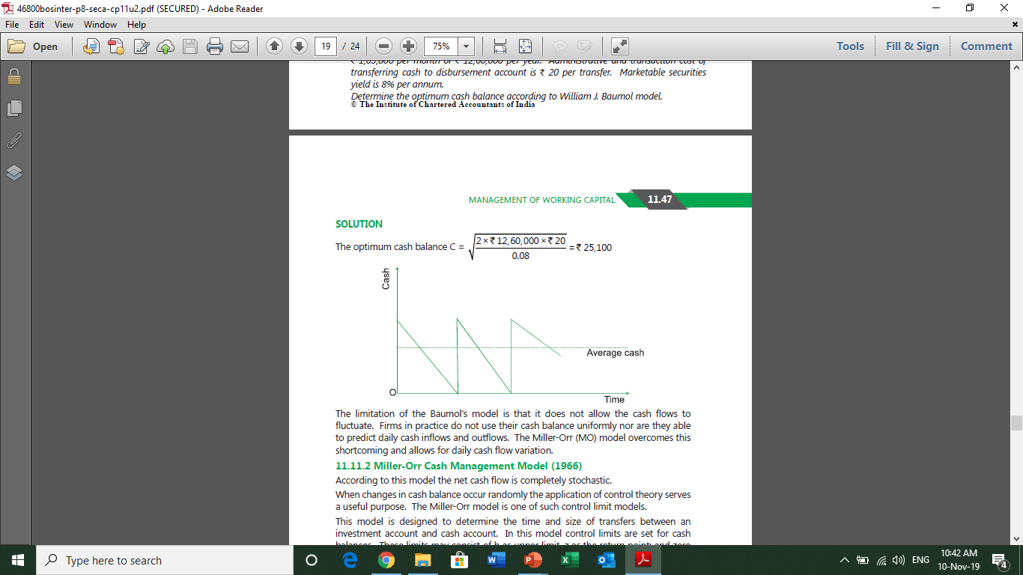
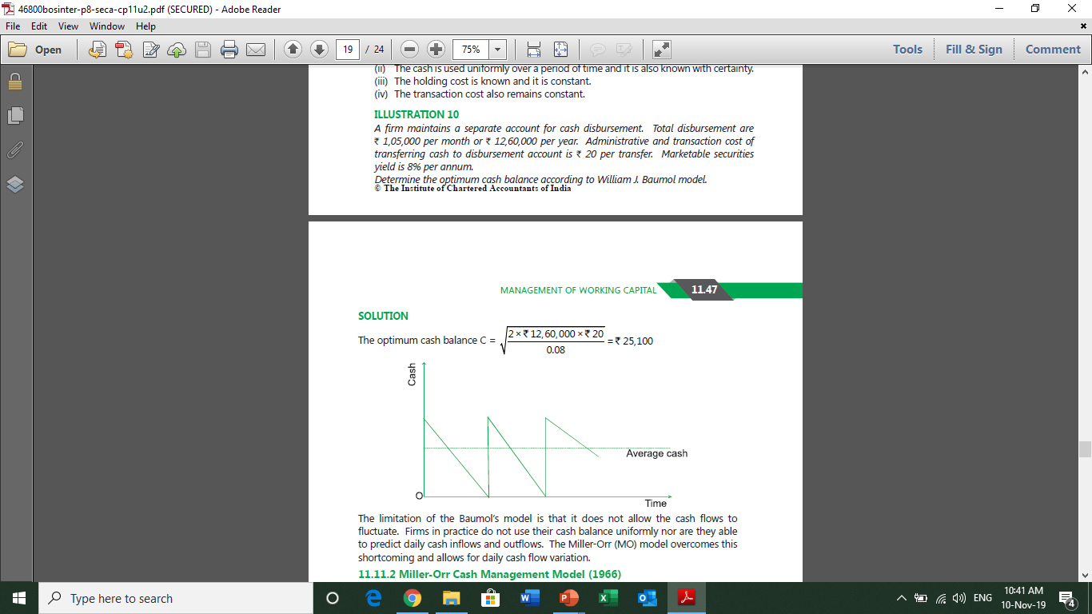
William J. Baumol’s Economic order quantity model (1952)

Slide 41


Miller – Orr cash management model (1966)

Slide 42

Question 11 & Solution 11

Slide 43
Inventory Management

Slide 44

Question 12 and solution 12

Slide 45

Question 13

Slide 46

Solution 13

Slide 47

Question 14

Slide 48

Solution 14

Slide 49
Receivables management

Slide 50



Slide 51



Slide 52

Question 15

Slide 53

Solution 15

Slide 54


Slide 55

The second method is incremental approach and we assume that all sales are credit sales

Slide 56

Another method is expected rate of return

Slide 57

Question 16

Slide 58

Solution 16

Slide 59
Financing Receivables

Slide 60



Slide 61

Question 17

Slide 62

Solution 17

Slide 63


Slide 64

Monitoring of receivables

Slide 65


Slide 66



Slide 67

Question 18

Slide 68


Solution 18

Slide 69

Question 19

Slide 70
Solution 19

Slide 71
Computation of cost of payables

Slide 72


Slide 73



Question 20 & Solution

Slide 74
Financing Working Capital

Slide 75

Forms of Bank Credit

Slide 76

Maximum permissible bank finance – Tandon Committee

Slide 77



Slide 78


Slide 79

Question

Slide 80

Solution

Slide 82
The

