Slide 1
Quality Management

Slide 2
Lecture Outline - 1
What Is Quality? – Slide 5
Quality Management Systems – Slide 16
Quality Tools – Slide 22
TQM and QMS – Slide 31
Focus of Quality Management – Slide 32
Role of Employees in Quality Improvement – Slide 35

Slide 3
Lecture Outline - 2
Quality in Services – Slide 38
Six Sigma – Slide 40
Cost of Quality – Slide 52
Effect of Quality Management on Productivity – Slide 61
Quality Awards – Slide 82
ISO 9000 – Slide 85

Slide 4
Learning Objectives
Discuss and define the dimensions of quality.
Articulate the benefits and costs of good quality, and the costs of poor quality
Understand how quality management systems have evolved and be able to assess the stage of quality evolution a particular company exhibits.
Utilize quality tools and the DMAIC methodology in problem solving
Explain the philosophy and magnitude of six sigma quality
Recognize quality awards and ISO certifications

Slide 5
What Is Quality?
Oxford American Dictionary
  a degree or level of excellence
American Society for Quality
  totality of features and characteristics that satisfy needs without deficiencies
Consumer’s and producer’s perspective

Slide 6
What Is Quality:
Customer’s Perspective
Fitness for use
  how well product or service does what it is supposed to
Quality of design
  designing quality characteristics into a product or service
A Mercedes and a Ford are equally “fit for use,” but with different design dimensions.

Slide 7
Dimensions of Quality:
Manufactured Products
Performance
  basic operating characteristics of a product; how well a car handles or its gas mileage
Features
  “extra” items added to basic features, such as a stereo CD or a leather interior in a car
Reliability
  probability that a product will operate properly within an expected time frame; that is, a TV will work without repair for about seven years

Slide 8
Dimensions of Quality:
Manufactured Products
Conformance
  degree to which a product meets pre–established standards
Durability
  how long product lasts before replacement; with care, L. L. Bean boots may last a lifetime
Serviceability
  ease of getting repairs, speed of repairs, courtesy and competence of repair person

Slide 9
Dimensions of Quality:
Manufactured Products
Aesthetics
  how a product looks, feels, sounds, smells, or tastes
Safety
  assurance that customer will not suffer injury or harm from a product; an especially important consideration for automobiles
Perceptions
  subjective perceptions based on brand name, advertising, etc.

Slide 10
Dimensions of Quality: Services
Time and timeliness
  how long must a customer wait for service, and is it completed on time?
  is an overnight package delivered overnight?
Completeness:
  is everything customer asked for provided?
  is a mail order from a catalogue company complete when delivered?

Slide 11
Dimensions of Quality: Service
Courtesy:
  how are customers treated by employees?
  are catalogue phone operators nice and are their voices pleasant?
Consistency
  is same level of service provided to each customer each time?
  is your newspaper delivered on time every morning?

Slide 12
Dimensions of Quality: Service
Accessibility and convenience
  how easy is it to obtain service?
  does service representative answer you calls quickly?
Accuracy
  is service performed right every time?
  is your bank or credit card statement correct every month?
Responsiveness
  how well does company react to unusual situations?
  how well is a telephone operator able to respond to a customer’s questions?

Slide 13
What Is Quality:
Producer’s Perspective
Quality of conformance
  making sure product or service is produced according to design
    if new tires do not conform to specifications, they wobble
    if a hotel room is not clean when a guest checks in, hotel is not functioning according to specifications of its design

Slide 14
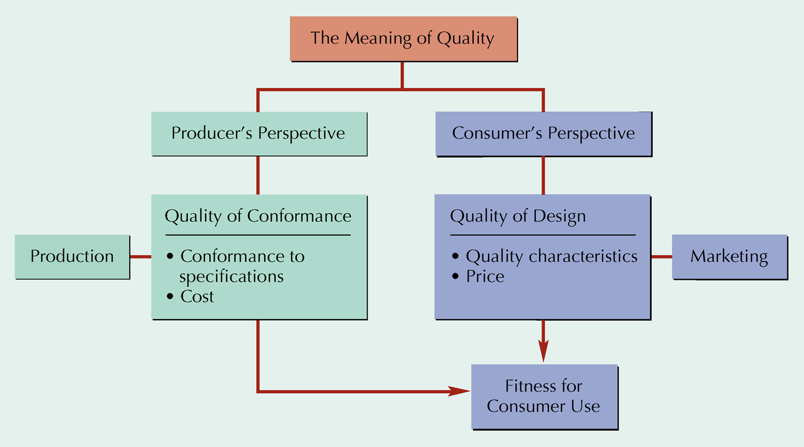
Meaning of Quality

Slide 15
What Is Quality:
A Final Perspective
Customer’s and producer’s perspectives depend on each other
Producer’s perspective:
  production process and COST
Customer’s perspective:
  fitness for use and PRICE
Customer’s view must dominate

Slide 16
Evolution of Quality Management: Quality Gurus
Walter Shewhart
  In 1920s, developed control charts
  Introduced term “quality assurance”
W. Edwards Deming
  Developed courses during WW II to teach statistical quality-control techniques to engineers and executives of military suppliers
  After war, began teaching statistical quality control to Japanese companies
Joseph M. Juran
  Followed Deming to Japan in 1954
  Focused on strategic quality planning
  Quality improvement achieved by focusing on projects to solve problems and securing breakthrough solutions

Slide 17
Evolution of Quality Management: Quality Gurus
Armand V. Feigenbaum
  In 1951, introduced concepts of total quality control and continuous quality improvement
Philip Crosby
  In 1979, emphasized that costs of poor quality far outweigh cost of preventing poor quality
  In 1984, defined absolutes of quality management—conformance to requirements, prevention, and “zero defects”
Kaoru Ishikawa
  Promoted use of quality circles
  Developed “fishbone” diagram
  Emphasized importance of internal customer

Slide 18
Deming’s 14 Points
Create constancy of purpose
Adopt philosophy of prevention
Cease mass inspection
Select a few suppliers based on quality
Constantly improve system and workers

Slide 19
Deming’s 14 Points
Institute worker training
Instill leadership among supervisors
Eliminate fear among employees
Eliminate barriers between departments
Eliminate slogans

Slide 20
Deming’s 14 Points
Eliminate numerical quotas
Enhance worker pride
Institute vigorous training and education programs
Develop a commitment from top management to implement above 13 points

Slide 21
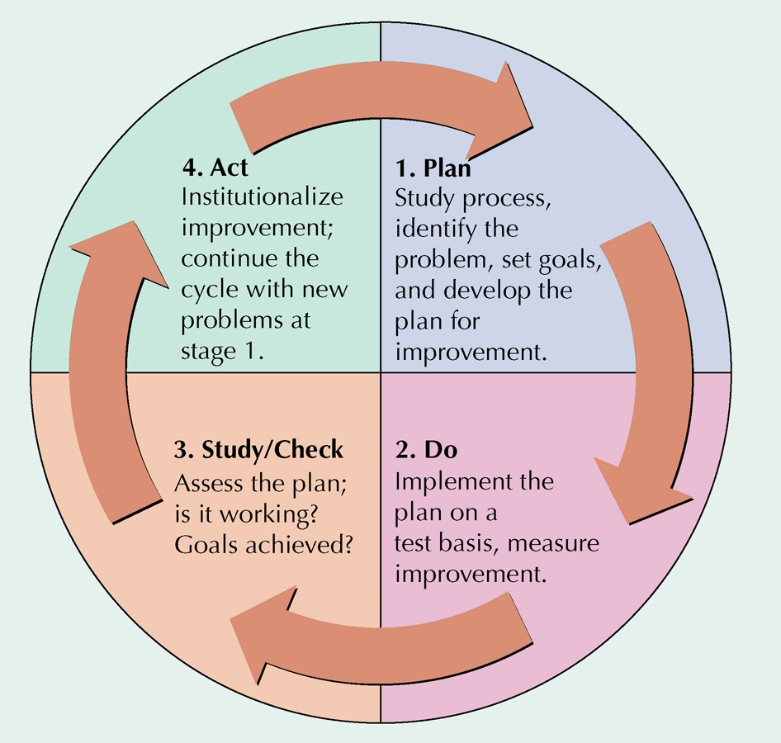
Deming Wheel: PDCA Cycle

Slide 22
Quality Tools
Process Flow Chart
Cause-and-Effect Diagram
Check Sheet
Pareto Analysis
Histogram
Scatter Diagram
Statistical Process
Control Chart

Slide 23
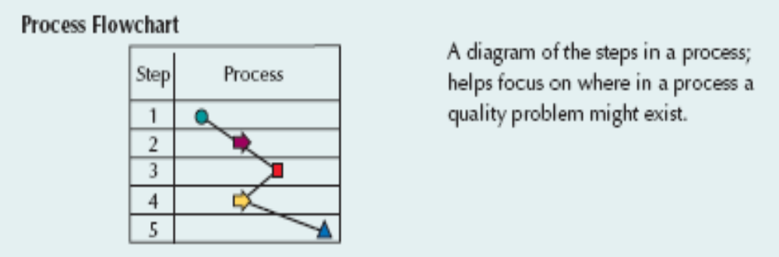
Flow Chart
A diagram of the steps in a process
Helps focus on location of problem in a process

Slide 24
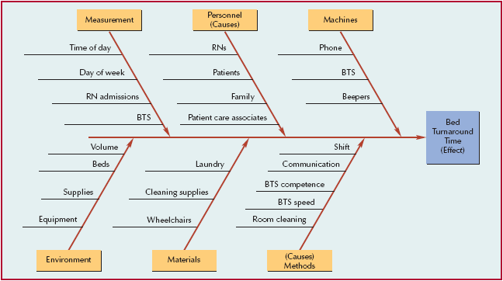
Cause-and-Effect Diagram
Cause-and-effect diagram (“fishbone” diagram)
  chart showing different categories of problem causes

Slide 25
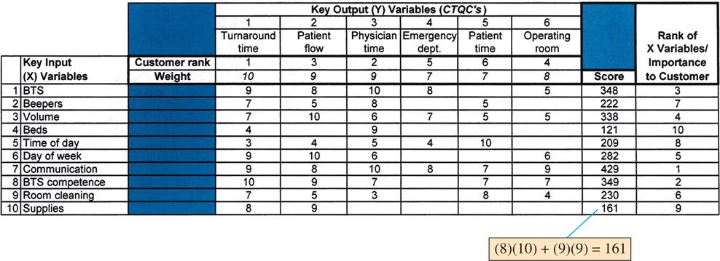
Cause-and-Effect Matrix
Cause-and-effect matrix
  grid used to prioritize causes of quality problems

Slide 26
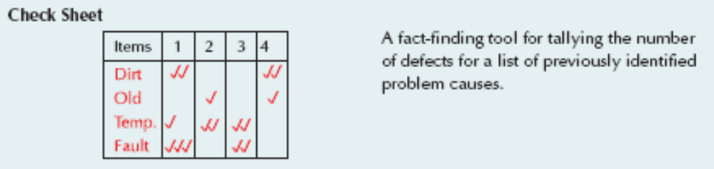
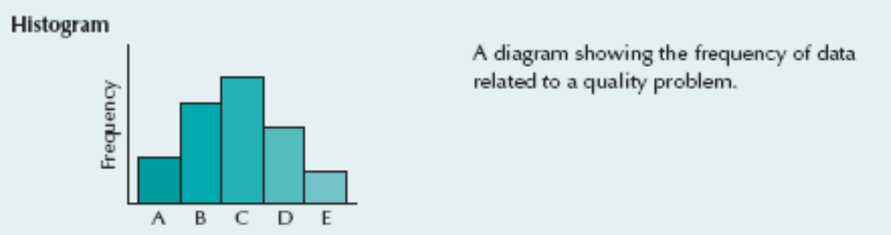
Check Sheets and Histograms
Tally number of defects from a list of causes
Frequency diagram of data for quality problem

Slide 27
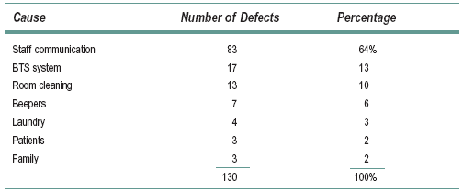
Pareto Analysis
Pareto analysis
  most quality problems result from a few causes

Slide 28
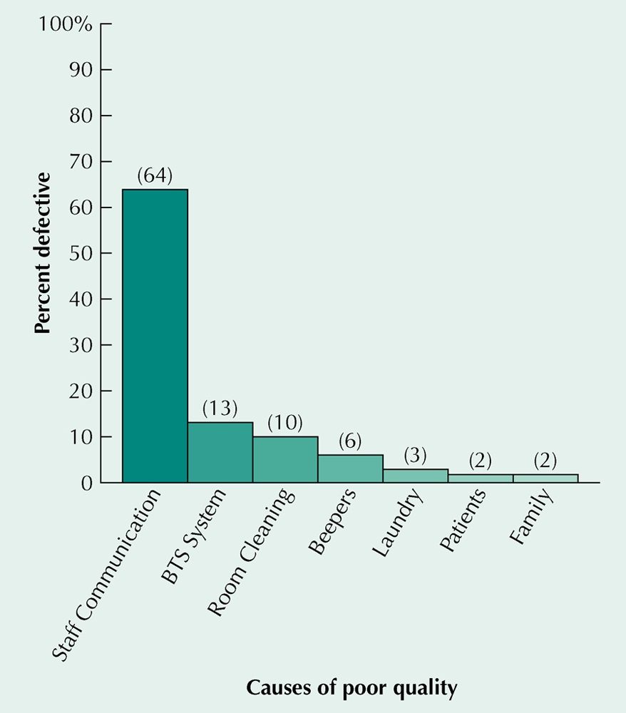
Pareto Chart

Slide 29
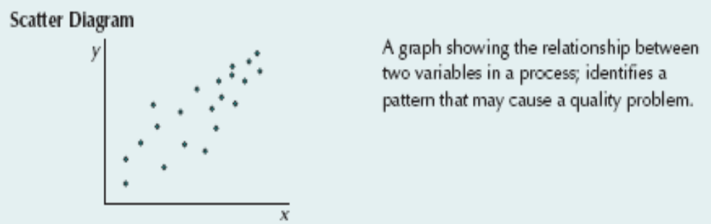
Scatter Diagram
Graph showing relationship between 2 variables in a process
Identifies pattern that may cause a quality problem

Slide 30

Control Chart
A chart with statistical upper and lower limits
If sample statistics remain between these limits we assume the process is in control

Slide 31
TQM and QMS
Total Quality Management (TQM)
  customer-oriented, leadership, strategic planning, employee responsibility, continuous improvement, cooperation, statistical methods, and training and education
Quality Management System (QMS)
  system to achieve customer satisfaction that complements other company systems

Slide 32
TQM Principles
Quality can and muse be managed
The customer defines quality
Management must be involved and provide leadership
Continuous quality improvements is “the” strategic goal
Quality problems are found in processes
The quality standard is “no defects”
Quality must be measured

Slide 33
Focus of Quality Management— Customers
TQM and QMSs
  serve to achieve customer satisfaction
Satisfied customers are less likely to switch to a competitor
It costs 5-6 times more to attract new customers as to keep an existing one
94-96% of dissatisfied customers don’t complain
Small increases in customer retention mean large increases in profits

Slide 34
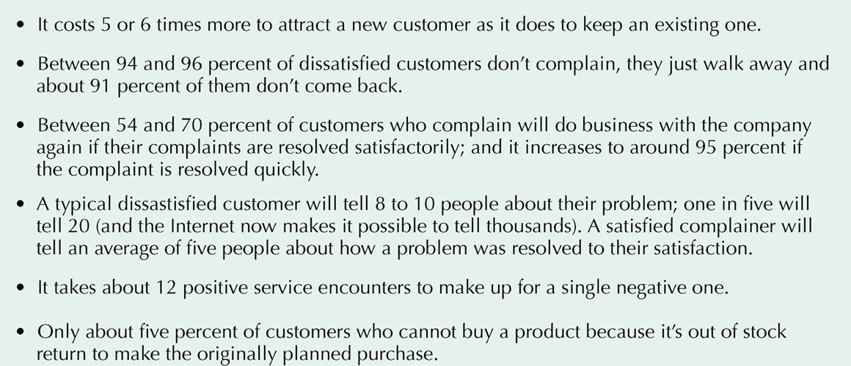
Customer Satisfaction

Slide 35
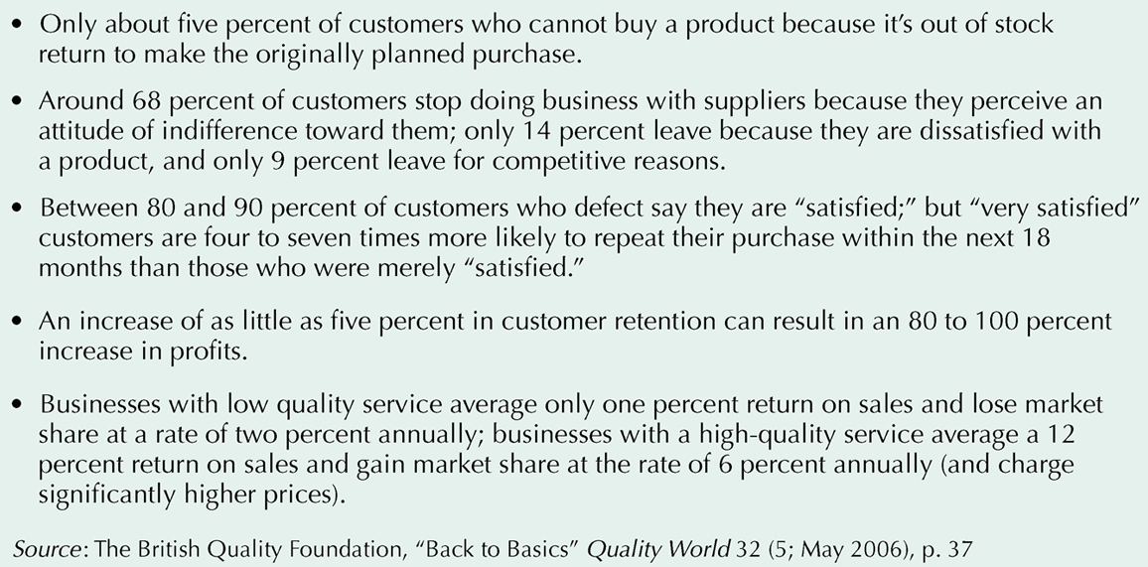
Customer Satisfaction

Slide 36
Quality Management in the
Supply Chain
Companies need support of their suppliers to satisfy their customers
Reduce the number of suppliers
Partnering
  a relationship between a company and its supplier based on mutual quality standards

Slide 37
Measuring Customer Satisfaction
An important component of any QMS
Use customer surveys to hear “Voice of the Customer”
American Customer Satisfaction Index (ACSI)

Slide 38
Role of Employees in Quality Improvement
Participative problem solving
  employees involved in quality-management
  every employee has undergone extensive training to provide quality service to Disney’s guests
Kaizen
  involves everyone in process of continuous improvement
  employees determining solutions to their own problems

Slide 39
Quality Circles
Voluntary group of workers and supervisors from same area who address quality problems
Organization
8-10 members
Same area
Supervisor/moderator
Training
Group processes
Data collection
Problem analysis
Presentation
Implementation
Monitoring
Problem Identification
List alternatives
Consensus
Brainstorming
Solution
Problem results
Problem Analysis
Cause and effect
Data collection and analysis

Slide 40
Process (Quality) Improvement Teams
Focus attention on business processes rather than separate company functions
Includes members from the interrelated departments which make up a process
Important to understand the process the team is addressing
Process flowcharts are key tools

Slide 41
Quality in Services
Service defects are not always easy to measure because service output is not usually a tangible item
Services tend to be labor intensive
Services and manufacturing companies have similar inputs but different processes and outputs

Slide 42
Quality Attributes in Services
Principles of TQM apply equally well to services and manufacturing
Timeliness is an important dimension
  how quickly a service is provided
Benchmark
  “best” level of quality achievement in one company that other companies seek to achieve

Slide 43
Six Sigma
A process for developing and delivering virtually perfect products and services
Six Sigma is a measure of how much a process deviates from perfection
Goal: 3.4 defects per million opportunities (DPMO)

Slide 44
Six Sigma Process
Align
  executives create balanced scorecard
Mobilize
  project teams formed and empowered to act
Accelerate
  black and green belts execute project
Govern
  monitor and review projects
Champion
  an executive responsible for project success

Slide 45
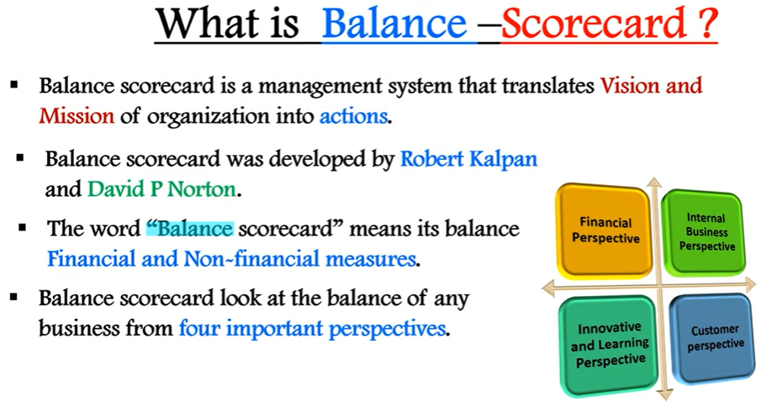

Slide 46
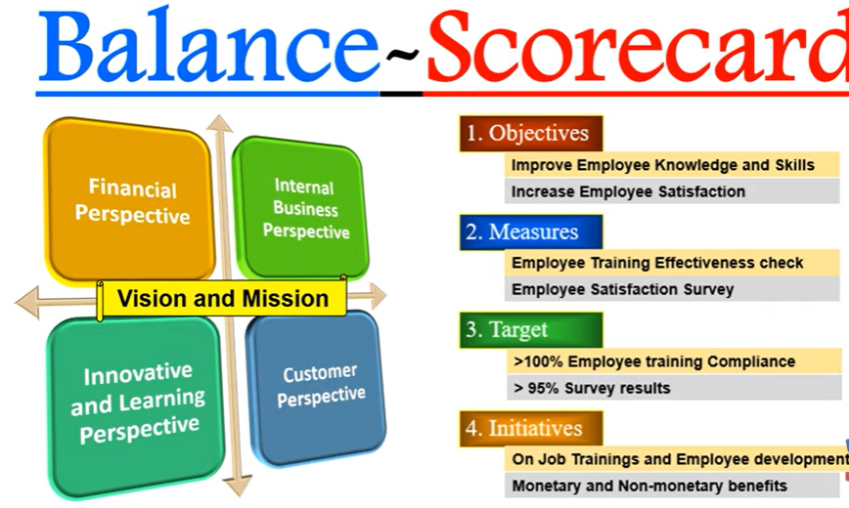

Slide 47
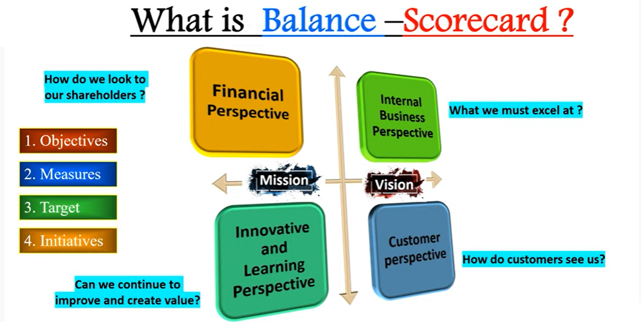

Slide 48
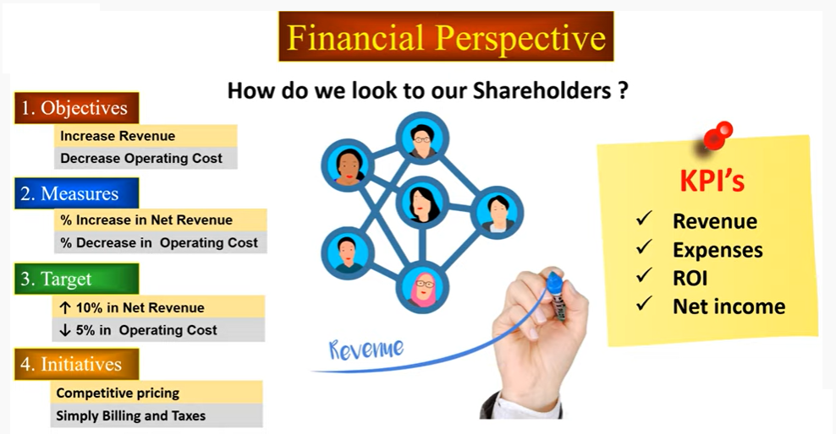

Slide 49
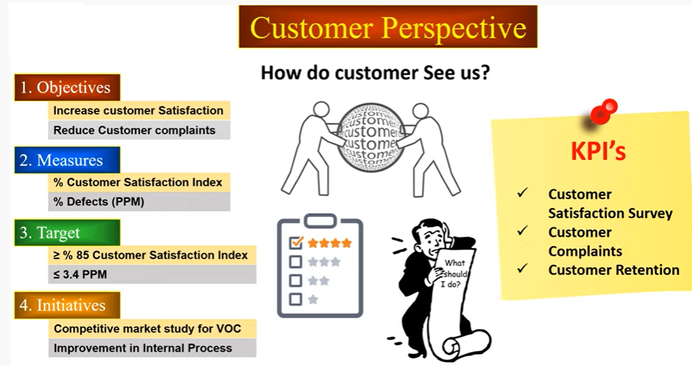

Slide 50
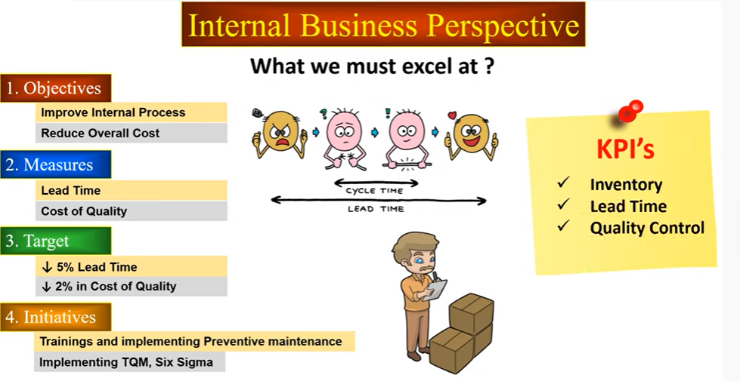

Slide 51
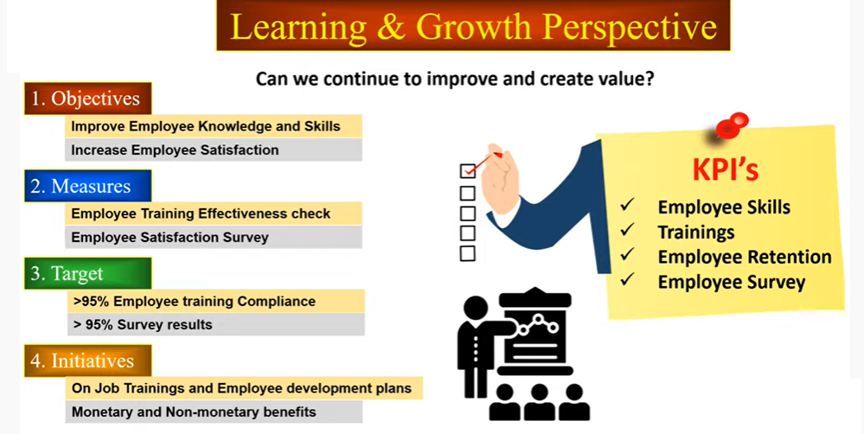

Slide 52
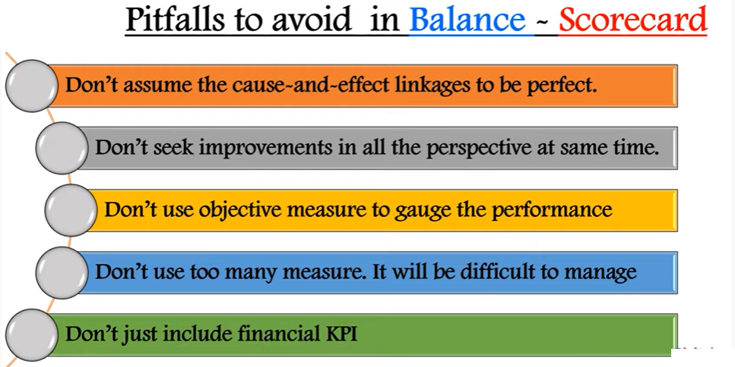

Slide 53
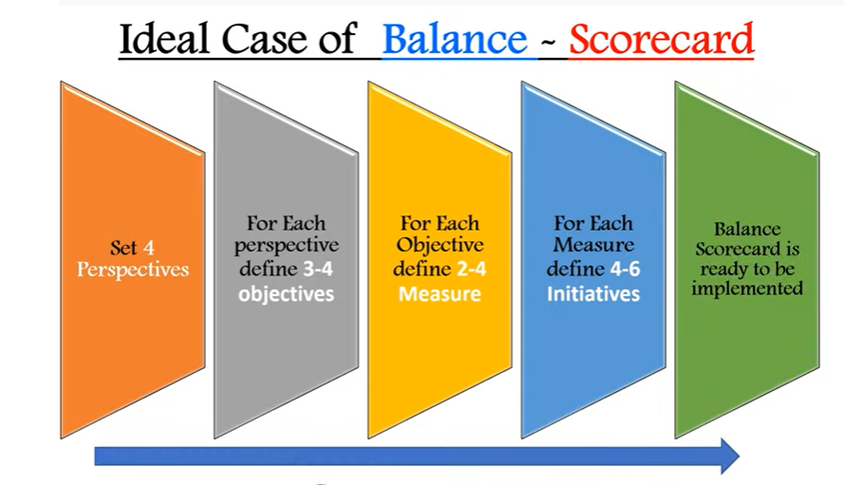

Slide 54
Breakthrough Strategy: DMAIC
Define
  problem is defined
Measure
  process measured, data collected
Analyze
  data analysis to find cause of problem
Improve
  develop solutions to problem
Control
  ensure improvement is continued

Slide 55
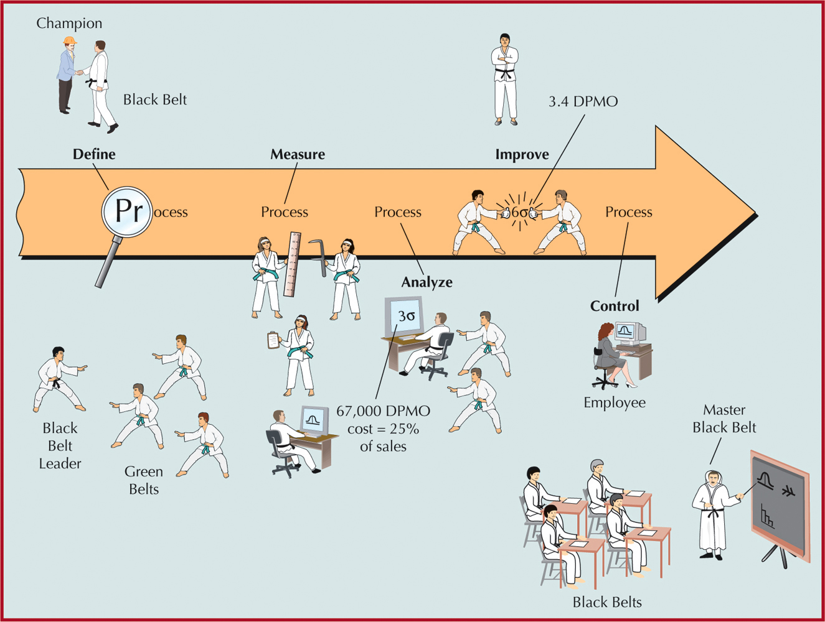
Six Sigma Process
DEFINE
MEASURE
ANALYZE
IMPROVE
CONTROL
3.4 DPMO
67,000 DPMO
cost = 25% of sales

Slide 56
Black Belts and Green Belts
Black Belt
  project leader
Master Black Belt
  a teacher and mentor for Black Belts
Green Belts
  project team members

Slide 57
Six Sigma Tools - 1
Quality Function Deployment (QFD)
  capture the “voice of the customer”
Cause & Effect Matrix
  identify and prioritize causes of a problem
Failure Modes and Affects Analysis (FMEA)
  analyze potential problems before they occur

Slide 58
Six Sigma Tools - 2
t-Test
  test for differences between groups
Statistical Process Control (SPC) Chart
  monitor a process over time for variations
Design of Experiments (DOE)
  determining relationships between factors affecting inputs and outputs of a process

Slide 59
Design for Six Sigma (DFSS)
A systematic approach to designing products and processes that will achieve Six Sigma
Uses same basic approach as breakthrough strategy
Employs the strategy up front in the design and development phases
A more effective and less expensive way to achieve Six Sigma

Slide 60
Lean Six Sigma
Integrate Six Sigma and “lean systems” (Ch 16)
Lean seeks to optimize process flows
Lean extends earlier efforts in efficiency
Lean process improvement steps
  determine what creates value for customers
  identify “value stream”
  remove waste in the value stream
  make process responsive to customer needs
  continually repeat attempts to remove waste

Slide 61
Lean Six Sigma
Six Sigma and Lean seek
  process improvements
  Increased value to customers
They approach the goals in different, complementary ways

Slide 62
Profitability
The typical criterion for selecting Six Sigma projects
One of the factors distinguishing Six Sigma from TQM
“Quality is not only free, it is an honest-to-everything profit maker”
Quality improvements reduce costs of poor quality

Slide 72
The Medtek Company produce parts for an electronic bed tracking system (BTS) it sells to medical suppliers and hospitals. It contracted for and sold 1,000 units of one of its products during the past quarter for $1000 each resulting in total sales of $1,000,000. During the quarter, the company incurred variable costs of $600,000, so that the unit variable cost was $600. The company also incurred fixed costs of $350,000 during the quarter. This resulted in a profit of $50,000 as shown in the following income statement:

Slide 73
Sales | $1000000
Variable costs | $600,000
Fixed costs | $350,000
Profit | $50,000

Slide 74
Cost Impact of Six Sigma
Medtek Company implements Six Sigma to reduce defects from 10% to 0 %. Then spend $120,000 for more change.
After Six
Original After Changes Sigma Costs
Sales $1,000,000 1,000,000 1,000,000
Variable cost 600,000 540,054 540,054
Fixed cost 350,000 350,000 360,000
Profit 50,000 109,946 99,946
Doubled 33.3% return
Return on 120,000 = 100*(49,946-10,000)/120,000 = 33.3%

Slide 75
Cost of Quality
Cost of Achieving Good Quality
  Prevention costs
    costs incurred during product design
  Appraisal costs
    costs of measuring, testing, and analyzing
Cost of Poor Quality
  Internal failure costs
    include scrap, rework, process failure, downtime, and price reductions
  External failure costs
    include complaints, returns, warranty claims, liability, and lost sales

Slide 76
Prevention Costs
Quality planning costs
  costs of developing and implementing quality management program
Product-design costs
  costs of designing products with quality characteristics
Process costs
  costs expended to make sure productive process conforms to quality specifications
Training costs
  costs of developing and putting on quality training programs for employees and management
Information costs
  costs of acquiring and maintaining data related to quality, and development and analysis of reports on quality performance

Slide 77
Appraisal Costs
Inspection and testing
  costs of testing and inspecting materials, parts, and product at various stages and at end of process
Test equipment costs
  costs of maintaining equipment used in testing quality characteristics of products
Operator costs
  costs of time spent by operators to gather data for testing product quality, to make equipment adjustments to maintain quality, and to stop work to assess quality

Slide 78
Internal Failure Costs
Scrap costs
  costs of poor-quality products that must be discarded, including labor, material, and indirect costs
Rework costs
  costs of fixing defective products to conform to quality specifications
Process failure costs
  costs of determining why production process is producing poor-quality products
Process downtime costs
  costs of shutting down productive process to fix problem
Price-downgrading costs
  costs of discounting poor-quality products—that is, selling products as “seconds”

Slide 79
External Failure Costs
Customer complaint costs
  costs of investigating and satisfactorily responding to a customer complaint resulting from a poor-quality product
Product return costs
  costs of handling and replacing poor-quality products returned by customer
Warranty claims costs
  costs of complying with product warranties
Product liability costs
  litigation costs resulting from product liability and customer injury
Lost sales costs
  costs incurred because customers are dissatisfied with poor-quality products and do not make additional purchases

Slide 80
Measuring and Reporting Quality Costs
Index numbers
  ratios that measure quality costs against a base value
  labor index
    ratio of quality cost to labor hours
  cost index
    ratio of quality cost to manufacturing cost
  sales index
    ratio of quality cost to sales
  production index
    ratio of quality cost to units of final product

Slide 81
Cost of Quality
Year
2009 2010 2011 2012
Quality Costs
Prevention 27,000 41,500 74,600 112,300
Appraisal 155,000 122,500 113,400 107,000
Internal failure 386,400 469,200 347,800 219,100
External failure 242,000 196,000 103,500 106,000
Total 810,400 829,200 639,300 544,400
Accounting Measures
Sales 4,360,000 4,450,000 5,050,000 5,190,000
Manufacturing costs 1,760,000 1,810,000 1,880,000 1,890,000

Slide 82
Cost of Quality
Quality index = total quality costs/base * 100
209 quality cost per sale
Quality Quality Manufacturing
Year Sales Index Cost Index
2009
2010
2011
2012

Slide 83
Cost of Quality
Quality index = total quality costs/base * 100
2006 quality cost per sale
810,400 * 100 / 4,360,000 = 18.58
Quality Quality Manufacturing
Year Sales Index Cost Index
2009 18.58 46.04
2010 18.63 45.18
2011 12.66 34.00
2012 10.49 28.80

Slide 84
Quality–Cost Relationship
Cost of quality
  difference between price of nonconformance and conformance
  cost of doing things wrong
    20 to 35% of revenues
  cost of doing things right
    3 to 4% of revenues

Slide 85
Effect of Quality Management on Productivity
Productivity = output / input
Quality impact on productivity
  fewer defects increase output, and quality improvement reduces inputs
Yield
  a measure of productivity

Slide 86
Measuring Product Yield and Productivity
Yield=(total input)(% good units) + (total input)(1-%good units)(% reworked)
or
Y=(I)(%G)+(I)(1-%G)(%R)
where
I = initial quantity started in production
%G = percentage of good units produced
%R = percentage of defective units that are successfully reworked

Slide 87
Computing Product Yield
Motor manufacturer
Starts a batch of 100 motors.
80 % are good when produced
50 % of the defective motors can be reworked
Y =(I)(%G)+(I)(1-%G)(%R)
=
Increase quality to 90% good
Y =

Slide 88
Computing Product Yield
Motor manufacturer
Starts a batch of 100 motors.
80 % are good when produced
50 % of the defective motors can be reworked
Y =(I)(%G)+(I)(1-%G)(%R)
= 100(.80) + 100(1-.80)(.50) = 90 motors
Increase quality to 90% good
Y =100(.90) + 100(1-.90)(.50) = 95 motors

Slide 89
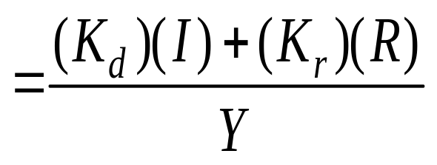
Computing Product Cost per Unit
Product Cost
where:
K_{d} = direct manufacturing cost per unit
I = input
K_{r} = rework cost per unit
R = reworked units
Y = yield

Slide 90
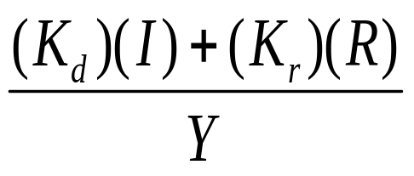
Cost per Unit
Direct cost = $30 Rework cost = $12
80% good 50% can be reworked
=
Increase quality to 90% good

Slide 91
Cost per Unit
Direct cost = $30 Rework cost = $12
80% good 50% can be reworked
$30*100 + $12*10
90 motors
=
=
$34.67/motor
Increase quality to 90% good
$30*100 + $12*5
95 motors
=
=
$32.21/motor

Slide 92
Computing Product Yield for Multistage Processes
Y = (I)(%g₁)(%g₂) … (%g_{n})
where:
I = input of items to the production process that will result in finished products
g_{i} = good-quality, work-in-process products at stage i

Slide 93
Multistage Yield
  Average Percentage
Stage Good Quality
1 0.93
2 0.95
3 0.97
4 0.92
Y = (I)(%g₁)(%g₂) … (%g_{n})

Slide 94
Multistage Yield
  Average Percentage
Stage Good Quality
1 0.93
2 0.95
3 0.97
4 0.92
Y = (I)(%g₁)(%g₂) … (%g_{n})
= 100 * .93 * .95 * .97 * .92 = 78.8 motors

Slide 95
Initial Batch Size For 100 Motors
Y
(%g₁)(%g₂) … (%g_{n})
I =

Slide 96
Initial Batch Size For 100 Motors
Y
(%g₁)(%g₂) … (%g_{n})
I =
100
100 * .93 * .95 * .97 * .92
=
= 126.88 → 127

Slide 97
Quality–Productivity Ratio
QPR
  productivity index that includes productivity and quality costs
(good-quality units)
QPR =
(100)
(input) (processing cost) + (reworked units) (rework cost)

Slide 98
Quality Productivity Ratio
Direct cost = $30 Rework cost = $12
80% good 50% can be reworked
Initial batch size = 100
Base Case
QPR =
Case 1: Increase I to 200
QPR =

Slide 99
Quality Productivity Ratio
Case 2: Reduce direct cost to $26 and rework cost to $10
QPR =
Case 3: Increase %G to 95%
QPR =
Case 4: Decrease costs and increase %G
QPR =

Slide 100
Quality Productivity Ratio
Direct cost = $30 Rework cost = $12
80% good 50% can be reworked
Initial batch size = 100
Base Case
80 + 10
QPR =
(100) = 2.89
100 * $30 + 10 * $12
Case 1: Increase I to 200
160 + 20
QPR =
(100) = 2.89 – NO CHANGE
200 * $30 + 20 * $12

Slide 101
Quality Productivity Ratio
Case 2: Reduce direct cost to $26 and rework cost to $10
80 + 10
QPR =
(100) = 3.33
100 * $26 + 10 * $10
Case 3: Increase %G to 95%
95 + 2.5
QPR =
(100) = 3.22
100 * $30 + 2.5 * $12
Case 4: Decrease costs and increase %G
95 + 2.5
QPR =
(100) = 3.71
100 * $26 + 2.5 * $10

Slide 102
Quality Awards
Baldrige Award
Deming Prize
Provide guidelines for quality management
Benchmarks to emulate

Slide 103
Malcolm Baldrige Award
Created in 1987 to stimulate growth of quality management in United States
Categories
  Leadership
  Information and analysis
  Strategic planning
  Human resource focus
  Process management
  Business results
  Customer and market focus

Slide 104
Other Awards for Quality
National individual awards
  Armand V. Feigenbaum Medal
  Deming Medal
  E. Jack Lancaster Medal
  Edwards Medal
  Shewhart Medal
  Ishikawa Medal
International awards
  European Quality Award
  Canadian Quality Award
  Australian Business Excellence Award
  Deming Prize from Japan

Slide 105
ISO 9000
Procedures and policies for international quality certification
ISO 9000:2008
  Quality Management Systems—Fundamentals and Vocabulary
  defines fundamental terms and definitions used in ISO 9000 family
ISO 9001:2008
  Quality Management Systems—Requirements
  standard to assess ability to achieve customer satisfaction

Slide 106
ISO 9000
ISO 9004:2008
  Quality Management Systems—Guidelines for Performance Improvements
  guidance to a company for continual improvement of its quality-management system

Slide 107
ISO 9000 Certification,
Implications, and Registrars
ISO 9001:2008—only standard that carries third-party certification
Many overseas companies will not do business with a supplier unless it has ISO 9000 certification
ISO 9000 accreditation
ISO registrars

