Slide 2
Check version
import sys
print(sys.version_info)

Slide 3
Strings
a = "abhi"
b = "shek"
c = a+b
print(c)
d=a*3
print(d)

Slide 4
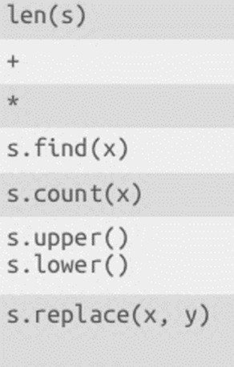
String operations

Slide 5
Data Structure
Lists
Tuples
Dictionaries

Slide 6
Python Lists
most versatile datatype, list of comma separated values , they need not be of same type
l1 = ['red', 'blue', 'green']
L2 = [42,1984]
L3 = [ 45,'red','green',87]
Print them , individual elements, try adding them

Slide 7
More on parsing list
l7 = [2323,323,345,46,4,35,65,7,7,76,67,342,32,4,32]
print(l7[2:5])
print(l7[2:])
print(l7[:5])
print(len(l7))

Slide 8
Sort , len , and more…
l7.sort()
print(l7)
Explore more methods

Slide 9
Changing elements
l7[1]=99
print(l7)
del l7[1]
print(l7)
nL = [x + 5 for x in L2]
print (nL)
Mutable

Slide 10
Tuples
Something like list, but immutable
tup1 = ('blue', 'red','green',542,2524,252)
print(tup1)

Slide 11
tup2 = (2342,542,2524,252)
print(max(tup2))
tup3 = ('blue', 'red','green',"orange")
print(max(tup3))

Slide 12
Python Dictionaries
Used to store Data in Key Value pairs
Mutable
dict1 = {'CATID': 'S19827', 'percentile': 98, 'Name': 'Tom', 'Gender': 'M'}
print(dict1['percentile’])
print(dict1)
print(len(dict1))
print(dict1.keys())
print(dict1.values())

Slide 13
Take home task
WAP to read a sentence and find total number of vowels in it

