Slide 1
PROTOTYPING
Presented by: Rajdip Sengupta 13/04/2024

Slide 2
About Me
B.Tech in Computer Science
Application Developer, IBM
MBA, IIM Ranchi
Consultant, KPMG
Assistant Product Manager, Flipkart
Senior Product Manager, Quinbay (Blibli.com)

Slide 3
Agenda
01. Role of a Product Manager
02. Stages of a Product Lifecycle
03. Prototyping: Forms and Types
04. Prototype Models : Advantages and Disadvantages
05. Prototype Tools: Balsamiq and Figma
06. Q&A

Slide 4
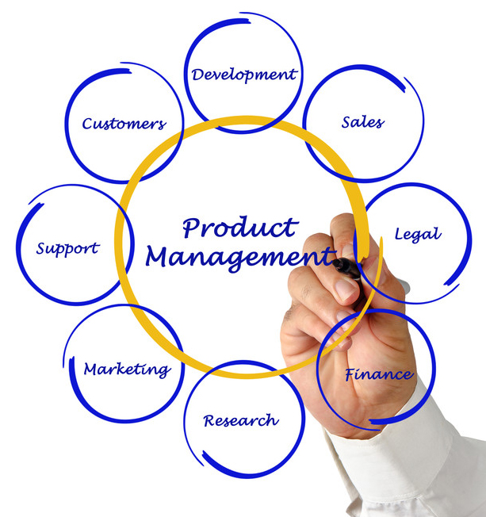
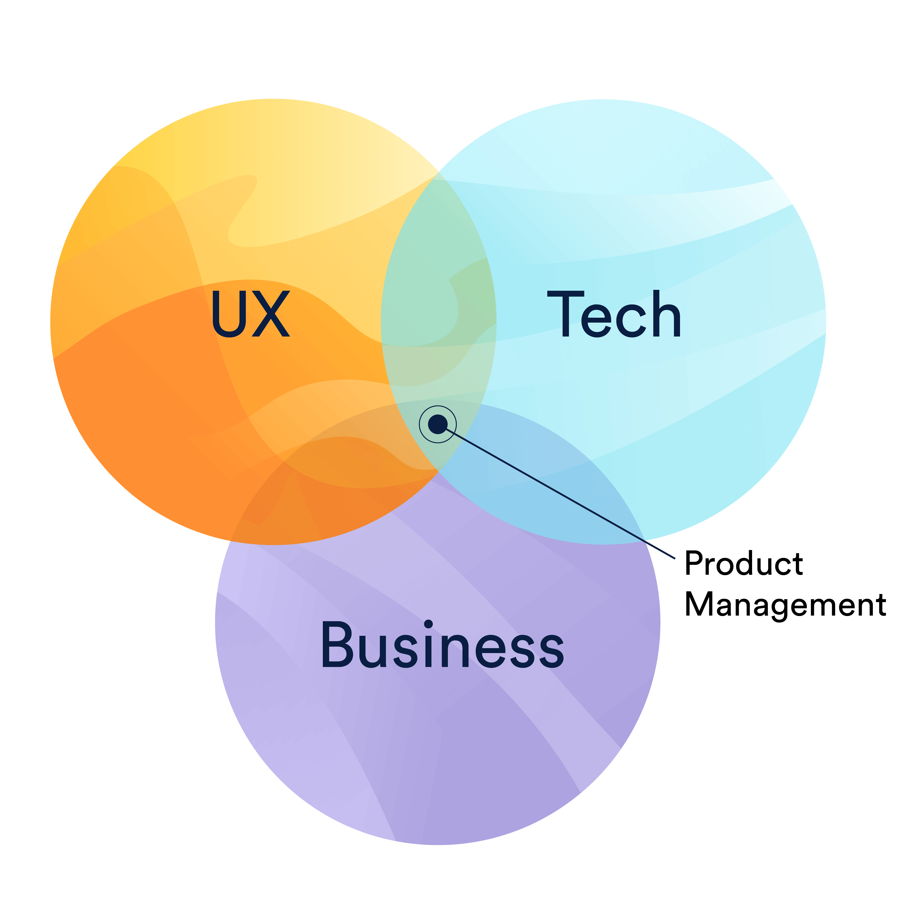
My Role as a Product Manager
Vaguely defining, the role of a Product Manager is to be the bridge between a need for a product to exist (Solving user problems) and making it possible for the product to exist (Design a feasible product for Tech to execute).

Slide 5
Stages of a Product’s Birth
Product Strategy
Organizational success metrics
Product vision
Discovery
User problem identification
Alignment with Product vision
Analysis and Design
Data analytics to assess impact
Ideate user flows and take user feedback
Assess Tech feasibility
Planning
Sprint prioritization
Backlog maintainance
Implementation
Development
Validation
Regression Testing
UAT Testing
Product Launch
Unit Testing
User Feedback
Product Maintenance

Slide 6

Product Analysis : The need for Prototyping

Slide 7
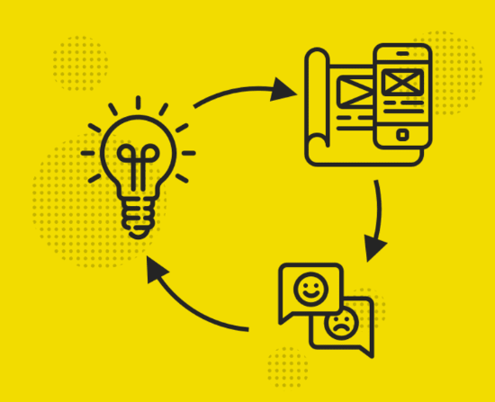
What is Prototyping?
As a Product Manager, one key decision that needs to be taken before any product implementation is the UX flow i.e. How the system is going to respond during various interaction points with the user and whether the user agrees to the response or not.
The best way to find out is to let the user use the product and provide feedback before the product is even developed.
How can we make that possible?
PROTOTYPING!
Prototyping 13/04/2024

Slide 8
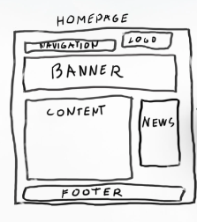
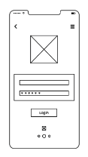
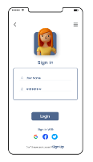
Forms of Prototyping
Low Fidelity
Rough high-level representation of the feature
Medium Fidelity
More polished state of prototype consisting of all basic functionalities of the feature
High Fidelity
Most polished form of prototype providing an accurate representation of the feature
Prototyping 13/04/2024

Slide 9
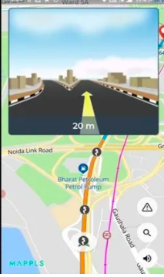

Prototypes leading to Product Maturity
Prototyping 13/04/2024

Slide 10
Types of Prototyping Models
Rapid (Throwaway) Prototyping
Explore multiple ideas and get user feedback for each
The probability of the best solution taken is maximum
Most effective when the feature is smaller in nature
Evolutionary Prototyping
Very limited features are initially developed, and additional features are incorporated based on user feedback
Most effective when the user requirement is vague or exploratory in nature
Incremental Prototyping
The feature is broken into smaller features and each prototype is developed in parallel
Most effective when the feature can be broken down into multiple fragments
Extreme Prototyping
Build the entire wireframes first -> Simulate service layers to make the existing wireframe interactive -> Implement the service layer as a scaled down version
Most effective for web development projects where designing the wireframe is almost equivalent to designing the front end
Notes:
Rapid prototyping : Adding offers into an existing Product details page
Evolutionary Prototyping : Adding a Product details page to a e-commerce site
Incremental Prototyping : Designing each stages of a customer journey from entering an ecommerce site to checkout individually as a prototype
Extreme Prototyping : Designing an entire e-commerce website first without the backend flow

Slide 11
Advantages and Disadvantages of Prototyping
Disadvantages
Costly considering investment of time of resources
May increase complexity due to customer feedback
Scalability may become an issue for actual product
User feedback may be biased towards certain demographics
User may get a false sense of completion of the product and request for timelines which are not feasible
Advantages
Improves Customer Satisfaction
Identifying Missing functionalities
Increasing Customer Adoption
Reduces Risk of Failure
Increases clarity of requirement improving the quality of the final product
Notes:
Scalability challenge: Increased page loading time

Slide 12


When to use Prototyping
When the product requirements are vague
When the user requirements are not clear for the dominant user demographics
When user flows are too complex
When user are available for the inputs, feedback, and sign offs
Developing an E-commerce website for fashion shopping
Developing a feature to download Bank statement for Customers

Slide 13
Prototype Tools
Balsamiq
Figma

Slide 14
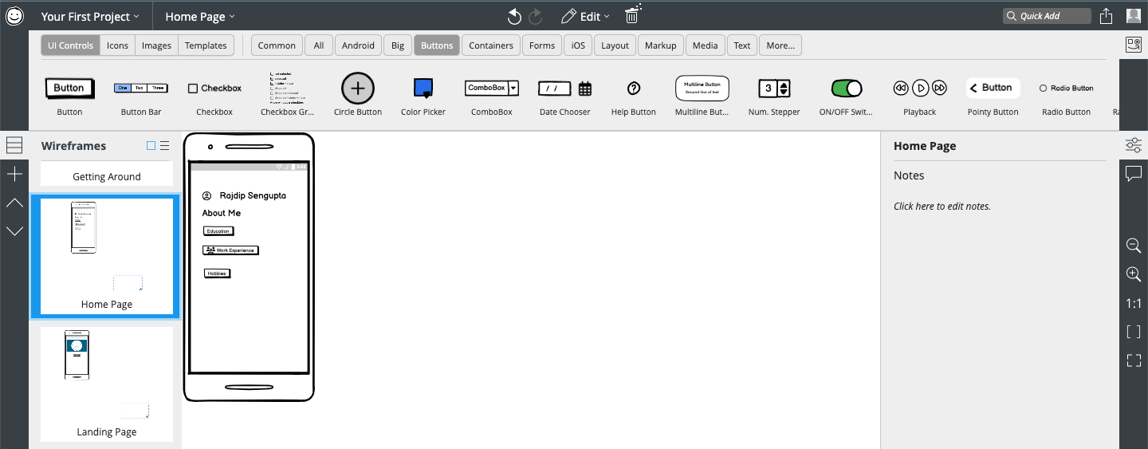
Balsamiq
Released in March 2008, Balsamiq Wireframes is a user interface design tool for creating wireframes (sometimes called mock-ups or low-fidelity prototypes).
You can use it to generate digital sketches of your idea or concept for a mobile application or website, to facilitate discussion and understanding before any code is written.
Notes:
Rapid prototyping : Adding offers into an existing Product details page
Evolutionary Prototyping : Adding a Product details page to a e-commerce site
Incremental Prototyping : Designing each stages of a customer journey from entering an ecommerce site to checkout individually as a prototype
Extreme Prototyping : Designing an entire e-commerce website first without the backend flow

Slide 15
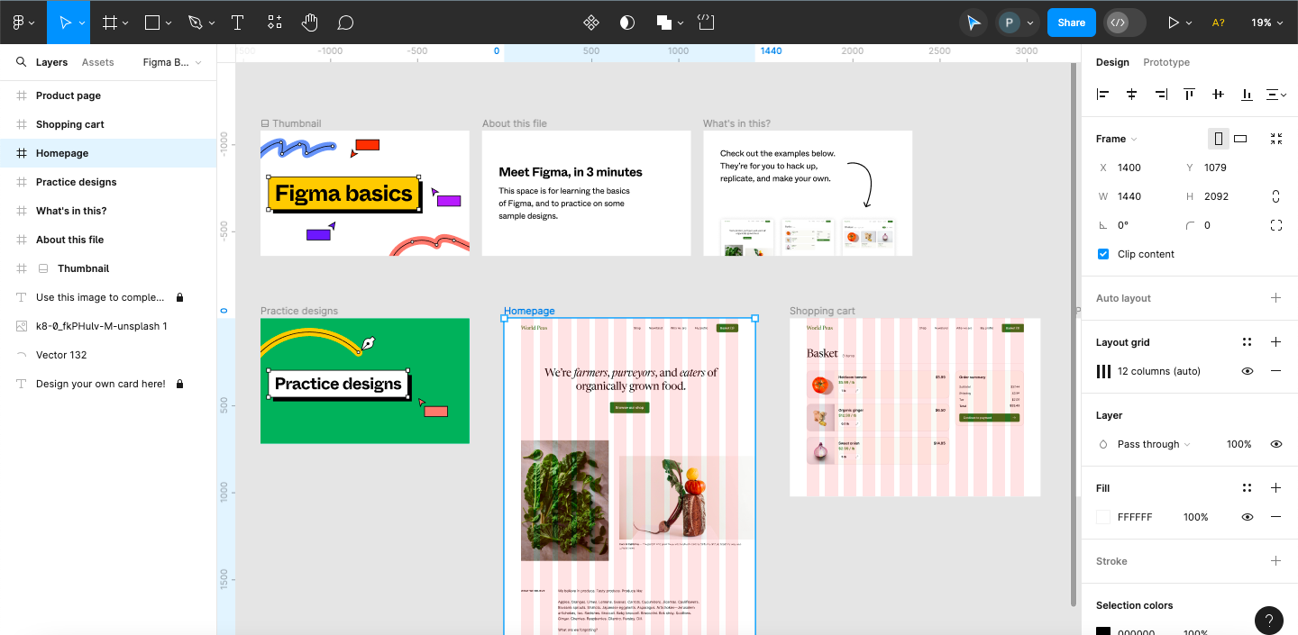
Figma
Released in September 2016, Figma design is for people to create, share, and test designs for websites, mobile apps, and other digital products and experiences. It is a popular tool for designers, product managers, writers and developers and helps anyone involved in the design process contribute, give feedback, and make better decisions, faster.
It is a tool extensively used by organizations for Wireframes as well as Interactive prototypes

Slide 16
Prototype Demo
Prototyping 13/04/2024

Slide 17
Q&A

Slide 18
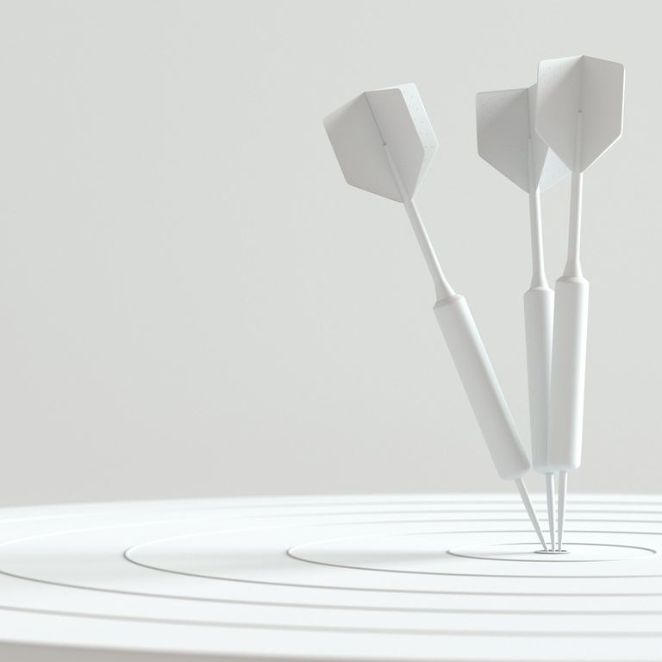
Thank you
Thanks to your commitment and participation throughout the session
For any queries feel free to write to me at:
Email ID:
Rajdip.sengupta17@iimranchi.ac.in
Prototyping 13/04/2024

