Slide 1

Prototyping
Instructor:
Dr. Sushil Kumar
Assistant Professor
Entrepreneurship , IIM Visakhapatnam

Slide 2
WHAT IS A PROTOTYPE?
A prototype is an approximation of the product along one or more dimensions of interest.

Slide 3
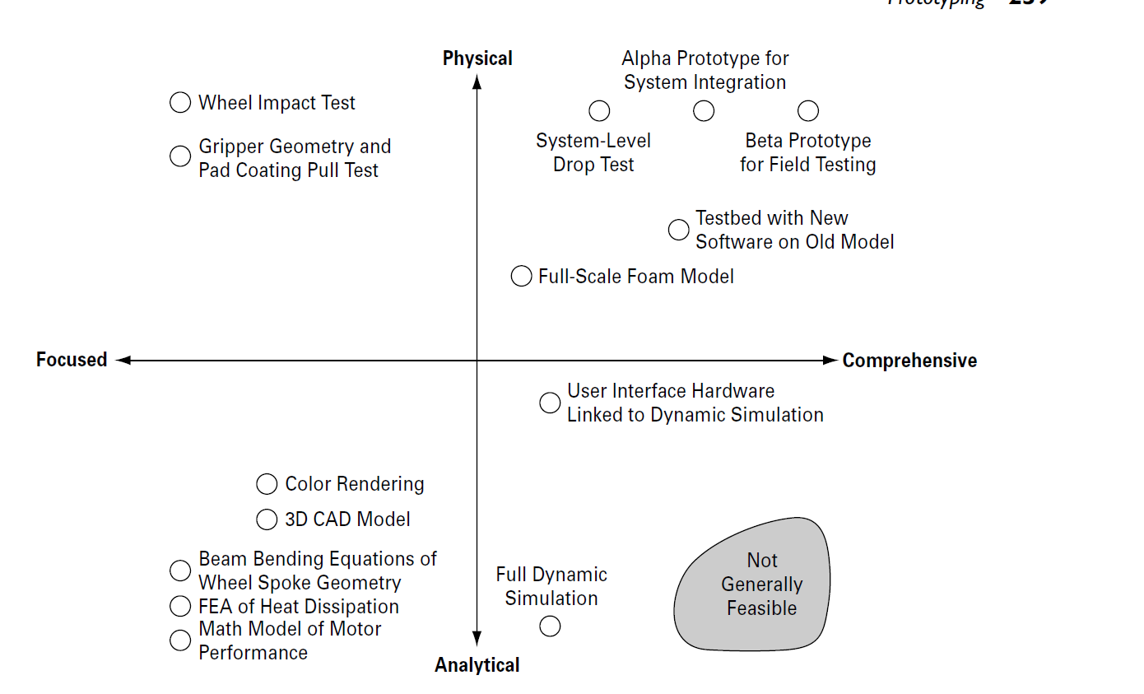
Types of prototypes. Prototypes can be classified according to the degree to which they are physical and the degree to which they implement all of the attributes of the product.

Slide 4
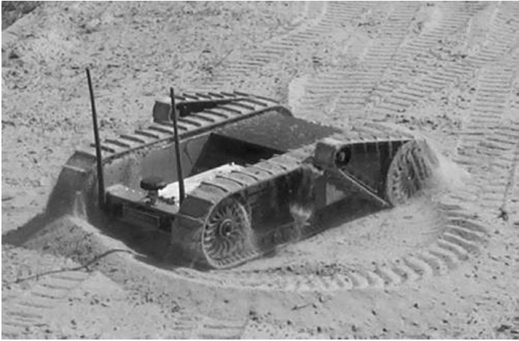
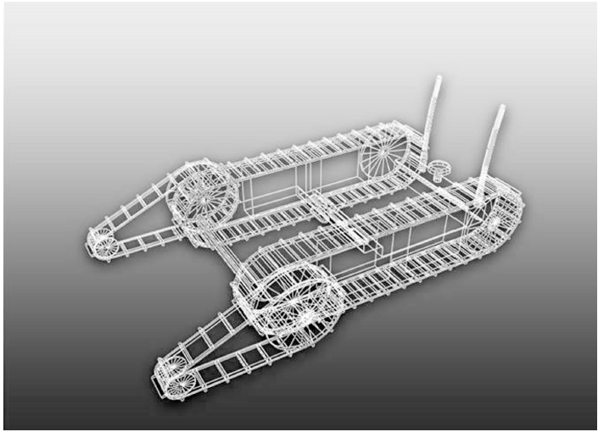
An example of Physical Prototype
An example of Analytical Prototype

Slide 5
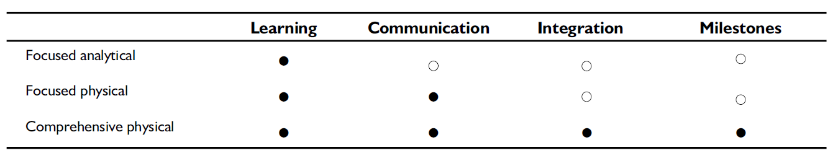
Appropriateness of different types of prototypes for different purposes (• = more appropriate, □= less appropriate).

Slide 6
PRINCIPLES OF PROTOTYPING
Analytical Prototypes Are Generally More Flexible than Physical Prototypes
Physical Prototypes Are Required to Detect Unanticipated Phenomena
Cont…

Slide 7
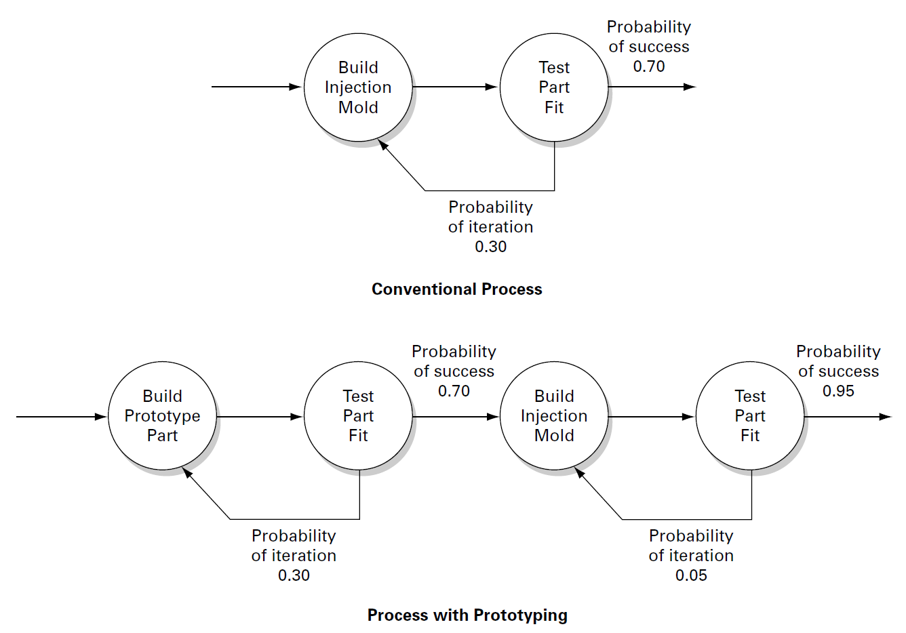
3. A Prototype May Reduce the Risk of Costly Iterations

Slide 8
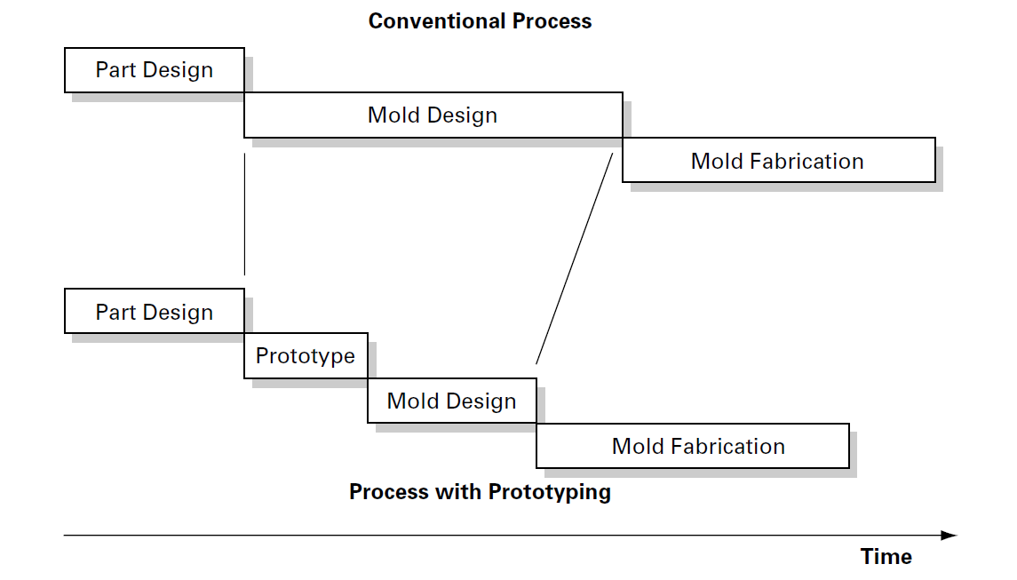
4. A Prototype May Expedite Other Development Steps

Slide 9
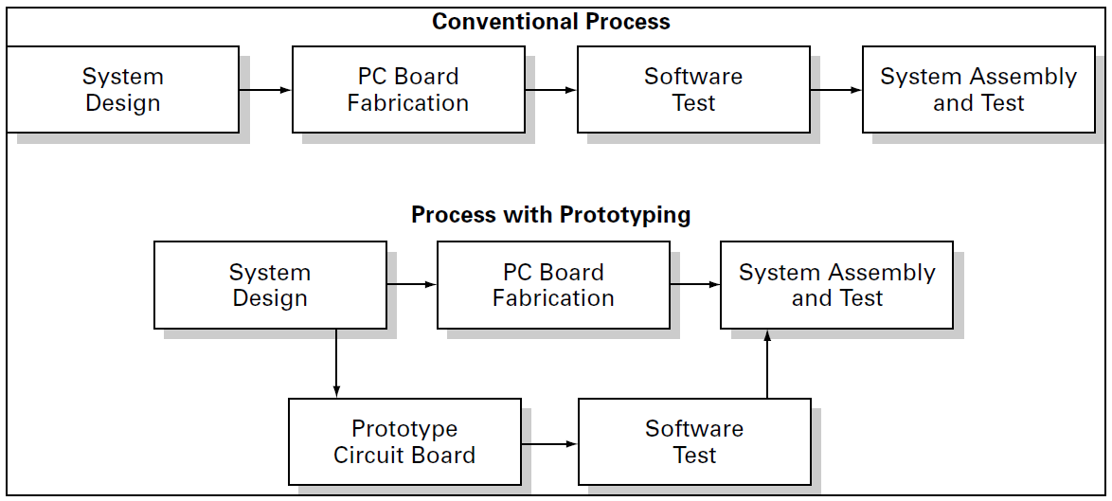
5. A Prototype May Restructure Task Dependencies
Use of a prototype to remove a task from the critical path

Slide 10
PROTOTYPING TECHNOLOGIES
3D CAD Modeling and Analysis
Free-Form Fabrication

Slide 11
PLANNING FOR PROTOTYPES
Step 1: Define the Purpose of the Prototype
Step 2: Establish the Level of Approximation of the Prototype
Step 3: Outline an Experimental Plan
Step 4: Create a Schedule for Procurement, Construction, and Testing

Slide 12
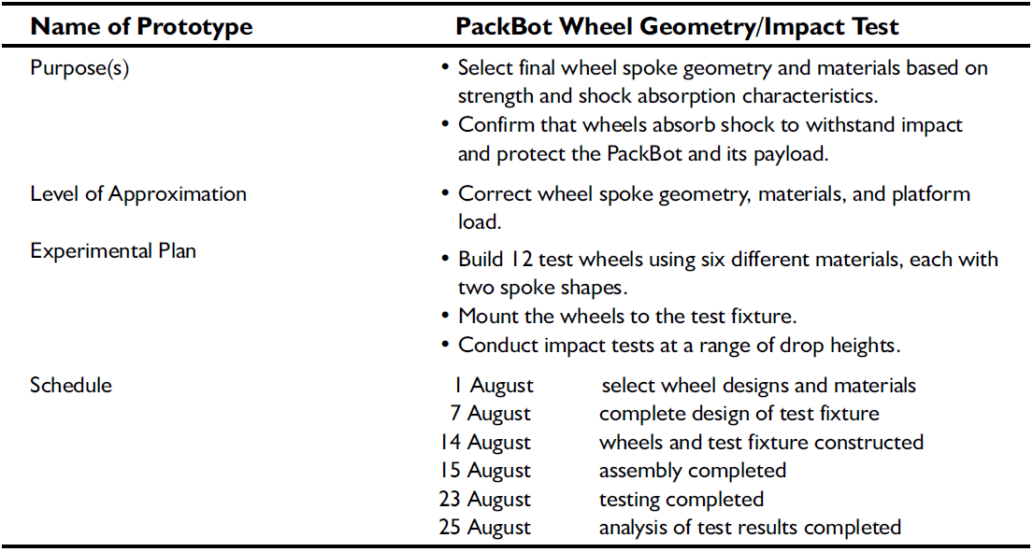
Planning template for the PackBot wheel geometry/impact test prototypes

Slide 13
Planning Milestone Prototypes
Alpha prototypes
Beta prototypes
Preproduction prototypes/ Pilot-production prototypes

