Slide 1

Project Team Management

Slide 5
Selecting the Project Team
At what point is the project team formed?
Who should select the project team?
What types of people should be on the team?
How do the team members get started?

Slide 6
Characteristics of Effective Teams
An effective project team has:
A clear understanding of the project objective
Clear expectations of each person’s role and responsibilities
A result orientation
A high degree of cooperation and collaboration
An atmosphere of open communication
A high level of trust

Slide 8
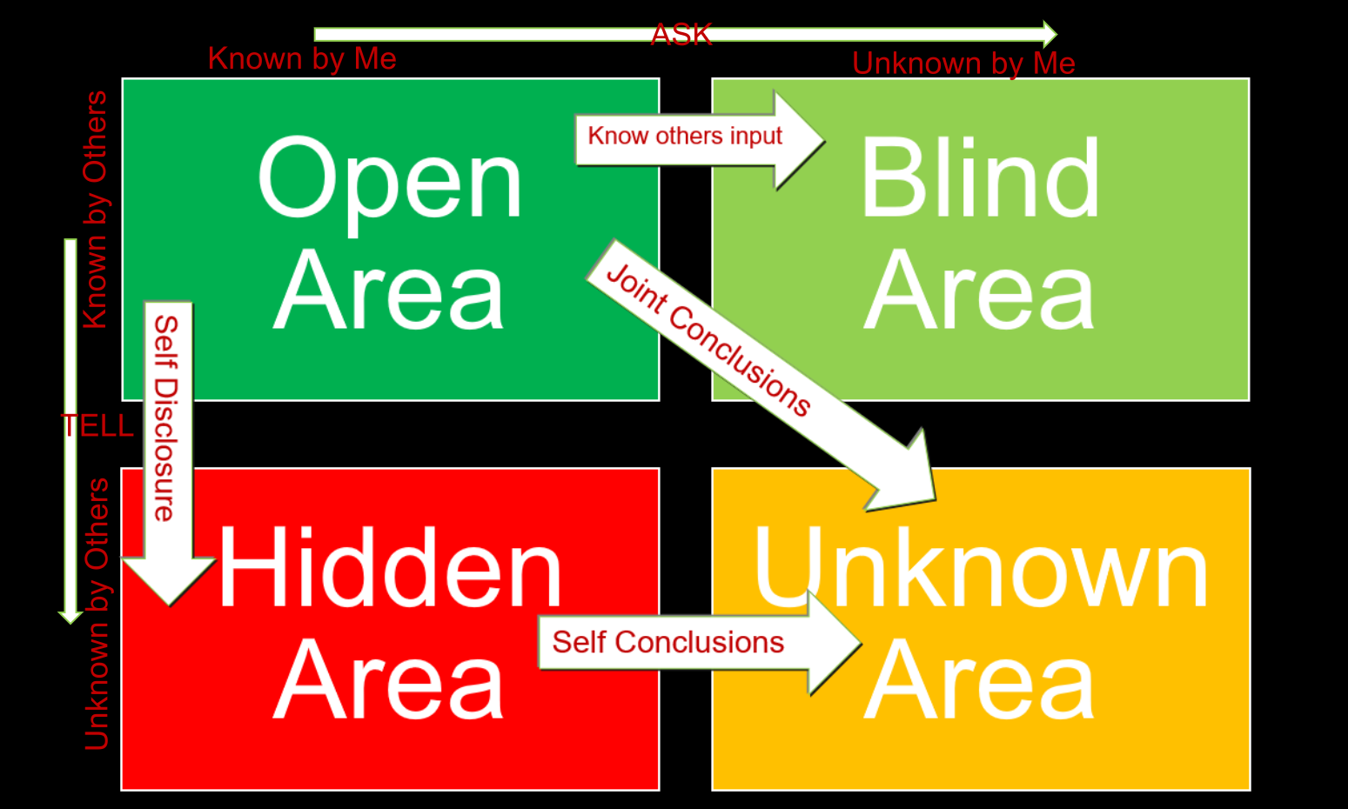

Slide 16
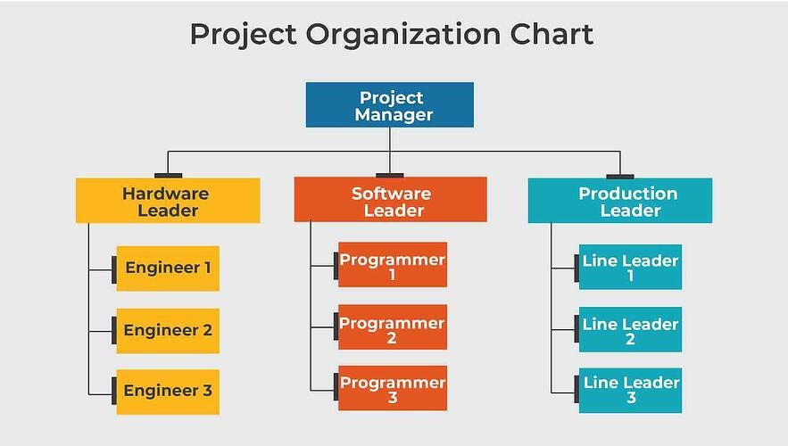

Slide 17
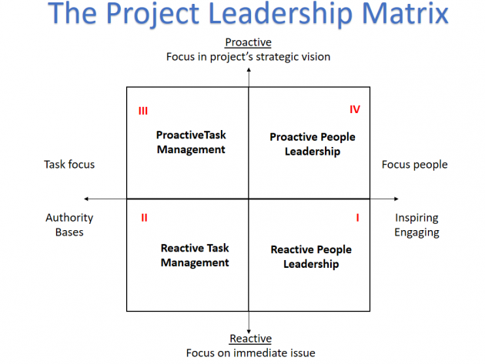

Slide 18
Management Styles
Most people believe that a participative management style works best with project teams
  It gives more empowerment to team members and
  Allows them to be more self-directed
  Requires less supervision by the PM

Slide 19
How to Empower People??
Give them CAR
Competency
Autonomy
Relatedness

Slide 20
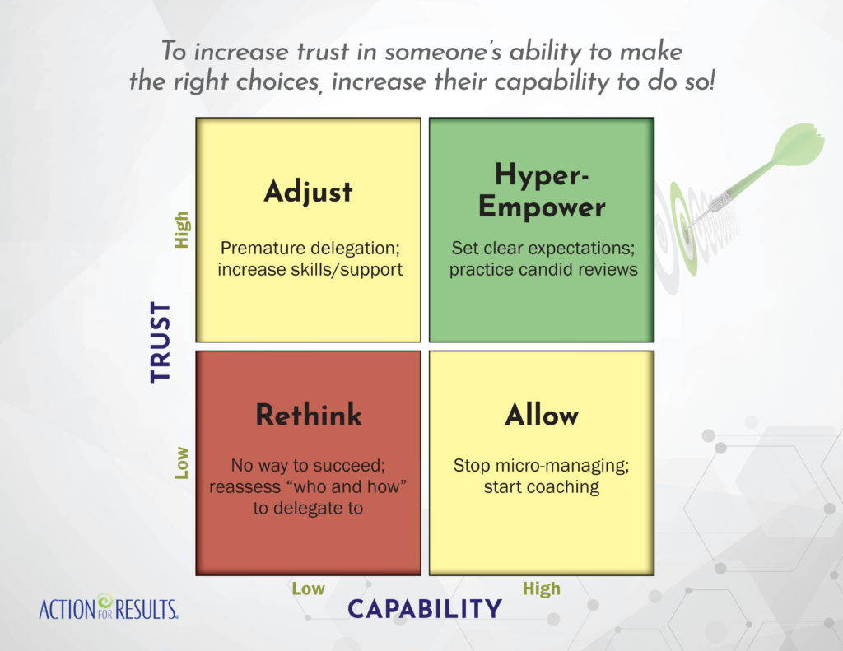

Slide 21
Conflict in Project Teams
Conflict is inevitable; PM should expect conflict
PM can anticipate and avoid some conflicts; others must be managed and resolved
PM can learn different approaches for managing and resolving conflict; it’s a learned skill
Fast conflict resolution is key to project success

Slide 22
PROJECT CONFLICTS AND RECOMMEND SOLUTIONS
Sources of Conflict | Definitions | Suggested Solutions
Conflict over project priorities | Views of project participants differ over sequence of activities and tasks. Includes goals incompatibility and differences in long-term versus short-term perspectives. | Develop a master plan compatible with long-term strategies.
Conflict over administration procedures | Conflicts over managerial and administrative issues of how the project will be organized and managed. | Clarify roles, responsibilities, and reporting relationships at the beginning of the project.
Conflict over technical opinions and performance trade-offs | Disagreements over technical issues, performance specifications, and technical trade-offs. | Use peer review and steering committees to review specifications and design.
Conflict over human resources | Conflicts concerning staffing and allocation of project personnel and where to get them and how. | Develop a work breakdown structure and a corresponding responsibility matrix.

Slide 23
Contd…
PROJECT CONFLICTS AND RECOMMEND SOLUTIONS
Conflict over cost and budget | Conflict over cost estimates from support areas regarding work breakdown structures and estimating techniques. | Develop overall budgets supported by detailed budget and cost estimates of subproject tasks and activities
Conflict over schedules | Disagreements about the timing, sequencing, and scheduling of project related tasks and information system to prepare and monitor project schedules. | Develop an overall schedule that integrates schedules for subprojects with staffing and other life constraints.
Personality conflict | Disagreements on Interpersonal issues. | Emphasize team building and create an environment that emphasizes respect, diversity, and equality.

Slide 24
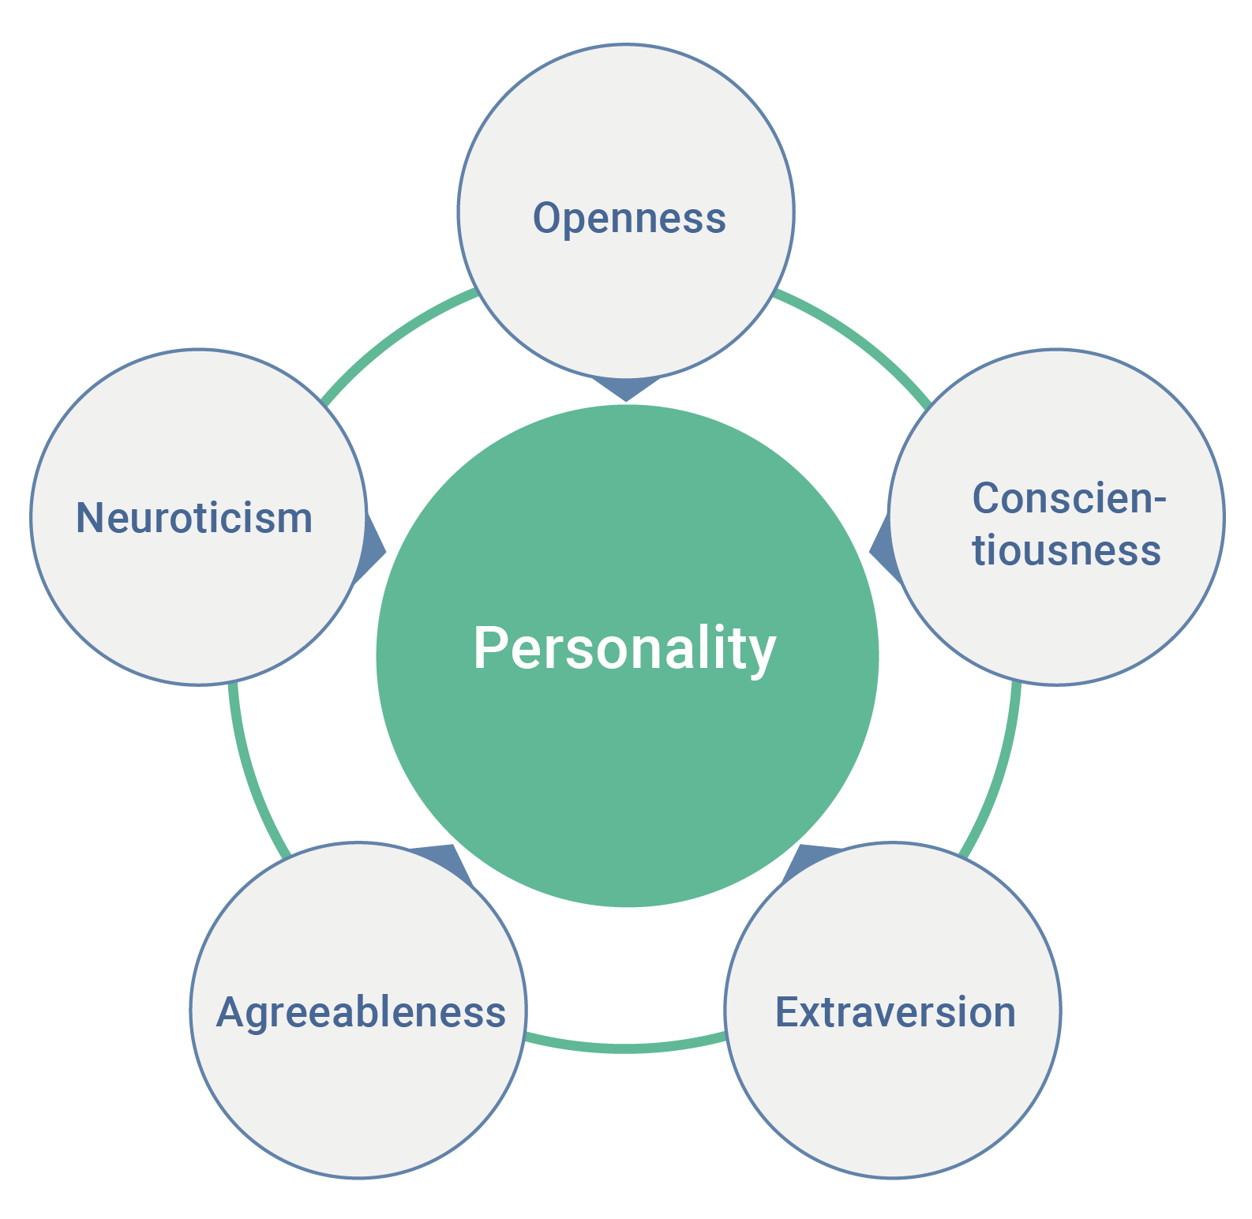

Slide 25
Root Causes of Conflict
Facts: People see the same fact from distinctly different viewpoints
Methods: People disagree on how to do something
Goals: The goals toward which people work are different
Values: People differ in their basic values

Slide 26
Managing Dysfunctional Conflict
5 Alternative Approaches to Managing Conflict:
Mediate the conflict – negotiate a solution
  emphasize urgency for the sake of project success
Arbitrate the conflict – impose a solution
  do what is best for project success
  try to allow both sides to save face
Control the conflict – reduce tensions; How?
Accept it – sometimes, learn to work around it
Eliminate people – if no longer tolerable
  remove one or both members from team

Slide 27
