Slide 1
Project Selection and Portfolio Management

Slide 2

Project Selection
Critical Decision
Highly sophisticated methods
Internal methods – technical concerns, available data, and corporate culture and preferences

Slide 3
Project Selection - Examples
Siemens
Every business unit in each of the 190 countries in which the company operates uses a system entitled “PM@Siemens” for categorizing projects that employs a two-digit code.
Each project is awarded a letter from A to F, indicating its significance to the company, and a number from 0 to 3, indicating its overall risk level.
Larger or riskier projects (e.g., an “A0”) require approval from Siemens’s main board in Germany, but many of the lesser projects (e.g., an “F3”) can be approved by local business units.
Too many A0s in the portfolio can indicate mounting risks while too many F3 projects may signal a lack of economic value overall.

Slide 4
Project Selection - Examples
The Royal Bank of Canada has developed a scoring model to rate its project opportunities.
The criteria for the portfolio scoring include:
  project importance – strategic importance, magnitude of impact, and economic benefits)
  ease of doing – cost of development, project complexity, and resource availability).
Expected annual expenditure and total project spending are then added to this rank-ordered list to prioritize the project options.
Decision rules are used (e.g., projects of low importance that are difficult to execute get a “no-go” rating).

Slide 5

Project Selection
Complexity and Consequences
Companies squander nearly billions of dollars on projects that are created but never used by their intended clients.
How do we make the most reasonable choices in selecting projects?
What kind of information should we collect?
Should decisions be based strictly on financial analysis, or should other criteria be considered?

Slide 6

Project Selection Models
Guidelines developed by organizational decision makers
To help managers pick winners from a pool of projects.
Suppose you were interested in developing a model that allowed you to effectively screen project alternatives.
How might you ensure that the model was capable of picking potential “winners” from the large set of possible project choices?
  High potential payoffs?
Would such a screening model be useful?

Slide 7
Project Selection Models – Critical Factors
Realism
Capability
Flexibility
Ease of use
Cost
Comparability

Slide 8

Project Selection Models – Decision Criteria
Risk—unpredictability to the firm
  Technical risk
  Financial risk
  Safety risk
  Quality risk
  Legal exposure

Slide 9

Project Selection Models – Decision Criteria
Commercial—market potential of the project
  Expected return on investment
  Payback period
  Potential market share
  Long-term market dominance
  Initial cash outlay
  Ability to generate future business/new markets

Slide 10

Project Selection Models – Decision Criteria
Internal operating—Change in internal operations
  Need to develop/train employees
  Change in workforce size or composition
  Change in physical environment
  Change in manufacturing or service operations resulting from the project
Additional factors, including:
  Patent protection
  Impact on company’s image
  Strategic fit

Slide 11
Project Selection Approaches
Checklist
Simple scoring models
Analytic hierarchy process
Profile models
Financial models

Slide 12
Project Selection Approaches – Checklist Model
A checklist is a list of criteria applied to possible projects.
Requires agreement on criteria
Assumes all criteria are equally important
Develop list of criteria that pertain to our choice of projects, and then apply them to different possible projects.
Simplest of all the models

Slide 13
Project Selection Approaches – Checklist Model
 |  | Performance
Project | Criteria | High | Medium | Low
Janus | Stategic fit |  | (×)
 | Prbability of technical success |  | (×)
 | Fiancial risk |  |  | (×)
 | Poential profit | (×)
 | Strategic leverage |  |  | (×)
Gemini | Stategic fit | (×)
 | Prbability of technical success |  | (×)
 | Fiancial risk |  | (×)
 | Poential profit | (×)
 | Stategic leverage |  | (×)
Checklists are valuable for recording opinions and encouraging discussion

Slide 14
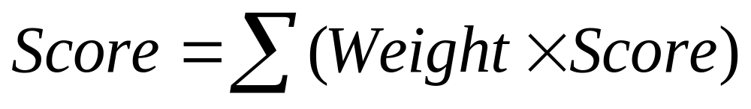
Project Selection Approaches – Simplified Scoring Models
Each project receives a score that is the weighted sum of its grade on a list of criteria. Scoring models require:
  agreement on criteria
  agreement on weights for criteria
  a score assigned for each criteria

Slide 15
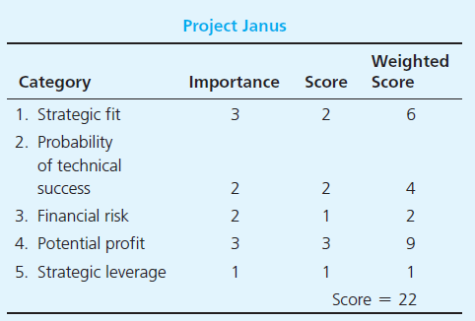
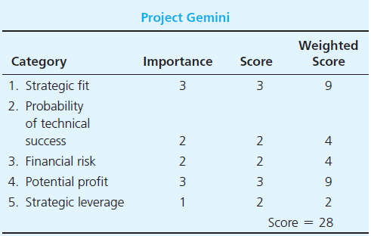
Project Selection Approaches – Simplified Scoring Models
Relative scores can be misleading!

Slide 16
Project Selection Approaches – Analytical Hierarchy Process
The AHP is a four-step process:
Construct a hierarchy of criteria and sub-criteria
Allocate weights to criteria
Assign numerical values to evaluation dimensions
Scores determined by summing the products of numeric evaluations and weights
Unlike the simple scoring model, these scores are comparable!

Slide 17
Project Selection Approaches – Analytical Hierarchy Process
First level | Second level
1. Financial benefits | 1A: Short-term
 | 1B: Long-term
2. Contribution to strategy | 2A: Increasing market share for product X;
 | 2B: Retaining existing customers for product Y;
 | 2C: Improving cost management
3. Contribution to IT infrastructure

Slide 18
Project Selection Approaches – Analytical Hierarchy Process
First level | Second level
1. Financial benefits (0.52) | 1A: Short-term (0.156)
 | 1B: Long-term (0.364)
2. Contribution to strategy (0.34) | 2A: Increasing market share for product X; (0.1020)
 | 2B: Retaining existing customers for product Y; (0.1564)
 | 2C: Improving cost management (0.0816)
3. Contribution to IT infrastructure (0.140)

Slide 19
Project Selection Approaches – Analytical Hierarchy Process
Evaluation Dimention | Numerical Value | Priority
Poor | 0 | 0
Fair | 10 | 0.05
Good | 30 | 0.15
Very Good | 60 | 0.3
Excellent | 100 | 0.5

Slide 20
Project Selection Approaches – Analytical Hierarchy Process
Evaluation Dimention | Numerical Value | Priority
Poor | 0 | 0
Fair | 10 | 0.05
Good | 30 | 0.15
Very Good | 60 | 0.3
Excellent | 100 | 0.5

Slide 21
Project Selection Approaches – Analytical Hierarchy Process
 | 1. Financial benefits (0.52) |  | 2. Contribution to strategy (0.34) |  |  | 3. Contribution to IT infrastructure (0.140)
Proj. | 1A: Short-term (0.156) | 1B: Long-term (0.364) | 2A: Increasing market share for product X; (0.1020) | 2B: Retaining existing customers for product Y; (0.1564) | 2C: Improving cost management (0.0816) |  | Total
 | 0.156 | 0.364 | 0.102 | 0.1564 | 0.0816 | 0.14 | 1
A | Excellent | Excellent | Excellent | Excellent | Excellent | Excellent | 1
B | Good | Excellent | Good | Excellent | Good | Excellent | 0.76228
C | Excellent | Good | Excellent | Good | Excellent | Good | 0.53772
D | Very Good | Very Good | Very Good | Very Good | Very Good | Very Good | 0.6
E | Poor | Fair | Good | Very Good | Excellent | Good | 0.28444

Slide 22
Project Selection Approaches – Profile Models
Show risk/return options for projects.
Requires:
  Criteria selection as axes
  Rating each project on criteria
X₆
Maximum Desired Risk
X₂
X₄
X₅
Risk
X₃
X₁
Efficient Frontier
Minimum
Desired Return
Return

Slide 23
Project Selection Approaches – Financial Models
Based on the time value of money principal
Payback period
Net present value
Internal rate of return
All of these models use discounted cash flows
Time value of money

Slide 24
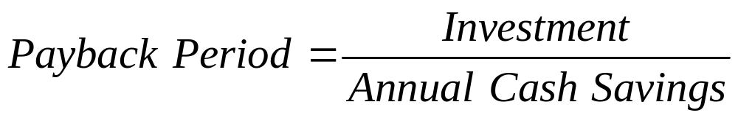
Project Selection Approaches – Payback period
Determines how long it takes for a project to reach a breakeven point
Lower numbers are better (faster payback)

Slide 25
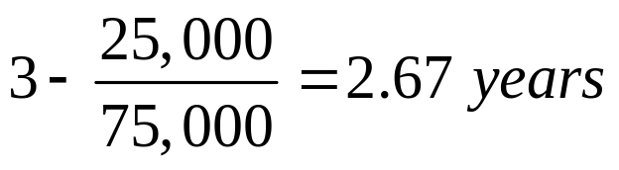
Project Selection Approaches – Payback period
A project requires an initial investment of $200,000 and will generate cash savings of $75,000 each year for the next five years. What is the payback period?
Divide the cumulative amount by the cash flow amount in the third year and subtract from 3 to find out the moment the project breaks even.
Year | Cash Flow | Cumulative
0 | ($200,000) | ($200,000)
1 | $75,000 | ($125,000)
2 | $75,000 | ($50,000)
3 | $75,000 | $25,000

Slide 26
Project Selection Approaches – Payback period
Calculate payback period for Nova Western.

Slide 27
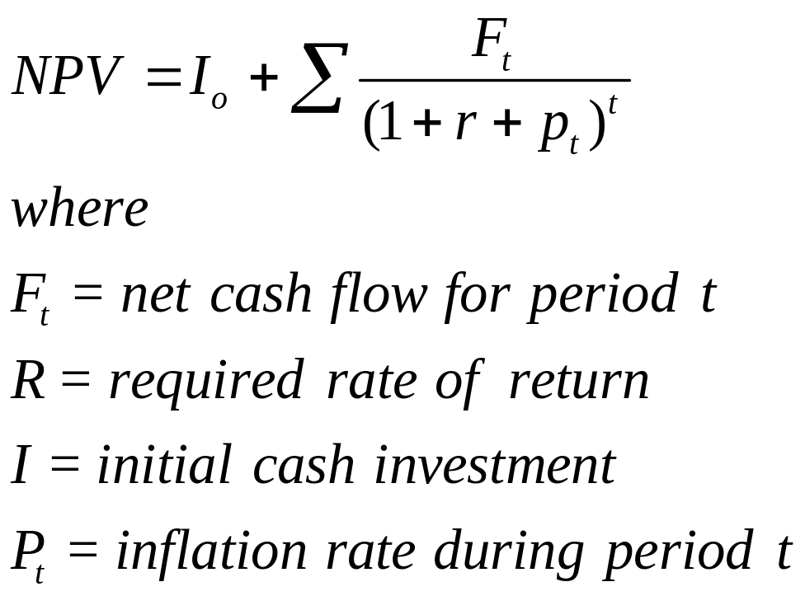
Project Selection Approaches – Net Present Value
Projects the change in the firm’s stock value if a project is undertaken.
Higher NPV values are better!

Slide 28
Project Selection Approaches – Net Present Value
Should you invest $60,000 in a project that will return $15,000 per year for five years? You have a minimum return of 8% and expect inflation to hold steady at 3% over the next five years.
Year | Net flow | Discount | NPV
0 | -$60,000 | 1.0000 | -$60,000.00
1 | $15,000 | 0.9009 | $13,513.51
2 | $15,000 | 0.8116 | $12,174.34
3 | $15,000 | 0.7312 | $10,967.87
4 | $15,000 | 0.6587 | $9,880.96
5 | $15,000 | 0.5935 | $8,901.77
 |  |  | -$4,561.54
The NPV column total is -$4561, so don’t invest!

Slide 29
Project Selection Approaches – Net Present Value
Calculate NPV for Nova Western.

Slide 30
Project Selection Approaches – Discounted Payback period
A project requires an initial investment of $200,000 and will generate cash savings of $75,000 each year for the next five years. What is the payback period? Calculate with a discount rate of 8%
Year | Cash Flow | Cumulative
0 | ($200,000) | ($200,000)
1 | $75,000 | ($125,000)
2 | $75,000 | ($50,000)
3 | $75,000 | $25,000
Cash flows should be discounted

Slide 31
Project Selection Approaches – Discounted Payback period
Calculate discounted payback period for Nova Western.

Slide 32
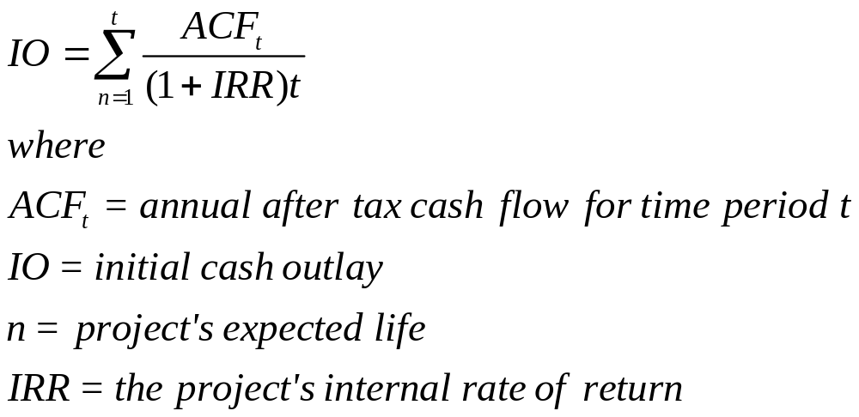
Project Selection Approaches – Internal Rate of Return
A project must meet a minimum rate of return before it is worthy of consideration.
Higher IRR values are better!

Slide 33
Project Selection Approaches – Internal Rate of Return
A project that costs $40,000 will generate cash flows of $14,000 for the next four years. You have a rate of return requirement of 17%; does this project meet the threshold?
Year | Net flow | Discount | NPV
0 | -$40,000 | 1.0000 | -$40,000.00
1 | $14,000 | 0.9009 | $12,173.91
2 | $14,000 | 0.8116 | $10,586.01
3 | $14,000 | 0.7312 | $9,205.23
4 | $14,000 | 0.6587 | $8,004.55
 |  |  | -$30.30
This table has been calculated using a discount rate of 11%
The project doesn’t meet our 17% requirement and should not be considered further.

Slide 34
Case
Scoring Method
Advantages
  Appropriate to use in terms of knowing whether a project is aligned with the company's strategic goals or not.
  Easy to use and to comprehend as well
Disadvantages
  The rating scale (1 3 or above) that is used is not very accurate.
  There is no certainty whether the link between the selected/chosen criteria and the company's strategic goals are 100% aligned or not

Slide 35
Case
AHP:
Advantages
  Ability to rank choices relative to their effectiveness in meeting conflicting objectives Ability to detect inconsistent judgments.
Disadvantages
  It only works because the matrices are all of the same mathematical form known as a positive reciprocal matrix.
  The rating scale that is used is not very accurate and is not standardized

Slide 36
Case
NPV:
Advantages
  Easy method to execute.
  Ensures that the company will invest in a project that will definitely generate profit.
Disadvantages
  Ignores probabilities and risk.
  Assumes that financial projections are accurate.
  Assumes that strategic considerations are irrelevant.
  Fails to deal with constrained resources.
  Difficulty in making accurate long-term predictions.

Slide 37
Case
Payback Period
  Advantages
    Allows the company to make a more intelligent determination of the length of time needed to satisfy the initial project investment(Pinto, 2010)
    Easy to compute
  Disadvantages
    Leaves out information regarding profitability during project payback periods as well as any profits made after payback periods end.

Slide 38
Project Selection Approaches – Multiple Projects
Excel Solver

