Slide 1
Project Management
Dr. Anurag Tiwari
Assistant Professor
IIM Rohtak

Slide 2
Learning Objectives
After completing this chapter, you should be able to:
Understand the importance of scope management for project success.
Understand the significance of developing a scope statement.
Construct a Work Breakdown Structure (WBS) for a project.
Construct a Organization Breakdown Structure (OBS) for a project.
Construct a Cost Breakdown Structure (CBS) for a project.
Critical Path Method (CPM)

Slide 3
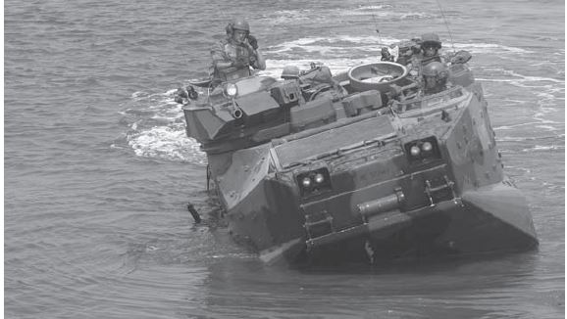
Case: The Expeditionary Fighting Vehicle

Slide 4
Expeditionary Fighting Vehicle
A state-of-the-art acquisition program for the Department of Defense (DoD).
began to replace the 1970s-era Amphibious Assault Vehicle.
The purpose was to provide armored support
The contract was awarded to General Dynamics Corporation (GDC) in June 1996 for full engineering and design work.
In 2001 the contract was further signed for system development and demonstration (SDD).

Slide 5
Expeditionary Fighting Vehicle
Far-too-ambitious schedule became a problem for GD and a series of technical problems began to surface.
Two additional years were added to the SDD
In December 2004, tests of EFV prototypes demonstrated:
  severe failure in the vehicle’s main computer system,
  causing the vehicle’s steering to freeze.
  hydraulic systems began leaking and failing.
Originally intended to operate for an average of 70 hours, which later reduced to 43.5 hours.

Slide 6
Expeditionary Fighting Vehicle
an additional two years were added
In 2006,
  the vehicles were able to operate for only 4.5 hours b/w each breakdown
  took nearly 3.5 hours of corrective maintenance
  poor reliability resulted in 117 mission failures
  could only completed 2 out of 11 amphibious tests,
  1 out of 10 gunnery tests,
  and none of the land mobility tests.

Slide 7
Expeditionary Fighting Vehicle
Initially Marines planned to purchase 1,025 of them at a total cost of $8.5 billion.
DoD estimated the program’s cost at more than $14 billion dollars, and reduced the order to 573 vehicles.
The cost of the EFV risen from $8.3 million/vehicle to more than $23 million.

Slide 8
Expeditionary Fighting Vehicle
So where was the problem lying?
Why the project incurred huge cost and consumed unnecessary time?
What was the outcome?

Slide 9
Project failure
More than 68% of IT projects fail (Source: TechRepublic)
75% of IT executives believe their projects are “doomed from the start” (Source: Geneca)
50% of all Project Management Offices (PMOs) close within just three years (Source: KeyedIN)
57% of projects fail due to “breakdown in communications” (Study source)
39% of projects fail due to lack of planning, resources, and activities (Study source)
For every $1 billion invested in the United States, $122 million was wasted due to poor performance (Source: PMI.org)

Slide 10
Causes of Project Failure
  Inaccurate requirements – 38%
  Change in project objectives – 35%
  Poor communication – 30%
  Undefined project goals – 30%
  Inadequate cost estimates – 29%
  Inaccurate task time estimate – 27%
  Resource dependency – 25%
  Poor change management – 25%
  Inexperienced project manager – 20%
  Limited resources – 20%

Slide 11
Projects
Projects
  Unique, one-time operations designed to accomplish a specific set of objectives in a limited time frame
  Examples:
    The Olympic Games
    Producing a movie
    Software development
    Product development
    ERP implementation

Slide 12
The Nature of Projects
Projects go through a series of stages – a life cycle
Projects bring together people with a diversity of knowledge and skills, most of whom remain associated with the project for less than its full life
Organizational structure affects how projects are managed

Slide 13
Project Life Cycle
Initiating
Planning
Executing
Monitoring and Controlling
Closing

Slide 14
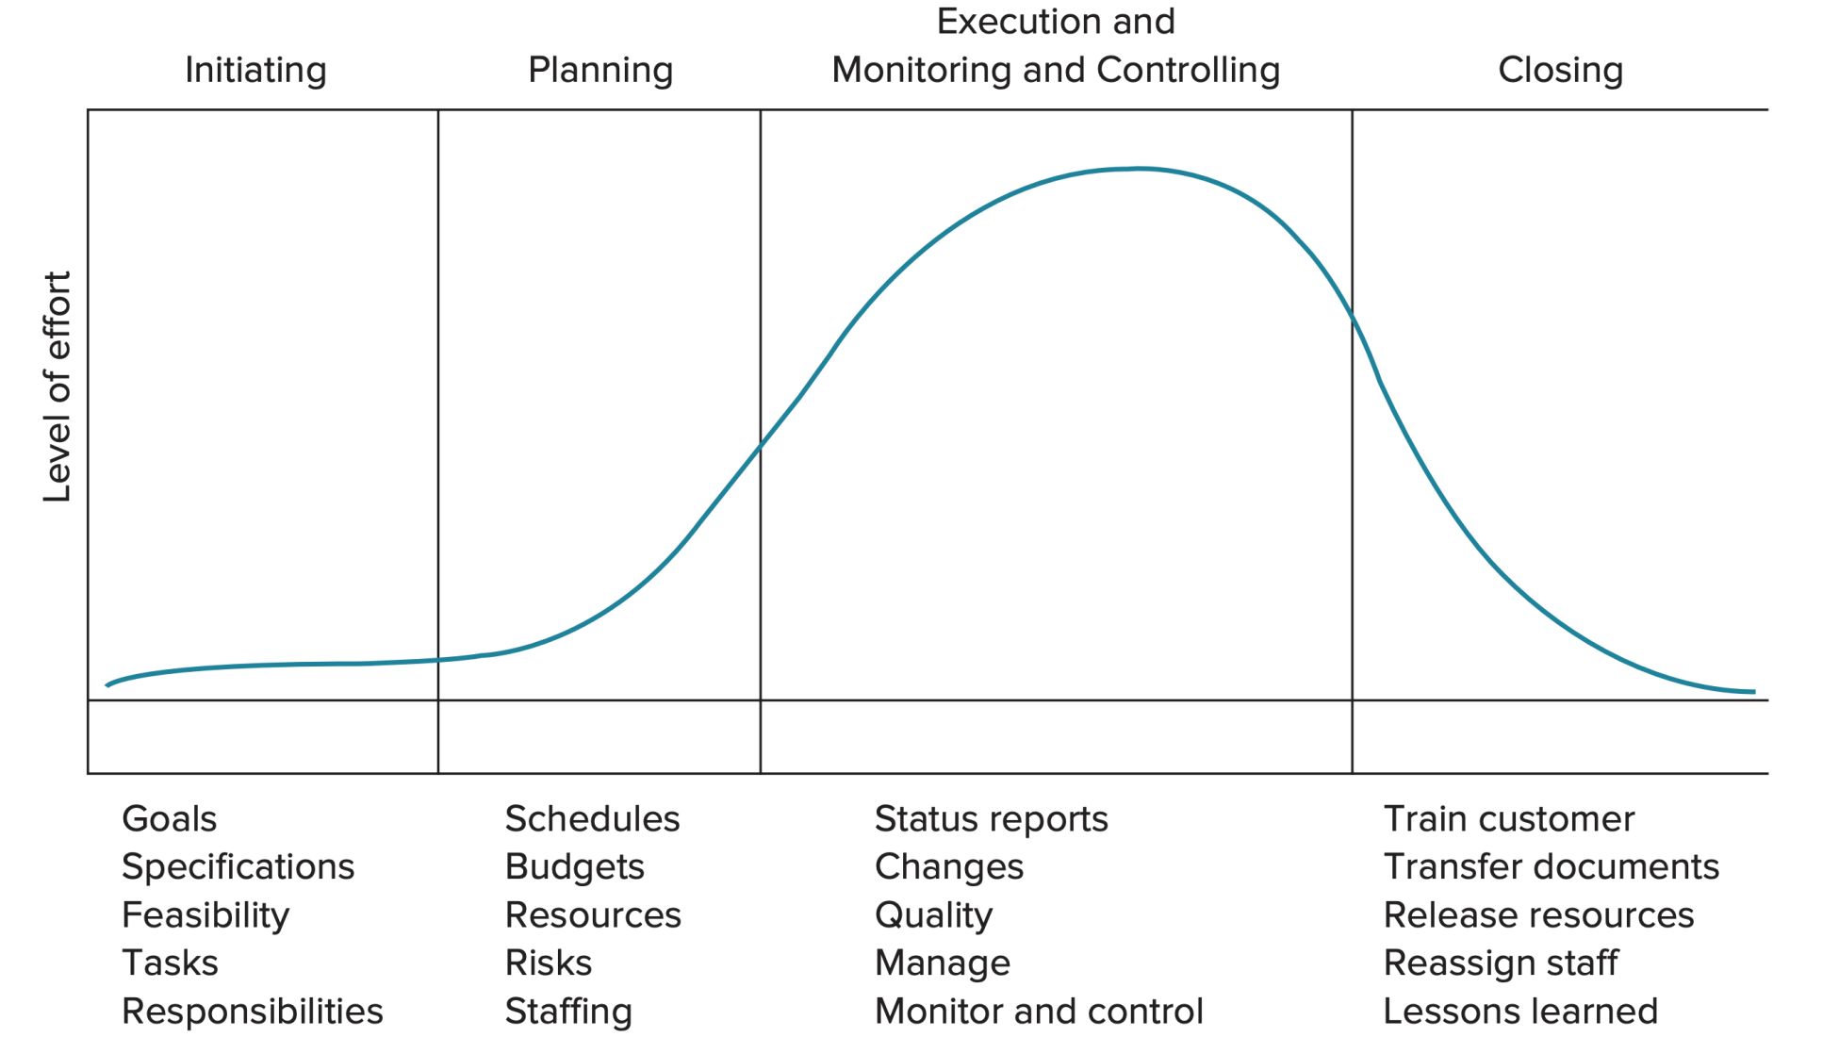
Project Life Cycle (cont.)

Slide 15
Project Scope Management
Project Scope Management includes the processes required to ensure that the project includes all the work required.
It is primarily concerned with defining and controlling what is or is not included in the project.
Figure provides an overview of the major project scope management processes:

Slide 16
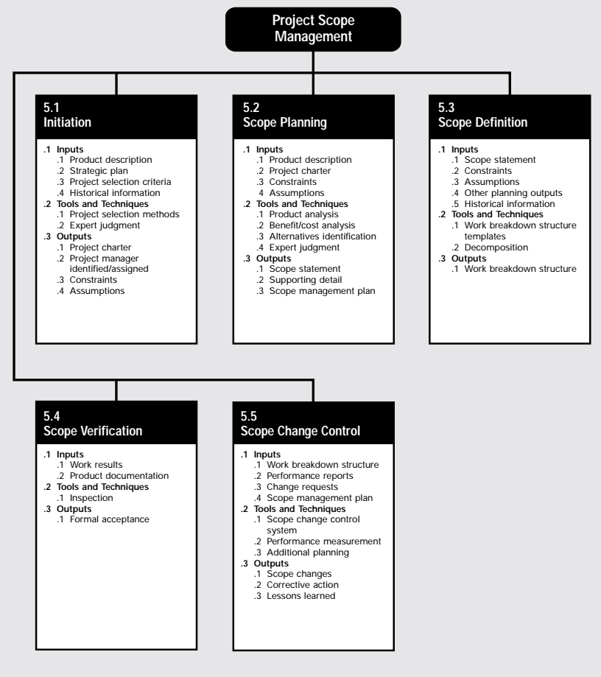
Project Scope Management

Slide 17
Project Scope Management
Initiation—committing the organization to begin the next phase of the project.
Scope Planning—developing a written scope statement as the basis for future project decisions.
Scope Definition—subdividing the major project deliverables into smaller,
more manageable components.
Scope Verification—formalizing acceptance of the project scope.
Scope Change Control—controlling changes to project scope

Slide 18
Project Scope Management
Controlling a project in terms of its goals and objectives and consists of:
  Conceptual development
    Statement of work
  Scope statement
    Work Break down structure
    Organization Break down structure
    Cost Break down structure
  Work authorization
  Scope reporting
  Control systems
  Project closeout

Slide 19
Project Scope Management
In the project context, the term “scope” may refer to
Product scope—the features and functions that are to be included in a product or service.
Project scope—the work that must be done in order to deliver a product with the specified features and functions.

Slide 20
Work Break Down Structure
Dividing complex projects to simpler and manageable tasks is the process identified as work breakdown structure(WBS).
Usually, the project manager use this method for simplifying the project execution.
In WBS, much larger tasks are broken-down to manageable chunks of work. These chunks can be easily supervised and estimated.
A work breakdown structure element may be a product, data a service or any combination.
A WBS also provides the necessary framework for detailed cost estimating and control along with providing guidance for schedule development and control.

Slide 21
Example of Outlined WBS.
Project Name
Task 1
Subtask 1.1
Work Package 1.1.1
Work Package 1.1.2
Subtask 1.2
Work Package 1.2.1
Work Package 1.2.2
Task 2
Subtask 2.1
Work Package 2.1.2
Work Package 2.1.2

Slide 22
WBS Helps Manager
Facilitates evaluation of cost, time and technical performance of the organization on a project.
Provides management with information appropriate to each organizational level.
Help in the development of the organization breakdown structure.
Help manager plan, schedule, and budget.

Slide 23
Process of WBS
First, let’s look at what al we need to get started. There are several inputs you will need to get you off on the right foot.
The project scope statement
The project scope management plan.
Organizational process Assets
Approve change requests.

Slide 24
How to built a WBS
Begins with the Charter, focusing on objectives and Deliverables
Break the main product(s) down into sub products.
Set the structure to match how you’ll manage the project
Lowest level not too detailed, not too large.
Is there a need for integration?
Identify support activities
Check of completeness-is all the effort included?
Develop a coding structure if needed
Assign work package managers.

Slide 25
Example
Consider the case of a large, urban hospital that has made the decision to introduce an organization-wide IT system for:
  billing,
  accounts receivable,
  patient record keeping,
  personnel supervision,
  and the medical process control.
The first step in launching this large installation project is to identify the important elements in introducing the technology.

Slide 26
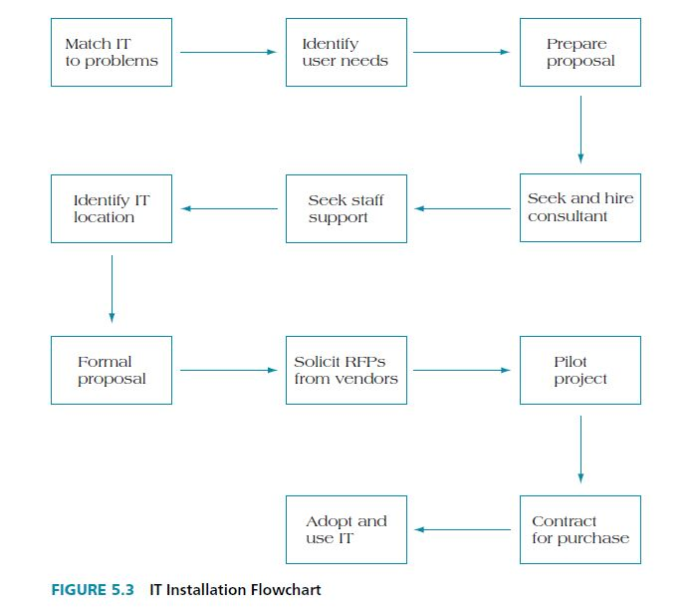
Example
Here is a basic approach to identifying the deliverables in a project to install a new information system for an organization.

Slide 27
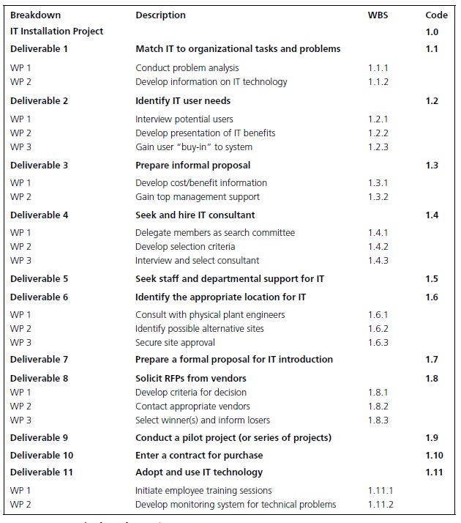

Slide 28
Organizational Breakdown Structure

Slide 29
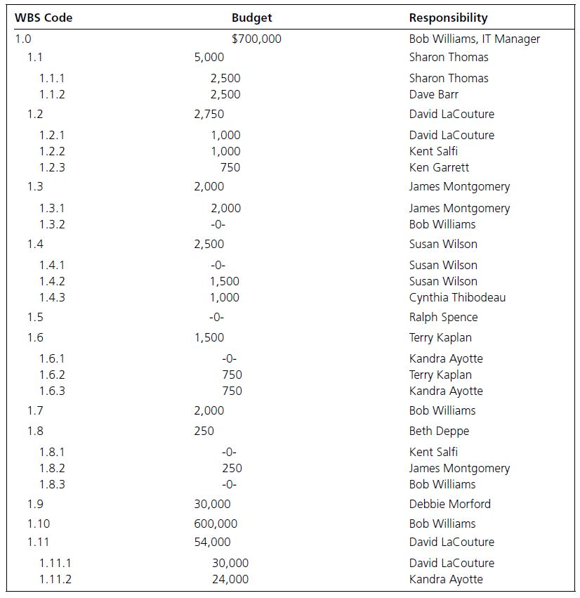

Slide 30
Critical Path Method
By using CPM, you will be able to answer questions such as:
When will the entire project be completed?
What are the critical activities or tasks in the project, that is, the ones that will delay the entire project if they are late?
Which are the noncritical activities, that is, the ones that can run late without delaying the whole project’s completion time?
At any particular date, is the project on schedule, behind schedule, or ahead of the schedule?
On any given date, is the money spent equal to, less than, or greater than the budgeted amount?

Slide 31
Critical Path-Example
3 Weeks
4 Weeks
2 Weeks
A
C
D
Start
Finish
B
E
F
4 Weeks
1 Weeks
3Weeks

Slide 32
Critical Path
Start – B – E – F – Finish: 8 weeks
Start – A – C – D – Finish: 9 weeks
Start – B – C – D – Finish: 10 weeks
The critical path is path B-C-D that which is of 10 weeks. WHY?
if activity D is delayed 1 week, the project will be delayed with 1 week.
But if activity E is delayed 1 week, it will not delay the project WHY?

Slide 33
Information Contents in an AON Node
Earliest Start Time (EST)
Duration
Earliest Finish Time (EFT)
Activity Name
Latest Start Time (LST)
Total Float
Latest Finish Time (LFT)

Slide 34
Example
Activity | Predecessor | Duration (days)
a | - | 5
b | - | 4
c | a | 3
d | a | 4
e | a | 6
f | b,c | 4
g | d | 5
h | d,e | 6
i | f | 6
j | g,h | 4

Slide 35
Finding the critical path
c 3
a 5
d 4
start
e 6
b 4

Slide 36
Finding the critical path
d 4
g 5
i 4
a 5
e6
h 6
finish
start
j 6
c 3
f 4
b 4

Slide 37
Finding the critical path
5 9
9 14
d4
g 5
17 21
i 4
0 5
7 11
5 11
12 17
11 17
a 5
17 21
12 18
e 6
h 6
finish
0 5
11
5 8
j 6
start
11 17
c3
8 12
15 21
0 4
8 11
f 4
b 4
11 15
7 11

Slide 38
Example
Activity | EST | EFT | LST | LFT | Slack Time
A | 0 | 5 | 0 | 5 | 0
B | 0 | 4 | 7 | 11 | 7
C | 5 | 8 | 8 | 11 | 3
D | 5 | 9 | 7 | 11 | 2
E | 5 | 11 | 5 | 11 | 0
F | 8 | 12 | 11 | 15 | 3
G | 9 | 14 | 12 | 17 | 3
H | 11 | 17 | 11 | 17 | 0
I | 12 | 18 | 15 | 21 | 3
J | 17 | 21 | 17 | 21 | 0

Slide 39
Example: Cool Homes (P) Ltd
Activity | Description | Immediate Predecessors | Duration
A | Design/Approval of plan | — | 8
B | Foundation/Superstructure | A | 12
C | Select and order accessories | A | 4
D | Wiring for building | B | 2
E | Carpentry Works | B | 8
F | Laying of roof | D | 2
G | Wall Plastering/Laying floors/painting | E, F | 3
H | Fixing fittings (Sanitary, electrical, etc.) | C, G | 2
I | Obtaining power/Water connection | E, F | 2
J | Final Polishing, testing, handover | I, H | 2

Slide 40
Critical path
D(2)
F(2)
B(12)
I(2)
Start
A(8)
J(2)
Finish
E(8)
G(3)
C(4)
H(2)

Slide 41
Critical path
20 22
22 24
D(2)
F(2)
8 20
28 30
B(12)
I(2)
0 8
33 35
Start
A(8)
J(2)
Finish
20 28
28 31
E(8)
G(3)
8 12
31 33
C(4)
H(2)

Slide 42
Critical path
20 22
22 24
D(2)
F(2)
8 20
24 26
26 28
28 30
B(12)
I(2)
0 8
33 35
Start
A(8)
8 20
31 33
J(2)
Finish
20 28
28 31
0 8
E(8)
G(3)
33 35
20 28
28 31
8 12
31 33
C(4)
H(2)
27 31
31 33

Slide 43
Cool Homes (P) Ltd
Activity | Early Start | Early Finish | Late start | Late finish | Total Slack
A | 0 | 8 | 0 | 8 | 0
B | 8 | 20 | 8 | 20 | 0
C | 8 | 12 | 27 | 31 | 19
D | 20 | 22 | 24 | 26 | 4
E | 20 | 28 | 20 | 28 | 0
F | 22 | 24 | 26 | 28 | 4
G | 28 | 31 | 28 | 31 | 0
H | 31 | 33 | 31 | 33 | 0
I | 28 | 30 | 31 | 33 | 3
J | 33 | 35 | 33 | 35 | 0

Slide 44
Hard Rock Cafe
The Hard Rock Café owns cafes, hotels and conducts live concerts and annual Rockfest
The Rockfest is attended by over 100,000 fans
Planning time nine months
10 major tasks were identified:
  Talent booking, Ticketing, PR, Online promotion, Television, Show production, travel, etc.
These activities were divided into a series of 26 sub-tasks

Slide 45
Hard Rock Cafe
ACTIVITY | IMMEDIATE PREDECESSORS | ACTIVITY | IMMEDIATE PREDECESSORS
A | NA | N | C
B | A | O | G, R
C | A | P | B
D | B | Q | B
E | D | R | Q
F | E | S | R, X
G | F | T | A
H | B | V | T
I | H | V | T
J | I | W | V
K | C | X | U
L | D, K | Y | B
M | L | Z | Y

Slide 46
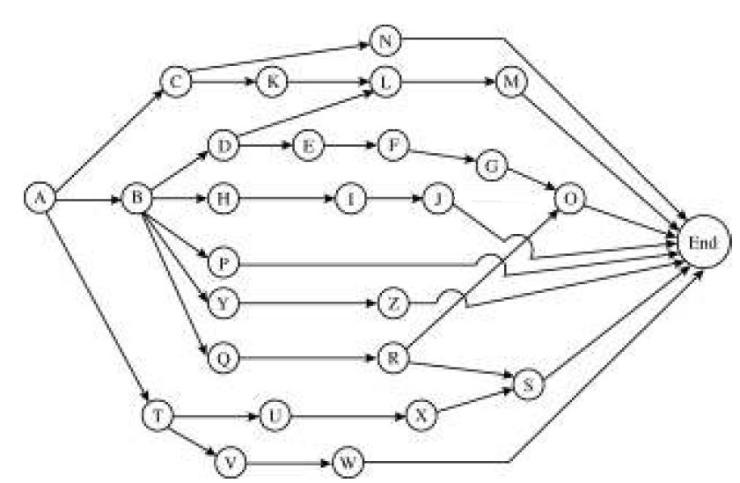

Slide 47
N6
C3
K2
L3
M8
D4
E6
F4
G2
H4
I4
J10
O7
A7
B3
P20
END
Y6
Z6
Q4
R4
S3
T4
U6
X8
V7
W4

Slide 48
ACTIVITY | Early start | Early finish | Late start | Late finish | Total Slack
A | 0 | 7 | 0 | 7 | 0
B | 7 | 10 | 7 | 10 | 0
C | 7 | 10 | 18 | 21 | 11
D | 10 | 15 | 10 | 15 | 0
E | 15 | 21 | 15 | 21 | 0
F | 21 | 25 | 21 | 25 | 0
G | 25 | 27 | 25 | 27 | 0
H | 10 | 14 | 16 | 20 | 6
I | 14 | 18 | 20 | 24 | 6
J | 18 | 28 | 24 | 34 | 6
K | 10 | 12 | 21 | 23 | 11
L | 15 | 18 | 23 | 26 | 8
M | 18 | 26 | 26 | 34 | 8

Slide 49
ACTIVITY | Early start | Early finish | Late start | Late finish | Total Slack
N | 10 | 16 | 28 | 34 | 8
O | 27 | 34 | 27 | 34 | 0
P | 10 | 30 | 14 | 34 | 4
Q | 10 | 14 | 19 | 23 | 9
R | 14 | 18 | 23 | 27 | 9
S | 25 | 28 | 31 | 34 | 6
T | 7 | 11 | 11 | 15 | 4
U | 11 | 17 | 17 | 23 | 6
V | 11 | 18 | 23 | 30 | 12
W | 18 | 22 | 30 | 34 | 12
X | 17 | 25 | 23 | 31 | 6
Y | 10 | 16 | 22 | 28 | 12
Z | 16 | 22 | 28 | 34 | 12

Slide 50
Hard Rock’s Rockfest
Challenge for Managers:
Keeping in touch with each person responsible for major activities
Managing 100000 fans entering the venue
Bottleneck in tasks with longer duration
Overshooting of cost
Resignations of any of the key manager

Slide 51
Work Break Down Structure
Website (D) Level 3
TV Deal (E)
Hire Director(F)
Camera Placement (G) level4
Select local Promoter(B) level2
Headline Entertainers(H)
Support Entertainers (I)
Travel for Talent(J)
Staff travel (P)
Merchandise Details(Y)
Online sales of Merchandise (Z)
Hire Sponsors(Q)
Finalize Sponsors(R)
Rockfest Event, with Site selected (A) Level 1
Signage for Sponsors(S)
Hire Production Manager ©
Sound/staging (N)
Ticketmaster contract(L)
Venue Capacity(K)
Onsite ticketing(M)
Passes and stage credential (O)
Site Plan(U)
Power, etc (X)
Hire Operations Manager(T)
Security director(V)
St police/fire plan (W)

Slide 52
WBS Six Main Purpose
Highlights the project objectives
Gives an organization chart
Create logic for tracking cost, schedule and performance specification
Communication project status
Avoid project miscommunication
Demonstrate control structure

Slide 53
Using Slack Times
Knowledge of slack times provides managers with information for planning allocation of scarce resources
  Control efforts will be directed toward those activities that might be most susceptible to delaying the project
  Activity slack times are based on the assumption that all of the activities on the same path will be started as early as possible and not exceed their expected time
  If two activities are on the same path and have the same slack, this will be the total slack available to both

Slide 54
Probabilistic Time Estimates
The beta distribution is generally used to describe the inherent variability in time estimates
The probabilistic approach involves three time estimates:
  Optimistic time, (t_{o})
    The length of time required under optimal conditions
  Pessimistic time, (t_{p})
    The length of time required under the worst conditions
  Most likely time, (t_{m})
    The most probable length of time required

Slide 55
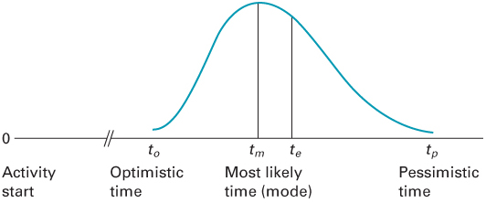
The Beta Distribution

Slide 56
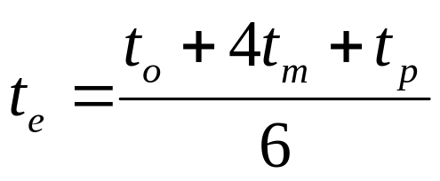
Probabilistic Time Estimates (2 of 3)
The expected time, t_{e} ,for an activity is a weighted average of the three time estimates:
The expected duration of a path is equal to the sum of the expected times of the activities on that path:
17-56

Slide 57
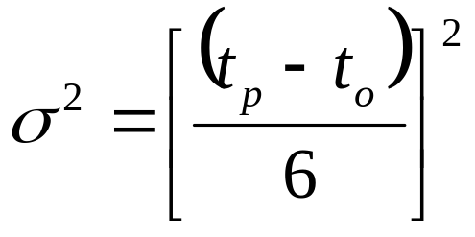
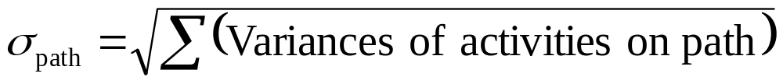
Probabilistic Time Estimates (3 of 3)
The standard deviation of each activity’s time is estimated as one-sixth of the difference between the pessimistic and optimistic time estimates. The variance is the square of the standard deviation:
Standard deviation of the expected time for the path:
17-57

Slide 58
Knowledge of Path Statistics
Knowledge of expected path times and their standard deviations enables managers to compute probabilistic estimates about project completion such as:
  The probability that the project will be completed by a certain time
  The probability that the project will take longer than its expected completion time

Slide 59
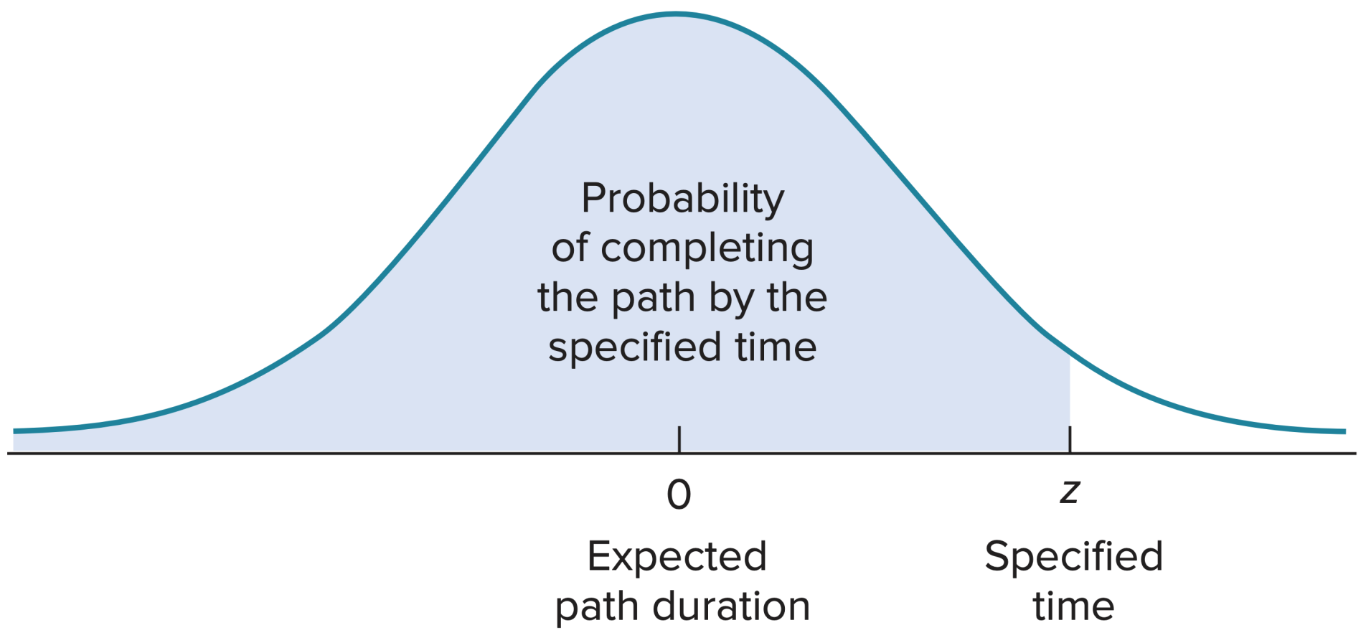
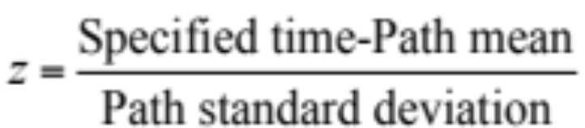
Determining Path Probabilities

Slide 60
Project Completion Time
A project is not complete until all project activities are complete
It is risky to only consider the critical path when assessing the probability of completing a project within a specified time
  To determine the probability of completing the project within a particular time frame
    Calculate the probability that each path in the project will be completed within the specified time
    Multiply these probabilities
  The result is the probability that the project will be completed within the specified time

Slide 61
Assumption: Independence
Independence
  Assumption that path duration times are independent of each other
    Requires that
      Activity times are independent
      Each activity is on only one path
    The assumption of independence is usually considered to be met if only a few activities in a large project are on multiple paths

Slide 62
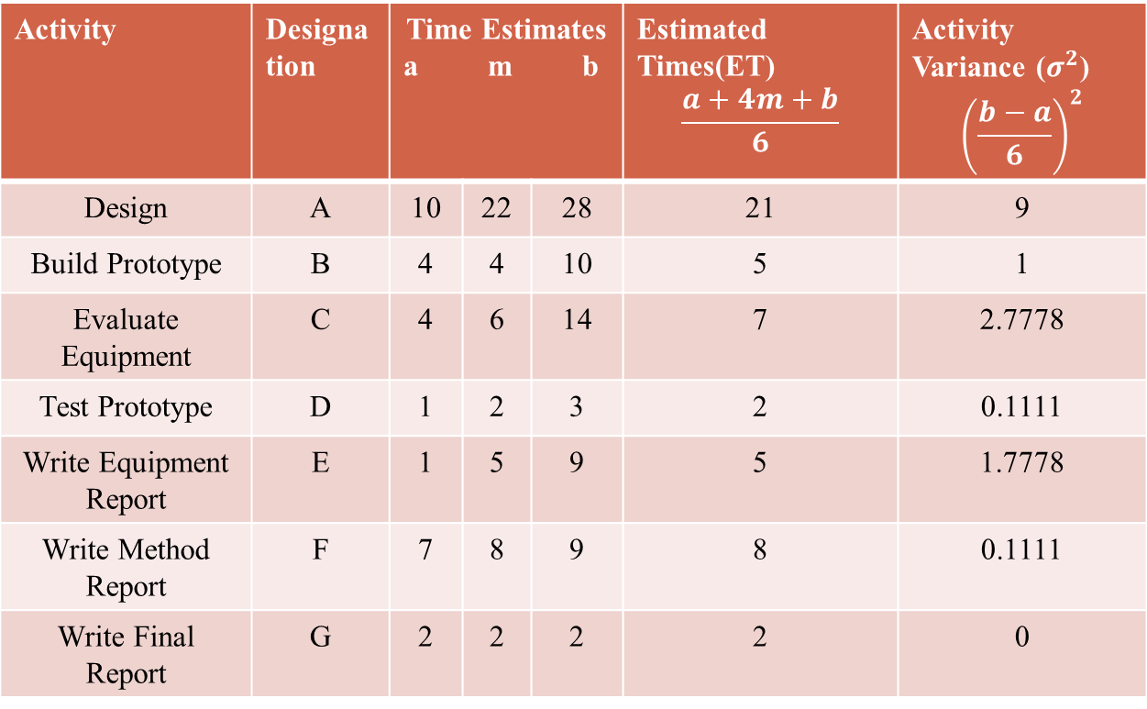
Pert Example
Activity | Designation | Time Estimates a m b |  |  | Estimated Times(ET) $$\frac{a+4m+b}{6}$$ | Activity Variance ($σ^{2}$) $${\left(\frac{b−a}{6}\right)}^{2}$$
Design | A | 10 | 22 | 28 | 21 | 9
Build Prototype | B | 4 | 4 | 10 | 5 | 1
Evaluate Equipment | C | 4 | 6 | 14 | 7 | 2.7778
Test Prototype | D | 1 | 2 | 3 | 2 | 0.1111
Write Equipment Report | E | 1 | 5 | 9 | 5 | 1.7778
Write Method Report | F | 7 | 8 | 9 | 8 | 0.1111
Write Final Report | G | 2 | 2 | 2 | 2 | 0

Slide 63
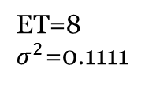
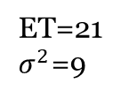
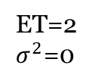
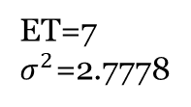
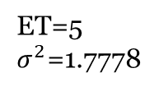
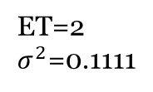
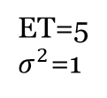
Example
ET=7
$σ^{2}$=2.7778
21 28
28 36
ET=8
$σ^{2}$=0.1111
C(7)
F(8)
0 21
21 28
28 36
36 38
A(21)
ET=21
$σ^{2}$=9
G(2)
21 26
26 28
28 33
0 21
36 38
B(5)
D(2)
E(5)
ET=2
$σ^{2}$=0
21 26
26 28
31 36
ET=5
$σ^{2}$=1
ET=2
$σ^{2}$=0.1111
ET=5
$σ^{2}$=1.7778

Slide 64
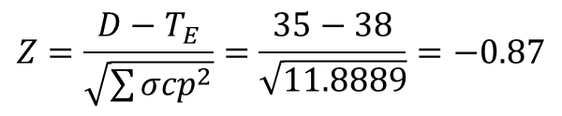
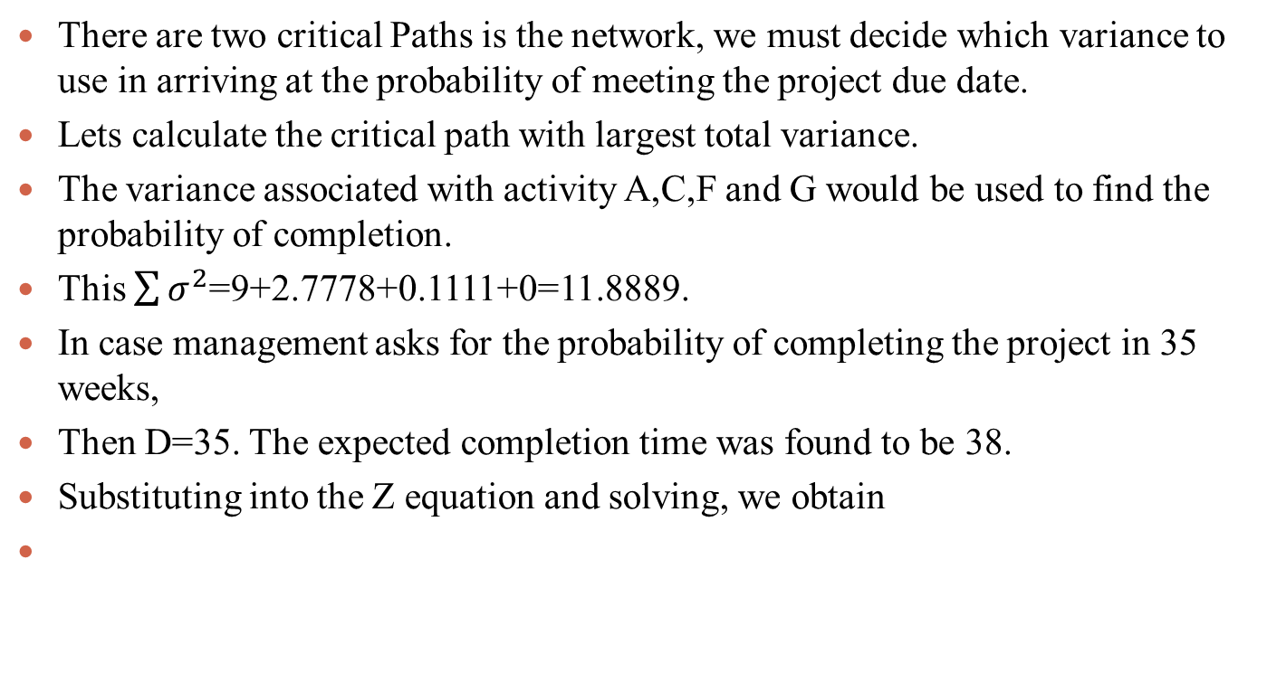
Example
There are two critical Paths is the network, we must decide which variance to use in arriving at the probability of meeting the project due date.
Lets calculate the critical path with largest total variance.
The variance associated with activity A,C,F and G would be used to find the probability of completion.
This $\sum{σ^{2}}$=9+2.7778+0.1111+0=11.8889.
In case management asks for the probability of completing the project in 35 weeks,
Then D=35. The expected completion time was found to be 38.
Substituting into the Z equation and solving, we obtain
$$Z=\frac{D−T_{E}}{\sqrt{\sum{{σcp}_{}^{2}}}}=\frac{35−38}{\sqrt{11.8889}}=−0.87$$

Slide 65
Southwestern University
Southwestern University
ACTIVITY | DESCRIPTION | IMMEDIATE PREDECESSORS
A | Bonding, Insurance, tax structuring | —
B | Foundation | A
C | Upgrading sky box stadium | A
D | Upgrading Walkways | C
E | Interior wiring | B
F | Inspection approvals | E
G | Plumbing | D, F
H | Painting | G
I | Hardware/AC/Metal working | H
J | Tile/Carpet | H
K | Inspection | J
L | Final detail work | I,K

Slide 66
Southwestern University
ACTIVITY | Optimistic | Most Likely | Pessimistic | Crash cost/day
A | 20 | 30 | 40 | 1500
B | 20 | 65 | 80 | 3500
C | 50 | 60 | 100 | 4000
D | 30 | 50 | 100 | 1900
E | 25 | 30 | 35 | 9500
F | 0.1 | 0.1 | 0.1 | 0
G | 25 | 30 | 35 | 2500
H | 10 | 20 | 30 | 2000
I | 20 | 25 | 60 | 2000
J | 8 | 10 | 12 | 6000
K | 0.1 | 0.1 | 0.1 | 0
L | 20 | 25 | 60 | 4500

Slide 67
Southwestern University
Activity A
(foundation)
B
A
Start Activity
C
Activity B
(Upgrading skybox)

Slide 68
Southwestern University
E
F
J
k
B
G
H
L
A
C
D
I

Slide 69
Southwestern University
Southwestern University
ACTIVITY | Duration | ES | EF | LS | LF | Slack
A | 30 | 0 | 30 | 0 | 30 | 0
B | 60 | 30 | 90 | 59.9 | 119.9 | 29.9
C | 65 | 30 | 95 | 30 | 95 | 0
D | 55 | 95 | 150 | 95 | 150 | 0
E | 30 | 90 | 120 | 119.9 | 149.9 | 29.9
F | 0.1 | 120 | 120.1 | 149.9 | 150 | 29.9
G | 30 | 150 | 180 | 150 | 180 | 0
H | 20 | 180 | 200 | 180 | 200 | 0
I | 30 | 200 | 230 | 200 | 230 | 0
J | 10 | 200 | 210 | 219.9 | 229.9 | 19.9
K | 0.1 | 210 | 210.1 | 229.9 | 230 | 19.9
L | 30 | 230 | 260 | 230 | 260 | 0

