Slide 1

Project Appraisal and Selection
Vishnuprasad nagadevara

Slide 2
My Journey
GB Pant University of Agrl and Technology
Agricultural College Bapatla
1970
1968
Iowa State University
1974
IIM Bangalore
1976-2014

Slide 3
Agenda
Project Life Cycle:
  Program Management
  Managing Project Risk
Project appraisal and Selection techniques
  Public Private Partnership
  Case: Kalihari Port Project
  Tool: Excel

Slide 4
What is a Project?
Involves Investment
Achieve an Objective
Can be Analyzed and Evaluated Independently
Program/Portfolio

Slide 5
Definition of A Project
Characteristics of a Project
  Has a Definite Start
  Has a Definite End
  Consumes Resources to Achieve the Objective
Elements of a Project
  Operations
  Resources
  Conditions or Constraints

Slide 6
The project life cycle
Identification
Post Project Evaluation
Formulation and Appraisal
Financing decision
Monitoring
Implementation Planning
Follows the life of a project from the initial idea through to its completion
Defines key decisions, information requirements and responsibilities at each phase

Slide 7
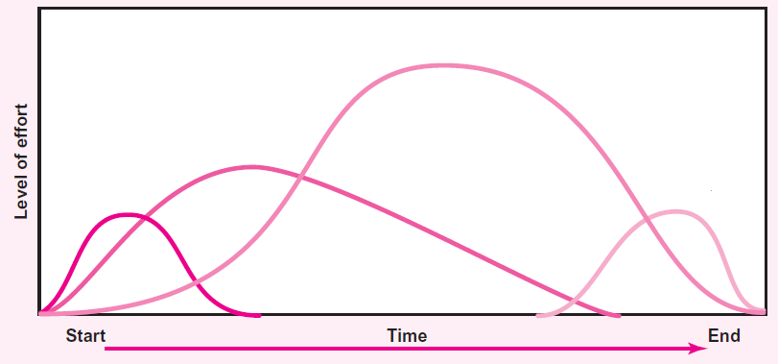
Identification and Appraisal
Executing and Monitoring
Implementation Planning
Post Project Evaluation

Slide 8
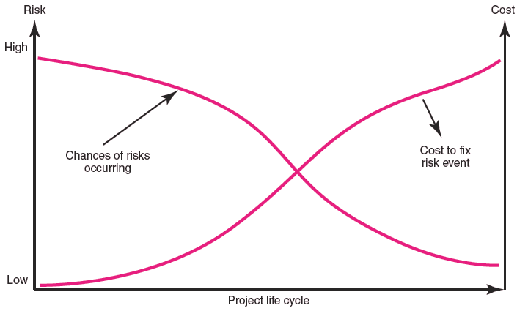
Risk Event Occurrence

Slide 9
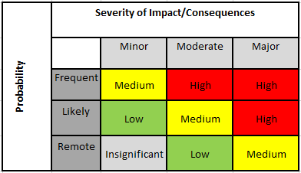
Risk Assessment Matrix

Slide 10
Project Appraisal

Slide 11
Project Appraisal
Concept of PIB:
Costs
  Direct Costs: Quantifiable Costs Incurred by the PIB
  Indirect Costs: Quantifiable Costs Incurred by Anyone other than PIB
  Intangible Costs: Non-Quantifiable Costs
Benefits
  Direct Benefits: Quantifiable Benefits Accruing to PIB
  Indirect Benefits: Quantifiable Benefits Accruing to Anyone Other than PIB
  Intangible Benefits: Non-Quantifiable Benefits

Slide 12
Truck Terminal
Approximately 25% road fatalities in Odisha are due to collision of vehicles with illegally parked trucks on the highways.
Government of Odisha planned to set up truck terminals along the national and state highways.
The terminal will have Petrol Bunk, Restaurant, Dormitory, Toilets and Bathrooms, ATMs, Health Clinic and Repair Facility.
Requirements
Financing the total project cost.
Construction of Truck Terminal along with parking facility.
Operation and maintenance of developed facilities during concession period.
Handover the facilities as per concession agreement.
Development of Commercial Facilities on PPP mode

Slide 13
Objectives
To reduce accident and fatalities due to on road parking.
To make best use and effective utilization of resources.
To provide best class facilities for parking of trucks
To monetize and enhance the revenue for Odisha Road Safety Society
To prevent encroachments
To comply with future demand and people’s expectations
To provide direct and indirect employment
To meet industry requirements
To create state of art infrastructure and Services for the users
To achieve self-sustaining through optimum utilization of resources
To encourage redevelopment of neighborhoods and to achieve foster greater economic health.

Slide 14
Costs
Who is the PIB? Department / Private Partner (PPP)?
Tangible (Quantifiable) Costs |  | Intangible Costs
Direct Costs | Indirect Costs
Cost of Land | Parking Charges | Land taken from Vegetation
Capital Cost | Rent (ATM)
Maintenance Cost | Charges for Health Facility
Tax | Rent for Petrol Pump
Interest | Rent for Repair Facility
 | Charges for Restaurant
 | Loss of Income from Land

Slide 15
Benefits
Tangible Benefits |  | Intangible Benefits
Direct Benefits | Indirect Benefits
Parking Charges | Tax to Government | Safety
Rent from Restaurant | Land value received | Health of Drivers
Rent from Petrol Pump | Wages received by Workers | Livelihood generated
Rent from ATM |  | Reduction in Poverty
Rent from Health Facility
Rent from Repair Shop

Slide 16
Role of PPP
Scenario 1:
  Direct Benefits > Direct Costs
  Private player will be most efficient
Scenario 2:
  Direct Benefits < Direct Costs, BUT
  Direct Benefits + Indirect Benefits > Direct Costs + Indirect Costs
  PPP is most appropriate with VGF and Transfer of Indirect Benefits to Direct Benefits
Scenario 3:
  Direct Benefits + Indirect Benefits < Direct Costs + Indirect Costs BUT
  Intangible Benefits Overweigh everything else
  Most appropriate for Government to Step in completely

Slide 17
Project Appraisal and Selection

Slide 18
Appraisal Criteria
Pay-back Period
Net Present Value
Internal Rate of Return
Benefit-Cost Ratio

Slide 19
Appraisal Examples
Project | Year | Capital Cost | Operational Cost | Value of Output | Net Value
A | 1 | 50000 | 10000 | 30000 | 20000
 | 2 |  | 10000 | 35000 | 25000
 | 3 |  | 10000 | 30000 | 20000
 |  |  |  |  | 65000
Payback period (Years)
2.25
2.25
3.00
B | 1 | 50000 | 10000 | 30000 | 20000
 | 2 |  | 10000 | 35000 | 25000
 | 3 |  | 10000 | 30000 | 20000
 | 4 |  | 10000 | 30000 | 20000
 |  |  |  |  | 85000
C | 1 | 50000 | 10000 | 0 | -10000
 | 2 | 25000 | 10000 | 35000 | 25000
 | 3 |  | 10000 | 40000 | 30000
 | 4 |  | 10000 | 40000 | 30000
 | 5 |  | 10000 | 40000 | 30000
 |  |  |  |  | 105000

Slide 20
Time Value for Money
If you have Rs. 100,000 today and if Bank interest is 10% per annum, what is its value one year from now?
100,000 principal and 10,000 interest = 110,000.
OR Rs. 110,000 one year from now is worth only 100,000 today! (if interest rate is 10%)
What about 2 years?
100,000 will become 110,000 in one year and 110,000 will become 121,000 one year later!
OR 121,000 two years from now is worth only 100,000 today!
We are calculating PRESENT VALUE of Future Income/ Revenue
We multiply with interest rate into the future
We divide by interest rate to get PRESENT VALUE

Slide 21
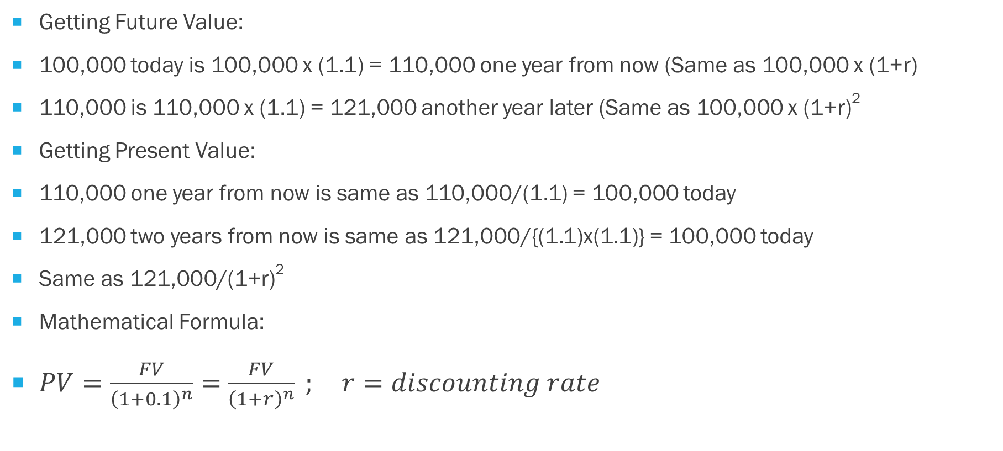
Calculating Future Value and Present Value
Getting Future Value:
100,000 today is 100,000 x (1.1) = 110,000 one year from now (Same as 100,000 x (1+r)
110,000 is 110,000 x (1.1) = 121,000 another year later (Same as 100,000 x (1+r)²
Getting Present Value:
110,000 one year from now is same as 110,000/(1.1) = 100,000 today
121,000 two years from now is same as 121,000/{(1.1)x(1.1)} = 100,000 today
Same as 121,000/(1+r)²
Mathematical Formula:
$PV=\frac{FV}{{\left(1+0.1\right)}^{n}}=$ $\frac{FV}{{\left(1+r\right)}^{n}} ; r=discounting rate$

Slide 22
Appraisal Criteria
Discounting Rate= |  | 10.00% |  |  |  | Present Value
Project | Year | Capital Cost | Operational Cost | Value of Output | Net Value | Benefits | Costs | BCR | NPV | IRR
A | 0 | 50000 | 10000 | 30000 | 20000 | 30000 | 60000 | 1.12 | 9256.20 | -30000
 | 1 |  | 10000 | 35000 | 25000 | 31818 | 9091 |  |  | 25000
 | 2 |  | 10000 | 30000 | 20000 | 24793 | 8264 |  |  | 20000
 |  |  |  |  | 65000 | 86612 | 77355 |  |  | 33.33%
B | 0 | 50000 | 10000 | 30000 | 20000 | 30000 | 60000 | 1.29 | 24282.49 | -30000
 | 1 |  | 10000 | 35000 | 25000 | 31818 | 9091 |  |  | 25000
 | 2 |  | 10000 | 30000 | 20000 | 24793 | 8264 |  |  | 20000
 | 3 |  | 10000 | 30000 | 20000 | 22539 | 7513 |  |  | 20000
 |  |  |  |  | 85000 | 109151 | 84869 |  |  | 54.45%

Slide 23
Appraisal Criteria
Discounting Rate= |  | 10.00% |  |  |  | Present Value
Project | Year | Capital Cost | Operational Cost | Value of Output | Net Value | Benefits | Costs | BCR | NPV | IRR
C | 0 | 50000 | 10000 | 0 | -10000 | 0 | 60000 | 1.07 | 7823.24 | -60000
 | 1 | 25000 | 10000 | 35000 | 25000 | 31818 | 31818 |  |  | 0
 | 2 |  | 10000 | 40000 | 30000 | 33058 | 8264 |  |  | 30000
 | 3 |  | 10000 | 40000 | 30000 | 30053 | 7513 |  |  | 30000
 | 4 |  | 10000 | 40000 | 30000 | 27321 | 6830 |  |  | 30000
 |  |  |  |  | 105000 | 122249 | 114426 |  |  | 14.71%

Slide 24
Questions?

