Slide 1
TOYOTA PRODUCTION SYSTEM
Dr. Anurag Tiwari
IIM Rohtak

Slide 2
TOYOTA PRODUCTION SYSTEM
1. INTRODUCTION
2. TPS TERMS
3. PHILOSOPHY
4. TPS CONCEPTS
(a)JIDOKA
(b)JIT
5. PROCESS & PRINCIPLES

Slide 3


Origin of Toyota Production System
Sakichi Toyoda(1867-1930 )
Automatic loom
Kiichiro Toyoda(1894-1952)
Used chain conveyor into the
Assembly line.
Eiji Toyoda(1913)
Implementation of Jidoka and JIT.
Type-G Automatic Loom assembly line
Toyota Standard Sedan Model AA announced in 1936

Slide 4
INTRODUCTION
https://www.youtube.com/watch?v=F5vtCRFRAK0

Slide 5
INTRODUCTION
Eiji Toyoda(born -1930) was the former chairman of Toyota motors co.
For over 25 years he was in the driver seat of Toyota motor co.
After his retirement he continue to hold the title of the honorary chair of the company.

Slide 6
Toyota in India
As a joint venture between Kirloskar group and Toyota Motor Corporation, Toyota Kirloskar Motor Pvt Ltd (TKM).
In India TKM was established on October 6, 1997.
The chairman is Mr.Ryoichi Saseki.

Slide 7
INTRODUCTION
Toyota motor corporation’s vehicle production system is a way of “making things” that is referred to as “lean manufacturing system”.
The TPS was developed to improve Quality and Productivity.
Objective: “making the vehicles ordered by customers in the quickest and most efficient way, in order to deliver the vehicles as quickly as possible”.

Slide 8
GOALS OF TPS
The goal of the Toyota Production System is to provide products at world class quality levels to meet the expectations of customers
The Toyota Production System historically has had four basic aims that are consistent with these values and objectives
Provide world class quality and service to the customer.
Develop each employee’s potential, based on mutual respect, trust and cooperation.
Reduce cost through the elimination of waste and maximize profit.
Develop flexible production standards based on market demand.

Slide 9
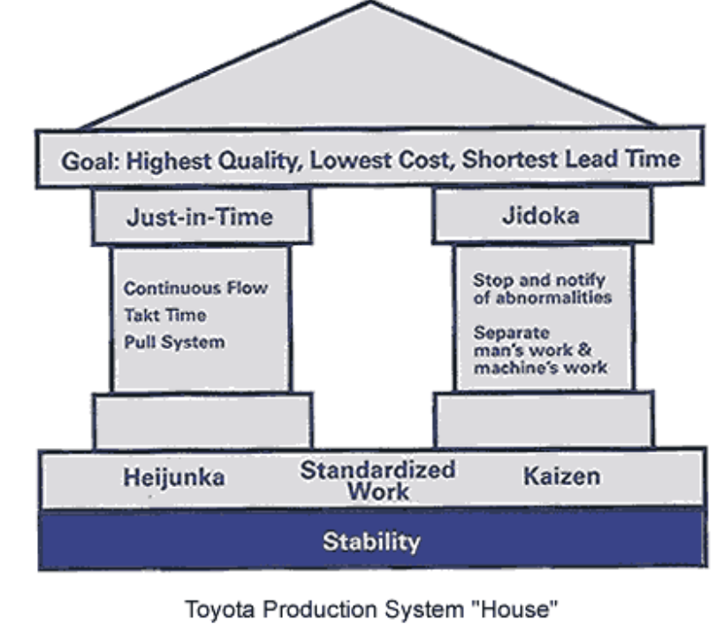
GOALS OF TPS

Slide 10
TPS TERMS
ANDON
GENCHI GENGUSTU
HEIJUNKA
OSHIN
JIDOKA
JISHUKAN
JIT
KANBAN
KAIZEN
MUDA
NEMAWASHI
POKAYOKE
YOKOTEN

Slide 11
TPS TERMS
NEMAWASHI:- Preliminary work to involve other sections/departments in discussions to seek input, information and/or support for a proposal or change (policy, etc.) that would affect them.
POKAYOKE:- Low cost, highly reliable devices, used in the jidoka system, that will stop processes in order to prevent the production of defective parts.
YOKOTEN:- Across everywhere. (Plant related activities and/or countermeasures that are communicated plant wide and with other company affiliates).

Slide 12
TPS TERMS
ANDON:- A type of visual control that displays the current state of work ( i.e abnormal condition ,work instruction and job progress information.) It is one of the main tools of Jidoka.
GENCHI GENGUSTU:- Go see the problem. This is belief that practical experience is valued over theoretical knowledge. You must see the problem to know the problem.
HEIJUNKA:- The overall leveling in the problem schedule, of the volume and variety of item produced in given time periods. It is prerequisite for JIT.
OSHIN:- Goals and means for achieving it to address business priorities to move the organization to a new level of performance variable from year to year ,is developed by executive management.

Slide 13
TPS TERMS
JIDOKA:- One of the two main pillars of TPS. It refers to the ability to stop production ,by man or machine.( equip malfunction)
JISHUKAN:- Management driven kaizen activity where mgt. members identifies areas in need of continuous improvement and spread information through the organization to stimulate the kaizen activity.

Slide 14
JUST IN TIME
One of the two main pillars of TPS. It refers to the manufacturing and conveyance of only ” what is needed, when is needed, and in the amount needed in the system”.
    1. The Pull System
    2. Continuous Flow Processing
    3. Take time

Slide 15
KANBAN
  Card or other device that communicates demand for work or materials from the preceding station
    Kanban is the Japanese word meaning “signal” or “visible record”
  Paperless production control system
  Authority to pull, or produce, comes from a downstream process
  Two main types of kanbans:
    Production kanban (p-kanban): signals the need to produce parts
    Conveyance kanban (c-kanban): signals the need to deliver parts to the next work center

Slide 16
KAIZEN
KAIZEN:- A system of continuous improvement in which instances of Muda (waste) are eliminated one-by-one at minimal cost. This is performed by all employees rather than by specialists.

Slide 17
Waste
Waste
  Represents unproductive resources
  Eight sources of waste in lean systems:
    Excess inventory
    Overproduction
    Waiting time
    Unnecessary transporting
    Processing waste
    Inefficient work methods
    Product defects
    Underused people

Slide 18
RESPECT FOR PEOPLE
Kiichiro Toyoda, began the culture of respect for people and of building trust between labor and management, company and suppliers, and within the company of Toyota itself.
Started building a framework of mutual trust between labor and management.
Toyota associates in all areas of operation must continue to work together “like a strong chain,” to nurture this culture of cooperation which helps Toyota, benefit people and society.
Toyota Production System identifies the four main areas where the production team members can participate in achieving company goals
setting and maintaining work standards (standards)
solving daily performance problems (problem solving)
participating in the continuous improvement process (improvement)
organizing teamwork efficiently (teamwork)

Slide 19
CULTURAL VALUES AND OTHER PHILOSPHIES
Having long-term philosophy that
drives a long-term approach to
building a learning organization
The right process will produce the right results
Add value to the organization by developing its people and partners
Continuously solving root problems to drive organizational learning

Slide 20
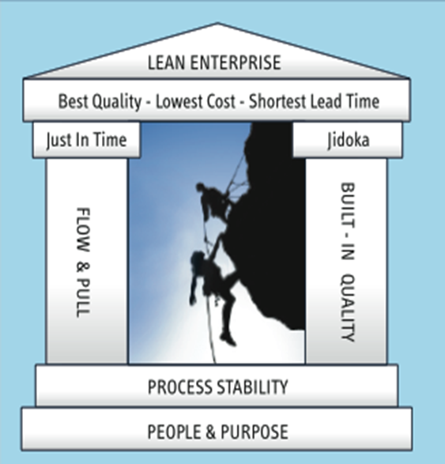
Concepts of Toyota Production System
JIDOKA
JUST-IN-TIME

Slide 21
Jidoka
Jidoka means “automation with a human touch”
Jidoka, in the production context means not allowing defective parts to go from one work station to the next. It specifically refers to machines or the production line itself being able to stop automatically in abnormal conditions (for example, when a machine breaks down or when defective parts are produced). This Automation allows machines to run autonomously, as they will stop when a problem occurs.
Jidoka is also used when individual people encounter a problem at their work station. They are responsible for correcting the problem - if they cannot, they should stop the line rather than let the defective part do.

Slide 22
Jidoka
First used by Sakichi Toyoda at the beginning of the 20th century
A pillar of the Toyota Production System
Jidoka is an important component of Lean Manufacturing Process.

Slide 23
PRINCIPLES
Jidoka prevents the production of defective products, eliminates overproduction and focuses attention on understanding the problem and ensuring that it never recurs. It is a quality control process that applies the following four principles:
1. Detect the abnormality.
2. Stop.
3. Fix or correct the immediate condition.
4. Investigate the root cause and install a countermeasure.

Slide 24
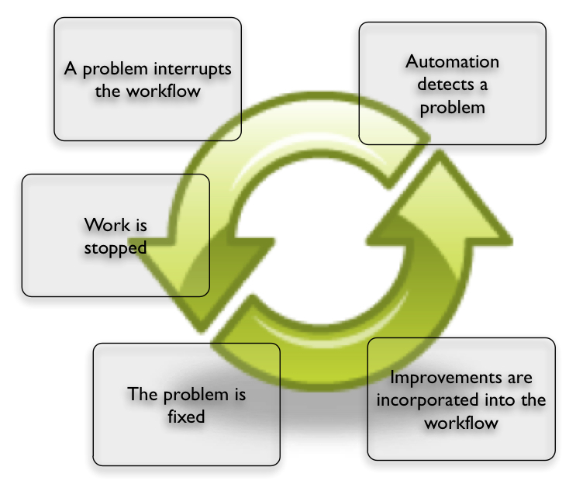
A Closer Look at Jidoka - Concept

Slide 25
Purpose & Implementation
The purpose of automation is that it makes possible the rapid or immediate address, identification and correction of mistakes that occur in a process. Automation relieves the worker of the need to continuously judge whether the operation of the machine is normal; their efforts are now only engaged when there is a problem alerted by the machine.

Slide 26
For instance rather than waiting until the end of a production line to inspect a finished product, automation may be employed at early steps in the process to reduce the amount of work that is added to a defective product.
A worker who is self-inspecting their own work, or source-inspecting the work produced immediately before their work station is encouraged to stop the line when a defect is found.

Slide 27
Once the line is stopped a supervisor or person designated to help correct problems gives immediate attention to the problem the worker or machine has discovered. To complete Jidoka, not only is the defect corrected in the product where discovered, but the process is evaluated and changed to remove the possibility of making the same mistake again.

Slide 28
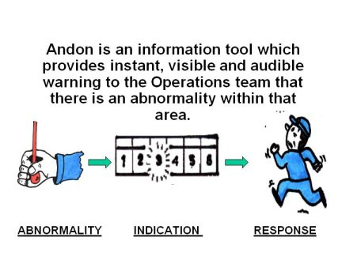
Andon
A tool of visual management, originating from the Japanese for "Lamp". Lights placed on machines or on production lines to indicate operation status. Commonly color-coded are:
- Green: normal operations
- Yellow: changeover or planned maintenance
- Red: abnormal, machine down
Often combined an audible signal such as music or an alarm

Slide 29
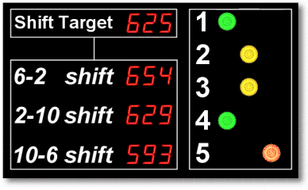
Andon Display Board
When a problem arises and is communicated via the "andon - problem display board (A type of visual control that displays the current state of work i.e., abnormal conditions, work instructions, and job progress information. It is one of the main tools of Jidoka) operators can confidently continue performing work at another machine, as well as easily identify the problem cause and prevent its recurrence.

Slide 30
Just-in-time
JIT is a philosophy of continuous improvement in which non-value-adding activities (or wastes) are identified and removed for the purposes of:
Reducing Cost
Improving Quality
Improving Performance
Improving Delivery
Adding Flexibility
Increase innovativeness

Slide 31
The American Production and Inventory Control Society (APICS) has the following definition of JIT:
“A philosophy of manufacturing based on planned elimination of all waste and continuous improvement of productivity. It encompasses the successful execution of all manufacturing activities required to produce a final product, from design engineering to delivery and including all stages of conversion from raw material onward. The primary elements include having only the required inventory when needed; to improve quality to zero defects; to reduce lead time by reducing setup times, queue lengths and lot sizes; to incrementally revise the operations themselves; and to accomplish these things at minimum cost."

Slide 32
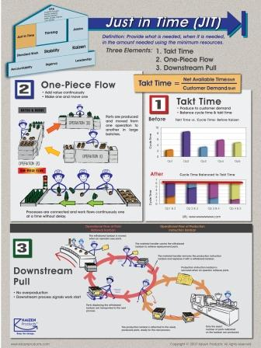
Three elements
Takt time
One-Piece Flow
Downstream pull

Slide 33
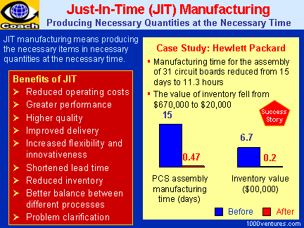

Slide 34
JIT usually identifies seven prominent types of waste to be eliminated:
Waste from Overproduction
Waste of waiting/idle time
Transportation Waste
Inventory Waste
Processing Waste
Waste of Motion
Waste from Product Defects

Slide 35
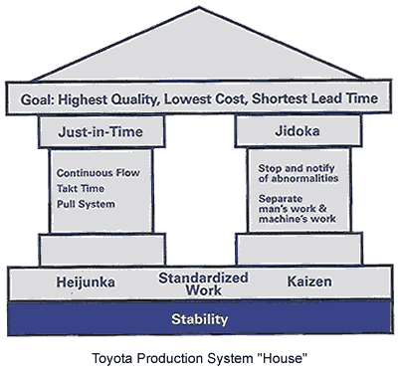
Toyota Production System

Slide 36
Kanban
A unique production control method .
It can be based on supermarket method.
Taiichi Ohno ,promoted the idea of JIT, applied this concept.

Slide 37
Kanban – Definition
Kanban is a simple but effective control that helps JIT production work.
The word KAN= card
BAN=signals
It is a Japanese word for card & the use of card is central to many Japanese control systems including one at Toyota whose kanban system has received.

Slide 38
Types of Kanban System
Single card Kanban System
Double card Kanban System
Withdrawal Kanban (C-Kanban)
Production Kanban (P-Kanban)

Slide 39
Drawbacks of the system
Any significant disruption at any work center results in stoppage of work flow & thus idling of the succeeding work centers.

Slide 40
14 Principles of TOYOTA Way
SECTION 1:LONG TERM PHILOSPHY
PRINCIPLE 1: BASE YOUR MANAGEMENT DECISION ON A LONG TERM PHILOSPHY,EVEN AT THE EXPENSE OF SHORT TERM FINANCIAL GOALS.
SECTION 2:RIGHT PROCESS,RIGHT RESULTS
PRINCIPLE 2:CREATE CONYINOUS PROCESS FLOW TO BRING PROBLEMS TO THE SURFACE.
PRINCIPLE 3:USE ‘PULL’SYSTEM TO AVOID OVER PRODCTION

Slide 41
14 Principles of TOYOTA Way
PRINCIPLE 4:LEVEL OUT THE WORK LOAD.
PRINCIPLE 5:BUILD A CULTURE OF STOPPING TO FIX PROBLEMS, TO GET QUALITY RIGHT THE FIRST TIME.
PRINCIPLE 6:STANDARDISE TASK ARE THE FOUNDATION FOR CONTINUOUS IMPROVEMENT AND EMPLOYEES EMPOWERMENT.
PRINCIPLE 7:USE VISUAL CONTROL SO NO PROBLEMS ARE HIDDEN.
PRINCIPLE 8:USE ONLY RELIABLE, THOROUGHLY TESTED TECHNOLOGY THAT SERVES YOUR PEOPLE AND PROCESSES.

Slide 42
14 Principles of TOYOTA Way
SECTION 3:ADD VALUE TO THE ORGANISATION BY DEVLOPING A PEOPLE AND PARTNERS.
PRINCIPLE 9:GROW LEADERS WHO THOROUGHLY UNDERSTAND THE WORK,LIVE THE PHILOSPHY AND TEACH IT TO OTHERS.
PRINCIPLE 10:DEVELOP EXCEPTIONAL PEOPLE AND TEAMS WHO FOLLOWS YOUR COMPANIES PHILOSPHY.

Slide 43
14 Principles of TOYOTA Way
PRINCIPLE 11:RESPECT YOUR EXTENDED NETWORK OF PARTNERS AND SUPPLIEDBY CHALLENGING THEM HELPING THEM TO IMPROVE.
SECTION 4:CONTINOUSLY SOLVING ROOT PROBLEMS DRIVES ORGANISATIONAL LEARNING.
PRINCIPLE 12: SEE FOR YOURSELF TO THOROUGHLY UNDERSTAND THE SITUATION.

Slide 44
14 Principles of TOYOTA Way
PRINCIPLE 13:MAKE DECISION SLOWLY BY CONSENSUS ,THOROGHLY CONSIDERING ALL OPTIONS, IMPLEMENT DECISION RAPIDLY.
PRINCIPLE 14:BECOME A LEARNING ORGANISATION THROUGH RELENTLESS REFLECTION AND CONTINOUS IMPROVEMENT.

Slide 45
Waste
Waste
  Represents unproductive resources
  Eight sources of waste in lean systems:
    Excess inventory
    Overproduction
    Waiting time
    Unnecessary transporting
    Processing waste
    Motion
    Product defects
    Underused people

Slide 46
Excess inventory
Preventing unnecessary inventory is critical to the success of the Toyota Production System.
The smooth, continuous flow of work through each process ensures that excess amounts of inventory are minimized.
Inventory ties up assets such as cash and real estate
Inventory often requires additional handling which requires additional labor and equipment.

Slide 47
What cause excess inventory
Poor Market forecast
Product complexity
Unlevelled scheduling
Unbalanced workloads
Unreliable or poor-quality shipments by supplier
Misunderstood communication
Reward System

Slide 48
Excess inventory
Misunderstood communication
Poorly understood customer requirements
Product or service is frequently delivered late
Poor customer satisfaction
Incomplete or inaccurate documentation
Poor work instructions
Inadequate information management systems
Barrier between departments
Conflicting measurement system

Slide 49
Overproduction
Overproduction means making more of a product than is needed by the next process or the end customer.
Making the product earlier in time than is needed or making a prioduct at a faster than is needed.
Extra inventory
Extra Space
Extra processing
Extra Interest charge
What is wrong with a little overproduction
Extra handling
Extra Machinery
Extra Defects
Extra overhead
Extra People
Extra paperwork

Slide 50
What cause overproduction
Just in case logic
Unlevelled scheduling
Unbalanced workloads
Misuse of automation
Long process setup times

Slide 51
Waiting time
Any waiting due to breakdowns, changeovers, delays, poor layout or work sequence needs to be eliminated.
Thorough preventative maintenance and rapid changeovers are essential to global competitiveness.
Reducing cycle time by eliminating waiting within the work sequence can also have a profound effect on productivity.

Slide 52
What cause waiting waste
Raw material outages
Unbalanced Scheduling or Workloads
Unplanned downtime for maintenance
Poor equipment or facility layout
Long process setup times
Misuses of automation
Upstream quality problems

Slide 53
Unnecessary transporting
Transportation waste is any activity that requires transporting parts and material around the facility.
Transportation waste is usually reserved for action involving equipment to move material and parts.

Slide 54
What cause Transportation Waste
Poor purchasing practice
Large batch sizes and storage areas
Inadequate facility layout
Limited understanding of the process flow

Slide 55
Processing waste
Over processing is as wasteful as insufficient processing.
Processing waste can steam many sources and is often present regardless of the activity type.
Processing waste that is found in front office areas, such as order processing, information gathering and dissemination and all accounting functions.

Slide 56
What cause Processing waste
Product changes without process change
Just in case logic
True customer requirement undefined
Over processing to accommodate downtime
Poor communication
Redundant approvals
Extra copies/excess information

Slide 57
Motion Waste
Wasted motion occupies time and energy
Ideally all unnecessary movements or actions are eliminated from the work process.
Much of this wasted motion is often overlooked because it hasbecome such a part of the process.
Work processes should be designed so that items are positioned close to each other.
Unnecessary amounts of turning, lifting and reaching are eliminated.

Slide 58
What cause Motion Waste
Poor people, material and machine effectiveness
Inconsistent work methods
Poor information management
Unfavourable facility or cell layout
Poor workplace organization and housekeeping

Slide 59
Product defects/Scrap
The waste of correction is a result of poor internal quality
Producing defective products or products requiring repairs adds the cost of extra manpower, materials, facilities and conveyance measures.
Some examples are

Slide 60
What cause Product defects/Scrap
The waste of extra handling.
The waste of additional labor.
The risk of further defects caused by additional handling.
The risk giving our customer an inferior product.
Poor Product design
Weak process control

Slide 61
What cause Product defects/Scrap
The waste of scrap is also a result of poor internal quality. When an item is scrapped, the impact is evident in several areas
The obvious financial loss related to the part.
The waste associated with holding extra parts in inventory.
The labor wasted producing the defective part.
The waste of handling, moving and discarding the scrap item.

Slide 62
Underused people
Waste of underused employees often occurs when we fail to recognize and harness people’s mental, creative, innovative and physical skills or ability.

Slide 63
What cause Underused people
Old guard thinking, politics and business culture
Poor hiring practice
Low or no investment in training
Low-pay high turnover strategy

