Slide 1

Product Life Cycle

Slide 2
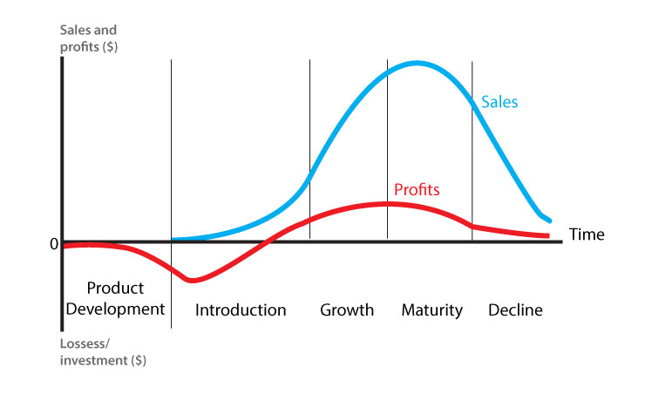
Product Life Cycle

Slide 3
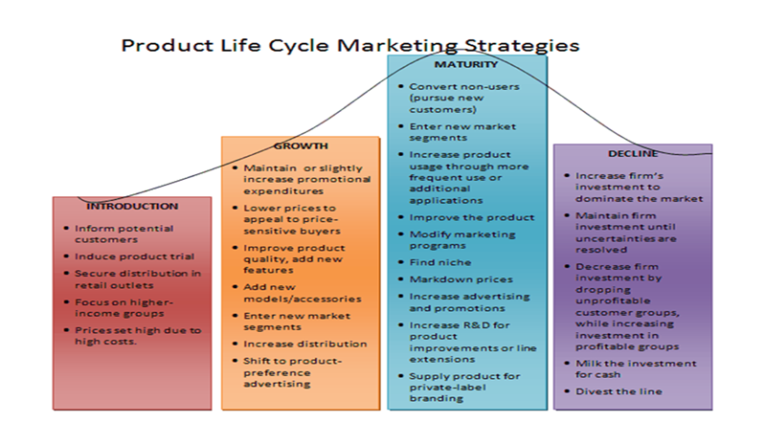

Slide 4
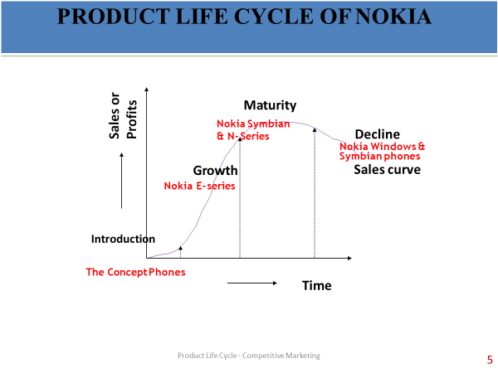

Slide 5


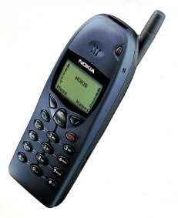
INTRODUCTION STAGE ( 1995 – 2002)
NOKIA 2110
12/14/2015
Product Life Cycle - Competitive Marketing
6

Slide 6
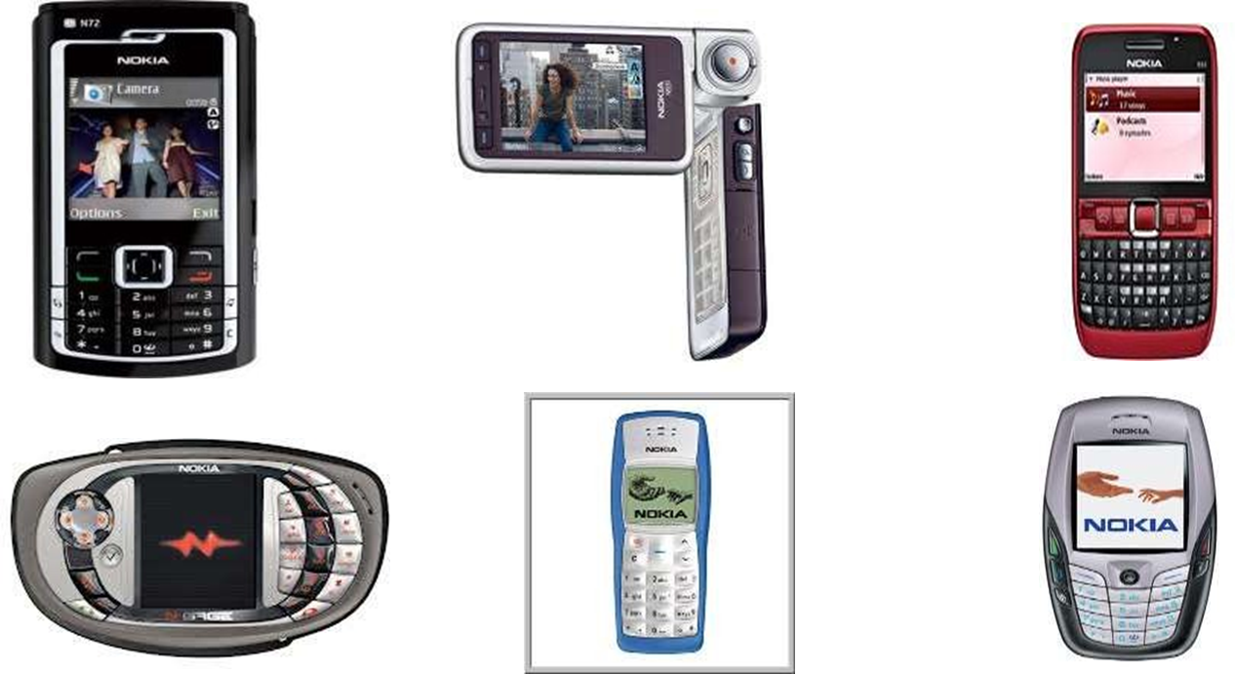
GROWTH STAGE ( 2003 – 2009 )

Slide 7
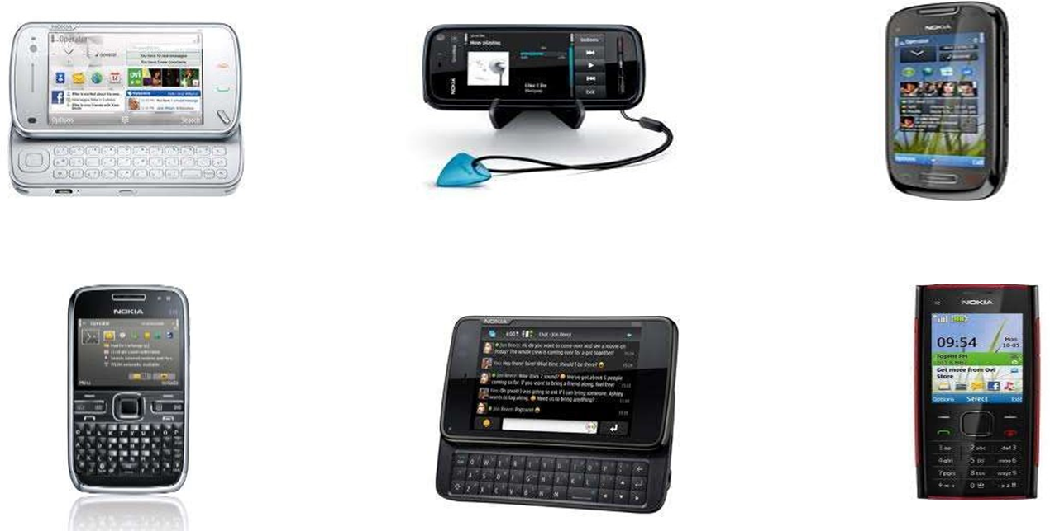
MATURITY STAGE ( 2009 – 2011 )

Slide 8

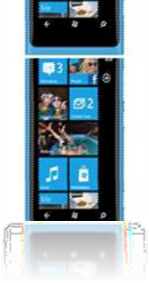
DECLINE STAGE ( 2011 Q3 – PRESENT )

Slide 9
Current Trends (Free from PLC)
Positioning strategies for Moving from Maturity to Growth position.
Reverse Positioning – Swatch Watch
Breakaway Positioning – EZ squirt Ketchup
Stealth Positioning – Eye toy, MAC MINI
Mee-too companies (Cost Leadership)

