Slide 1
Process selection and Facility Layout
Dr. Anurag Tiwari
IIM Rohtak

Slide 2
Learning Objectives
Types of manufacturing firms
Types of manufacturing process depending on the product characteristics
Assembly line balancing
Measures of process analysis

Slide 3
Types of Firms
Make-to-Stock
Assemble-to-Order
Make-to-Order
Engineer-to-Order
Serve customers from finished goods inventory
Combine a number of preassembled modules to meet a customer’s specifications
Make the customer’s product from raw materials, parts, and components
Work with the customer to design and then make the product

Slide 4
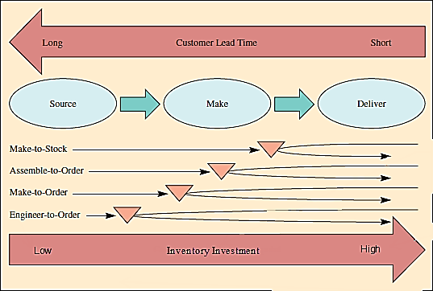
Positioning inventory in supply chain

Slide 5
Process Selection
Process selection
  Refers to deciding on the way production of goods or services will be organized
  It has major implications for
    Capacity planning
    Layout of facilities
    Equipment
    Design of work systems

Slide 6
Process Selection and System Design
Facilities and
Equipment
Forecasting
Capacity
Planning
Product and
Service Design
Layout
Process
Selection
Technological
Change
Work
Design

Slide 7
Process Selection (cont.)
Two key questions in process selection:
How much variety will the process need to be able to handle?
How much volume will the process need to be able to handle?
Job Shop
Repetitive
Batch
Continuous

Slide 8
Types of Processing
 | Job Shop | Batch | Repetitive/ Assembly | Continuous
Description | Customized goods or services | Semi- standardized goods or services | Standardized goods or services | Highly standardized Goods or services
Advantages | Able to handle a wide variety of work | Flexibility; easy to add or change products or services | Low unit cost, high volume, efficient | Very efficient, very high volume
Disadvantages | Slow, high cost per unit, complex planning and scheduling | Moderate cost per unit, moderate scheduling complexity | Low flexibility, high cost of downtime | Very rigid, lack of variety, costly to change, very high cost of downtime

Slide 9
How Production Processes are Organized
Project:
Workcenter (job shop)
Manufacturing cell
Assembly line
Continuous process

Slide 10
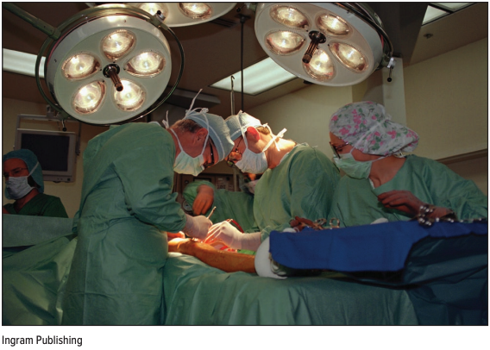
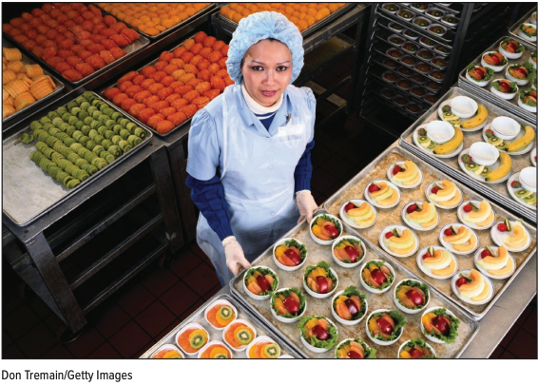
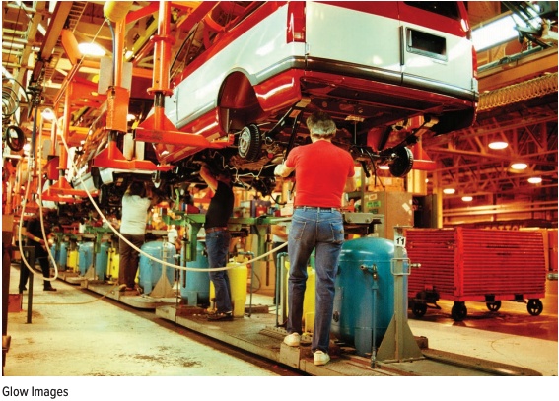
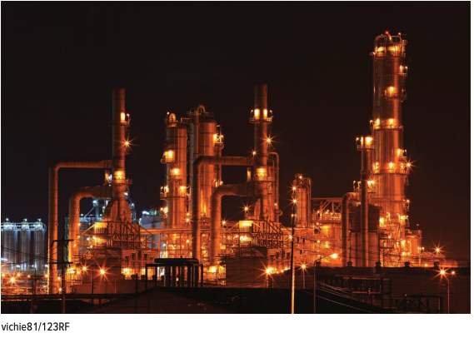
Process Types
A job shop
A batch process
A repetitive process
A continuous process

Slide 11
Project Layout
The product remains in a fixed location
Hub of a wheel structure
Low number of production units
Work break down structure
Precedence determines production stages
Material is arranged as per the technological priority
A high degree of task scheduling

Slide 12
Workcentre (Job Shop)
Sometimes referred to as Job shop/department
Focus on a particular type of operation
Similar equipment's or functions are grouped together
Products move through work centers as per required sequence of operations
The layout should optimize the movement of material.
Place workcenters (with large interdepartmental traffic) adjacent to each other
Handles large variety of products in low volume

Slide 13
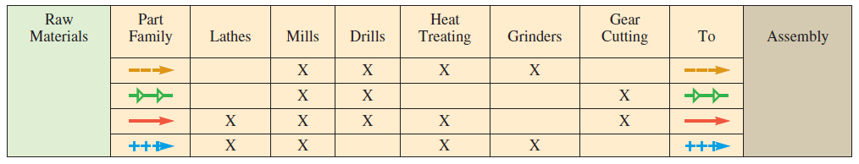
Routing Matrix Based upon Flow of Parts

Slide 14
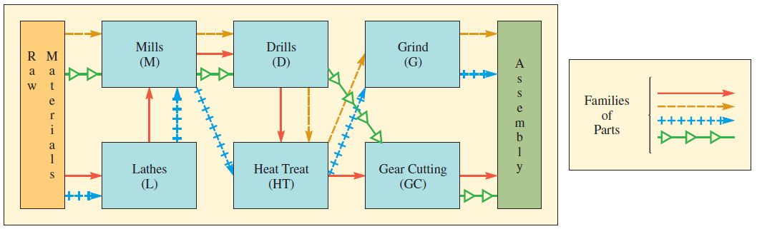
Workcenter Layout

Slide 15
Manufacturing Cell
A dedicated area where similar products are manufactured
Formed by allocating dissimilar machines to cells that are designed to work on similar products
Cells are designed to perform specific set of processes and dedicated to limited range of products
Handles limited volume and variety

Slide 16
Routing Matrix

Slide 17
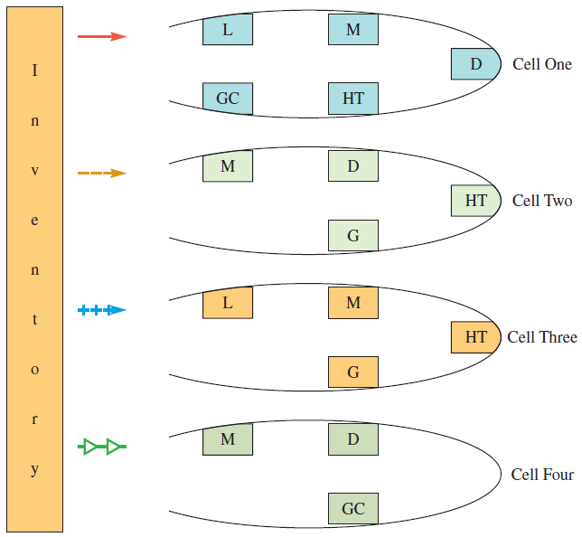
Manufacturing Cells

Slide 18
Assembly Line
Work processes are arranged according to the progressive steps by which the product is made
Steps are defined so that specific production rate can be achieved
The path fro each part is straight line
Handles small variety of products in high volume

Slide 19
Assembly-Line Design
Workstation cycle time: the time between successive units coming off the line
Assembly-line balancing: assigning all tasks to a series of workstations so that each workstation consume no more than workstation cycle time
Precedence relationship: the order in which tasks must be performed in the assembly process

Slide 20
Assembly-Line Balancing
Specify the sequential relationships among tasks.
Determine the required workstation cycle time.
Determine the theoretical minimum number of workstations.
Select a primary and secondary assignment rule.
Assign multiple tasks to workcentres
Evaluate the efficiency of the assembly line

Slide 21
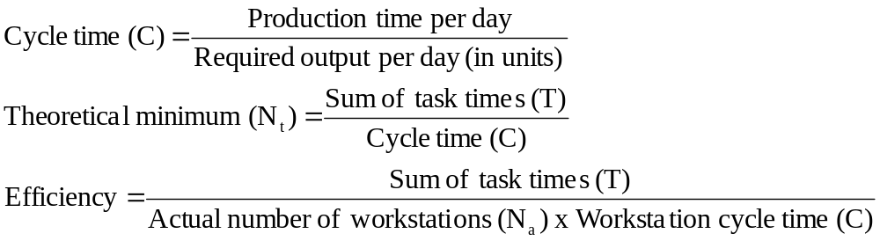
Assembly-Line Balancing

Slide 22
Example:
The model J Wagon is to be assembled on a conveyor belt
Five hundred wagons are required per day
Production time per day is 420 minutes
Find the balanced assembly line that minimizes the number of workstations, subject to cycle time and precedence constraints.

Slide 23
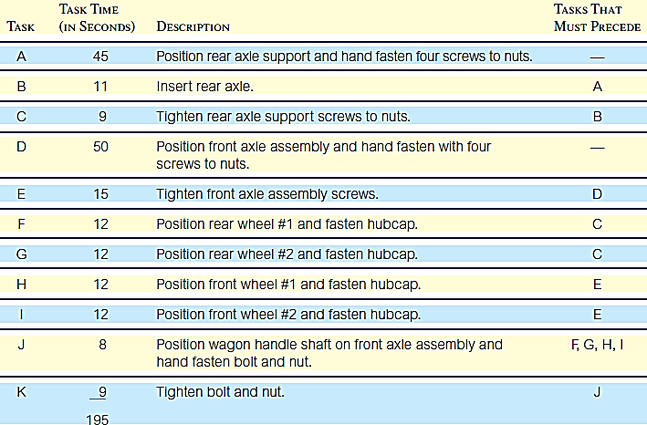
Example: Assembly Steps and Times

Slide 24
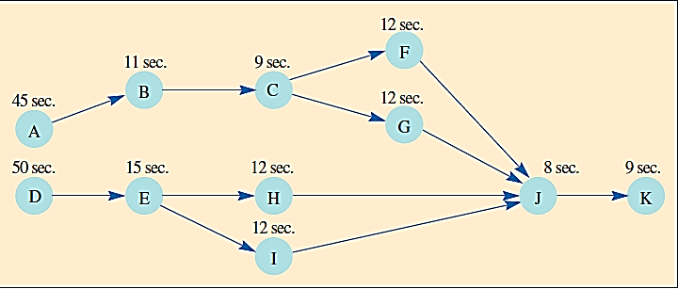
Example: Precedence Graph

Slide 25
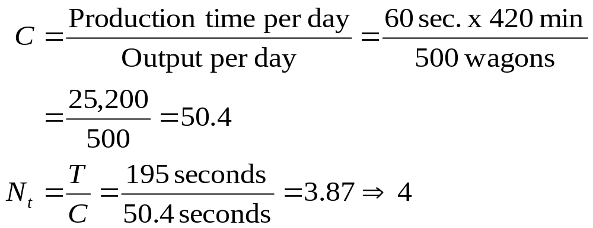
Example: C and Nt

Slide 26
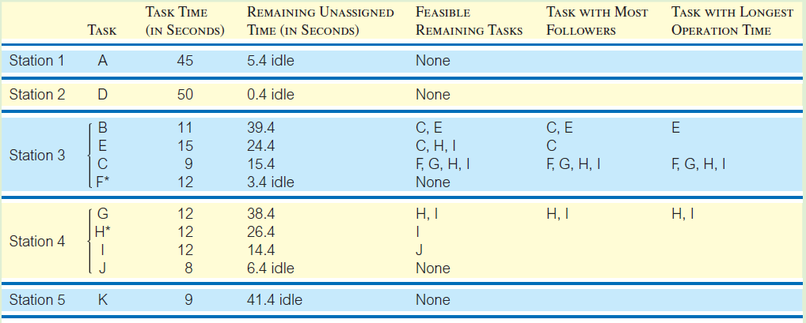
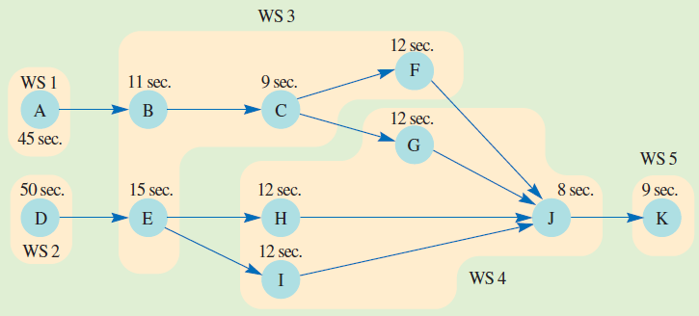
Example: Assignment

Slide 27
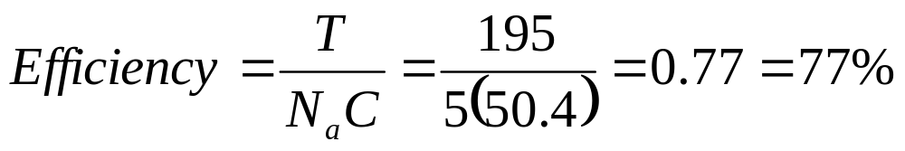
Example: Efficiency

Slide 28
Task Splitting
Split the task
Share the task
Use parallel workstations
Use a more skilled worker
Redesign

Slide 29
Continuous Process
Same as assembly line
But product is not discrete
Large volume low variety
Process operate for long duration due to high setup/changeover cost

Slide 30
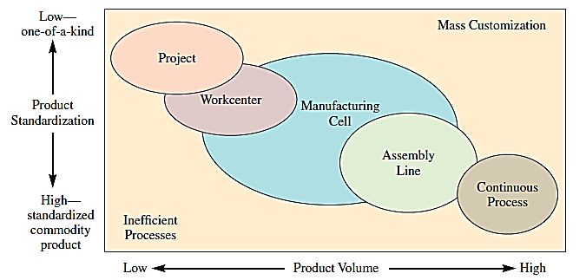
Product–Process Matrix

Slide 31
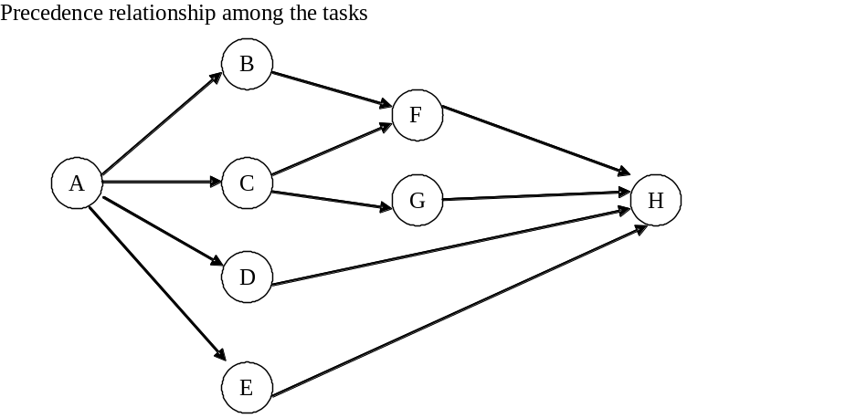
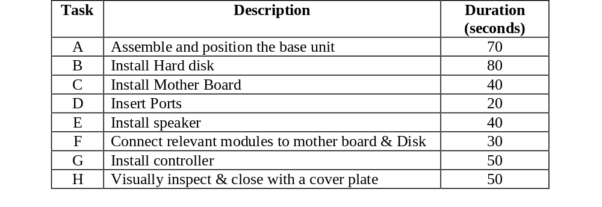
Assignment
A computer manufacturer needs to design the assembly stations in the factory where the cabinet housing the hard disk, motherboard and other accessories are to be done. The factory currently works for one shift of 8 hours. The tasks, their duration and their precedence relationships are given below:
If the cycle time is 80 seconds, what will be the daily production of cabinets?
If the desired production rate is 320 cabinets per day, what is the maximum permissible cycle time?
What is the maximum and minimum number of workstations required to maintain this daily production rate?
Design an assembly setup with 5 workstations and 6 workstations.

Slide 32
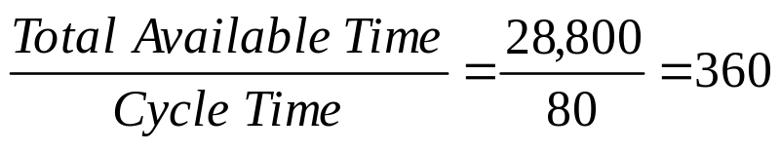
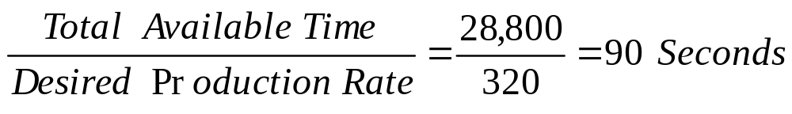
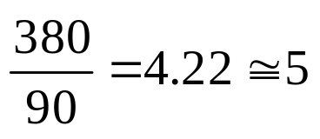
Solution
Total available time per day = 8*60*60 = 28,800 seconds
If the cycle time is 80 seconds, then
Daily production rate =
Since the desired production rate is only 320 cabinets, one can obtain the maximum permissible cycle time for the assembly stations
Maximum Cycle Time =
Minimum number of workstations is dictated by the maximum cycle time permissible
Sum of all task times = 380 seconds
Minimum number of workstations =

Slide 33
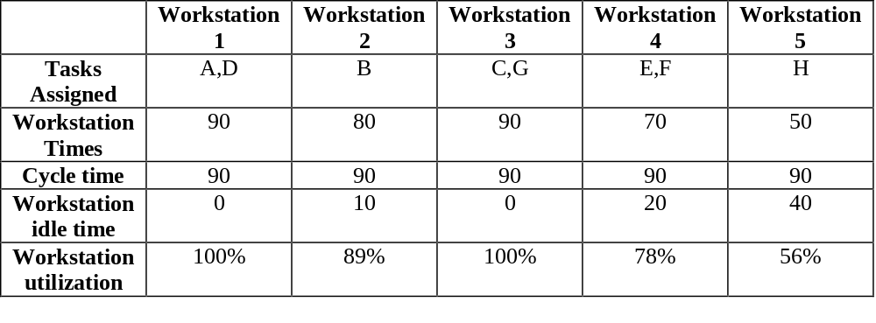
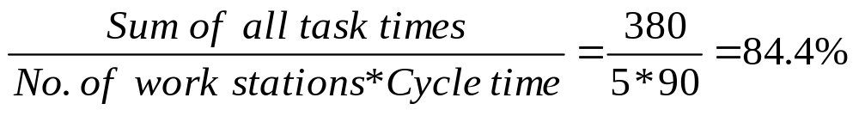
Solution
We assign tasks to the five workstations on the basis of the following two criteria:
  Workstation times should not exceed maximum permissible cycle time of 90 seconds
  The precedence relationships need to be honored
  Average Utilization =

Slide 34
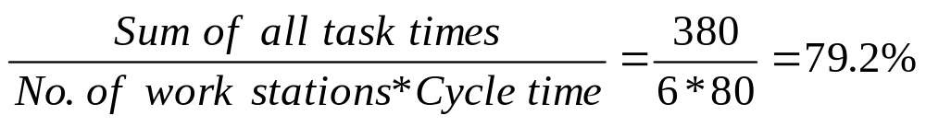
Solution
 | Work station 1 | Work station 2 | Work station 3 | Work station 4 | Work station 5 | Work station 6
Tasks Assigned | A | B | C,D | E,F | G | H
Workstation Times | 70 | 80 | 60 | 70 | 50 | 50
Cycle time | 80 | 80 | 80 | 80 | 80 | 80
Workstation idle time | 10 | 0 | 20 | 10 | 30 | 30
Workstation utilisation | 87.5% | 100% | 75% | 87.5% | 62.5% | 62.5%
Average Utilization =

Slide 35
Process Analysis
Cycle Time (CT)
Bottleneck
Idle Time
Work-in-Process (WIP)
Manufacturing Lead Time (MLT)

Slide 36
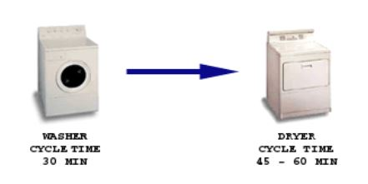
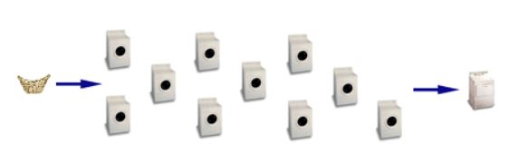
Cycle Time (time/unit)
Cycle Time is the length of time, on average, that it takes to complete a step or set of steps within an operation

Slide 37
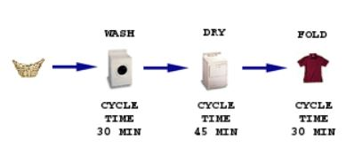
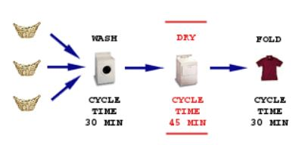
Bottleneck
Within a set of dependent steps, there is generally one step that defines the speed at which the entire operation can run.

Slide 38
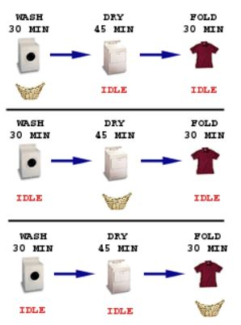
Idle Time

Slide 39
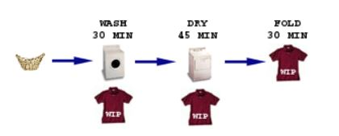
Work-in-Process (WIP)
Work-in-process, or WIP, refers to inputs that are still in the operation. WIP is sometimes discussed in dollar terms, but will generally be considered in whatever units.

Slide 40
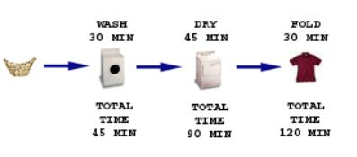
Manufacturing Lead Time (MLT)
Manufacturing lead-time, or MLT, is the average length of time it will take a new set of inputs to move all the way through the operation. (Little’s Law)
Manufacturing Lead Time = Cycle Time * Work-in-Process

Slide 41
Process Flow Charting
The design of a process is a matter of detail
Every activity that contributes a process must be identified.
It is also important to know the time taken for each activity and the nature of flow material/information in the process.
A pictorial representation of all this information could be developed using process flow charting.
Process flow charting employs a set of standard symbols and graphical tools to represent all the information about the process
The symbols used are as follows
A step in the process
Transportation
Storage and inventory

Slide 42
Process Flow Charting
Inventory of Cloth and other materials
Stitching 1
WIP Inventory
Spreading
Cutting
Stitching 2
Inventory of Shirts
Processing and inspection
Assembly

Slide 43
Analyzing Process
Throughout time: Throughout is the elapsed time from the first stage of the process to the last stage of the process. It is also known as lead time.
Cycle Time: Cycle time is the elapsed time between two successive outputs from a process that is continuously operating in a given period of time.
Bottleneck: That stage of process that dictates the output of a process is the bottleneck.

Slide 44
Example :1
A toy manufacturer receives crafted toys from the local carpenters and perform the final operations before stocking it for sale. The Process consists of five steps. The first step is to arrange a set of four toys in pallet. After this, the pallet moves to the next station where the toys are pre-treated. This is to increase toys life, prevent from attacks of pests in the future, and also to improve the effectiveness of the printing operations. The next step is to send it to the spray-painting chamber, where it is painted as per the specification. At present there is one spray painting machine. After painting, it is left in an open area for drying. The painting process and the pretreatments are specialized so that the paint dries quickly. Finally the toys are inspected and packed.
The Steps in the process, along with the relevant details are as follows:
Step 1: Preparation of toys (8 Minute)
Step 2: Pre-treatment : (12 Minute)
Painting (20 Minute)
Dying (10 Minute)
Inspection and Packing (5 Minute)

Slide 45
Example :1
Develop a Process flow diagram for these steps and answer the following questions:
What is the throughput time for this manufacturing process?
Identify the bottleneck for this process
What is the cycle time for this process
What is the productivity capacity for this process
What are the assumption behind this computation

Slide 46
Example :1
Inspect and pack 5 minutes
Prepare
(8 Minutes)
Pre-treat
12 Minutes
Paint
20 Minutes
Dry
10 minutes
What is the throughput time for this manufacturing process?
The throughput time for the process is the sum of all processing times.
In this example time is 55 minutes.
This implies that if all the required resources are available, then from the time the job is launched at the first step, a pallet consisting of four toys will come out of the system after 55 minutes.

Slide 47
Example :1
Identify the bottleneck for this process:
The bottleneck in the stage of the process that dictates the output of the process.
In this example, the spray painting is the bottleneck.
What is the cycle time for this process?
The cycle time is determined by the process time at the bottleneck station in the process.
In this example, cycle time is 20 minutes. The implication of this is that when the process operates in continues manner.
Prepare
0 8
20 28
40 48
Pre-treat
8 20
28 40
48 60
Paint
20 40
40 60
60 80
Dry
40 50
60 70
80 90
Inspect and pack
50 55
70 75
90 95

Slide 48
Example :1
What is the productivity capacity for this process
In order to compute the productivity capacity of the process, we shall compute the production rate at each stage of the process.
The manufacturer can produce three pallets(12 toys) per hour.
If the manufacturer works with 8 hour operations, he/she could produce up to 24 pallets a day.
Inspect and pack 5 minutes
12 pallets/hour
Prepare
(8 Minutes)
7.5 pallets/hour
Pre-treat
12 Minutes
5 pallets/hour
Paint
20 Minutes
3 pallets/hour
Dry
10 minutes

Slide 49
Example :1
What are the assumption behind this computation
These computation are based on certain assumptions.
The process is a continues operations.
An adequate amount of resources are available
Once the operations starts, there are no delays and breakdown in the system.
There is no variance and fluctuation in the systems.
The process produces a standard set of items.

Slide 50
Executive Shirt Company, Inc.

Slide 51
Executive Shirt Company
ESC was planning to expand its product line of customized shirts
Increased profit margin (75%)
Whole sale price $10
Retail price $20
Expected delivery time 10 days

Slide 52
Production Process
16,000 regular shirts per month
Computer controlled Cutting machine
  60 layers of cloth
  8 shirts patterns
  1.5 minutes for each layer of cloth
  30 minute cutting time
Sewing
Inspection
Ironing
Packaging

Slide 53
Current Production Process
60 layers of cloths are laid on top of each other, and 8 different pattern.
Because each piece is cut out of 60 layers of cloth simultaneously
So total =60*8=480 shirts can be cut during each two hour.
The cycle time for the cutting operations to be =120/480=0.25 minutes per shirt.
Since the four cutting machine operators work the full two hour to produce a batch of 480 shirts, the labor content for the cutting operation is also 0.25 minutes per shirt per person.

Slide 54
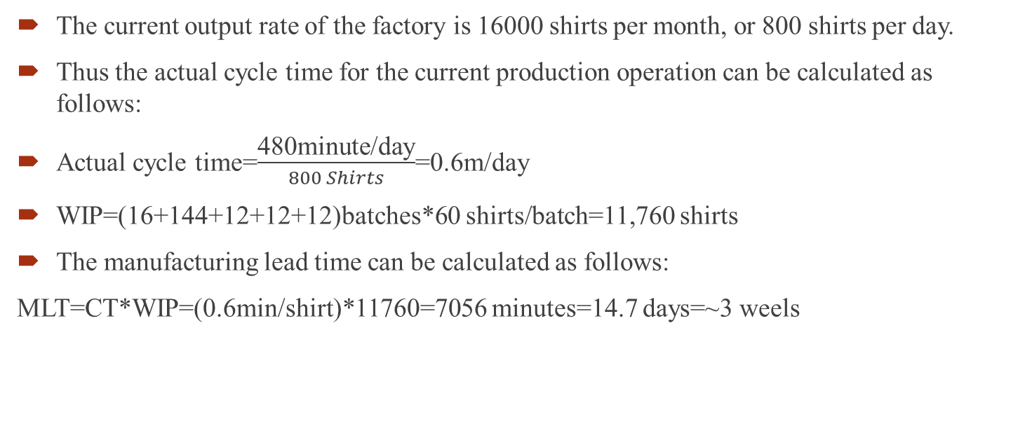
Current Production Process
The current output rate of the factory is 16000 shirts per month, or 800 shirts per day.
Thus the actual cycle time for the current production operation can be calculated as follows:
Actual cycle time=$\frac{\text{480}\text{minute}\text{/}\text{day}}{800 Shirts}$=0.6m/day
WIP=(16+144+12+12+12)batches*60 shirts/batch=11,760 shirts
The manufacturing lead time can be calculated as follows:
MLT=CT*WIP=(0.6min/shirt)*11760=7056 minutes=14.7 days=~3 weels

Slide 55
Current Production Process
To determine the production capacity of the factory, we first calculate the cycle times for all operations to determine the cycle time of the slowest step in the process.
Operation | Regular Shirts Laber Content (Minutes per shirt) | Number of Workers | Cycle Time | Capacity (No. of shirts/day)
Cutting | 30.00 | 4
Setup for Cutting | 1.50 | 4 | 0.25 | 1920
1. Make Collar | 3.90 | 8 | 0.49 | 985
2. Make cuffs | 2.00 | 4 | 0.50 | 960
3. Make sleeves | 0.65 | 2 | 0.33 | 1477
4. Make front | 2.50 | 6 | 0.42 | 1152
5. Make back | 1.70 | 4 | 0.43 | 1129
6. Join shoulders | 0.66 | 2 | 0.33 | 1455
7. Attach collar | 1.65 | 4 | 0.41 | 1164
8. Attach sleeves | 1.55 | 4 | 0.39 | 1239
9. Stitch down sleeves | 0.65 | 2 | 0.33 | 1477
10. Sew side seam | 1.80 | 4 | 0.45 | 1067
11. Attach cuffs | 1.55 | 4 | 0.39 | 1239
12. Hem bottom | 1.70 | 4 | 0.43 | 1129
13. Inspect | 1.50 | 4 | 0.38 | 1280
14.Iron | 1.95 | 4 | 0.49 | 985
15. Fold, Package | 1.75 | 4 | 0.44 | 1097
 | 26.51 | 64.00
Labor Content for Cutting | 1

Slide 56
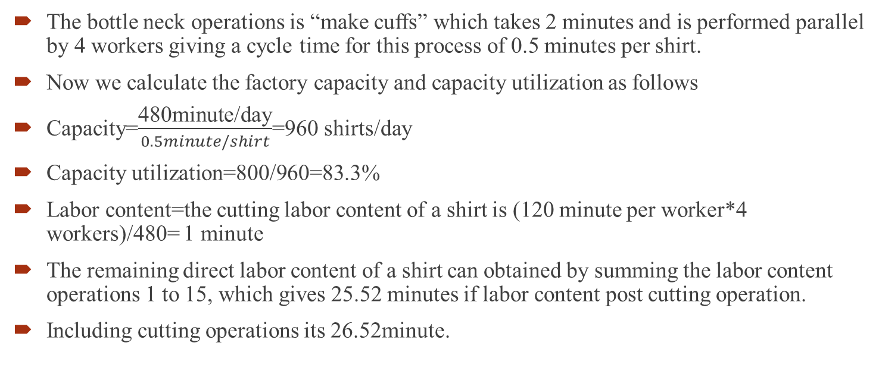
Current Production Process
The bottle neck operations is “make cuffs” which takes 2 minutes and is performed parallel by 4 workers giving a cycle time for this process of 0.5 minutes per shirt.
Now we calculate the factory capacity and capacity utilization as follows
Capacity=$\frac{\text{480}\text{minute}\text{/}\text{day}}{0.5minute/shirt}$=960 shirts/day
Capacity utilization=800/960=83.3%
Labor content=the cutting labor content of a shirt is (120 minute per worker*4 workers)/480= 1 minute
The remaining direct labor content of a shirt can obtained by summing the labor content operations 1 to 15, which gives 25.52 minutes if labor content post cutting operation.
Including cutting operations its 26.52minute.

Slide 57
Current Production Process
To calculate the labor utilization, we first calculate how many minutes the workers are available to work each shift
Total labor utilization available= (480minutes/day*64 workers)/800shirts/day=38.4 minute/shirt.
Labor utilization=26.51/38.4=69%
Direct labor cost=(64 workers*6$/hour*8hour/day)/800 shirts/day=$3.48/shirts.

Slide 58
Laser cutting machine
Laser cutting machine
  One shirt pattern at a time
  5 layers of cloth
  Total time 2.5 minutes
  Material costs10% higher
Initially the quantity for production of shirts was 2,000 per month

Slide 59
Mike’s plan
New machine for Custom shirts
Old machine for Regular shirts
Produce in a batch size of 5 shirts
After cutting, both custom shirts and regular shirts would be sewn together
Buffer inventory: 6 batches per worker

Slide 60
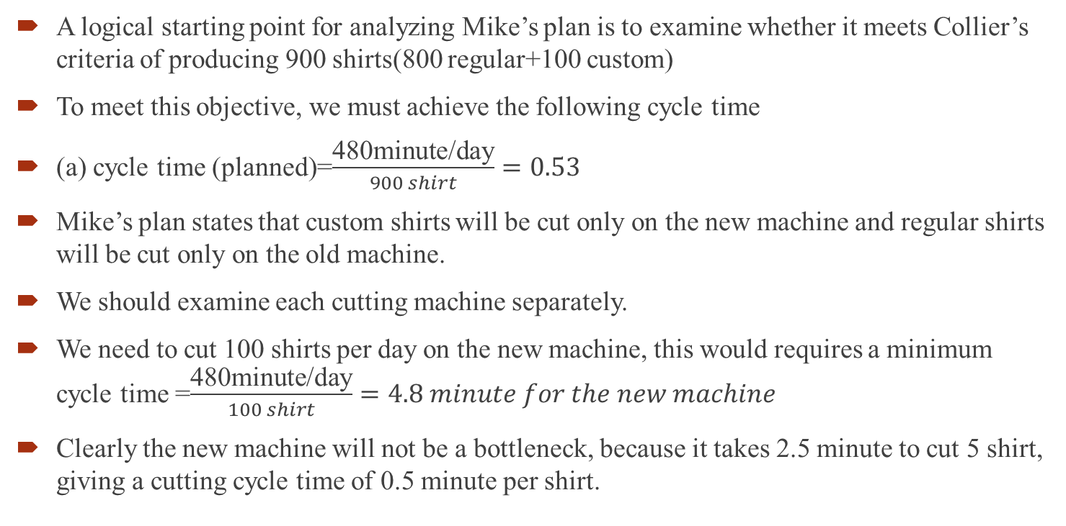
Analysis of Mike’s plan
A logical starting point for analyzing Mike’s plan is to examine whether it meets Collier’s criteria of producing 900 shirts(800 regular+100 custom)
To meet this objective, we must achieve the following cycle time
(a) cycle time (planned)=$\frac{\text{480}\text{minute}\text{/}\text{day}}{900 shirt}=0.53$
Mike’s plan states that custom shirts will be cut only on the new machine and regular shirts will be cut only on the old machine.
We should examine each cutting machine separately.
We need to cut 100 shirts per day on the new machine, this would requires a minimum cycle time =$\frac{\text{480}\text{minute}\text{/}\text{day}}{100 shirt}=4.8 minute for the new machine$
Clearly the new machine will not be a bottleneck, because it takes 2.5 minute to cut 5 shirt, giving a cutting cycle time of 0.5 minute per shirt.

Slide 61
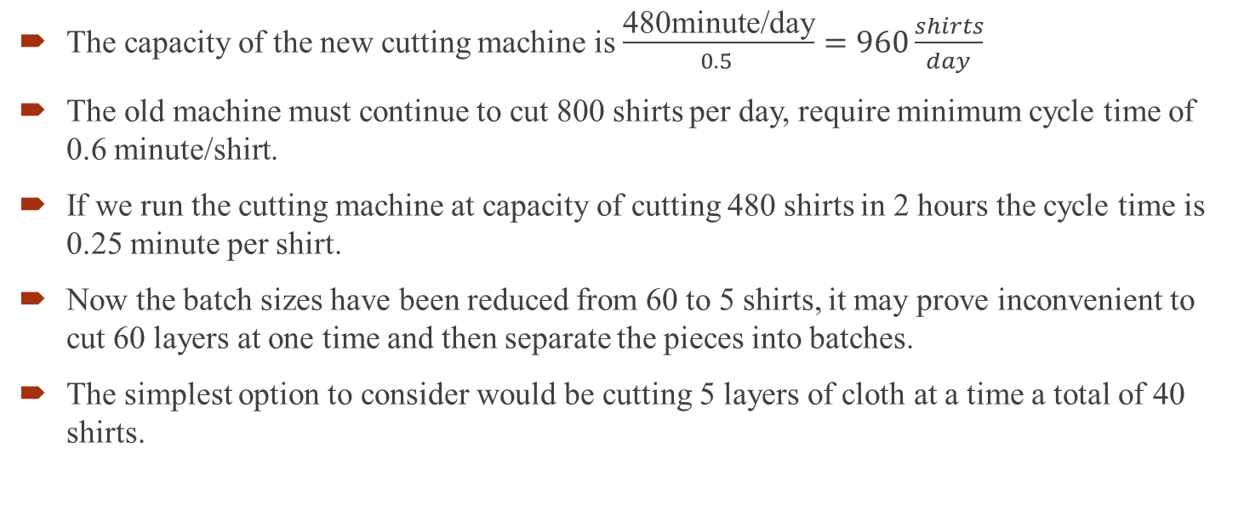
Analysis of Mike’s plan
The capacity of the new cutting machine is $\frac{\text{480}\text{minute}\text{/}\text{day}}{0.5 }=960\frac{shirts}{day}$
The old machine must continue to cut 800 shirts per day, require minimum cycle time of 0.6 minute/shirt.
If we run the cutting machine at capacity of cutting 480 shirts in 2 hours the cycle time is 0.25 minute per shirt.
Now the batch sizes have been reduced from 60 to 5 shirts, it may prove inconvenient to cut 60 layers at one time and then separate the pieces into batches.
The simplest option to consider would be cutting 5 layers of cloth at a time a total of 40 shirts.

Slide 62
Analysis of Mike’s plan
Based on our formula to calculate above (1.5*L+30), we can calculate that the cutting time for L=5 would then be 37.5 minute.
The cycle time is taken 37.5/40=.94 minute per shirt, the cutting would be the bottleneck and company would not be able to produce 800 regular shirts.
Solution of this problem is to assume that the number of layers of cloths that will be cut on the old machine is a multiple of 5, and layers are then separated into batches of 5 after cutting.
For example the number of layers was 10, cutting would take 45 minute for 80 shirt which gives a cycle time 0.56 minute per shirts.
This would allow us to cut all 800 shirts per day.

Slide 63
Analysis of Mike’s plan
If we examine WIP allotted to cutting under Mike’s plan, we see that 36 batches could cut by divided between the two cutting machine as follows:
16 batches (80 shirt) being cut on the old machine and sorted into batches, and an additional 4 batches of custom shirt being cut or sorted at the new machine.
Therefore 0.53 minute cycle time is achievable.
Now we assume that 0.53 will be actual cycle time if Mike’s plan is implemented.
Thus the WIP and MLT are given by
WIP=(36+288+24+24+24)*5sirts/batch=1980
MLT=(CT*WIP)=(0.53*1980)=1056 minute=2.2 days

Slide 64
Analysis of Mike’s plan
Operation | Regular Shirts Laber Content (Minutes per shirt) | Number of Workers
Cutting | 30.00 | 4
Setup for Cutting | 1.50 | 4
Cutting(Custom shirts) | 2.50 | 1
1. Make Collar | 3.90 | 8
2. Make cuffs | 2.00 | 4
3. Make sleeves | 0.65 | 2
4. Make front | 2.50 | 6
5. Make back | 1.70 | 4
6. Join shoulders | 0.66 | 2
7. Attach collar | 1.65 | 4
8. Attach sleeves | 1.55 | 4
9. Stitch down sleeves | 0.65 | 2
10. Sew side seam | 1.80 | 4
11. Attach cuffs | 1.55 | 4
12. Hem bottom | 1.70 | 4
13. Inspect | 1.50 | 4
14.Iron | 1.95 | 4
15. Fold, Package | 1.75 | 4
 | 25.51

Slide 65
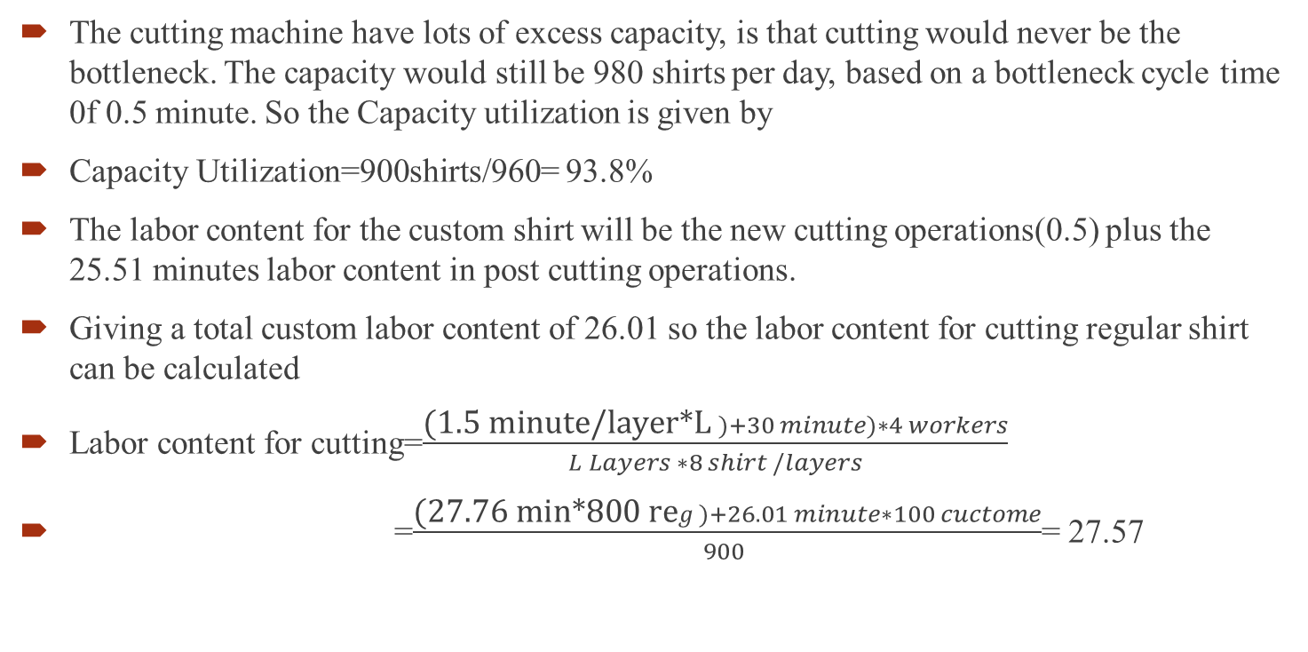
Analysis of Mike’s plan
The cutting machine have lots of excess capacity, is that cutting would never be the bottleneck. The capacity would still be 980 shirts per day, based on a bottleneck cycle time 0f 0.5 minute. So the Capacity utilization is given by
Capacity Utilization=900shirts/960= 93.8%
The labor content for the custom shirt will be the new cutting operations(0.5) plus the 25.51 minutes labor content in post cutting operations.
Giving a total custom labor content of 26.01 so the labor content for cutting regular shirt can be calculated
Labor content for cutting=$\frac{\text{(1.5 }\text{minute}\text{/}\text{layer}\text{∗}\text{L} )+30 minute)∗4 workers}{L Layers ∗8 shirt /layers}$
=$\frac{\text{(}\text{27.76 }\text{min}\text{∗800 }\text{re}g)+26.01 minute∗100 cuctome}{900 }$= 27.57

Slide 66
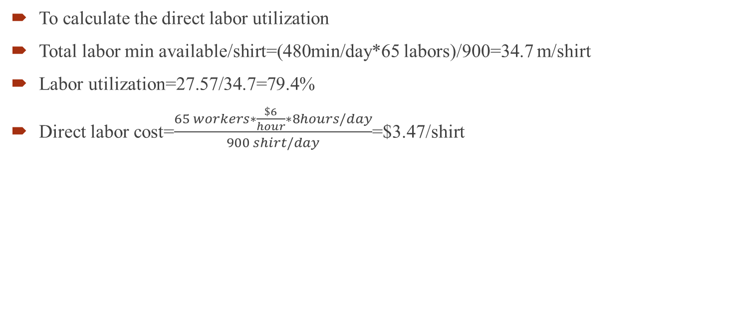
Analysis of Mike’s plan
To calculate the direct labor utilization
Total labor min available/shirt=(480min/day*65 labors)/900=34.7 m/shirt
Labor utilization=27.57/34.7=79.4%
Direct labor cost=$\frac{65 workers∗\frac{\$6}{hour}∗8hours/day}{900 shirt/day}$=$3.47/shirt

Slide 67
Outcome: Under Mike’s plan
Increased utilization
Small WIP
Small MLT
High Indirect cost
10% addition cost of material
Reduced manufacturing cost
Suggestion:
  Go for cellular manufacturing
  Reduce transportation within facility

Slide 68
Ike’s plan
Separate line for Custom-shirt
Moving one worker from each operation to the Custom line
A new worker will operate laser cutting machine
4 existing worker will operate old machine for regular shirt
Overtime if necessary
Buffer inventory: 3 shirts for each of the 15 workers

Slide 69
Analysis of Ike’s plan (Regular Shirt)
If we move 15 people out of the current factory floor onto a separate assembly line. The cycle time per operation would increase with fewer operations.
Operation | Regular Shirts Laber Content (Minutes per shirt) | Number of Workers for Reg. shirts | Cycle time | Individual Capacity (Reg. shirts/day) | Number of Workers for Cust. shirts | Cycle time | Individual Capacity (cust. shirts/day)
Cutting | 30.00 | 4
Setup for Cutting | 1.50 | 4 |  | 1920
Cutting(Custom shirts) | 2.50 | 1 |  | 960 | 1 |  | 960
1. Make Collar | 3.90 | 7 | 0.56 | 862 | 1 | 3.90 | 123
2. Make cuffs | 2.00 | 3 | 0.67 | 720 | 1 | 2.00 | 240
3. Make sleeves | 0.65 | 1 | 0.65 | 738 | 1 | 0.65 | 738
4. Make front | 2.50 | 5 | 0.50 | 960 | 1 | 2.50 | 192
5. Make back | 1.70 | 3 | 0.57 | 847 | 1 | 1.70 | 282
6. Join shoulders | 0.66 | 1 | 0.66 | 727 | 1 | 0.66 | 727
7. Attach collar | 1.65 | 3 | 0.55 | 873 | 1 | 1.65 | 291
8. Attach sleeves | 1.55 | 3 | 0.52 | 929 | 1 | 1.55 | 310
9. Stitch down sleeves | 0.65 | 1 | 0.65 | 738 | 1 | 0.65 | 738
10. Sew side seam | 1.80 | 3 | 0.60 | 800 | 1 | 1.80 | 267
11. Attach cuffs | 1.55 | 3 | 0.52 | 929 | 1 | 1.55 | 310
12. Hem bottom | 1.70 | 3 | 0.57 | 847 | 1 | 1.70 | 282
13. Inspect | 1.50 | 3 | 0.50 | 960 | 1 | 1.50 | 320
14.Iron | 1.95 | 3 | 0.65 | 738 | 1 | 1.95 | 246
15. Fold, Package | 1.75 | 3 | 0.58 | 823 | 1 | 1.75 | 274
 | 25.51 | 49 |  | 16

Slide 70
Analysis of Ike’s plan
The bottleneck operations is still make cuffs, but it is now 0.67 minute to complete.
We need 800 shirt per day, if the bottleneck cycle time is 0.67 per shirt, we can produce 716 shirt per 480 minute daily. This tell us immediately that we must run overtime to meet Coller’s output requirement.
The remaining 84 shirts takes 84*.67=56.3 minute of .94 hour. Clearly workers would expect to pay 1 hour overtime.
We calculate the WIP from=(16+108+9+9+9)*60 shirts/batch=9060
MLT=CT*WIP=(0.67*9060)=6040=12.6 days.
At a cycle time of 0.67 minute, the capacity of the regular shirt production is 716 shirt per day
The capacity utilization is therefore 800/716=112%
The direct labor content of regular shirts is still =26.31 minutes.

Slide 71
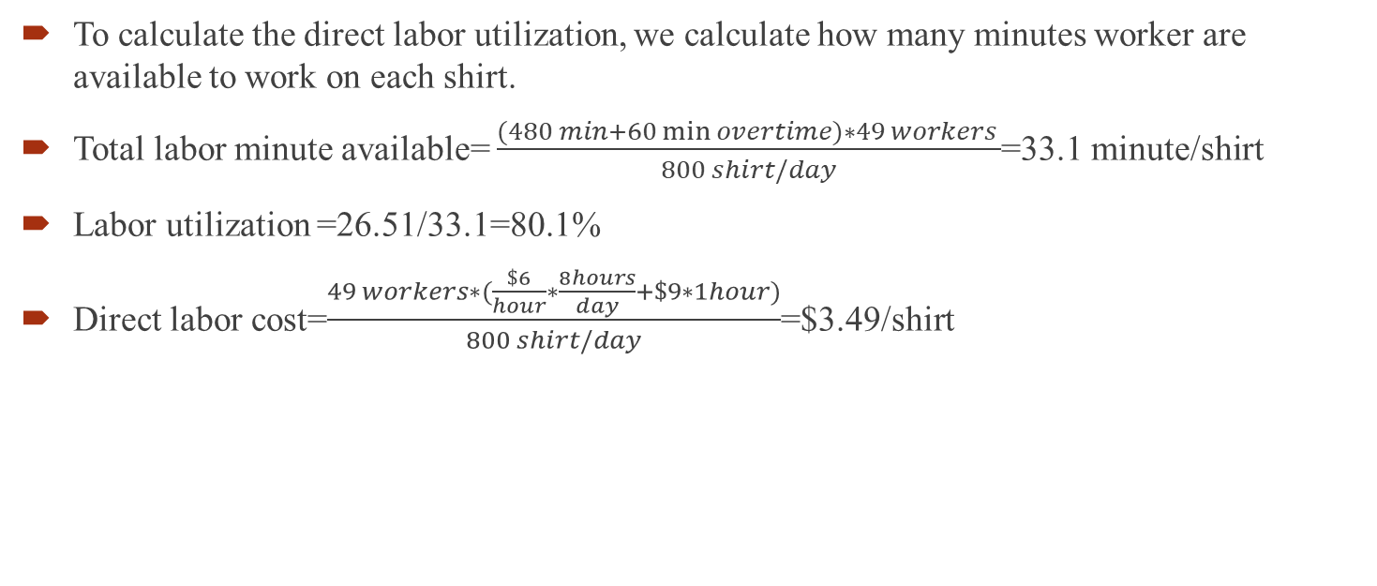
Analysis of Ike’s plan
To calculate the direct labor utilization, we calculate how many minutes worker are available to work on each shirt.
Total labor minute available= $\frac{(480 min+60\min{overtime)∗49 workers }}{800 shirt/day}$=33.1 minute/shirt
Labor utilization =26.51/33.1=80.1%
Direct labor cost=$\frac{49 workers∗(\frac{\$6}{hour}∗\frac{8hours}{day}+\$9∗1hour)}{800 shirt/day}$=$3.49/shirt

Slide 72
Analysis of Ike’s plan(Custom Shirt)
The bottleneck operations here is make collar which takes 3.9 minute. However we need to make only 100 shirt in 480 minutes, so we only need to run at the rate of 4.8 minutes per shirt. So our actual cycle time is 4.8 minute
Given that there are on average 3 shirts per workers for 15 workers, there will be about 45 unit of WIP on the line after cutting as well as up to 5 units being cut, for a total of 45 to 60 shirts.
The MLT can then be calculated as follows: MLT=CT*WIP=(4.8*50)=240 minute.=0.5 days
The capacity of the line is 480 minutes/3.9 minutes=123 shirt per day

Slide 73
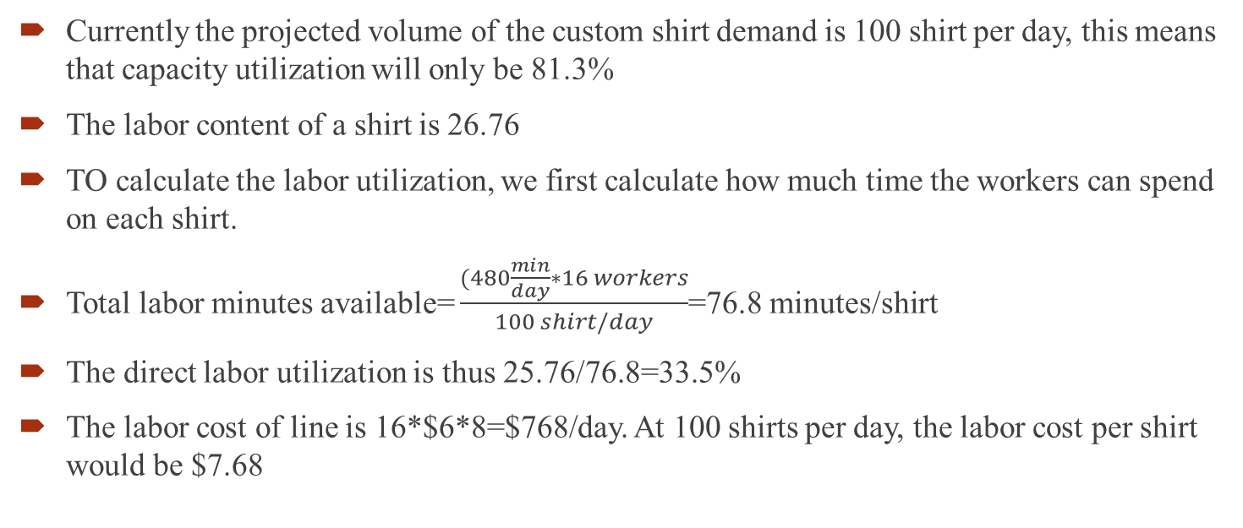
Analysis of Ike’s plan(Custom Shirt)
Currently the projected volume of the custom shirt demand is 100 shirt per day, this means that capacity utilization will only be 81.3%
The labor content of a shirt is 26.76
TO calculate the labor utilization, we first calculate how much time the workers can spend on each shirt.
Total labor minutes available= $\frac{(480\frac{min}{day}∗16 workers}{100 shirt/day}$=76.8 minutes/shirt
The direct labor utilization is thus 25.76/76.8=33.5%
The labor cost of line is 16*$6*8=$768/day. At 100 shirts per day, the labor cost per shirt would be $7.68

Slide 74
Outcome: Under Ike’s plan
Higher ideal time
Low lead time for custom shirts
Minimum order size can be one
Go for assembly line balancing
Remaining worker can be assigned on regular line
Eliminate overtime

Slide 75
Comparison
 | Current(R only) | Mike's Plan(R+C) | Ike's Plan ( R ) | Ike's Plan( C )
Actual Cycle Time(min./shirt)* | 0.60 | 0.53 | 0.67 | 4.80
WIP Inventory(shirts) | 11760 | 1980 | 9060 | 50
Manufacturing Lead Time(days) | 14.7 | 2.2 | 12.6 | 0.5
Production Capacity(shirts/day)** | 960 | 960 | 720 | 123.08
Capacity Utilization | 83.33 | 93.75 | 111.11 | 81.25
Direct Labor Content(min./shirt) | 26.51 | 27.57 | 26.51 | 26.01
Direct Labor Content Available(min/shirt) | 38.40 | 34.67 | 32.67 | 76.80
Direct Labor Utilization | 69.04 | 79.52 | 81.15 | 33.87
Direct Labor Cost($/shirt) | 3.84 | 3.47 | 3.43 | 7.68
Overtime (minutes) |  |  | 53.33

Slide 76
Thank You

