Slide 1
Introduction to Process view of the organization

Slide 2
Business Process
Business Process: A collection of inter-related events, activities, and decision points that involve several actors and objects, which collectively lead to an outcome that is of value to at least one customer.
Business Process Management: A body of methods, techniques, and tools to identify, discover, analyze, redesign, execute, and monitor business processes in order to optimize their performance.

Slide 3
Business Process
Event: Events correspond to things that happen atomically, which means that they have no duration.
Activities: Both fine-grained or coarse-grained units of work.
  Tasks: refers to a fine-grained unit of work performed by a single process.
Decision points: points in time when a decision is made that affects the way the process is executed.
Actors: Human actors, organizations, or software systems acting on behalf of human actors or organizations.
  Internal - process participants.
  External

Slide 4
Business Process
Physical objects: Equipment, materials, products, paper documents.
Informational objects: Electronic documents and electronic records.
Outcomes: an outcome should deliver value to the actors involved in the process.
  Negative outcome
  Positive outcome
Customer: The one who consumes the output.

Slide 5
Processes and Outcomes
Every Process leads to one or more outcomes – Positive or Negative
  Positive outcomes add value
  Negative outcome reduce value
Outcomes:
  Items received as requested
  Items received but different from requested
  Items requested rejected by supervisor
  Items not available
  Items received as per changed request from supervisor

Slide 6
Business Process Management (BPM)
Art and science of overseeing how work is performed in an organization to ensure consistent outcomes and to take advantage of improvement opportunities.
Improvement:
  Reducing costs
  Reducing execution times
  Reducing error rates
  Gaining competitive advantage through innovation.
Improvement initiatives may be one-off or of a continuous nature; they may be incremental or radical.

Slide 7
Examples of Business Processes
Order-to-cash
Quote-to-order
Procure-to-pay
Issue-to-resolution
Application-to-approval
Claim-to-Settlement

Slide 8
Ford Case – Don’t Automate, Obliterate
Procure-to-pay process
Accounts Payable – 500 people
Automation (20% improvement)
Mazda

Slide 9
Ford Case – Don’t Automate, Obliterate
Result:
  75% reduction in head count
  More accurate information with everyone
  Purchase requisition faster
  Payment overdue reduced
    Earlier: Pay when we get invoice
    Later: Pay when we get the goods

Slide 10
Ford Case – Don’t Automate, Obliterate
Principal of Business Process Reengineering:
  Organize around outcomes, not tasks
  Have those who use the output of the process, drive the process
  Subsume information processing work into the real work that produces the information
  Treat geographically dispersed resources as if they are centralized
  Link parallel activities instead of integrating their results
  Put decision point where the work is performed and build control into the process
  Capture the information once and at the source

Slide 11
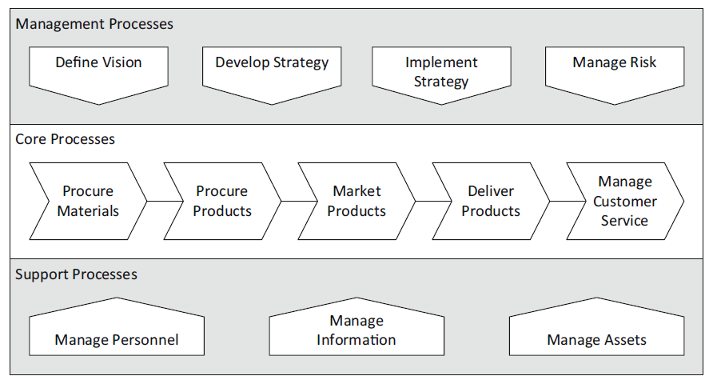
Category of Processes

Slide 12
Process Mapping & Process Modelling
Process mapping is the process of drawing out all the steps and tasks involved in a business process, to create a process map, also known as a workflow diagram, which visually describes what happens, step-by-step.
  A map to guide you through the business process
  Process maps can support activities such as business monitoring and reporting, and compliance activities such as auditing.
Process modeling is the graphical representation of business processes or workflows in detail and in the context of business operations.
  A process model will include elements of process documentation, noting all information necessary to properly execute the process and how it fits into the wider organization.
  Basis for continuous improvement

Slide 13
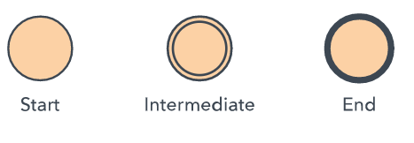
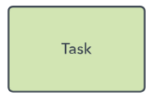

Rules
Events are represented by circles
Task or Activities by rounded rectangles
Sequence flows (also called arcs) are represented by arrows with a full arrow-head

Slide 14
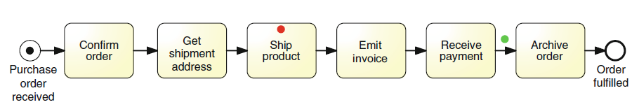
Token
Represents state of an Instances of a process

Slide 15
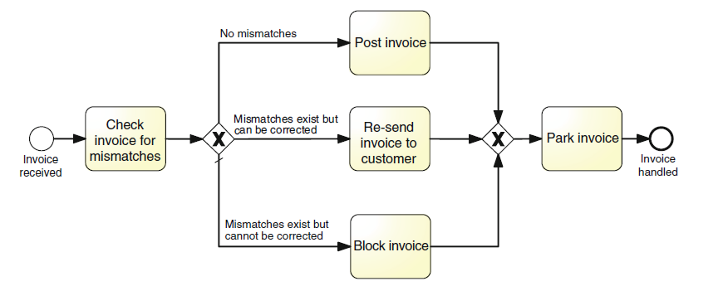
Branching and Merging - Mutually exclusive paths
Gateways – XOR gateway
  XOR split
  XOR join
Default flow

Slide 16
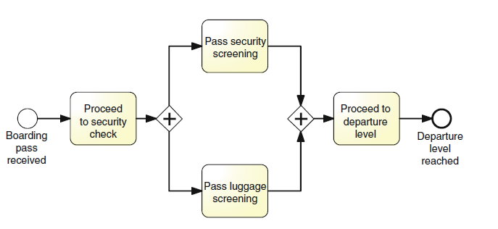
Branching and Merging – Parallel paths
Gateways – AND gateway
  AND split
  AND join
Synchronization

Slide 17
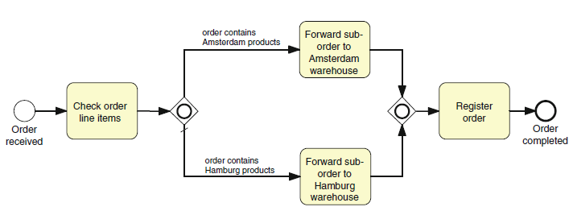
Branching and Merging – Multiple paths
Gateways – OR gateway
  OR split
  OR join
Synchronization

Slide 18
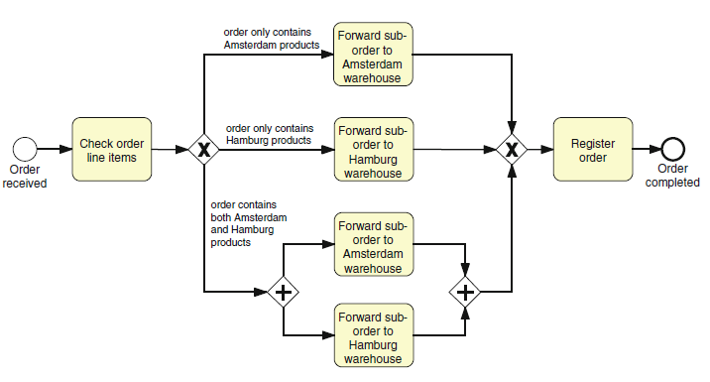
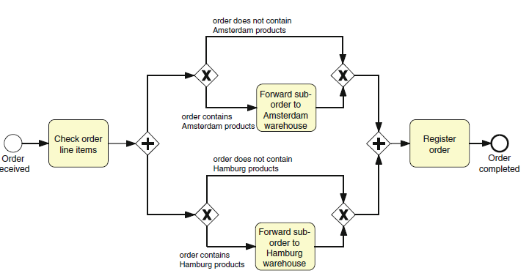
Branching and Merging – Interpret the models

Slide 19
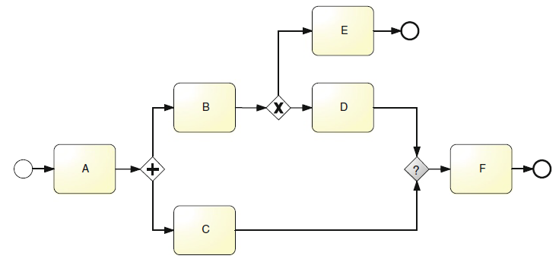
Branching and Merging – Deadlock, Lack of synchronization

Slide 20
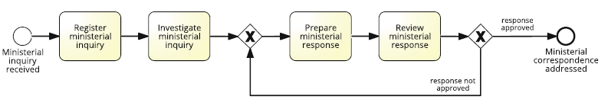
Branching and Merging – Repetition block

Slide 21

Business Objects
Data objects – Artefacts
  As a document with the upper-right corner folded over
Link them to activities with a dotted arrow with an open arrowhead
  Data Association
State
Data store – A place containing data objects that need to be persisted beyond the duration of a process instance

Slide 22
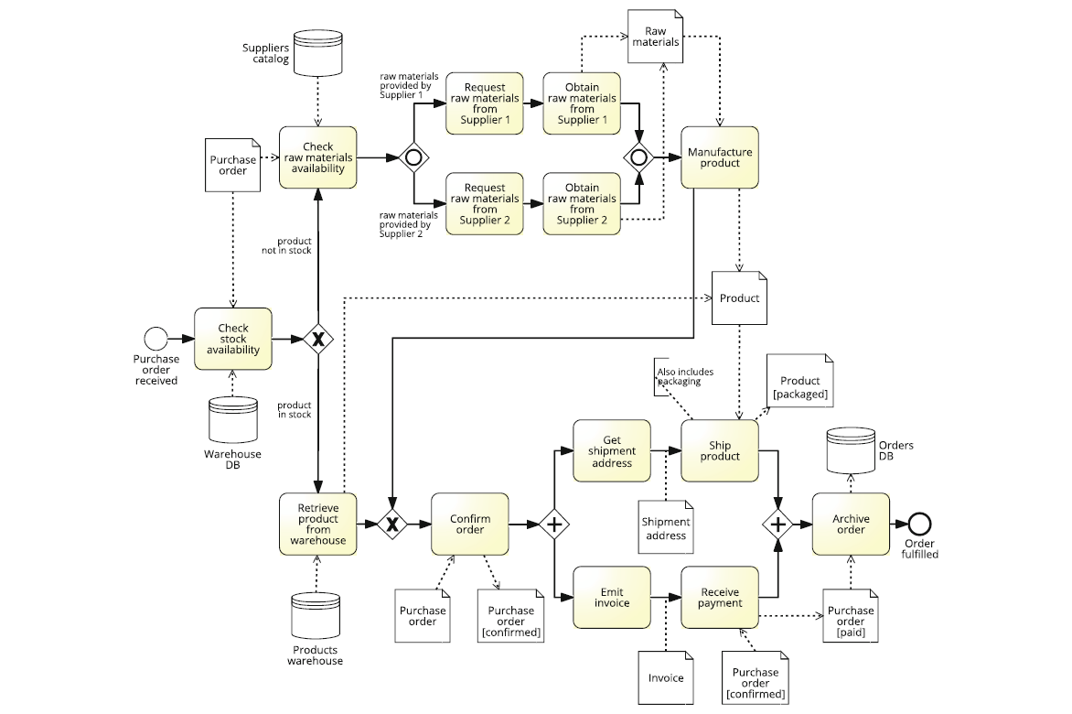

Slide 23
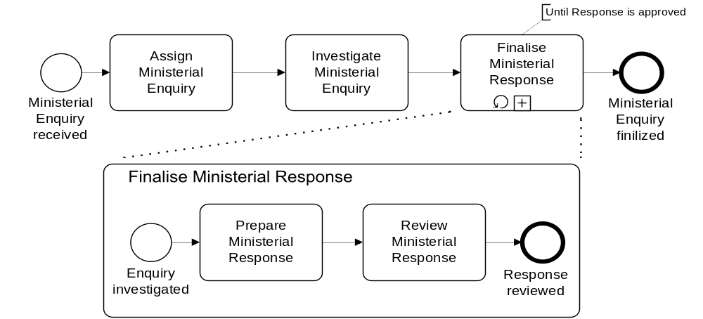
Example: block-structured repetition
Completion condition
Must have a decision activity

Slide 24
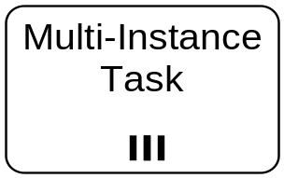
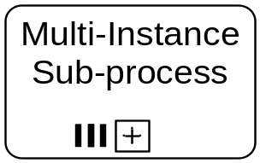
Parallel repetition: multi-instance activity
Provides a mechanism to indicate that an activity is executed multiple times concurrently
Useful when the same activity needs to be executed for multiple entities or data items, such as:
  Request quotes from multiple suppliers
  Check the availability for each line item in an order separately
  Send and gather questionnaires from multiple witnesses in the context of an insurance claim

Slide 25
Disability Insurance Claims Handling at InsureIT

Slide 26
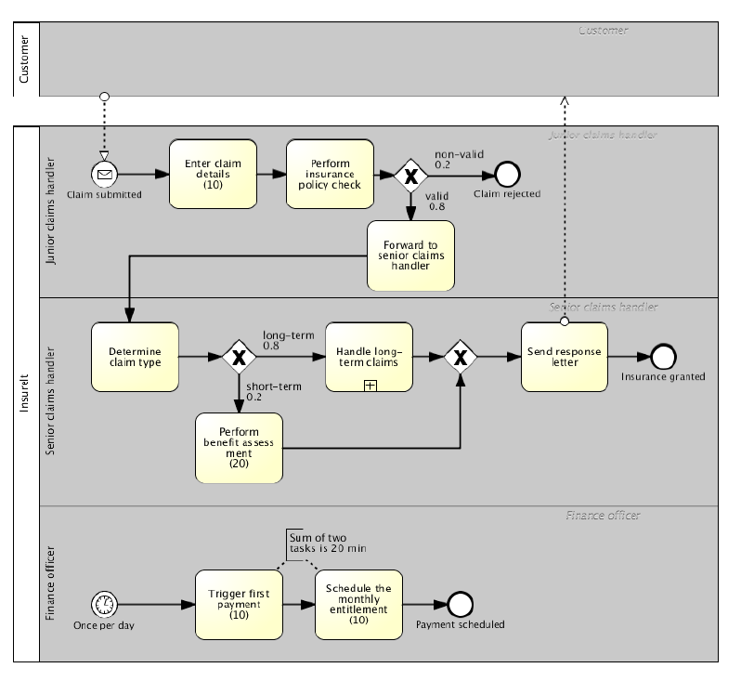

Slide 27
Value-added analysis
Divide the process into steps
  Steps performed before a task
  The task itself, possibly decomposed into smaller steps
  Steps performed after a task, in preparation for the next task
Classify each step
  Value-adding (VA)
  Business value-adding (BVA)
  Non-value-adding (NVA)

Slide 28
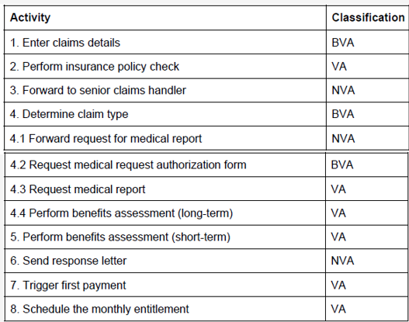

Slide 29
Seven sources of waste
Move
Motion
Hold
Waiting (and idleness)
Over-do
Over-Processing
Over-Production
Unnecessary Transportation
Inventory
Defects

Slide 30
Issue register
Purpose: to maintain, organize and prioritize perceived weaknesses of the process (issues)
Sources of issues:
  Input to a process modelling project
  Collected as part of ongoing process improvement actions
  Collected during process discovery (modelling)
  Value-added/waste analysis

Slide 31
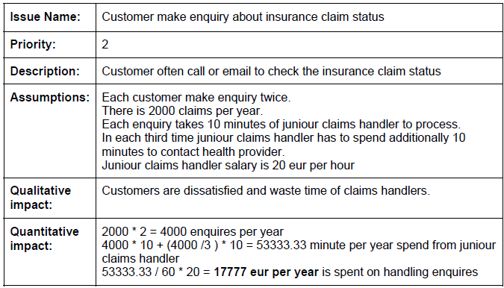
Issue Register Example
Notes:
HDD

Slide 32
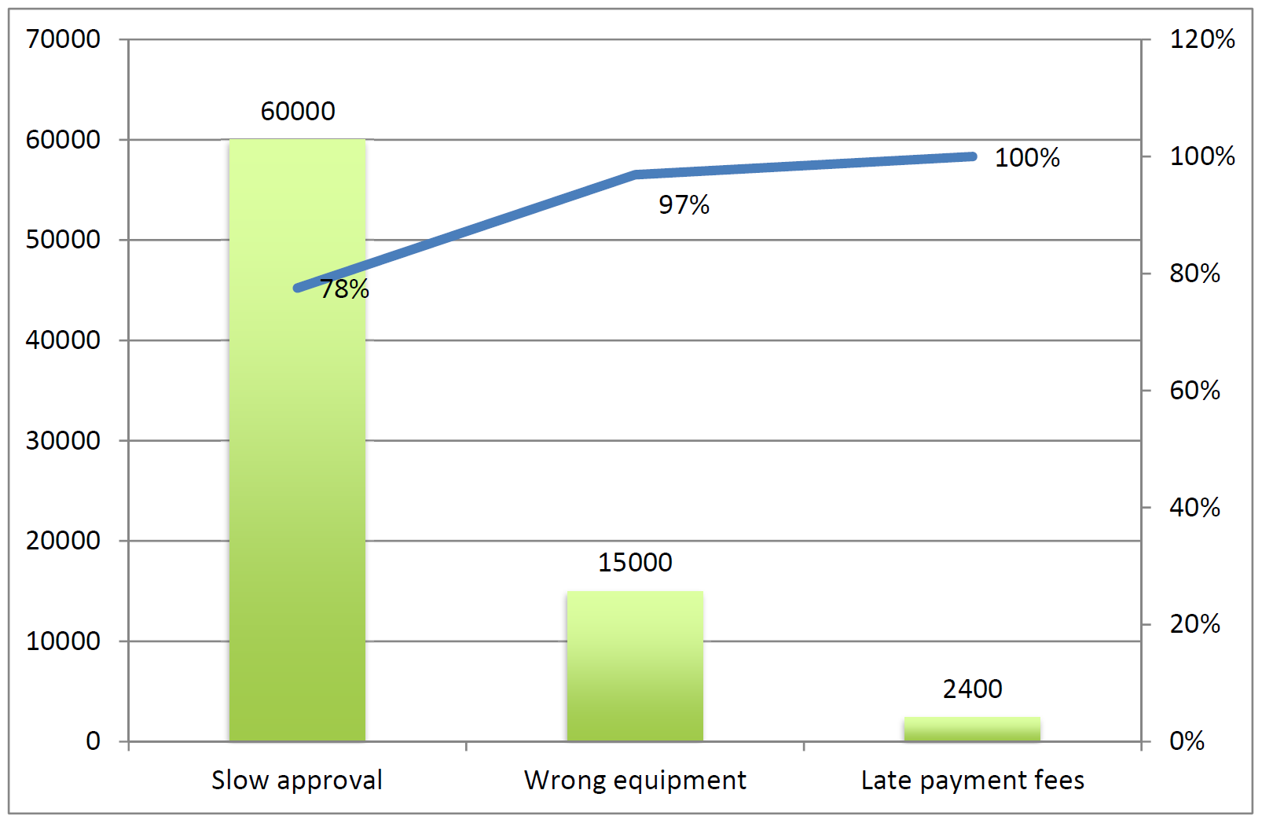
Pareto chart example

Slide 33
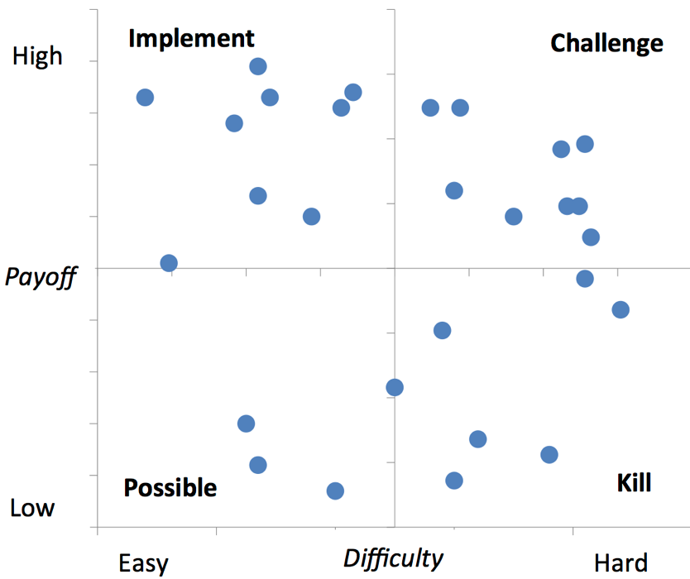
Two-Dimensional Prioritization: PICK Chart

Slide 34
Root-cause analysis
Why-why diagram
Factors
Issue
Cause-effect diagram

Slide 35
Why-why diagram example
Why-why diagram
Handling complex claims is time consuming, why?
  Juniour claims handler has to request customer authorization form, why?
    Health provider does not provide the report without customer authorization form, why?
      It is the policy or health provider
      It is the law
  Juniour claims has to wait for health provider to send health report, why?
    Health provider is not sending the health report right away, why?
      Health provider does not put enough resources to handle health reports, why?
        They perceive that issue is of secondary importance
        They do not have any financial interest in performing the process faster

Slide 36
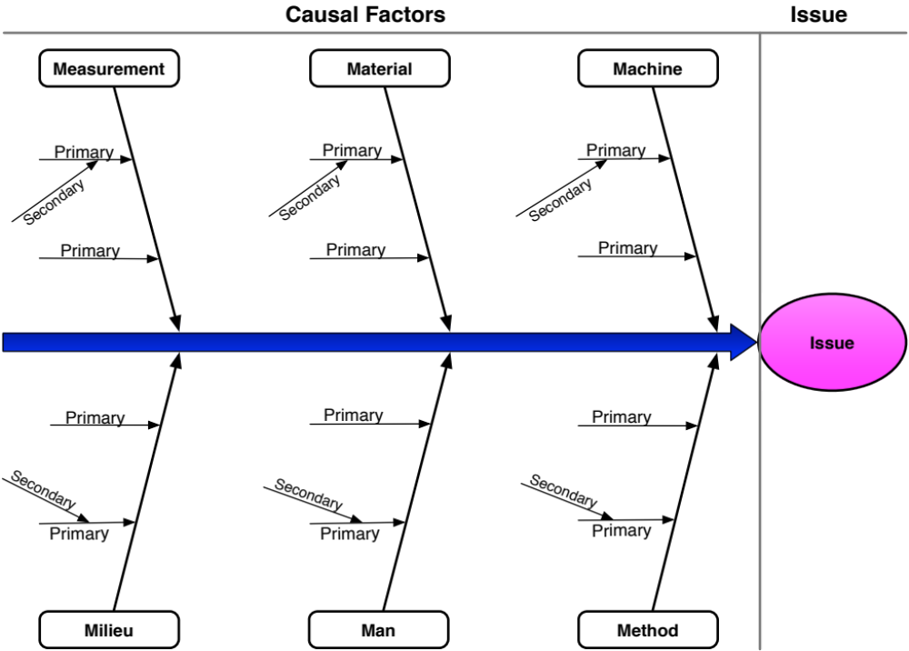
Cause-effect (Fishbone) diagram
Notes:
HDD

Slide 37
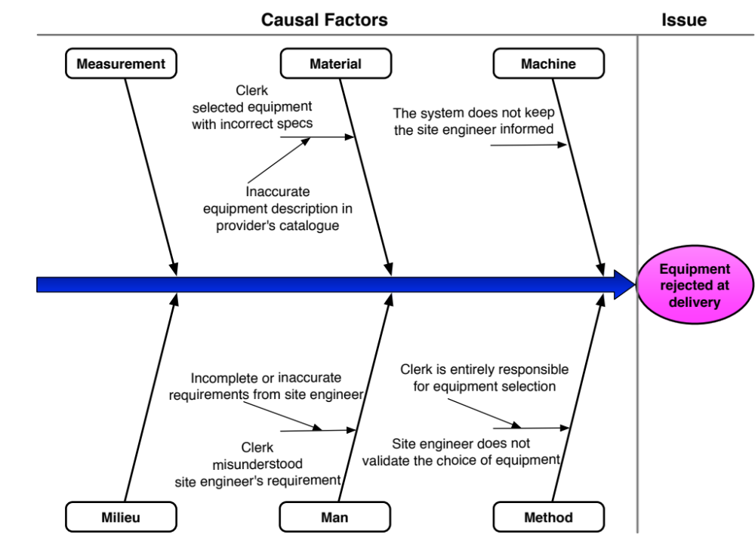
Cause-effect diagram example

Slide 38
Common time-related measures
Time taken by value-adding activities
Processing time
Waiting time
Cycle time
Time between start and completion of a process instance
Time taken by non-value-adding activities

Slide 39
Cycle time efficiency
Processing Time
Cycle Time
Cycle Time Efficiency

Slide 40
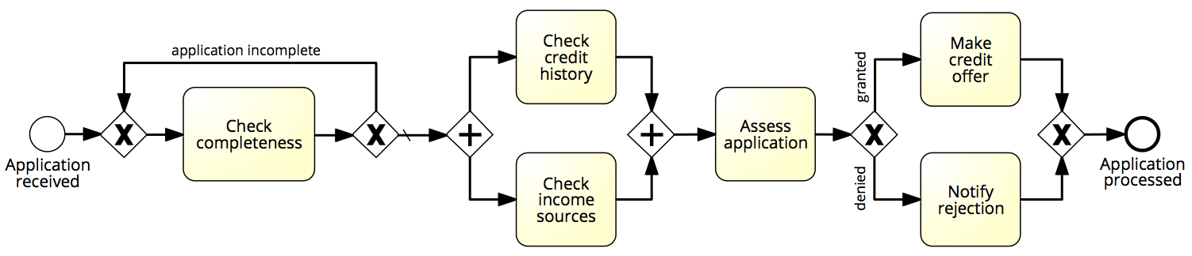
Flow analysis of cycle time
1 day
1 day
1 day
3 days
3 days
2 days
Cycle time = X days

Slide 41
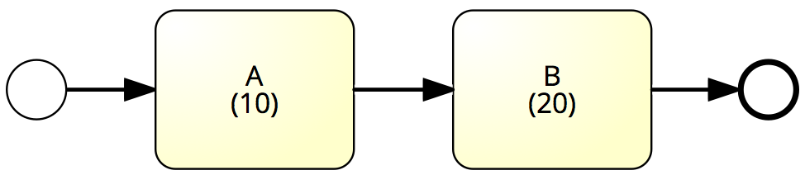
Sequence – Example
What is the average cycle time?
Cycle time = 10 + 20 = 30

Slide 42
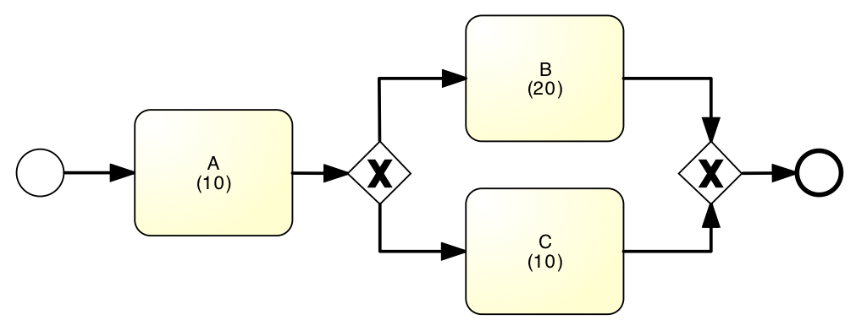
Example: Alternative Paths
What is the average cycle time?
50%
90%
50%
10%
Cycle time = 10 + (20+10)/2 = 25
Cycle time = 10 + 0.9*20+0.1*10 = 29

Slide 43
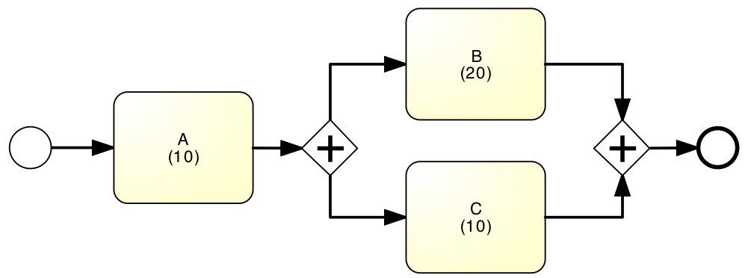
Example: Parallel paths
What is the average cycle time?
Cycle time = 10 + 20 = 30

Slide 44
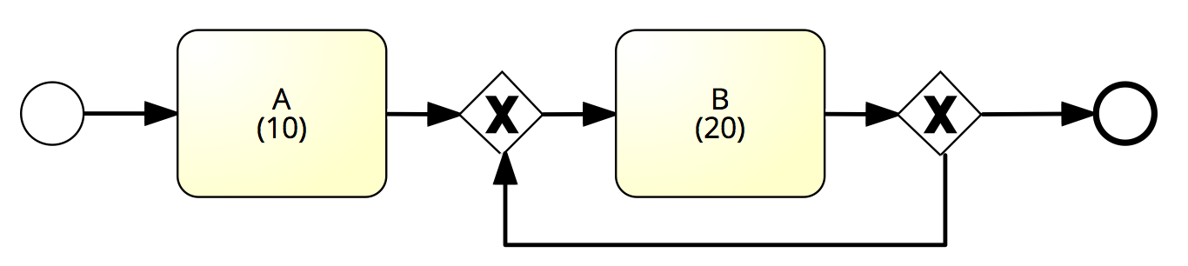
Example: Rework loop
What is the average cycle time?
80%
100%
1%
0%
99%
20%
Cycle time = 10 + 20 = 30
Cycle time = 10 + 20/0.01 = 2010
Cycle time = 10 + 20/0.8 = 35

Slide 45
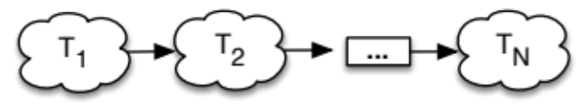
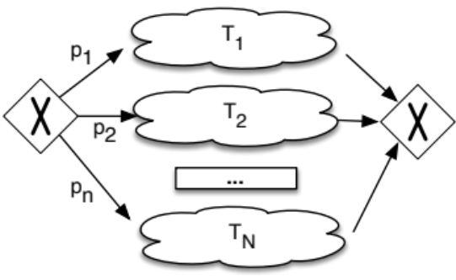
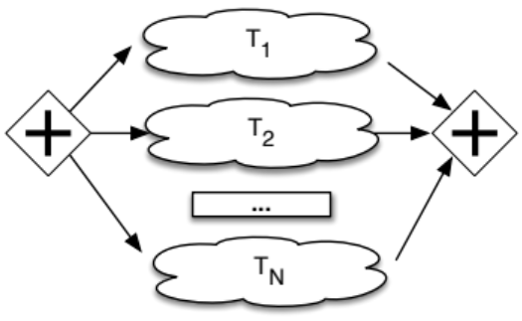
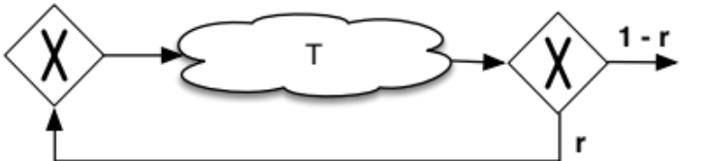
Flow analysis equations for cycle time
CT = T₁+T₂+…+ T_{N}
CT = p₁*T₁+p₂*T₂+…+ p_{n}*T_{N}
CT = max(T₁, T₂,…, T_{N})
CT = T / (1-r)

Slide 46
Flow analysis of cycle time
1 day
1 day
20%
60%
80%
1 day
3 days
40%
3 days
2 days
1/0.8
max(1,3)
3
0.6*1+0.4*2
Cycle time = 1.25 + 3 + 3 + 1.4 = 8.65 days

Slide 47
Flow analysis of processing time
0.5 hour
2 hours
20%
60%
80%
2 hours
2 hours
40%
3 hours
0.5 mins.
2/0.8
max(0.5,3)
2
0.6*2+0.4*0.5
Processing time = 2.5 + 3 + 2 + 1.4 = 8.9 hours
Cycle time efficiency = 8.9 hours / 8.65 days = 12.9%

Slide 48
Resource utilization
Time spent per resource on process work
Time available per resource for process work
Resource utilization
Resource utilization = 60%
➔ on average resources are idle 40% of their allocated time

Slide 49
Resource utilization vs. waiting time
Resource utilization
Waiting time
Typically, when resource utilization > 90%
➔ Waiting time increases steeply

Slide 50
Cycle Time & Work-In-Progress
WIP = (average) Work-In-Process
  Number of cases that are running (started but not yet completed)
  E.g. # of active and unfilled orders in an order-to-cash process
Little’s Formula: WIP = λ·CT
  λ = arrival rate (number of new cases per time unit)
  CT = cycle time

Slide 51
Exercise
A fast-food restaurant receives on average 1200 customers per day (between 10:00 and 22:00). During peak times (12:00-15:00 and 18:00-21:00), the restaurant receives around 900 customers in total, and 90 customers can be found in the restaurant (on average) at a given point in time. At non-peak times, the restaurant receives 300 customers in total, and 30 customers can be found in the restaurant (on average) at a given point in time.
  What is the average time that a customer spends in the restaurant during peak times?
  What is the average time that a customer spends in the restaurant during non-peak times?

Slide 52
Queuing theory: basic concepts
waiting
service
arrivals
λ
c
μ
Basic characteristics:
λ (mean arrival rate) = average number of arrivals per time unit
μ (mean service rate) = average number of jobs that can be handled by one server per time unit:
c = number of servers

Slide 53
Queuing theory concepts (cont.)
λ
c
μ
Wq,Lq
W,L
Given λ , μ and c, we can calculate :
occupation rate: ρ
Wq = average time in queue
W = Cycle time
Lq = length of queue
L = Work-in-Progress

Slide 54
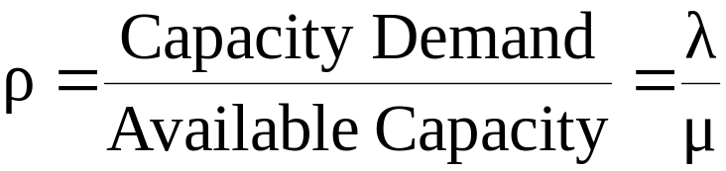
M/M/1 queue
Wq = average time in queue
W = Cycle time
Lq = length of queue
L = Work-in-Progress
λ
1
μ
Assumptions:
time between arrivals and processing time follow a negative exponential distribution
1 server (c = 1)
FIFO
L=ρ/(1- ρ)
L_{q}= ρ²/(1- ρ) = L-ρ
W=L/λ=1/(μ- λ)
Wq=Lq/λ= λ /( μ(μ- λ))

Slide 55
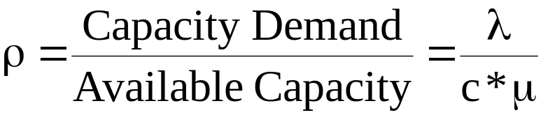
M/M/c queue
Wq = average time in queue
W = Cycle time
Lq = length of queue
L = Work-in-Progress
Now there are c servers in parallel, so the expected capacity per time unit is then c*μ
Little’s Formula ⇒ Wq=Lq/λ
W=Wq+(1/μ)
Little’s Formula ⇒ L=λW

Slide 56
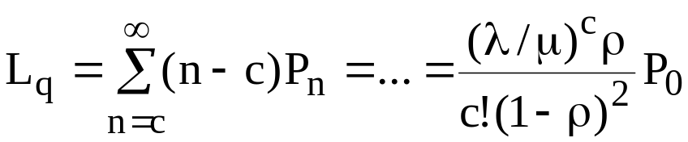
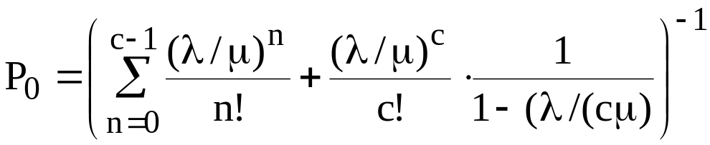
Tool Support
Wq = average time in queue
W = Cycle time
Lq = length of queue
L = Work-in-Progress
For M/M/c systems, the exact computation of Lq is rather complex…
Consider using a tool, e.g.
  http://www.supositorio.com/rcalc/rcalclite.htm

Slide 57

Example – ER at County Hospital
Situation
  Patients arrive according to a Poisson process with intensity λ (⇔ the time between arrivals is exp(λ) distributed.
  The service time (the doctor’s examination and treatment time of a patient) follows an exponential distribution with mean 1/μ (=exp(μ) distributed)
  The ER can be modeled as an M/M/c system where c = the number of doctors
Data gathering
  λ = 2 patients per hour
  μ = 3 patients per hour
Question
Should the capacity be increased from 1 to 2 doctors?

Slide 58
Queuing Analysis – Hospital Scenario
Wq = average time in queue
W = Cycle time
Lq = length of queue
L = Work-in-Progress
Interpretation
  To be in the queue = to be in the waiting room
  To be in the system = to be in the ER (waiting or under treatment)
Should we increase the capacity from one to two doctors?
Characteristic | One doctor (c=1) | Two Doctors (c=2)
ρ | 2/3 | 1/3
Lq | 4/3 patients | 1/12 patients
L | 2 patients | 3/4 patients
Wq | 2/3 h = 40 minutes | 1/24 h = 2.5 minutes
W | 1 h | 3/8 h = 22.5 minutes

