Slide 1
Process Analysis and Value Stream Mapping
Sachin Kamble

Slide 2
Process Terminologies
Batch
A group of items or orders that is processed at one time.
For example, a company may manufacture different types of bread. Such as plain, sugarless, wheat, multi-grain etc. In such instance each product will be required to be processed separately in different batches.
The batch size and number of batches to be processed will be determined based on the capacity of the individual process and the customer demand.
Mix preparation Capacity: 10kg/hour
Dough making Capacity: 5kg/hour
Baking Capacity: 7kg./hour
Packing Capacity: 15kg/hour
Figure 1: Bread manufacturing process
The bread manufacturing process is shown in fig. 1.
The processing time shown for various stages is applicable for bread type-plain and may vary for different products (multigrain, wheat etc.)

Slide 3
Process Terminologies
Setup time
It is the amount of time required to set up or organize the resources for processing a batch.
For instance, it takes one hour to clean the dough-making equipment before processing the batch of another product type to avoid product contamination. Set-up changeovers will be also required during the baking and packaging process as different bread products will require different baking time and has different packing style.
Setup time is also referred to as changeover time.

Slide 4
Process Terminologies
Run time
It is the time taken to process an item or a batch of items at a specific stage and excludes any setup time. If the dough-making equipment has a setup time of one hour and takes three hours to process the batch then the run time is three hours.
If the company runs five batches after every setup, then the total runtime will be 5 batches*three hours = 15 hours.

Slide 5
Process Terminologies
The capacity of a resource
It is the maximum number of items that can be processed by a resource in a given length of time.
For instance, the resources (labor, machines, and equipment) are deployed at the packing stage process at a rate of 15kg/hour. The capacity of a process can be increased or decreased by changing the deployment of resources.
Bottleneck
The resource that limits the production or service delivery.
In our example, the different stages have their own processing times. However, the final output per hour is controlled by the slowest process. The dough-making process which is the slowest process controlling the flow of the bread to 5kg per hour in the system is therefore identified as the bottleneck process.

Slide 6
Process Terminologies
Throughput rate
The rate at which the finished goods emerge from the process. That is the number of items passing through the process /unit time.
In our example, the throughput time is determined by the bottleneck activity. The throughput rate is 5kg of bread/hour.
Cycle time
It is defined as the inverse of the capacity of the system or the throughput rate.
For instance, the throughput rate is 5kgs/hour. Therefore, the cycle time will be 0.2 hours/kg (i.e., 1/5kg) or 12 mins per kg. It means that the firm produces 1kg of bread every 12 mins.

Slide 7
Process Terminologies
Capacity utilization
It is defined as the ratio of the amount of resource used to the amount available.
Suppose if the demand for the bread is 40kg per day and the company operates for 8 hours a day. In such an instance the company will be able to meet the demand as it can produce a maximum of 5kg/hour i.e., 40kg in an 8-hour day. In doing so the resources at the mixing process will be used to 100% (full capacity).
However, the other resources are underutilized. For example, the batch preparation process will only work for 4hours to process 40 kg of bread (@10kg/hour) remaining idle for 4 hours a day. The utilization rate is 50%.

Slide 8
Process Terminologies
Raw material
Materials that are processed to produce bread.
Work-In-Process (WIP) inventory
The processing of raw material will begin as soon as it enters the manufacturing process.
For instance, in the batch preparation stage, the raw material is mixed together and transformed into WIP. Any work-in-process items waiting to get processed in the next stage are referred to WIP inventory.
Finished product
The completely processed items result in finished goods, which are ready for consumption or use by the customers.

Slide 9












Process analysis at HR Anna Company
The Product- Window Boxes (See Figure)
WINDOW BOX
PART A
PART B

Slide 10
The production process
Stamping
  Parts are fabricated using a stamping machine
  Switching between the two parts A and B
  Setup time 120 minutes
  Run time for A: One minute per part
  Run time for B: 30 seconds per part
  Currently parts are switched after every 360 parts of A and 720 parts of B.
Painting
  A robot is used (can paint in 5 different colors)
  30 seconds for one part A and 10 seconds for one part B
  A switch in color requires 20 minutes of setup
  120 minutes drying time is required after the part is colored
  Present program: Change in color after 360 parts of A and 720 parts of B are finished.
Assembly
  Manual assembly is done
  It takes 27 minutes to assemble a single unit by a worker.
  12 workers available for assembly.
General information
  Works for 8 hours shift/day, five days a week.
  Average demand per week: 800 window boxes.

Slide 11
Process analysis
Draw the process flow for the production process

Slide 12
Process analysis
Identify the bottleneck for the current process and calculate the average weekly capacity in terms of the number of units of final product produced per week.

Slide 13
Process analysis
What is the average utilization of the workers and the machines?

Slide 14
Process analysis
What impact would doubling the batch sizes at the stamping operation have on average daily capacity? Be number-specific. Explain qualitatively what other effects this change would have?

Slide 15
Process analysis
Management is considering investing in a setup reduction program for the stamping machine. Suppose the setup time could be reduced to 20 minutes, with some additional investment cost. What would happen to the average capacity if the batch size remained the same as in question 1?

Slide 16
Process analysis at Benihana of Tokyo
https://youtu.be/XOJVfxMVehA

Slide 17
Process analysis at Benihana of Tokyo
Process Details
Customer enters the bar area and spends the time until he gets the entry for the dining.
A batch of 8 people is made and allowed to enter the dining area.
The serving time each table is approximately 60 minutes.
The exit is through the bar area.
Can we draw a process for the above information?

Slide 18
The Process for Benihana of Tokyo
IN
OUT
60 minutes
Bar area
Dining area
What are your observations?

Slide 19
Consider the additional information
There are 8 seats in the bar and 40 seats in the dining area (20%).
No. of tables =?
Dining area cycle time =?
Bar wait time =?

Slide 20
Consider the additional information
There are 16 seats in the bar and 80 seats in the dining area (20%).
No. of tables =?
Dining area cycle time =?
Bar wait time =?

Slide 21
Consider the additional information
There are 56 seats in the bar and 120 seats in the dining area (47%).
No. of tables =?
Dining area cycle time =?
Bar wait time =?

Slide 22
Value Stream Mapping
Value stream mapping is a method for documenting business processes, allowing project managers and analysts to analyze the different states and identify areas of improvement.
Every business has processes for making and selling products and services. The more you know about those processes, the more effectively you can manage and improve them.

Slide 23


Value Stream Map Components
Process Box Person Databox Order
Inventory Workflow Customer/supplier Information
  10 days
  RM: Raw Material
  FG: Finished goods
P/T = 275 secs
C/T = 275 secs
Utilization: 82%
Assembly
2FTE 4 persons
RM

Slide 24
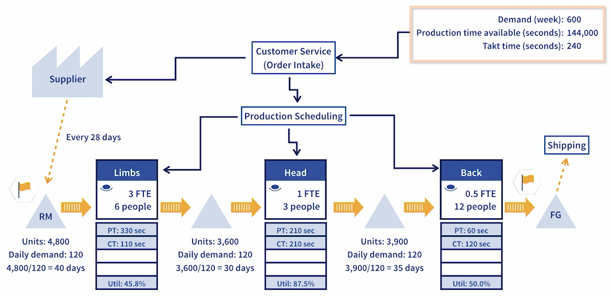
Read a Value Stream Map
Stamping
Painting
Assembly

Slide 25
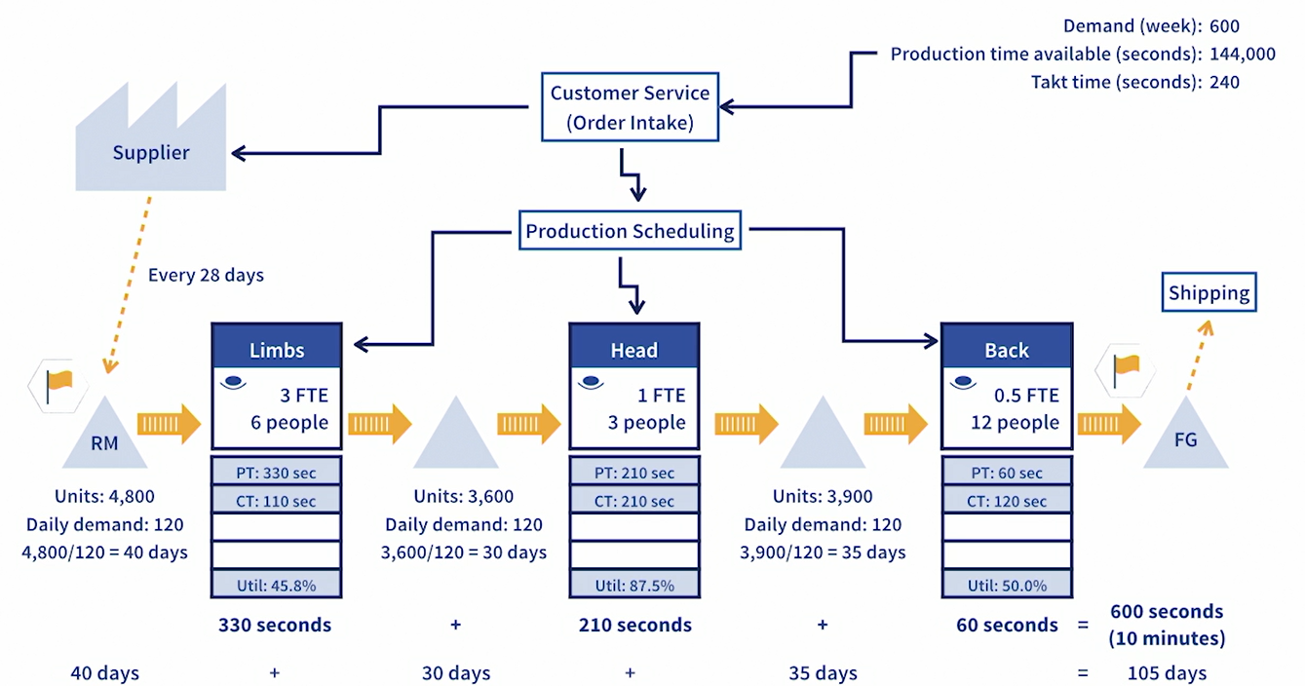
Total lead time and processing time
Stamping
Painting
Assembly

Slide 26
A case study
Ribbons Cake Company

Slide 27
THANK YOU & BEST WISHES

