Slide 1
MANUFACTURING
PROCESSES

Slide 2
Learning Objectives
LO–1: Understand what a manufacturing process is.
LO–2: Explain how manufacturing processes are organized.
LO–3: Analyze simple manufacturing processes.

Slide 3
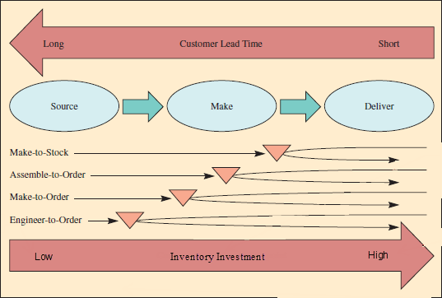
Production Processes
Production processes are used to make any manufactured item.
  Step 1 – Source the parts needed
  Step 2 – Make the product
  Step 3 – Deliver the product

Slide 4
Production Process Terms
Lead time – the time needed to respond to a customer order
Customer order decoupling point – where inventory is positioned to allow entities in the supply chain to operate independently
Lean manufacturing – a means of achieving high levels of customer service with minimal inventory investment

Slide 5
Types of Firms
Make-to-Stock
Assemble-to-Order
Make-to-Order
Engineer-to-Order
Serve customers from finished goods inventory
Combine a number of preassembled modules to meet a customer’s specifications
Make the customer’s product from raw materials, parts, and components
Work with the customer to design and then make the product

Slide 6
Make-to-Stock
Examples of products include the following:
  Televisions
  Clothing
  Packaged food products
Essential issue in satisfying customers is to balance the level of inventory against the level of customer service.
  Easy with unlimited inventory, but inventory costs money
  Trade-off between the costs of inventory and level of customer service must be made.
Use lean manufacturing to achieve higher service levels for a given inventory investment.

Slide 7
Assemble-to-Order
A primary task is to define a customer’s order in terms of alternative components because these are carried in inventory.
  An example is the way Dell Computer makes their desktop computers.
One capability required is a design that enables as much flexibility as possible in combining components.
There are significant advantages from moving the customer order decoupling point from finished goods to components.

Slide 8
Make-to-Order/Engineer-to-Order
Boeing’s process for making commercial aircraft is an example.
Customer order decoupling point could be in either raw materials at the manufacturing site or the supplier inventory.
Depending on how similar the products are, it might not even be possible to preorder parts.

Slide 9
How Production Processes Are Organized
Project: the product remains in a fixed location
  Manufacturing equipment is moved to the product.
Workcenter (job shop): similar equipment or functions are grouped together
Manufacturing cell: a dedicated area where products that are similar in processing requirements are produced
Assembly line: work processes are arranged according to the progressive steps by which the product is made
Continuous process: assembly line only the flow is continuous such as with liquids
Notes:
11

Slide 10
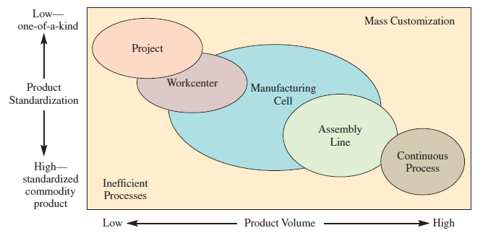
Product–Process Matrix: Framework Describing Layout Strategies

Slide 11
Production System Design
Project Layout
The product remains in a fixed location.
Workcenter
A high degree of task ordering is common.
A project layout may be developed by arranging materials according to their assembly priority.
Most common approach to developing this type of layout is to arrange workcenters in a way that optimizes the movement of material.
Sometimes is referred to as a department and is focused on a particular type of operation.
Optimal placement often means placing workcenters with large interdepartmental traffic adjacent to each other.

Slide 12
Production System Design
Manufacturing Cell
Formed by allocating dissimilar machines to cells that are designed to work on similar products (shape, processing, etc.)
Assembly Line and Continuous Layout
Designed for the special purpose of building a product by going through a series of progressive steps

Slide 13
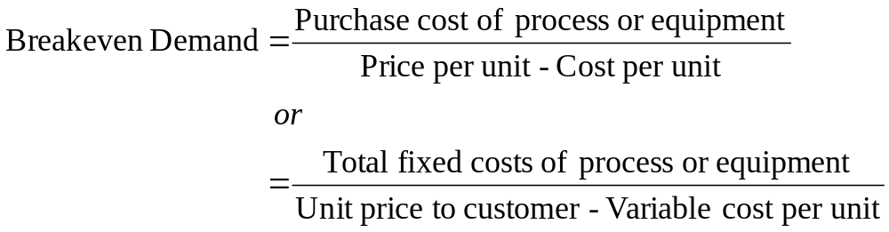
Break-Even Analysis
Defined as standard approach to choosing among alternative processes or equipment.
Model seeks to determine the point in units produced where a company will start making profit on the process.
Model seeks to determine the point in units produced where total revenue and total cost are equal.
Notes:
14

Slide 14
Example : Break-Even Analysis
Buy for $200
Make on lathe for $75
Make on machining center for $15
Buy has no fixed costs
Lathe has $80,000 fixed costs
Machining center has $200,000 fixed costs

Slide 15
Example: Total Cost for Each Option
Purchase
Cost = $200 x Demand
Produce Using Lathe
Cost = $80,000 + $75 x Demand
Produce Using Machining Center
Cost = $200,000 + $15 x Demand

Slide 16
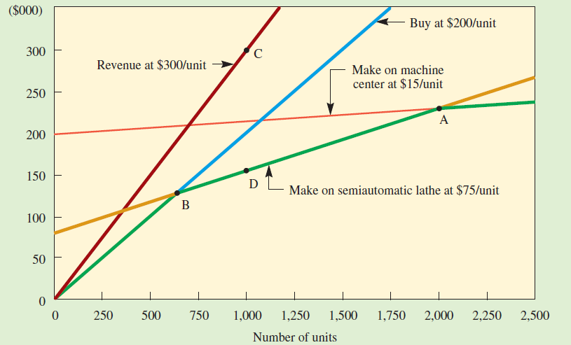
Example : Costs Shown Graphically

Slide 17
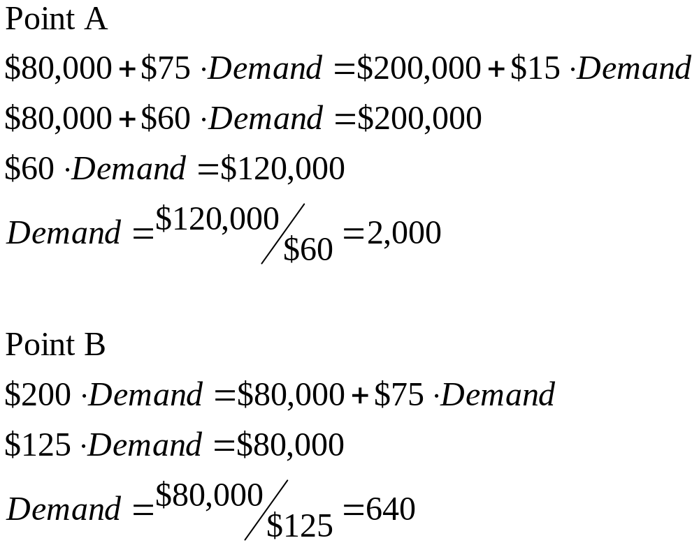
Example:Finding Points A and B

Slide 18
Manufacturing Process Flow Design
Manufacturing process flow design – a method to evaluate the specific processes that material follow as they move through the plant
Focus should be on the identification of activities that can be minimized or eliminated
  Movement and storage
  The fewer the moves, delays, and storage, the better the flow

Slide 19
The Charts
Assembly drawing: an exploded view of the product showing its component parts
Assembly chart: defines how parts go together, their order of assembly, and overall flow pattern
Operation and route sheet: specifies operations and process routing
Process flowchart: denotes what happens to the product as it progresses through the production facility

Slide 20
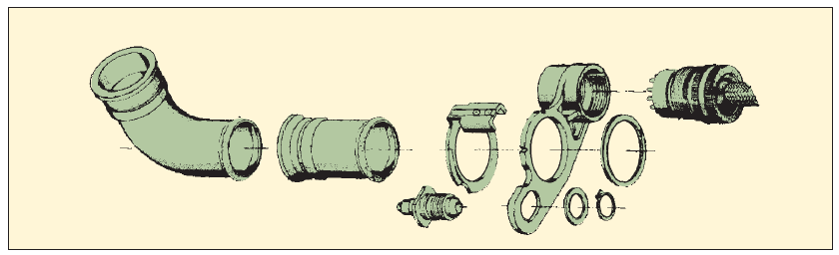
Sample Assembly Drawing

Slide 21
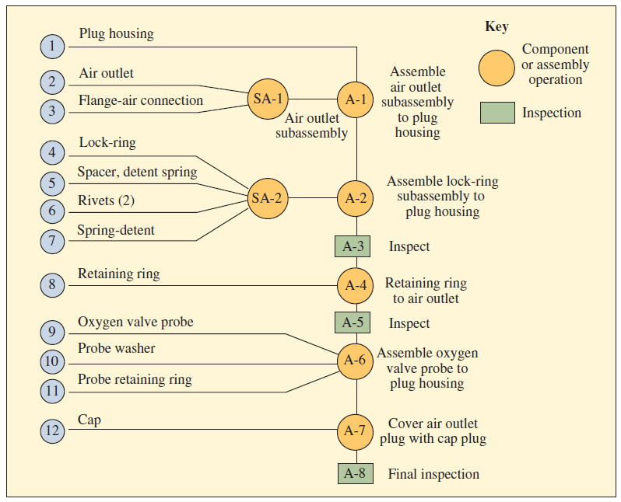
Sample Assembly Chart

Slide 22
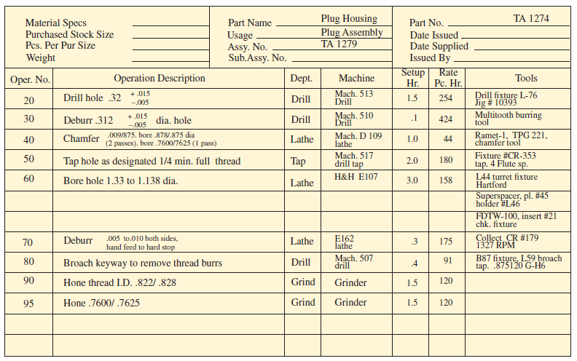
Sample Operation and Route Sheet

Slide 23
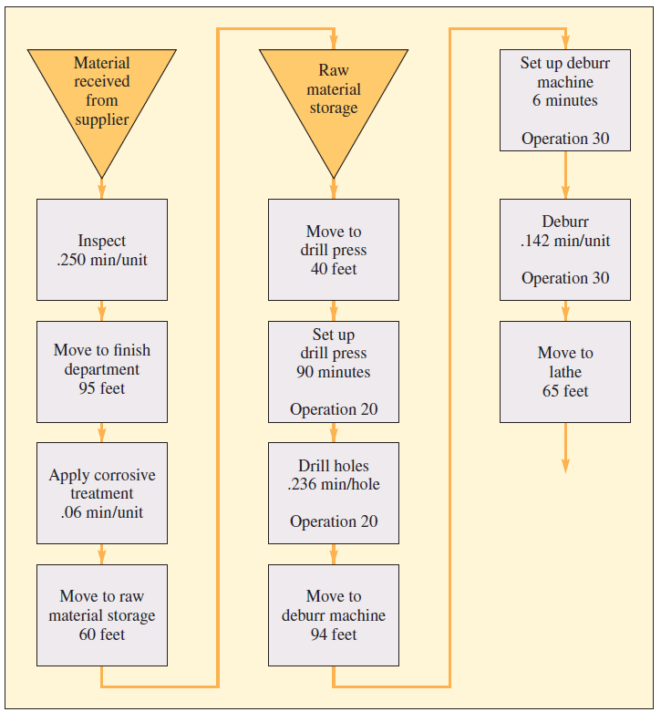
Sample Flowchart

Slide 24
Example: Manufacturing Process Analysis
15 workers, eight-hour shift
Incentive pay of 30¢ per good part
Can hire 15 more workers for second shift if needed
All but molding from outside vender

Slide 25
Example: Molding
11 Machines
  One usually down
  One operator per machine
25 parts per hour
Paid 20¢ per part
Overtime is 30¢ per part
Employment is flexible
  Currently 6 employees
  4 more available

Slide 26
Example: Remaining Costs
Raw materials are 10¢ per part
Electricity is 2¢ per part
Purchased parts cost 30¢ per component
Other weekly expenses
  Rent is $100
  Other employees receive $1,000
  Accounting depreciation is $50

Slide 27
Example : Questions to Answer
Determine the capacity of the process. Are the capacities balanced?
If the molding process were to use 10 machines instead of 6, what would be the capacity of the entire process?
If the company went to a second shift, what would be the new capacity?
Determine the cost per unit output when the capacity is 6,000 per week or 10,000 per week.

Slide 28
Example: Capacity of Entire Process
Molding Capacity
6 x 25 x 8 x 5 = 6,000
Assembly Capacity
150 x 8 x 5 = 6,000
The capacities are balanced.

Slide 29
Example : Increasing Molding to 10 Machines
Molding Capacity
10 x 25 x 8 x 5 = 10,000
Assembly capacity has not changed from 6,000.
The capacities are no longer balanced.

Slide 30
Example: Increasing Assembly Capacity
Molding Capacity
10 x 25 x 8 x 5 = 10,000
Assembly Capacity
150 x 16 x 5 = 12,000
New capacity is 10,000.

Slide 31
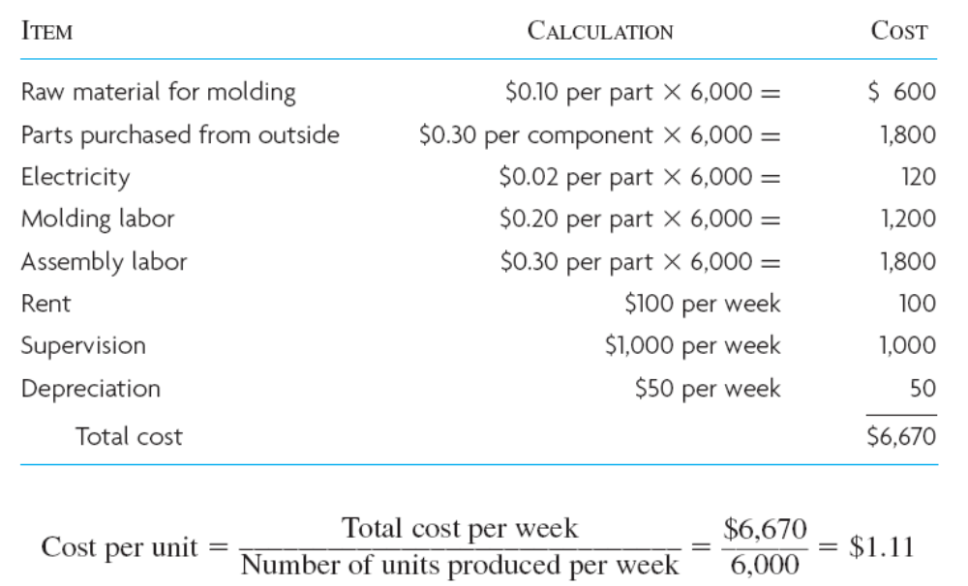
Example : Cost for 6,000 Parts per Week

Slide 32
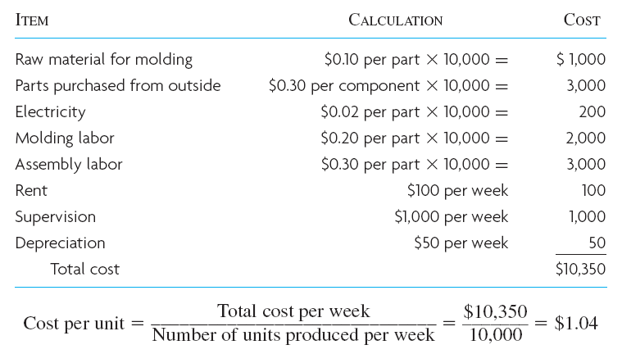
Example: Cost for 10,000 Parts per Week

