Slide 1
Processes and Technology

Slide 2
Process Planning
Process
  Group of related tasks with specific inputs & outputs
Process design
  tasks to be done & how they are coordinated among functions, people, & organizations
Process strategy
  an organization’s overall approach for physically producing goods and services
Process planning
  converts designs into workable instructions for manufacture or delivery

Slide 3
Process Strategy
Vertical integration
  extent to which firm will produce inputs and control outputs of each stage of production process
Capital intensity
  mix of capital (i.e., equipment, automation) and labor resources used in production process
Process flexibility
  ease with which resources can be adjusted in response to changes in demand, technology, products or services, and resource availability
Customer involvement
  role of customer in production process

Slide 4
Outsourcing
Cost
  Is it cheaper to make or buy the item
Capacity
  Does the company have the capacity
Quality
  Easier to control quality in your own factory
Speed
  Shipping time can reduce savings
Reliability
  Quality and timing are reliability measures
Expertise
  Protect proprietary information

Slide 5
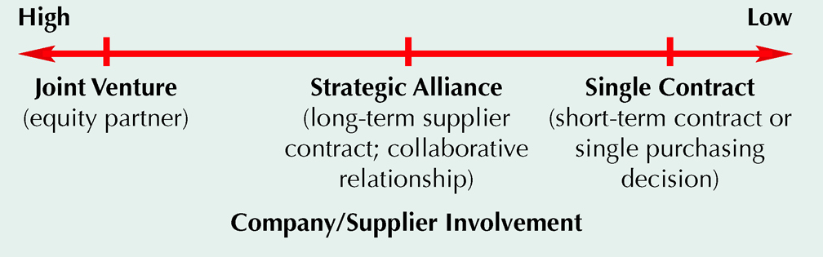
Sourcing Continuum

Slide 6
Process Selection
Projects
  one-of-a-kind production of a product to customer order
Batch production
  process many different jobs at the same time in groups or batches
Mass production
  produce large volumes of a standard product for a mass market
Continuous production
  used for very-high volume commodity products

Slide 7
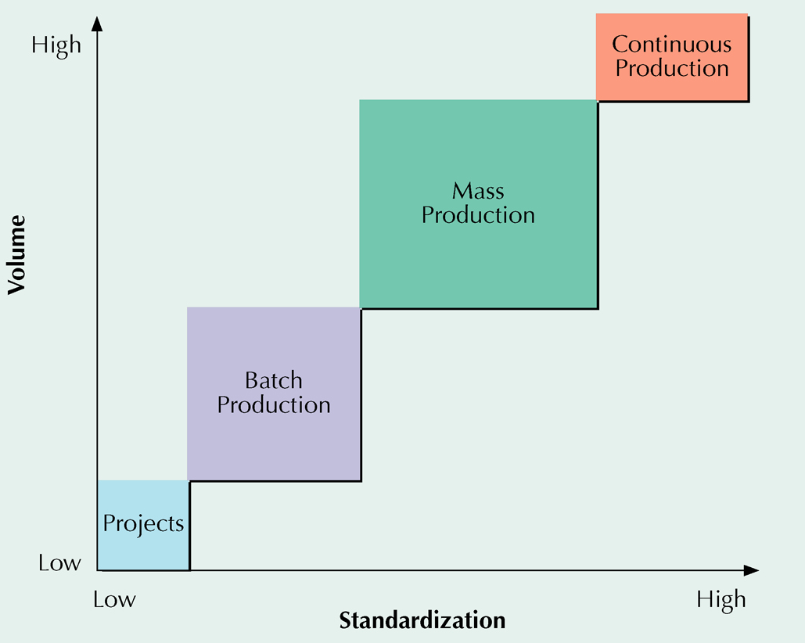
Product-Process Matrix

Slide 8
Types of Processes
PROJECT
BATCH
MASS
CONT.
Type of product
Unique
Made-to- order
(customized)
Made-to- stock
(standardized )
Commodity
Type of customer
One-at-a-time
Few individual
customers
Mass
market
Mass
market
Product demand
Infrequent
Fluctuates
Stable
Very stable

Slide 9
Types of Processes
PROJECT
BATCH
MASS
CONT.
Demand volume
Very low
Low to medium
High
Very high
No. of different products
Infinite variety
Many, varied
Few
Very few
Production system
Long-term project
Discrete, job shops
Repetitive, assembly lines
Continuous, process industries

Slide 10
Types of Processes
PROJECT
BATCH
MASS
CONT.
Equipment
Varied
General-purpose
Special-purpose
Highly automated
Primary type of work
Specialized contracts
Fabrication
Assembly
Mixing, treating, refining
Worker skills
Experts, crafts-persons
Wide range of skills
Limited range of skills
Equipment monitors

Slide 11
Types of Processes
PROJECT
BATCH
MASS
CONT.
Advantages
Custom work, latest technology
Flexibility, quality
Efficiency,
speed,
low cost
Highly efficient,
large capacity,
ease of control
Dis-advantages
Non-repetitive, small customer base, expensive
Costly, slow,
difficult to
manage
Capital
investment;
lack of
responsiveness
Difficult to change,
far-reaching errors,
limited variety
Examples
Construction, shipbuilding, spacecraft
Machine shops,
print shops,
bakeries,
education
Automobiles,
televisions,
computers,
fast food
Paint, chemicals, foodstuffs

Slide 12
Process Selection With
Break-Even Analysis
Study cost trade-offs based on demand volume
Cost
  Fixed costs
    constant regardless of the number of units produced
  Variable costs
    vary with the volume of units produced
Revenue
  price at which an item is sold

Slide 13
Process Selection With
Break-Even Analysis
Total revenue
  price times volume sold
Profit
  difference between total revenue and total cost

Slide 14
Travis and Jeff own Up Right Paddlers, a new startup company with the goal of designing, making, and marketing stand-up paddle boards for streams and rivers. A new fitness craze, stand-up paddle boards are similar to surfboards in appearance, but are used by individuals to navigate down rivers in an upright position with a single paddle, instead of sitting in tubes or rafts and floating down. The boards are constructed from heavy-duty raft material that is inflatable, rather than the fiberglass material used in surfboards. Unlike surfboards for $500 to $1000 each, paddle boards are typically sold for between $100 and $400. Since Travis and Jeff are just starting out and the demand for paddle boards on the East Coast has not been firmly established, they anticipate selling their product for $100 each. Travis estimates the fixed cost for equipment and space will be $2000, and the material and labor costs will run $50 per unit. What volume of demand will be necessary for Travis and Jeff to break even on their new venture?

Slide 15
Process Selection With
Break-Even Analysis
Total cost = fixed cost + total variable cost
    TC = c_{f} + vc_{v}
Total revenue = volume x price
    TR = vp
Profit = total revenue - total cost
    Z = TR – TC = vp - (c_{f} + vc_{v})
c_{f} = fixed cost
V = volume (i.e., number of units produced and sold)
c_{v} = variable cost per unit
p = price per unit

Slide 16
Process Selection With
Break-Even Analysis
TR = TC
vp = c_{f} + vc_{v}
vp - vc_{v} = c_{f}
v(p - c_{v}) = c_{f}
v =
c_{f}
p - c_{v}
Solving for Break-Even Point (Volume)

Slide 17
Break-Even Analysis
Fixed cost = c_{f} = $2,000
Variable cost = c_{v} = $50 per unit
Price = p = $100 per unit
Break-even point is
c_{f}
p - c_{v}
v = =

Slide 18
Break-Even Analysis
Fixed cost = c_{f} = $2,000
Variable cost = c_{v} = $50 per unit
Price = p = $100 per unit
Break-even point is
c_{f}
p - c_{v}
2000
100 - 50
v = = = 40 units

Slide 19
Break-Even Analysis: Graph
Dollars
$3,000 —
$2,000 —
$1,000 —
Total cost line
Total revenue line
40 Units
Break-even point

Slide 20
Jeff the more optimistic of the two owners of UpRight Paddlers, believes that the demand for paddle boards will exceed the breakeven point of 40 units calculated earlier. He proposes spending Rs $10,000 in fixed costs to buy more automated equipment that would reduce the materials and labor cost to $30 per board. The boards would sell for $100, regardless of which manufacturing process is chosen.
Compare the two processes and determine for what level of demand each process is chosen. Compare the two processes and determine for what level of demand each process would be preferred. Label Travis’s proposal as Process A and Jeff’s proposal as Process B.

Slide 21
Process Selection – Multiple Processes
Process A Process B
$2,000 + $50v = $10,000 + $30v

Slide 22
Process Selection – Multiple Processes
Process A Process B
$2,000 + $50v = $10,000 + $30v
$20v = $8,000
v = 400 units
Demand Below or equal to 400 boards, the alternative with the lowest fixed cost, choose A
Demand Above or equal to 400 boards, the alternative with the lowest variable cost, choose B

Slide 23
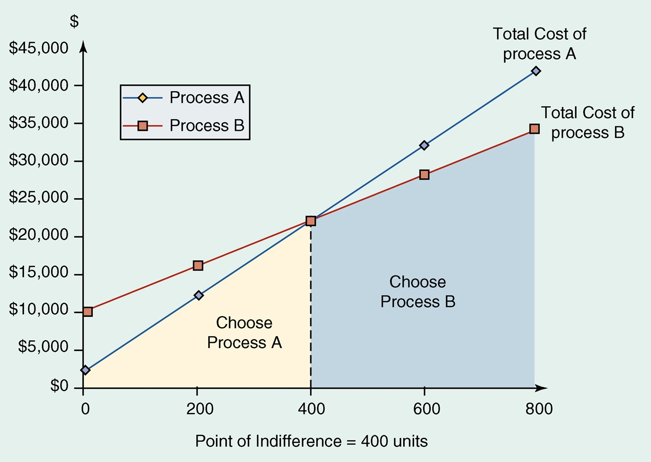
Multiple Processes – Indifference Point

Slide 24
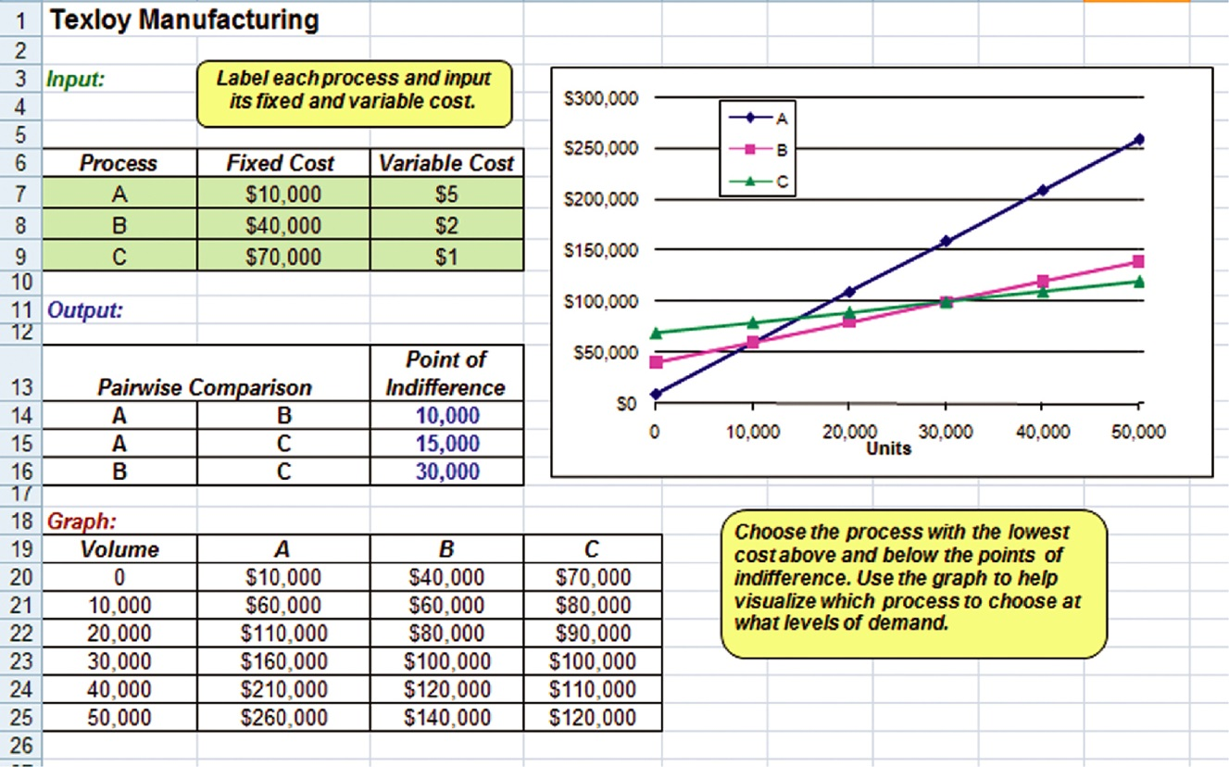
Process Selection in Excel

