Slide 1
Process Design and Analysis
McGraw-Hill/Irwin
Copyright © 2014 by The McGraw-Hill Companies, Inc. All rights reserved.

Slide 2
Learning Objectives
LO–1: Exemplify a typical business process and how it can be analyzed.
LO–2: Compare different types of processes.
LO–3: Explain how jobs are designed.
LO–4: Analyze manufacturing, service, and logistics processes to ensure the competitiveness of a firm.

Slide 3
Process Analysis
Process: any part of an organization that takes inputs and transforms them into outputs
Cycle time: the average successive time between completions of successive units
Utilization: the ratio of the time that a resource is actually activated relative to the time that it is available for use

Slide 4
Analyzing a Las Vegas Slot Machine
Analyzing the mechanical slot machine
Analyzing the new electronic slot machine
Comparison
The slot machine is one of many casino processes

Slide 5
Process Flowcharting
Process flowcharting: the use of a diagram to present the major elements of a process
The basic elements can include tasks or operations, flows of materials or customers, decision points, and storage areas or queues
It is an ideal methodology by which to begin analyzing a process

Slide 6
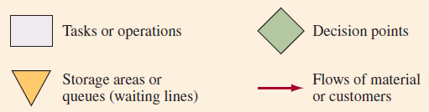
Flowchart Symbols

Slide 7
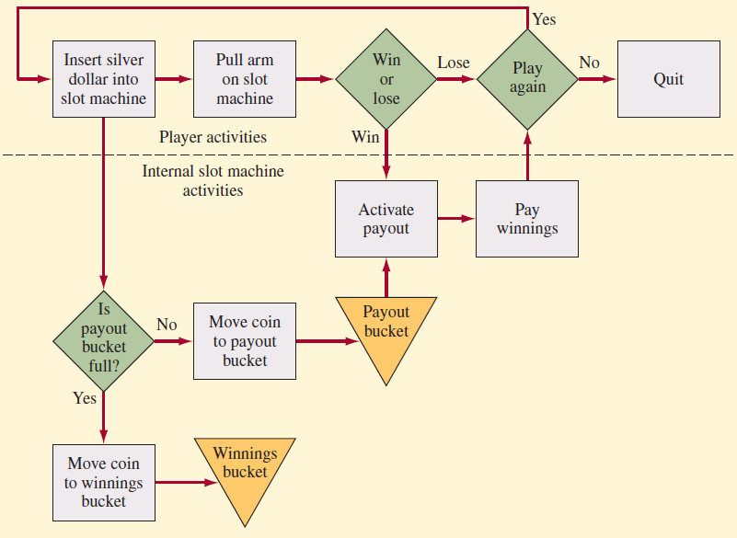
Process Flowchart Example (Slot Machine)

Slide 8
Types of Processes
Single-stage process
Stage 1
Multistage process
Stage 1
Stage 2
Stage 3

Slide 9
Buffering, Blocking, and Starving
Buffer: a storage area between stages where the output of a stage is placed prior to being used in a downstream stage
Blocking: occurs when the activities in a stage must stop because there is no place to deposit the item
Starving: occurs when the activities in a stage must stop because there is no work
Bottleneck: stage that limits the capacity of the process

Slide 10
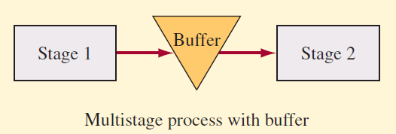
Multistage Process with Buffer

Slide 11
Other Types of Processes
Serial flow process: a single path for all stages of production
Parallel process: some of production has alternative paths where two or more machines are used to increase capacity
Logistics processes: the movement of things such as materials, people, or finished goods

Slide 12
Make-to-Stock versus Make-to-Order
Make-to-order
  Only activated in response to an actual order.
  Both work-in-process and finished goods inventory kept to a minimum.
Make-to-stock
  Process activated to meet expected or forecast demand.
  Customer orders are served from target stocking level.
Hybrid
  Combines the features of both make-to-order and make-to-stock.

Slide 13
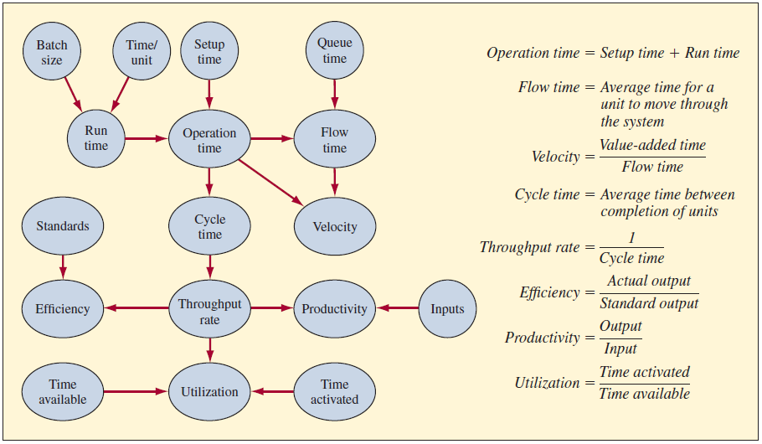
Measuring Process Performance

Slide 14
Production Process Mapping and
Little’s Law
Total average value of inventory
  Sum of the value of raw materials, work-in-process, and finished goods inventory
Inventory turns
  Cost of goods sold divided by the average inventory value
Days-of-supply
  Inverse of inventory turns scaled to days
Little’s law
  There is a long-term relationship among inventory, throughput, and flow time
  Inventory = Throughput rate x Flow time

Slide 15
Example 1V: Car Batteries
Average cost $45
12 hours to make a car
Assembles 200 cars per 8-hour shift
  Currently one shift
Holds on average 8,000 batteries in raw material inventory

Slide 16
Example 1V: Average Inventory
WIP = Throughput x Flow time
WIP = 25 batteries x 12 hours
WIP = 300 batteries
Total = 8,000 + 300 = 8,300 batteries

Slide 17
Example 1V: Value and Flow Time
Value = 8,300 x $45 = $375,000
Flow time = Inventory/Throughput
Flow time = 8,000/200 = 40 days

Slide 18
Behavioral Considerations in
Job Design
Specialization of labor
  Made high-speed, low-cost production possible
  Greatly enhanced standard of living
  Adverse effects on workers
Job enrichment
  Making job more interesting to the worker
  Horizontal enrichment: worker performs a greater number of variety of tasks
  Vertical enrichment: worker is involved in planning, organizing, and inspecting work

Slide 19
Work Measurement and Standards
Work measurement is a process of analyzing jobs for the purpose of setting time standards.
Why use it?
  Schedule work and allocate capacity
  Motivate and measure work performance
  Evaluate performance
  Provide benchmarks

Slide 20
Work Measurement Techniques
Direct methods
  Time study
  Work sampling
Indirect methods
  Predetermined motion-time data system
  Elemental data

Slide 21
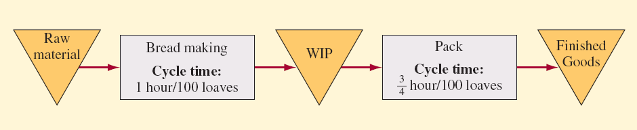
Example 1: Bread Making
Current Layout

Slide 22
Example 11: Running at 100 Loaves per Hour
Both bread making and packaging operate the same amount of time.
Capacity is 100 loaves per hour.
Packaging is idle for a quarter hour.
  Has 75 percent utilization.

Slide 23
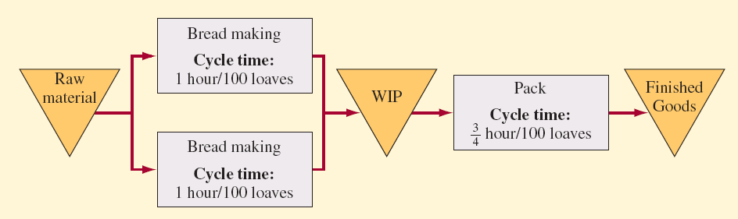
Example 11: Bread Making on Two Parallel Lines

Slide 24
Example 11.2: Multiple Shifts
Bread making runs two shifts.
  Produces 200 x 8 x 2 = 3,200
Packaging runs three shifts.
  Produces 133.3 x 8 x 3 = 3,200
Capacities are roughly equal.

Slide 25
Example 111: A Restaurant
Consider the restaurant in the casino. Because it is important that customers be served quickly, the managers have set up a buffet arrangement where customers serve themselves. The buffet is continually replenished to keep items fresh. To further speed service
Fixed amount is charged for the meal.

Slide 26
Example 111: A Restaurant
Customers take an average of 30 minutes to get their food and eat.
They typically eat in groups (or customer parties) of two or three to a table.
The restaurant has 40 tables. Each table can accommodate four people.
What is the maximum capacity of this restaurant?

Slide 27
Example 11I: Solution Approach
Utilization: It is easy to see that the restaurant can accommodate 160 people seated at tables at a time. Actually, in this situation, it might be more convenient to measure the capacity in terms of customer parties because this is how the capacity will be used. If the average customer party is 2.5 individuals, then the average seat utilization is 62.5 percent (2.5 seats/party 4; 4 seats/table) when the restaurant is operating at capacity.

Slide 28
Example 11I: Solution Approach
Cycle time: When operating at capacity, is 0.75 minute (30 minutes/table: 40 tables). So, on average, a table would become available every 0.75 minute or 45 seconds.
Capacity: The restaurant could handle 80 customer parties per hour (60 minutes/0.75 minute/party).

Slide 29
Example 11I: Challenges in Restaurant Problem
The problem with this restaurant is that everyone wants to eat at the same time. Management has collected data and expects the following profile for customer parties arriving during lunch, which runs from 11:30 a.m. until 1:30 p.m. Customers are seated only until 1:00 p.m.

Slide 30
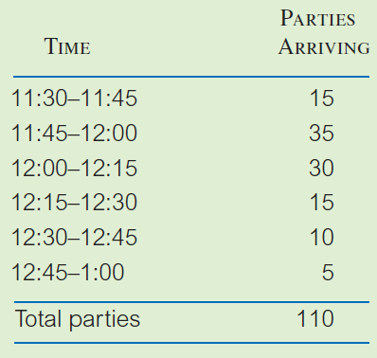
Example 11I: Arrival Data

Slide 31
Example 11I: Restaurant
Restaurant operates for two hours for lunch and the capacity is 80 customer parties per hour.
A simple way to analyze the situation is to calculate how we expect the system to look in terms of number of customers being served and number waiting in line at the end of each 15-minute interval (a snapshot every 15 minutes).
The key to understanding the analysis is to look at the cumulative numbers. The difference between cumulative arrivals and cumulative departures gives the number of customer parties in the restaurant (those seated at tables and those waiting).

Slide 32
Example : Restaurant
Since there are only 40 tables, when the cumulative difference through a time interval is greater than 40, a waiting line forms.
Cycle time for the entire restaurant is 45 seconds per customer party at this time (this means that on average, a table empties every 45 seconds or 20 tables empty during each 15-minute interval). The last party will need to wait for all of the earlier parties to get a table, so the expected waiting time is the number of parties in line multiplied by the cycle time.

Slide 33
Example 11.3
In the following table, when the cumulative number of parties is 50, there are 10 parties waiting to be seated (since there are only 40 tables).
The average time they wait is 10 x 45 secs = 7.5 minutes.
During 12:00 to 12:15, parties that arrived during 11:30 to 11:45 would have left, which makes the cumulative number of parties at the end of 12:15 = 50 (number at the end of 12:00) + 30 (arrivals during 12:00 to 12:15) – 15 (departures during 12:00 to 12:15) = 65.

Slide 34
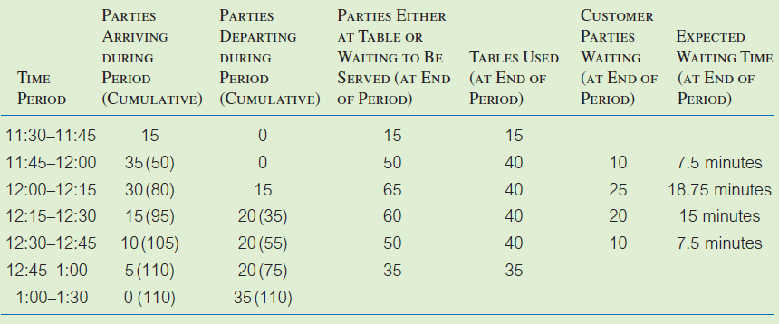
Example 11.3: Customer Status

Slide 35
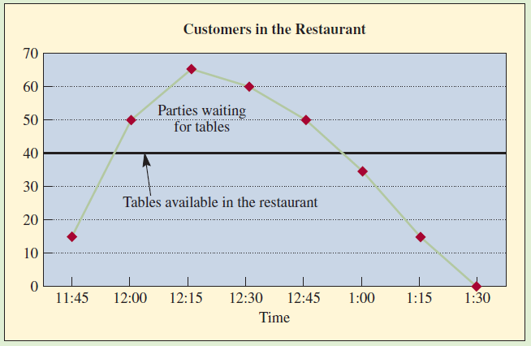
Example 11.3 Customers vs. Time

Slide 36
Example 11.4: The Balabus (“Tourist Bus”) in Paris
Two hours for the route during peak traffic
Route has 60 stops
Each bus has seating capacity of 50
  Another 30 passengers can stand
Busy much of the day

Slide 37
Example 11.4: Initial Analysis
With one bus, maximum wait is two hours.
If bus is halfway through cycle, wait is one hour.
Average wait is one hour.
  In general, average wait is ½ cycle time.
If two buses used…
  Cycle time is one hour
  Average wait is 30 minutes.
For a two-minute wait…
  Need four-minute cycle time.
  Need 30 buses (120 minutes/4 minute cycle time).

Slide 38
Example 11.4: Capacity
Each bus has total capacity of 80 passengers.
  50 seated
  30 standing
30 buses can accommodate…
  1,500 seated
  2,400 total

Slide 39
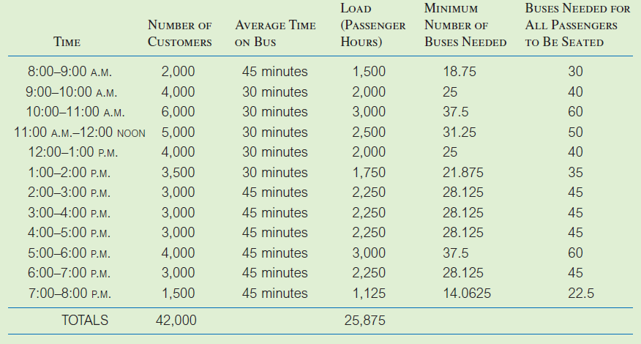
Example 11.4: Detailed Analysis

Slide 40
Example 11.4: Conclusion
With 30 buses, many will stand.
During morning and afternoon rush, not all customers can be accommodated.
  Need at least 40 buses during rush hours.
With 40 buses all the time…
  24,000 seat-hours available.
    40 buses x 12 hours x 50 seats per bus
25,875 seat-hours needed.
  107.8 percent utilization
  7.8 percent of customers must stand

Slide 41
Process Flow Time Reductions
Perform activities in parallel.
Change the sequence of activities.
Reduce interruptions.

