Slide 1
Capital Formation:
Keys to obtaining the right kind, type, amount & source of capital to fund your venture

Slide 2
Truth #1
Venture Capital
is NOT Philanthropy

Slide 3
Truth #2
What you have determines
the type of capital you obtain
…not the other way around

Slide 4
What Gets Funded
Scalable Businesses
Experienced Management Teams
Growing Markets
Proprietary & Defensible Technology
Profitable Economic Model
Executable Business Plan
Clear Exit Potential

Slide 5
Do you know what you
are asking for and what it will do for you?

Slide 6
Types of Financing
Internal Financing - Accounts Receivable, Inventory &
Fixed Assets, Vendor Payments; Evaluating Expenses
Joint Ventures, Strategic Alliances, Dealmaking
Customers
Commercial Lenders - Banks & S&Ls, Finance Companies
(asset-based lenders), Life Insurance Companies
Equity Investors - Private Individuals/ Angels, Employees
(ESOPS), Corporations, Venture Capital, Institutional Investors
Government - Small Business Admin., SBIC’s, MESBIC, SBIR
Private Placements - Sale of equity through an agent
IPO

Slide 7
Types of Financing Used
38% Commercial Bank Loans
34% Credit Cards
30% No Financing at All
20% Vendor Credit
16% Personal Loans or Leasing
3% Selling Accounts Receivable
3% Asset-based Lending
2% Private Placement
>2% Venture Capital & Angel Investors (private equity)
>1% IPO

Slide 8
FUNCTION
Knowing WHAT to present
to WHOM and WHEN

Slide 9
Must Have….
90 second - 3 Minute “elevator pitch”
One Page Summary (see angelsoft)
Multiple Page Detailed Executive Summary
PPT presentation - (for Investors not customers)
A Business Plan (for YOU not me)
A Website - (for your customers not investors)
Youtube/Video demonstrations
Twitter, Facebook, etc… (as appropriate)

Slide 10
The “Pitch”
My company is __________ (Name)
We (Have/Do What?) that (Solves What?).
We are located (Where?)
Our customers are (Who?)
We currently have (How many out of how many?)
If Mgmt is strength … (Who are you?). Ie. Our
CEO comes from Johnson & Johnson.
We are seeking (How much?) (For What?)
Repeat your name and your company name.

Slide 11
Always be prepared.
Do your homework.

Slide 12
What’s important?
Industry
Geography
Scalability
Stage of Business (Concept v. Expansion)
Types of Investment Structure
Return on Investment
Available Capital under Management

Slide 13
Value Proposition
Market
Revenue Model
Business Model
Competitiveness/IP
Team
Appropriate
Funding/Valuation
Exit Strategy
Presentability

Slide 14
Business
Financial
People

Slide 15
20% Product/Technology
80% Business

Slide 16
Business: What do you do?
How do you do it?
Business Resume
  Venture Concept/Business Description
  Products and/or Services
  Technology/Proprietary Rights
  Targeted Markets/Market Opportunities
  Marketing Plan/Distribution Strategy
  Company Strategy
  Outlook

Slide 17
Financial: Where do you make money?
How can you make more?
Financial Resume
  Current Financial Results/Forecast
  Funding to Date
  Current Investors (if any)
  Financial Requirements
  Use of Requested Funds

Slide 18
People: Who are you?…
Why should I care?
People Resume
  Management Team
  Bank
  Auditor
  Legal Counsel
  Business Consultants

Slide 19
to attract investors……
Know what THEY care to know
…not what you want to tell them.

Slide 20
11 Must-Have Slides
1. Cover - Business Positioning Statement
2. Market - the need and what customers have it
3. Solution - product, core benefit, protectable Technology
4. Competitive Position - Who they are and your defenses
5. Marketing/Sales/Support - Channels and skills
6. Business Strategy - How you plan to grow beyond launch
7. Financial Projections - Spreadsheet
8. Funding Sought - Amount, comparables, use of funds
9. Management - relevant experience
10. Milestones - e.g. product launch, next funding, breakeven
11. Exit Strategy - IPO/Acquistion (who?)

Slide 21
1. Business Basics
Company name
One sentence on “what we do”
Presenters name
Visual Image of product
Product in hand, if possible

Slide 22
2. Market Need/Customers
What creates the demand for your solution? – why?
Define characteristics of customers who need your solution - who?
Quantify the opportunity - How many?

Slide 23
3. Solution - Your product
What exactly is the customer is buying?
Where does your product fits in the market?
What is the big “value-add”of your product?
What is the benefits of your solution?
What problem are you solving?

Slide 24
4. Competition
Address the barriers to adoption
What is the “gold standard” now?
What will it take to get customers
to use your product?
What are YOUR barriers to other competition
should you be successful and become “the gold standard”?

Slide 25
5. Marketing
Explain your expected selling cycle
How do you propose to reach your
customers?
Describe your process of marketing
sales & support
How do you plan to get customers both directly and indirectly?
Why will YOU succeed?

Slide 26
6. Business Strategy
Describe 3-5 year business goals
Identify steps to reach each goal
Explain what you need to achieve - positive cash flow and how long it will take to get there.
Place key steps/milestones in Gantt chart
Identify major development risks

Slide 27
7. Financial Projections
Keep the financials simple
Explain any “dramatic” numbers
Units shipped
Revenues
Gross Profit
Gross Margin %
SG&A
Net Pre-tax
Cashflow

Slide 28
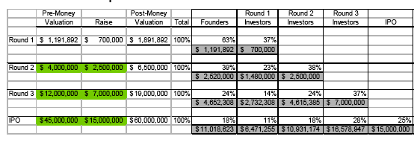
8. Funding Sought
Provide a cap table, if possible
Identify major uses in each round
Describe current “burn rate”
Note: Listing a full cap table in the presentation is not necessary but it is something that a company should have available upon request.

Slide 29
9. Management
Focus on Management Team
  CEO - prior experience
  CTO - proven know-how
  CMO - proven knowledge/Key relationships
  CFO - Prior acquisition experience
Part-time vs full-time
Board of Directors/ Board of Advisors
Demonstrate how you value existing investors

Slide 30
10. Milestones
Company formed
Prototypes developed
New management
Testing
Angel Round
Production ship
Positive Cash-flow
Annualized revenue

Slide 31
11. Exit Strategy
How does the investor get their return?
If IPO:
  Explain comparable
  Describe “why you?”
If Acquisition:
  identify 2-3 likely buyers
  Explain why they are interested
  Explain how you know them or will get to them

Slide 32
Most Importantly
Never hide behind technology. Use it to advance & enhance what you have.
Investors want to meet YOU, not your “cool” technology.
“scalability” of your business
Raising money takes time. Start early. Go everywhere. Attend often. “See and be Seen”
Relationships: You ARE judged by the company you keep. Get good advisors….they will be your best advocates.
Be prepared. Always. Think on your feet.

Slide 33
Private Equity & Venture Finance

Slide 34
Private equity: contents
Learning objectives
The universe of equity investment
Structure of a typical private equity fund
The infrastructure of private equity players
Common types of private equity transaction
The private equity deal process
The ideal PE candidate
Impetus for a buyout
Selecting financiers
Deal structure
Parties to the transaction
Structuring the deal
An example (1)
An example (2)
Tweaking the deal terms
How PE companies will evaluate their investment
Don’t just use IRR
Contrasting a buyout with an acquisition
Ethical issues in private equity

Slide 35
Learning objectives
Explain how private equity firms are structured, and how they make their money.
Understand the different types of leveraged deal, and how value is created for investors.
Create or use a financial model for structuring a private equity transaction.

Slide 36
The universe of equity investment
Listed equity
Private equity
Venture capital
Business angels
Not to scale

Slide 37
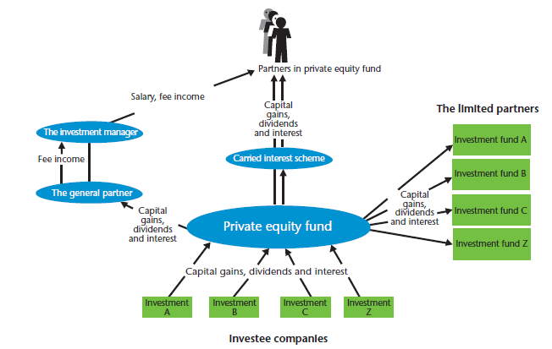
Structure of a typical private equity fund
Gilligan, J. and Wright, M. (2010) Private Equity Demystified, Corporate Finance Faculty of the ICAEW.
Used with permission.

Slide 38
The infrastructure of private equity players
competitors
fund
providers
acquirers
vendors
PE
companies
management
teams
angels
advisers
banks
regulators
Notes:
Who’s involved?
This is not exhaustive, but there are a lot
now move more closely

Slide 39
Common types of private equity transaction
LBO | leveraged buyout – can be any of the following
MBO | management buyout – the existing management of the company buy the company
MBI | management buy-in – incoming management buy the company
BIMBO | combination buyout and buy-in
IBO | institutional buyout – a PE company buys the company and then puts in the management of its choice
P to P | public to private (i.e. delisting)
Leveraged build up (Buy & Build) | The PE company makes an investment in order to buy a lot more companies in that sector and put them together to make something big and profitable

Slide 40
The private equity deal process
Negotiate the deal
Find investments
Make the investment
Manage the investment
Exit
Due diligence

Slide 41
The ideal PE candidate
Good business model, with competitive advantage
Considerable growth potential
Potential to reduce costs
Good management team (existing or brought in)
Cash-generative
Can be bought cheaply

Slide 42
Impetus for a buyout
OWNER’S REASONS
MANAGEMENT’S REASONS
Disposal of non-core operations
Release of funds for the rest of the group
Passing on a family owned business
Desire for autonomy in running the business
Fear of redundancy
Dislike of potential trade buyers

Slide 43
Selecting financiers
Only approach banks and investors who might be interested in your business
  Geographical area
  Industry type
  Size of investment
  Type of investment
Do not approach all potential investors at one

Slide 44
Deal structure
What funding is needed?
What can the business afford?
What do the parties want?
Consideration to be paid to vendor
Fees
Additional injection to develop business
Evaluate debt capacity using cover ratios, and cash flow forecasts
Covenant limitations
Each investing party wants financial return and some element of control rights
Other stakeholders are also relevant

Slide 45
Parties to the transaction
Syndicate
Syndicate
PE company
Mgt
Banks
Vendor
Newco
Pension fund
Employees
Customers
Target business
Suppliers

Slide 46
Structuring the deal
How much finance is needed?
How much can be debt?
How much can management invest?
Balance the PE investment between ordinary shares and preference shares or subordinated debt

Slide 47
An example (1)
Purchase price of business 80
Additional funds required 5
Total finance needed 85
Financed by debt 42
Finance needed as ‘equity’ 43
Provided by:
Management (1%) 0.5
Private equity (99%) 42.5
43.0
The business will be sold for 150 in Year 3. At that time, 20 of the debt will have been repaid

Slide 48
An example (2)
Invest Yr 0
Money out / in 85
Less Debt [10 repaid] 42
Available for ‘equity’ 43
Less ‘subordinated loan’ * 38
For ordinary shareholders 5
Management – 10% 0.5
Institutions – 90% 4.5
*Could be preference shares instead
Sell Yr 3
150
22
128
38
90
9
81
162%
>41%

Slide 49
Tweaking the deal terms
Yield | PE returns can be increased without affecting management % ownership by increasing their yield during the investment period
Ratchets | A positive ratchet can give management a higher % of the equity if performance is good A negative ratchet can reduce management’s % ownership if performance is less than expectations
Leverage | A leveraged recapitalization can ensure that the PE company recovers its equity investment early while still retaining the investment

Slide 50
How PE companies will evaluate their investment
 | Year 0 | Years 1-y | Year z
What happens | Money spent to buy Co and finance the deal | Dividends or interest received (?) Or extra finance? | Proceeds of selling stake in Co
Cash flows | - – - | + | + + + +
All evaluated to determine if the IRR is going to exceed their required cost of capital
The greater the cash generation in years 1 – y, the more the proceeds in z.

Slide 51
Don’t just use IRR
IRR is a flawed measure, especially if a leveraged recapitalization is done
Although IRR is commonly used, PE companies also use cash-to-cash return as a measure as well, in order to allow for the size of the return

Slide 52
Contrasting a buyout with an acquisition
 | PE acquirer | Corporate acquirer
Use of a Newco | Newco must be created to hold the shares | Target can be taken as a subsidiary of the acquirer
Impact of debt | Acquisition debt is held in the Newco and does not gear up the PE fund | Debt relating to the acquisition is not ring-fenced and affects the acquirer’s capital structure
Conditional payments | Ratchets can be used change shareholdings, dependent on performance | Earn-outs can be used to give the sellers further proceeds, dependent on performance
Changes to target business operations | Part of the acquisition plan agreed with management | Generally plans for synergies to be created
Management incentives | Linked completely to the eventual exit from the investment | Will depend on the corporate objectives
Purpose and timescale of acquisition | The acquisition is made with an ultimate profitable disposal in mind | Probably made for strategic reasons with no expectation of selling on
Funding the acquisition | A relatively high level of debt | To meet the corporate financial structure

Slide 53
Ethical issues in private equity
Conflicts of interest | Management should be acting for the owners, but planning a buyout presents a conflict of interest
Vulnerability of employees | Taking on too much debt makes the company vulnerable, which is a problem for employees, although not for diversified investors – This applies to initial structure and, particularly, to leveraged recapitalizations Restructuring is often a euphemism for lay-offs. Is it always useful?
Capital markets | Public-to-private deals can destroy confidence in the capital markets, e.g. for fear of insider information
Tax avoidance | PE companies, their directors, and the portfolio companies tend to be ‘efficient’ at managing their tax affairs

Slide 54
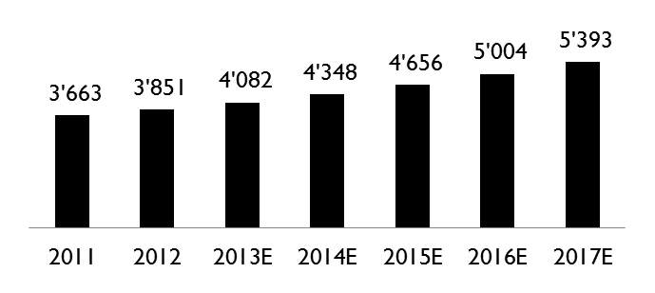
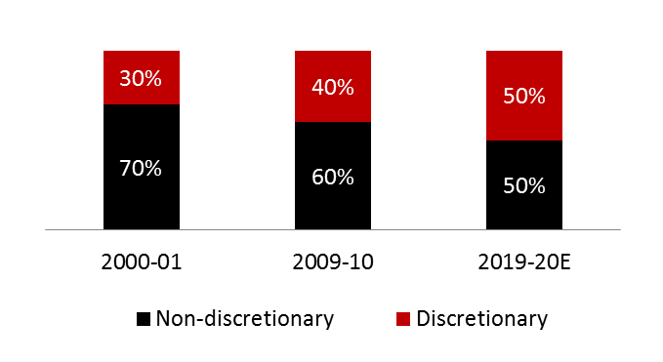
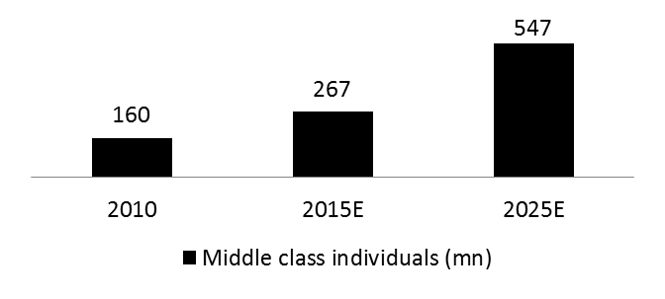
India’s strong macro story driven by suitable demographics and growing disposable income
Steady growth in per capita GDP (in USD)
Favorable demographics
Currently 65% of population is in the age group 15-64
65+ (5%)
0-14 (30%)
15-64 (65%)
GDP per capita (ppp)
Growing middle class population
Average household incomes to triple over the next two decades
India to become the 5th-largest consumer economy by 2025
Consumption shifting from necessity to discretionary
Rising income resulting in increasing discretionary spending
Source: IMF 2012, CSO, RBI, Ministry of Finance, Demographics 2025 report, BCG-CII report
54

Slide 55
Huge amount of capital formation will be required especially in SMEs to sustain this growth
India needs to create 10-15 million jobs per year over the next decade to provide a gainful employment to its expanding young population
Innovation driven businesses crucial for such large – scale employment generation
Need of successful businesses that will help generate solutions in the sector of education, affordable health care, clean energy, waste management etc.
Over USD 100 billion required in next few years to sustain reasonable growth rate and employment in India
Financing deficiency will put the high growth companies at the risk of failure
CHALLENGE
55

Slide 56
Large gap between the funding needs and available options for high growth companies
Financing options for an MSME company
Funds from banks
Angel Investor / Venture Capital
Excessive collateral driven instrument
Stringent norms and mandatory past record requirement
Rigid covenant structure which might hamper the growth of the company
Difficult to avail for companies that create less tangible assets, are innovation driven and are promoted by first generation entrepreneurs
Demand outstripping supply
Trading away ownership of the company for funding
Discomfort of the investors to deploy their capital in assets
High level of controls from the investor due to stage and risk of the business
Expectation mismatch
Highest cost instrument
SMEs struggling to raise “real” capital putting many businesses with high growth potential at risk
56

Slide 57
FUND RAISING PROCESS

Slide 58

Private Equity and Venture Capital- Concept
Private equity is equity investment in high growth companies whether listed or unlisted
Investments in private equity most often involve either
  an investment of capital into an operating company or
  the acquisition of an operating company (Buyout funds) or
  purchase of shares of existing investors / promoters
Venture capital- It is a broad subcategory of private equity that refers to equity investments made, typically in less mature companies, for the launch, early development, or expansion of a business.
In India, private equity funds are active across sectors funding both listed and unlisted companies. Funding in listed companies is called PIPE (Private Investment in Public Enterprises)
Start-up/
Early Stage
Seed & Technology
Expansion/
Growth
Buyouts
PIPE
Various Stages of Investment
Venture Capital
Private Equity
58

Slide 59

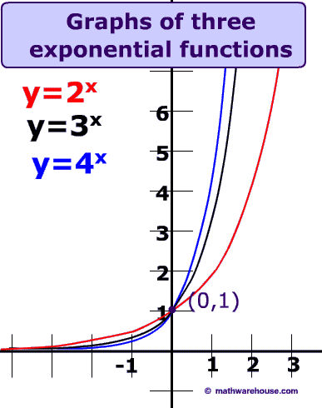
Why Venture Capital? Why Private equity?
Startup / early Stage
Bank saying NO to loans and seed funding !!
You have a new concept and friends and family do not believe the potential !! They say NO !
You have limited capital after initial stage – for achieving growth
Growth Stage
But a venture capital fund takes a bet on you and your business model !
Demand in your industry is constantly outstripping the supply !
You wish to have growth in multiples and not in percentages
Company is fully leveraged and no room for additional bank funding!
You believe that your service / product can achieve the exponential growth and you have the right strategies in place!
A growth oriented private equity fund will fund the required growth and ride the upside !
59

Slide 60
Key parameters considered by VC/PE
Business Idea
Revenue Trends
Business plan
Promoters & Management
Industry & Market
Competition
Profitability
Proposed Capex
Historical Financials
Cash flows
Continuous
cash
USP
Transparency
Any company is viewed holistically by the funds before infusing capital
Execution
Growth
rate
Most critical document
Highlights all the factors considered by funds
Realistic projection of the future
Assigns numbers around vision
Valuation
High
margins
positioning
Quality &
Corporate governance
60

Slide 61
Broad process of raising Private equity capital
Pre infusion of money
Preparation of business plan
Submission to fund
Indepth analysis
Valuation & commercial terms
Execution of term sheet
Due diligence
Shareholder Agreement
Business plan highlights markets, company, expansion plan
Indepth financial model
Fund carries out extensive research and business analysis
Broad valuation parameters and commercials are agreed
Term sheet highlights inprinciple agreement to key commercial terms
External party appointed for financial due diligence
Valuation adjustment post Due Diligence report
Execution of shareholder agreement and closure
Post infusion of money
MIS & Budgeting
Periodic monitoring
Reporting to Board nominee
Create MIS systems and budgeting to formulate and track business numbers
Private equity fund would monitor business numbers periodically on its own or through external party
Key business parameters are taken up at Board for discussion
61

Slide 62
Typical issues faced in concluding private equity deals
Business model – Call of PE fund on the business
Valuation – Both parties to agree on valuation
Agreement Terms – Stringent terms if things don’t work out as planned
Exit options – Fund requiring immense clarity on exit
Confidence in promoter – Will the promoter deliver?
Fear of private equity fund running the show – Monitoring vis-à-vis micro management
62

Slide 63
Typical dilemma's faced by the management
Growth v/s Dilution
PE leads to both growth and dilution – thus important to strike a balance between the two
Control &
interference
Fear of the management that the fund will exercise control and interference
Valuation on
future earnings
Structuring the investment on future earnings and profitability
Investment Horizon
Investment Horizon typically ranges between 3 to 5 years – can extend upto 7 years. Exceptions are family houses
Exit Options
IPO, Strategic Sale, Next round of larger fund
63

Slide 64
Critical evaluation of raising private equity capital
ADVANTAGES
CHALLENGES
Institutionalisation of the company
Corporate governance
Strategic insights and direction
Definitive growth vision and plan
Efficiency in capital
Global connect
Exit pressure
Most expensive form of capital
To prepare for strategic sale
Cap on privileges of the management team
Mismatch of growth plan between the investor and the management team down the line
64

